Slide 1
Efficient FDMA MU Transmission Schemes for WUR WLAN
Date: 2017-10-10
Authors:
Name | Affiliation | Address | Phone | Email
Jianhan Liu | Mediatek | 2840 Junction Ave, San Jose, CA 95134, USA | +1-408-526-1899 | jianhan.Liu@mediatek.com
Thomas Pare

Slide 2
Operation of WUR
To reduce power consumption, even the WUR will not be always on. In each beacon interval, there is a 2ms awake window for WURs.
The duration of a WUR frame can be about 1ms.
For example, with 48bits date field, the duration is about 800us.
With 60 bits data field, the duration is over 1ms (60*16us+40us~1ms).
We need to enhance the efficiency of wake-up operations.
To avoid reducing the WLAN network throughputs due to wake-ups, especially with a lot of stations without WURs.

Slide 3
Multi-user (MU) Wake-up Operations
Enabling MU wake-up operations enhances efficiency significantly
If a WUR frame wakes up 2 stations one time, the efficiency increases 100%!
Enabling MU wake-up operations is a good approach to fully exploit the advantages provided by11ax MU transmissions.
Most WUR stations for IOT and they just need to transmit/receive short data packets.
11ax OFDMA transmissions achieves highest efficiency for short packets.
If the WUR station needs to be waked up one by one, then they are likely to be waked in different beacon interval or awake window. 11ax OFDMA transmission is hard to use.
MU wake-up operations by grouping wake-up only has limitations too.
Grouping management adds a lot of overhead. For example, group ID update, re-grouping, etc.
It is not flexible and not efficient when there are large number of groups.

Slide 4
FDMA MU wake-up operations
Compared to MU wake-ups using grouping method, FDMA MU wake-up operations is particularly useful for wake-up a small number of WUR stations.
For example, FDMA with two or three 4Mhz sub-channels can wake-up any two or three WUR stations with a single wake-up frame transmissions.
Enabling FDMA MU wake-up does not increase any cost at TX and RX.
At TX, AP just need to use the sub-carries of the multiple sub-channels using OFDM. There is no cost at all at TX.
At RX, each WUR station only needs to operated on the sub-channel that assigned to it during the association.
There is no extra cost because WUR receiver already has mixer.
Our analysis that 3-order Butterworth filter is good enough for two or three sub-channels.

Slide 5
Two possible FDMA MU transmissions
Based on the interference analysis with a low-cost analog filter, there are two possible FDMA MU transmissions.

Slide 6
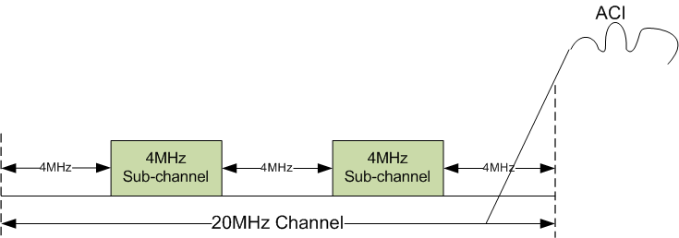
Sub-Channel Allocation scheme for two Sub-channels
The 20MHz WiFi can be divided into two 4MHz sub-channels as shown in the following figure.
Transmitter transmits OOK wake-up signal on each sub-channel to a station with WUR receiver.
The protection frequency band between two sub-channels and enamoring 20MHz WiFi channel is 4MHz. It enables low-cost and low-power filter to reduce the adjacent channel interferences (ACI).

Slide 7
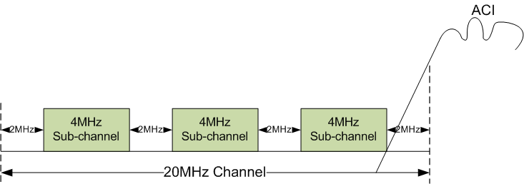
Sub-Channel Allocation scheme for three sun-channels
The 20MHz WiFi can be divided into three 4MHz sub-channels as shown in the following figure.
Transmitter transmits OOK wake-up signal on each sub-channel to a station with WUR receiver.
The protection frequency band between three sub-channels and enamoring 20MHz WiFi channel is 2MHz. It enables low-cost and low-power filter to reduce the adjacent channel interferences (ACI).

