Slide 1
Dual Sync Designs
Date: 2017-11-03
Authors:

Slide 2
Goals
Two Sync Designs: Short and Long
The Short Sync is used with the High Data rate
The Long Sync is used with the Low Data rate
In one design the Sync for the High and Low data rates are the same duration (but we still use “Long” and “Short” for consistency)
Based on previous simulations [1] a Long sync duration of 128 µs is sufficient. We expect that we can use a shorter duration for the high data rate given the higher SNR
The design of these Dual Syncs must support three requirements
  Packet Detection
  Symbol Timing Recovery
  Identification of Sync type (short or long) to indicate the data rate of the Data Field

Slide 3
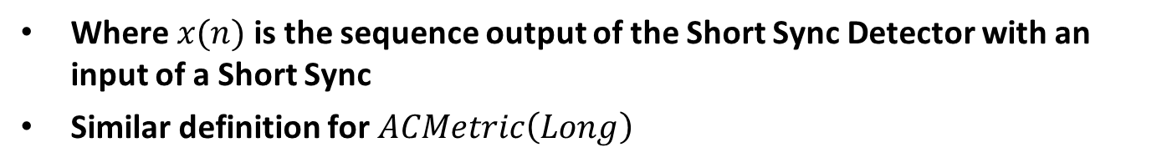
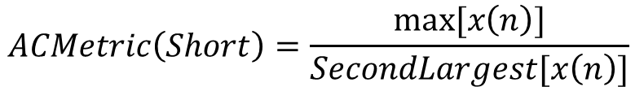
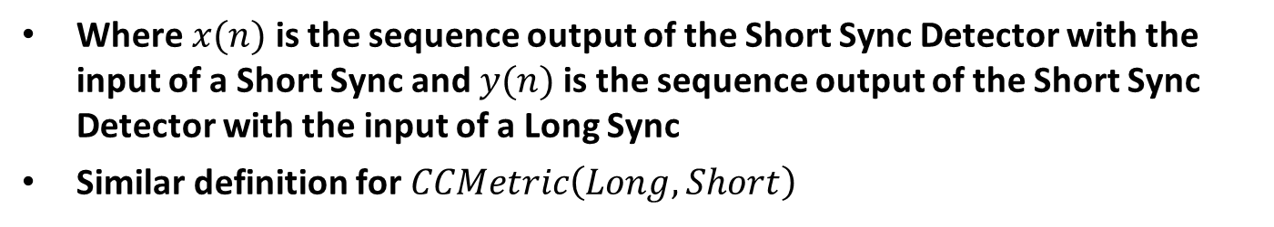
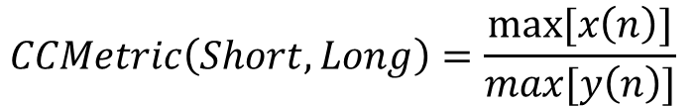
Correlation Metrics
Introduce auto and cross correlation metrics for the Long and Short Sequences, like in [2]. The larger the metric the lower the false alarm rate and the better the timing estimate
Autocorrelation Metric
$$ACMetric\left(Short\right)=\frac{max⁡[x\left(n\right)]}{SecondLargest[x\left(n\right)]}$$
Where $x(n)$is the sequence output of the Short Sync Detector with an input of a Short Sync
Similar definition for $ACMetric\left(Long\right)$
Cross Correlation Metric
$$CCMetric\left(Short, Long\right)=\frac{max⁡[x\left(n\right)]}{max[y\left(n\right)]}$$
Where $x(n)$ is the sequence output of the Short Sync Detector with the input of a Short Sync and $y(n)$is the sequence output of the Short Sync Detector with the input of a Long Sync
Similar definition for $CCMetric\left(Long, Short\right)$

Slide 4
Design Summary
Will Show Three Sync Designs
Equal Duration Sync Fields for High and Low Data Rates
  1. Equal Duration Sync Fields
Unequal Duration Sync Fields for High and Low Data Rates
  2. Dual Correlators and Aggregator
  3. Correlator and Dual Aggregators

Slide 5
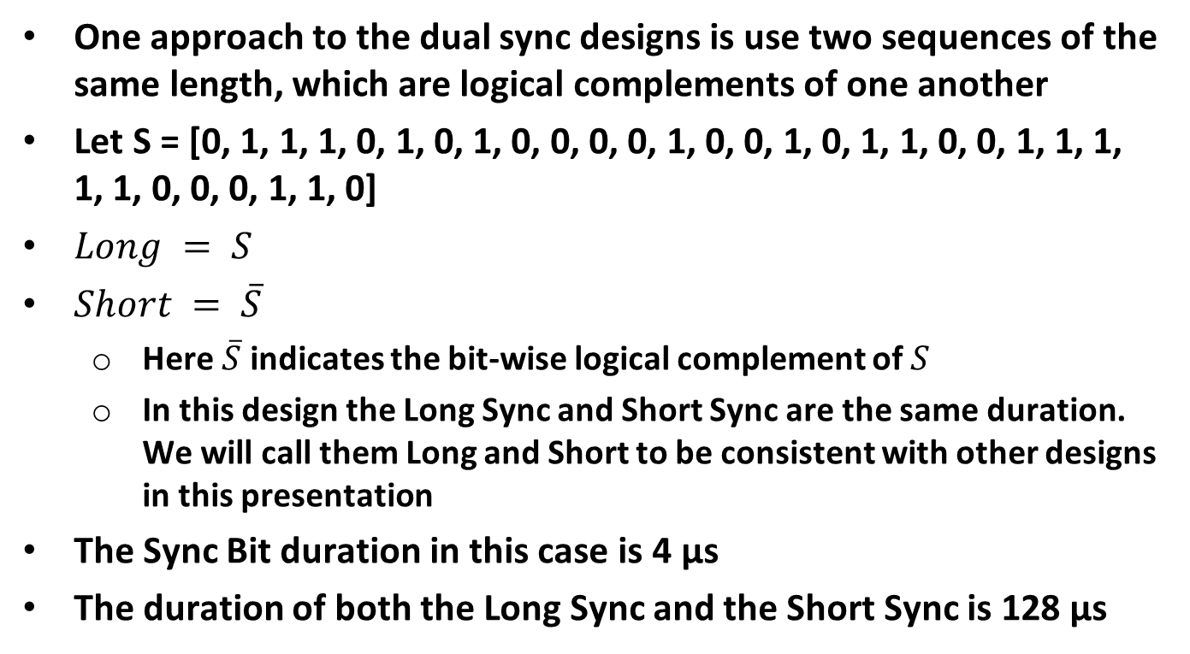
Equal Duration Sync Field Design
One approach to the dual sync designs is use two sequences of the same length, which are logical complements of one another
Let S = [0, 1, 1, 1, 0, 1, 0, 1, 0, 0, 0, 0, 1, 0, 0, 1, 0, 1, 1, 0, 0, 1, 1, 1, 1, 1, 0, 0, 0, 1, 1, 0]
$Long = S$
$Short = \overline{S}$
  Here $\overline{S}$ indicates the bit-wise logical complement of $S$
  In this design the Long Sync and Short Sync are the same duration. We will call them Long and Short to be consistent with other designs in this presentation
The Sync Bit duration in this case is 4 µs
The duration of both the Long Sync and the Short Sync is 128 µs

Slide 6
Equal Duration Sync – Correlation Metrics
Metric | Value
ACMetric(Short) | 5.3
CCMetric(Short, Long) | 8
ACMetric(Long) | 5.3
CCMetric(Long, Short) | 8
Correlation Plots provided in Backup

Slide 7
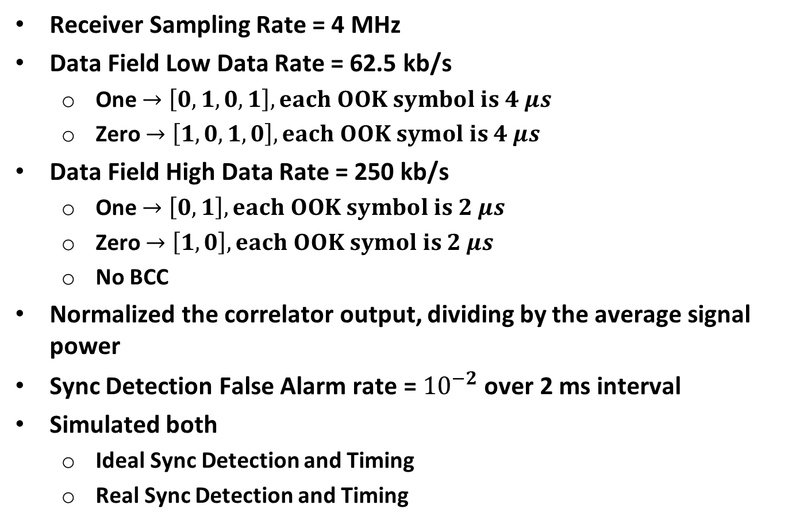
Simulation
Receiver Sampling Rate = 4 MHz
Data Field Low Data Rate = 62.5 kb/s
  One $→\left[0,1,0,1\right], each OOK symbol is 4 μs$
  Zero $→\left[1, 0, 1, 0\right], each OOK symol is 4 μs$
Data Field High Data Rate = 250 kb/s
  One $→\left[0,1\right], each OOK symbol is 2 μs$
  Zero $→\left[1, 0\right], each OOK symol is 2 μs$
  No BCC
Normalized the correlator output, dividing by the average signal power
Sync Detection False Alarm rate = ${10}^{−2}$ over 2 ms interval
Simulated both
  Ideal Sync Detection and Timing
  Real Sync Detection and Timing

Slide 8
Equal Duration Sync – PER Sim: Low Rate, Model D
AWGN and UMi PER plots provided in Backup
Loss due to real Sync Detection and Timing = 0.87 dB

Slide 9
Equal Duration Sync – PER Sim: High Rate, Model D
Loss due to real Sync Detection and Timing = 0.40 dB

Slide 10
Equal Duration Sync – Computational Complexity
Parameter | Value
Duration of Correlator (µs) | 128
Sampling Rate (MHz) | 4
Length of Correlator (Samples) | 512
Number of Adds each Sample Time | 512
Number of Adds Per Second | 2048 Million

Slide 11
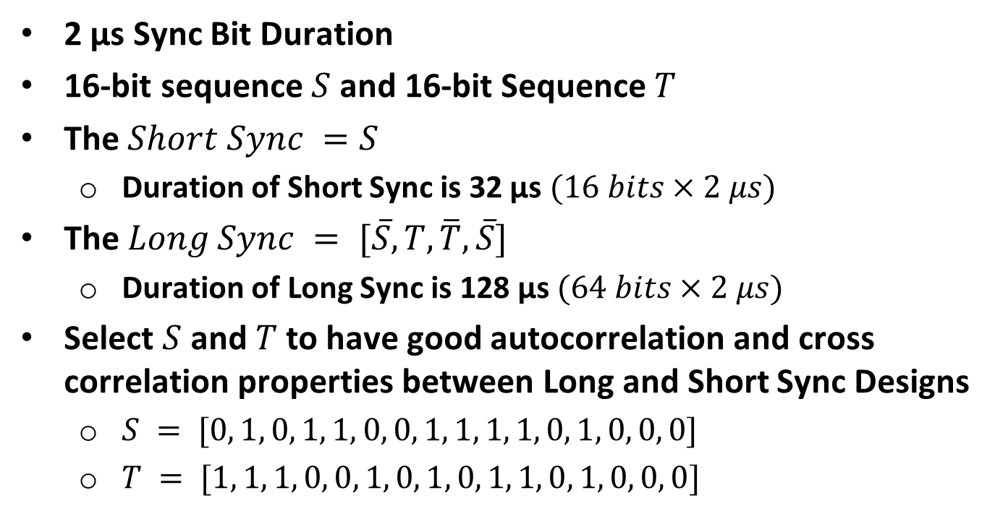
Unequal Duration Sync – Dual Correlators and Aggregator
2 µs Sync Bit Duration
16-bit sequence $S$ and 16-bit Sequence $T$
The $Short Sync =S$
  Duration of Short Sync is 32 µs $(16 bits×2 μs)$
The $Long Sync = [\overline{S}, T, \overline{T}, \overline{S}]$
  Duration of Long Sync is 128 µs $(64 bits×2 μs)$
Select $S$ and $T$ to have good autocorrelation and cross correlation properties between Long and Short Sync Designs
  $S = [0, 1, 0, 1, 1, 0, 0, 1, 1, 1, 1, 0, 1, 0, 0, 0]$
  $T = [1, 1, 1, 0, 0, 1, 0, 1, 0, 1, 1, 0, 1, 0, 0, 0]$

Slide 12
Dual Correlator/Aggregator – Correlation Metrics
Metric | Value
ACMetric(Short) | 8
CCMetric(Short, Long) | 4
ACMetric(Long) | 4
CCMetric(Long, Short) | 8
Correlation Plots provided in Backup

Slide 13
Dual Correlator/Aggregator – PER Sim: Low Rate, Model D
Loss due to real Sync Detection and Timing = 1.01 dB

Slide 14
Dual Correlator/Aggregator – PER Sim: High Rate, Model D
Loss due to real Sync Detection and Timing = 1.28 dB

Slide 15
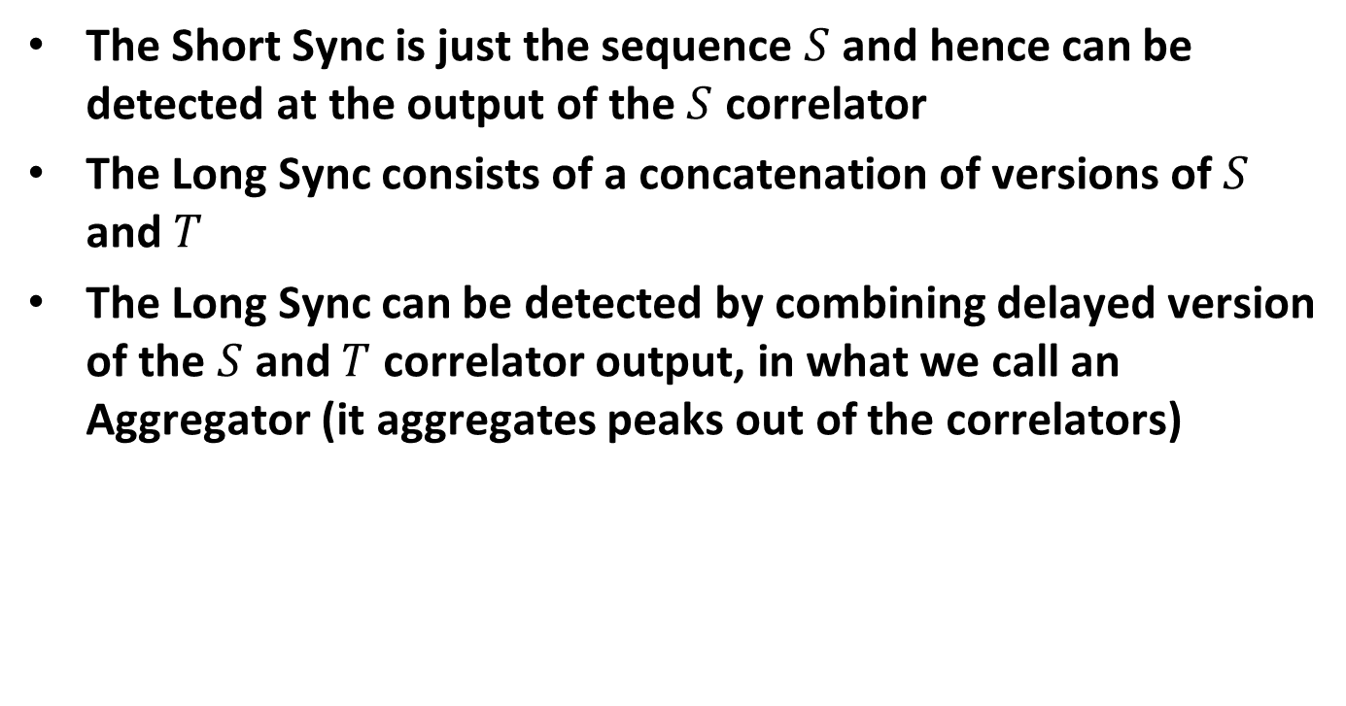
Dual Correlator/Aggregator – Sync Detection
The Short Sync is just the sequence $S$ and hence can be detected at the output of the $S$ correlator
The Long Sync consists of a concatenation of versions of $S$ and $T$
The Long Sync can be detected by combining delayed version of the $S$ and $T$ correlator output, in what we call an Aggregator (it aggregates peaks out of the correlators)

Slide 16
Dual Correlator/Aggregator – Low Complexity Long Sync Detector

Slide 17
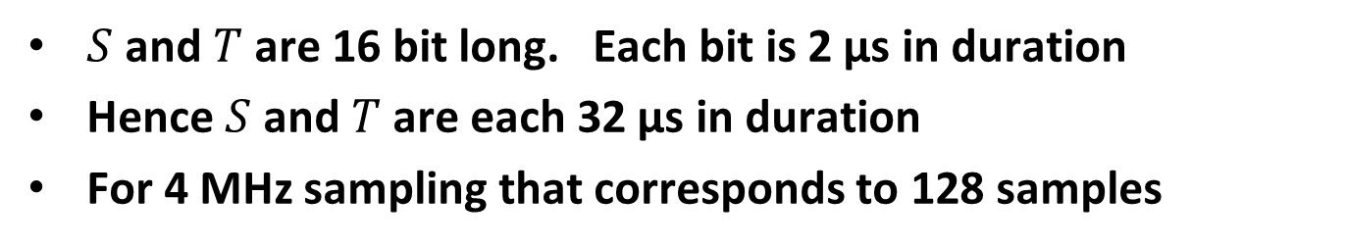
Dual Correlator/Aggregator – Aggregator
$S$ and $T$ are 16 bit long. Each bit is 2 µs in duration
Hence $S$ and $T$ are each 32 µs in duration
For 4 MHz sampling that corresponds to 128 samples

Slide 18
Dual Correlator/Aggregator– Computational Complexity
Parameter | Value
Duration of S Correlator (µs) | 32
Sampling Rate (MHz) | 4
Length of S Correlator (Samples) | 128
Number of Adds in S Correlator | 128
Number of Adds in T Correlator | 128
Number of Adds in Aggregator | 4
Total Number of Adds Per Sample Time | 260
Number of Adds Per Second | 1040 Million

Slide 19
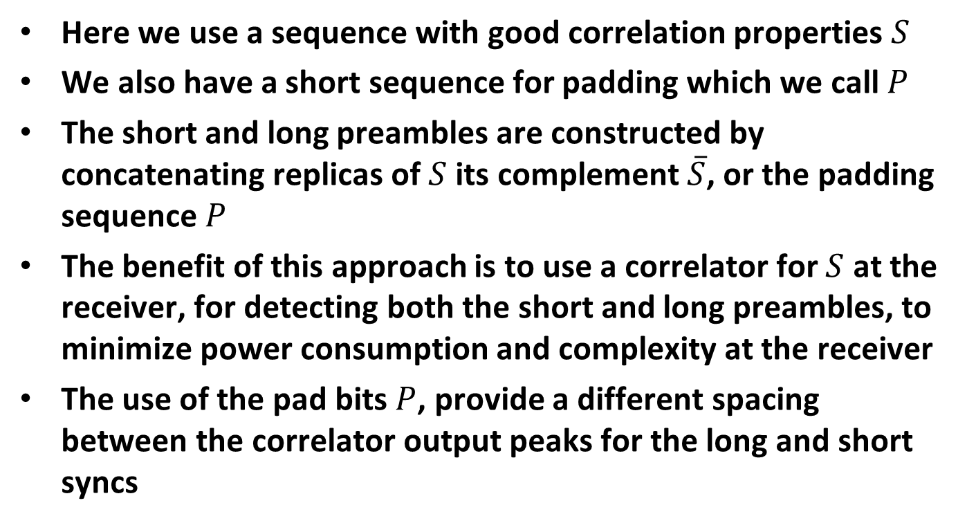
Unequal Duration Sync – Correlator plus Dual Aggregator: Design Approach
Here we use a sequence with good correlation properties $S$
We also have a short sequence for padding which we call $P$
The short and long preambles are constructed by concatenating replicas of $S$ its complement $\overline{S}$, or the padding sequence $P$
The benefit of this approach is to use a correlator for $S$ at the receiver, for detecting both the short and long preambles, to minimize power consumption and complexity at the receiver
The use of the pad bits $P$, provide a different spacing between the correlator output peaks for the long and short syncs

Slide 20
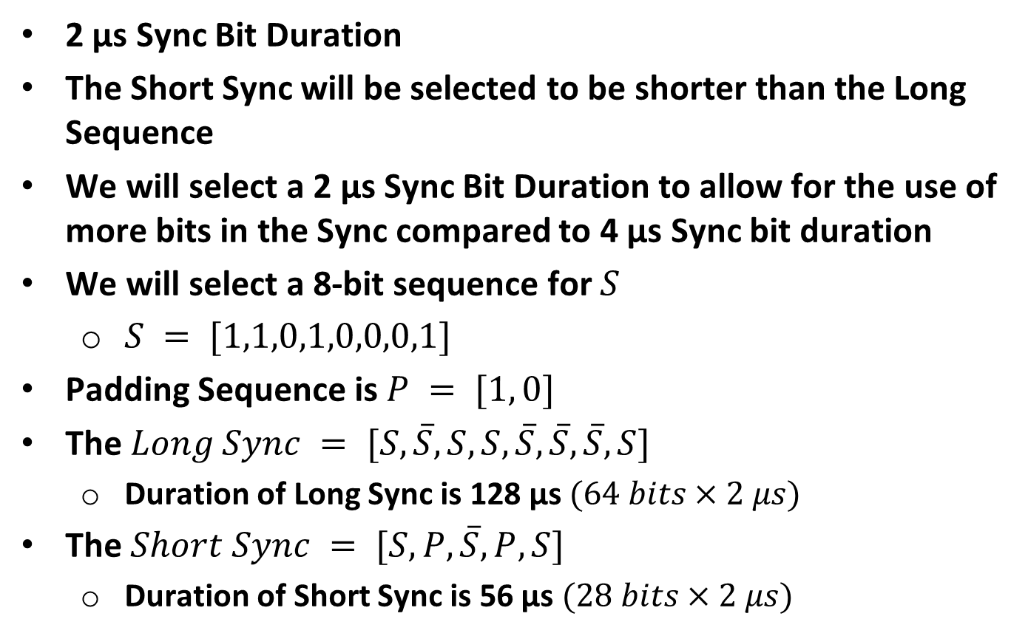
Correlator/Dual Aggregators
2 µs Sync Bit Duration
The Short Sync will be selected to be shorter than the Long Sequence
We will select a 2 µs Sync Bit Duration to allow for the use of more bits in the Sync compared to 4 µs Sync bit duration
We will select a 8-bit sequence for $S$
  $S = [1,1,0,1,0,0,0,1]$
Padding Sequence is $P = [1, 0]$
The $Long Sync = [S, \overline{S}, S, S, \overline{S}, \overline{S}, \overline{S}, S]$
  Duration of Long Sync is 128 µs $(64 bits×2 μs)$
The $Short Sync = [S, P, \overline{S}, P, S]$
  Duration of Short Sync is 56 µs $(28 bits×2 μs)$

Slide 21
Correlator/Dual Aggregators – Correlation Metrics
Metric | Value
ACMetric(Short) | 3
CCMetric(Short, Long) | 3
ACMetric(Long) | 6.4
CCMetric(Long, Short) | 5.3
Correlation Plots provided in Backup

Slide 22
Correlator/Dual Aggregators – PER Sim: Low Rate, Model D
Loss due to real Sync Detection and Timing = 1.01 dB

Slide 23
Correlator/Dual Aggregators – PER Sim: High Rate, Model D
Loss due to real Sync Detection and Timing = 0.46 dB

Slide 24
Correlator/Dual Aggregators – Sync Detector

Slide 25
Correlator/Dual Aggregators – Long Aggregator
Sampling Rate = 4 MHz
Delay = 16 µs at 4 MHz = 64 samples

Slide 26
Correlator/Dual Aggregators – Short Aggregator
Sampling Rate = 4 MHz
Delay = 20 µs at 4 MHz = 80 samples

Slide 27
Correlator/Dual Aggregators – Computational Complexity
Parameter | Value
Duration of Correlator (µs) | 16
Sampling Rate (MHz) | 4
Length of Correlator (Samples) | 64
Number of Adds in Correlator | 64
Number of Adds in Long Aggregator | 8
Number of Adds in Short Aggregator | 3
Total Number of Adds Per Sample Time | 75
Number of Adds Per Second | 300 Million

Slide 28
Comparison – Correlation Metrics
Design | Short Duration (µs) | Long Duration (µs) | Short AC Metric | Short CC Metric | Long AC Metric | Long CC Metric
Equal Duration | 128 | 128 | 5.3 | 8 | 5.3 | 8
Dual Correlators /Aggregator | 32 | 128 | 8 | 4 | 4 | 8
Correlator /Dual Aggregators | 56 | 128 | 3 | 3 | 6.4 | 5.3
All three designs have high correlation metrics leading to low miss-classification rate

Slide 29
Comparison – Demodulation Performance
Design | Short Duration (µs) | Long Duration (µs) | Loss – Real Sync Detect Low Rate AWGN (dB) | Loss – Real Sync Detect High Rate AWGN (dB) | Loss – Real Sync Detect Low Rate Model D (dB) | Loss Real Sync Detect High Rate Model D (dB)
Equal Duration | 128 | 128 | 0.34 | 0.16 | 0.87 | 0.4
Dual Correlators /Aggregator | 32 | 128 | 0.32 | 0.90 | 1.01 | 1.28
Correlator /Dual Aggregators | 56 | 128 | 0.31 | 0.04 | 1.01 | 0.46
Long Sync duration of 128 µs gives around 1 dB loss (Model D), due to Sync detection and timing. To do better we would need to go to 256 µs, which is excessively long
Short Sync of 32 µs gives around 1 dB loss, while 56 µs gives around ½ dB loss. There seems to be no need to use 128 µs for the high data rate

Slide 30
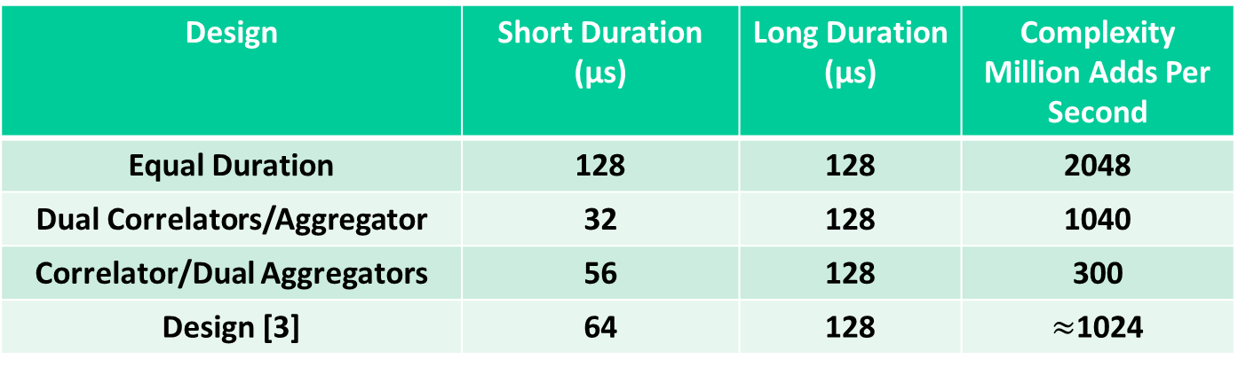
Comparison – Overhead and Complexity
Design | Short Duration (µs) | Long Duration (µs) | Complexity Million Adds Per Second
Equal Duration | 128 | 128 | 2048
Dual Correlators/Aggregator | 32 | 128 | 1040
Correlator/Dual Aggregators | 56 | 128 | 300
Design [3] | 64 | 128 | $≈$1024
The three designs covered in this presentation have satisfactory PER performance
The Dual Correlators/Aggregator and the Correlator/Dual Aggregators designs have both lower overhead and comparable or lower complexity than the Equal Duration design and the Design in [3]
Have not simulated the Design in [3]. The cross correlation of the Long and Short is only 2 which is poorer than the other designs

Slide 31
Summary
We recommend 128 µs Sync Field for the low data rate and a shorter duration (e.g. 32 or 56 µs) Sync Field for the high data rate
We recommend a structured sequence design for the long Sync Field to enable lower complexity implementations
All our designs have been simulated to demonstrate satisfactory performance

Slide 32
Straw Poll #1
Do you support a Sync field duration of 128 µs for the low data?
Yes
No
Abstain

Slide 33
Straw Poll #2
Do you support a Sync field duration less than 128 µs for the high data rate?
Yes
No
Abstain

Slide 34
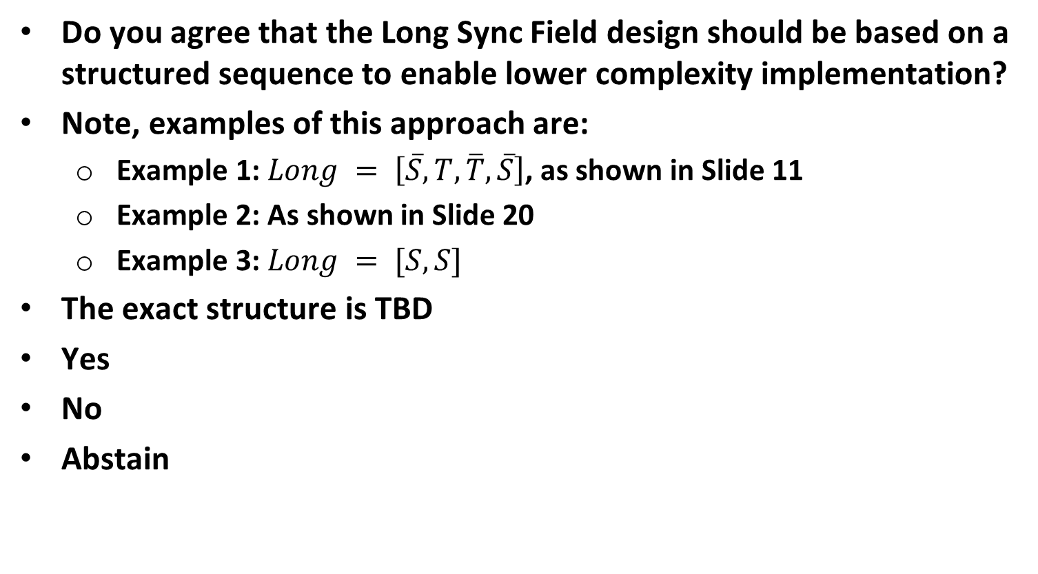
Straw Poll #3
Do you agree that the Long Sync Field design should be based on a structured sequence to enable lower complexity implementation?
Note, examples of this approach are:
  Example 1: $Long = \left[\overline{S}, T, \overline{T}, \overline{S}\right]$, as shown in Slide 11
  Example 2: As shown in Slide 20
  Example 3: $Long = [S, S]$
The exact structure is TBD
Yes
No
Abstain

Slide 35
References
Steve Shellhammer, Bin Tian, Lochan Verma, “WUR Preamble Evaluation,” IEEE 802.11-17/1355r1, Sept 2017
Rui Cao, Hongyuan Zhang, “WUR Preamble SYNC Field Design,” IEEE 802.11-17/1343r0, Sept 2017
Shahrnaz Azizi, Juan Fang, Vinod Kristem, Thomas Kenney, “WUR Preamble Performance Study with Phase Noise and ACI,” IEEE 802.11-17/1442r1, Sept 2017

Slide 36
Backup

Slide 37
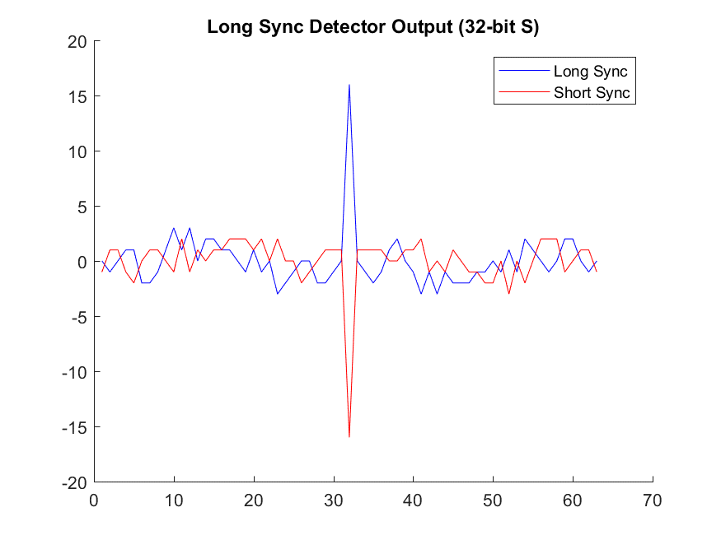
Equal Duration Sync – Long Sync Correlator Output
The Short Sync Correlator is the same as the Long Sync Correlator, we just look for negative peaks

Slide 38
Equal Duration Sync – PER Sim: Low Rate, AWGN
Loss due to real Sync Detection and Timing = 0.34 dB

Slide 39
Equal Duration Sync – PER Sim: High Rate, AWGN
Loss due to real Sync Detection and Timing = 0.16 dB

Slide 40
Equal Duration Sync – PER Sim: Low Rate, UMi
Loss due to real Sync Detection and Timing = 0.97 dB

Slide 41
Equal Duration Sync – PER Sim: High Rate, UMi
Loss due to real Sync Detection and Timing = 0.37 dB

Slide 42
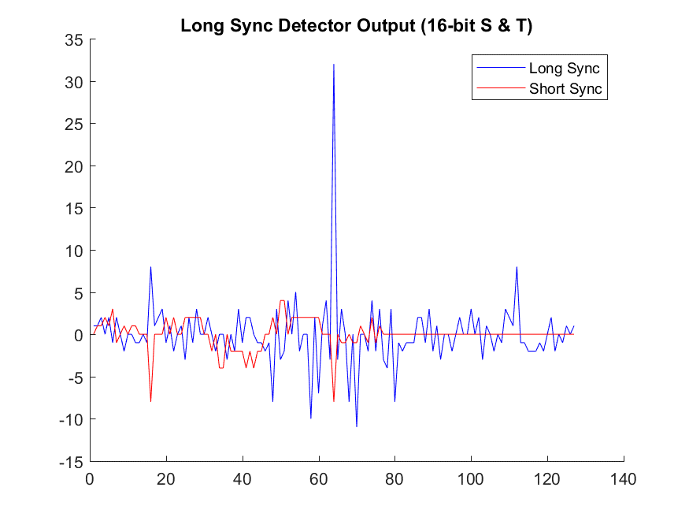
Dual Correlator/Aggregator – Long Sync Detector Output

Slide 43
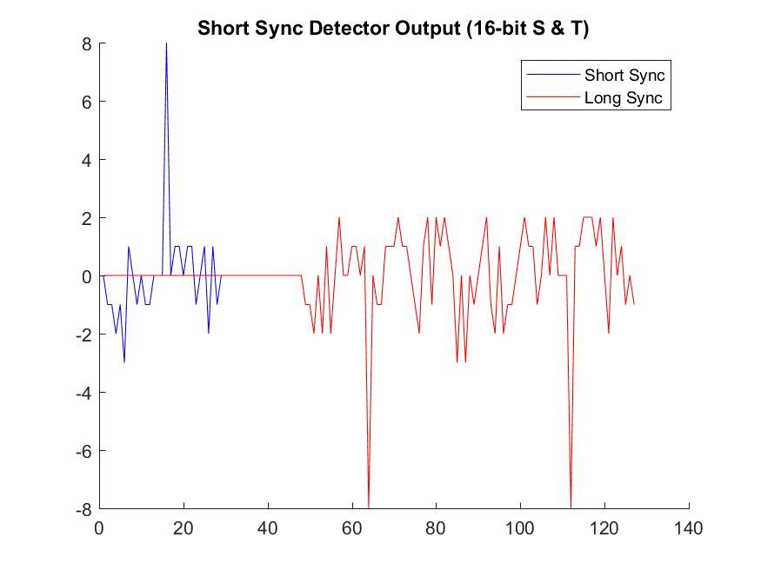
Dual Correlator/Aggregator – Short Sync Detector Output

Slide 44
Dual Correlator/Aggregator – PER Sim: Low Rate, AWGN
Loss due to real Sync Detection and Timing = 0.32 dB

Slide 45
Dual Correlator/Aggregator – PER Sim: High Rate, AWGN
Loss due to real Sync Detection and Timing = 0.90 dB

Slide 46
Dual Correlator/Aggregator – PER Sim: Low Rate, UMi
Loss due to real Sync Detection and Timing = 1.10 dB

Slide 47
Dual Correlator/Aggregator – PER Sim: High Rate, UMi
Loss due to real Sync Detection and Timing = 1.28 dB

Slide 48
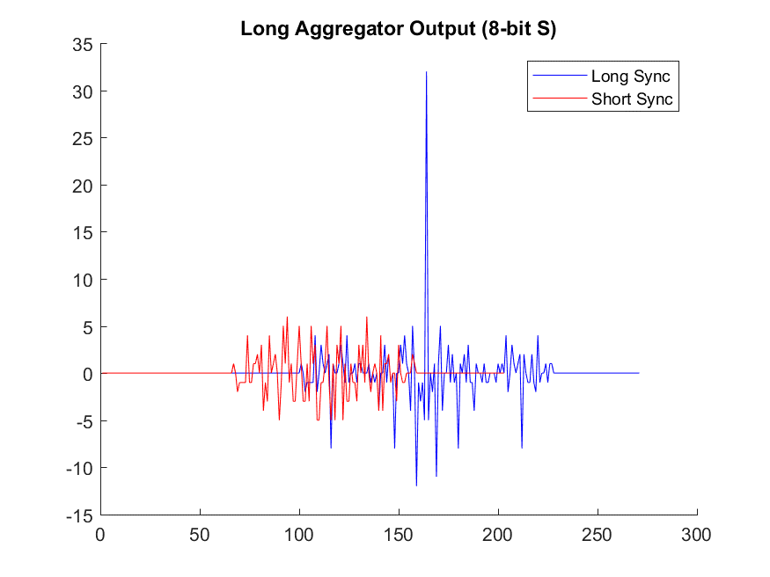
Correlator/Dual Aggregators – Long Aggregator Output

Slide 49
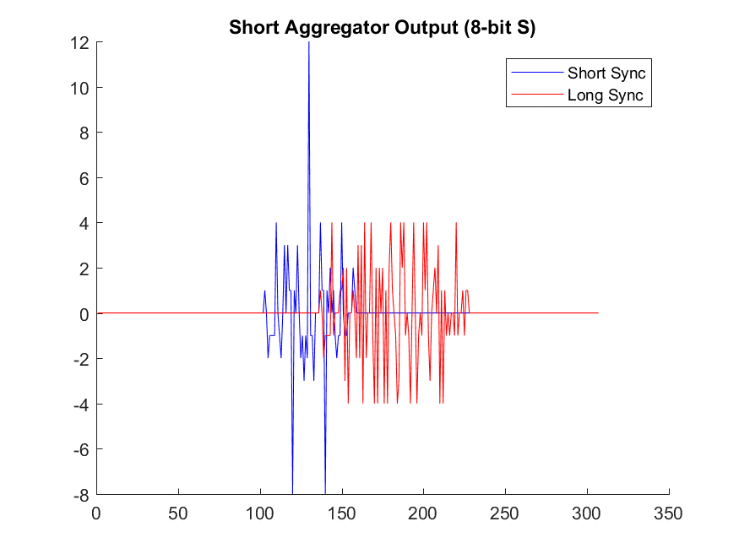
Correlator/Dual Aggregators – Short Aggregator Output

Slide 50
Correlator/Dual Aggregators – PER Sim: Low Rate, AWGN
Loss due to real Sync Detection and Timing = 0.31 dB

Slide 51
Correlator/Dual Aggregators – PER Sim: High Rate, AWGN
Loss due to real Sync Detection and Timing = 0.04 dB

Slide 52
Correlator/Dual Aggregators – PER Sim: Low Rate, UMi
Loss due to real Sync Detection and Timing = 1.09 dB

Slide 53
Correlator/Dual Aggregators – PER Sim: High Rate, UMi
Loss due to real Sync Detection and Timing = 0.51 dB

