Slide 1
Discussion on Preamble Sequences For Indication of the WUR Rates
Date: 2017-11-06
Authors:

Slide 2
Introduction
In this presentation, options of WUR Preamble to support different data rates are discussed
Considering the discussions in [1-4] and the results of straw polls during the IEEE meeting, the following two cases are discussed to provide two different preamble durations for the rate indication
Use of one and two 15-bit PN and/or complement of the 15-bit PN sequences
Shorter OOK symbol duration of 2usec (option 5 in backup slides)

Slide 3
Proposal 1: Use of 4usec Bit Duration Sequence S
Use S = 15-bit Maximal Length PN sequence for higher rate, and signal the lower rate by including two repetitions of S.
The bit 0 is added to make it 16 bits, which gives equal number of ones and zeroes
24 µs
Legacy + WUR Mark
Wake-up preamble
MAC header
Payload
FCS
Low Rate
0
15-bit PN seq.
0
15-bit PN seq.
128 µs
64 µs
Higher Rate
0
15-bit PN seq.

Slide 4
Rate Detection at The Receiver
Earlier proposal [1-2]
Correlate with 32-bit (128 us) sequence (see backup slides)
Low rate transmission: 3 peaks, with strong center peak
High rate transmission: 2 peaks, with similar strength
The Discussion with other members during the September session and offline indicated that finding 3 peaks and identifying the strongest one appear to be complex to them. Therefore:
Current proposal
Use 16-bit (64 us) correlator
Low rate transmission: 2 peaks, separated by PN seq length
High rate transmission: single peak
Advantages
Lower complexity compared to single long (128 us) correlator by exploiting the structure
Lower overhead for higher rate

Slide 5
Detection Method for the Common Sequence Case: lower Rate
Correlating with the known sequence results in two peaks:
The two peaks roughly separated by PN seq length
0
15-bit PN seq.
Other received samples
Received samples prior to the preamble
no peak
0
15-bit PN seq.
0
15-bit PN seq.
Other received samples
Received samples prior to the preamble
0
15-bit PN seq.
0
15-bit PN seq.
1st Peak
Other received samples
0
Received samples prior to the preamble
2nd Peak
0
15-bit PN seq.
15-bit PN seq.
Other received samples
Received samples prior to the preamble
0
15-bit PN seq.
15-bit PN seq.
0
no Peak

Slide 6
Detection Method for the Common Sequence Case: Higher Rate
Correlating with the known sequence results in one peaks:
0
15-bit PN seq.
Other received samples
Received samples prior to the preamble
no peak
0
15-bit PN seq.
Other received samples
Received samples prior to the preamble
0
15-bit PN seq.
1st Peak
Other received samples
Received samples prior to the preamble
No Peak
0
15-bit PN seq.

Slide 7
Proposal 2: 4usec bit-duration S and Its Complement
Use sequence S = 15-bit Maximal Length PN sequence.
Signal higher rate using $\overline{S}$; Signal the lower rate by including concatenating S and S
$\overline{S}$ is the bit-wise logical complement of $S$
24 µs
Legacy + WUR Mark
Wake-up preamble
MAC header
Payload
FCS
Low Rate
S
S
128 µs
64 µs
Higher Rate
S Complement

Slide 8
Proposal 2 – (S, S) for Low Rate and $\overline{S}$ for High rate: Rate detection at the receiver
Correlate with short sequence
Low rate transmission: Two positive peaks, separated by PN seq length
High rate transmission: one negative peak
Advantages
Easy to differentiate the two rates compared to proposal 1
Similar to proposal 1: Lower complexity compared to single long (128 us) correlator
Similar to proposal 1: Lower overhead for higher rate

Slide 9
Simulation parameters (Transmitter)
20MHz Bandwidth (legacy)
100 symbols of silence
Wake-up preamble
MAC header
Payload
FCS
Low rate transmissions
Preamble (S, S)
S: 15-bit PN seq and added 0
Bit duration: 4 us
4 MHz, 4 us OOK pulse
Data
MC-[1 0 1 0], with bit duration: 4 us
4 MHz, 4 us OOK pulse
High rate transmissions
Preamble
Two cases: S and $\overline{S}$
Bit duration: 4 us
4 MHz, 4 us OOK pulse
Data
MC-[1 0], with Bit duration: 2 us
4 MHz, 2 us OOK pulse generated using 32 pt FFT in 20 MHz [5]

Slide 10
Simulation parameters (Receiver)
The known S sequence is cross correlated (normalized output) with a sliding window of the received samples
Low rate: Two positive peaks, spaced apart by PN seq length
High rate: Single peak (positive or negative)
4 MHz LPF (IIR) – generated using MATLAB
Numerator order=1, denominator order=1
Passband freq. = 2MHz, Stopband freq.=6MHz, Sampling freq. =160MHz
WUR with in-phase only (single rx chain)
Channels: AWGN and Channel D
No phase noise
2.4 GHz band operation
25 MHz away ACI: 16 dB higher than the received signal
SNR is measured at 20 MHz bandwidth
Performance quantified with respect to Genie approaches

Slide 11
Genie Approaches
Genie with ideal rate and timing
Genie knows incoming rate and the precise Timing
Best possible performance
Non-realistic, but acts like a baseline
Genie with ideal rate
Genie only knows if packet is low/high rate, but not the timing
Timing acquisition
Low rate transmission: Considered several approaches and picked the best
Correlating with 128 us sequence and comparing strongest peak to threshold
Correlating with 128 us sequence and looking for three peaks (strong center peak)
Later approach gave better PER performance
High rate transmission
Correlating with 64 us sequence and comparing strongest peak to threshold was good

Slide 12
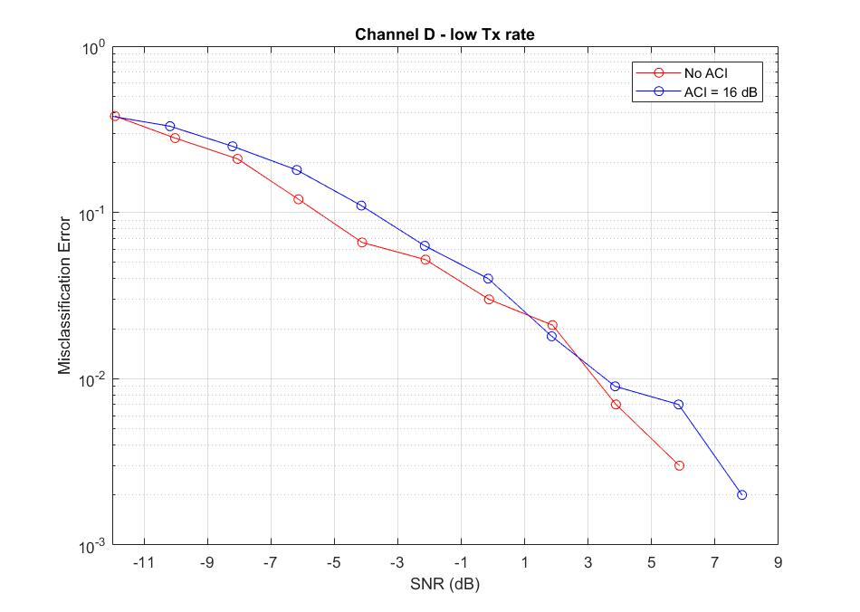
Miss Classification of Low Rate (S, S) as High Rate (S) (Proposal 1)
16 bit correlator better than 32 bit correlator, as expected

Slide 13
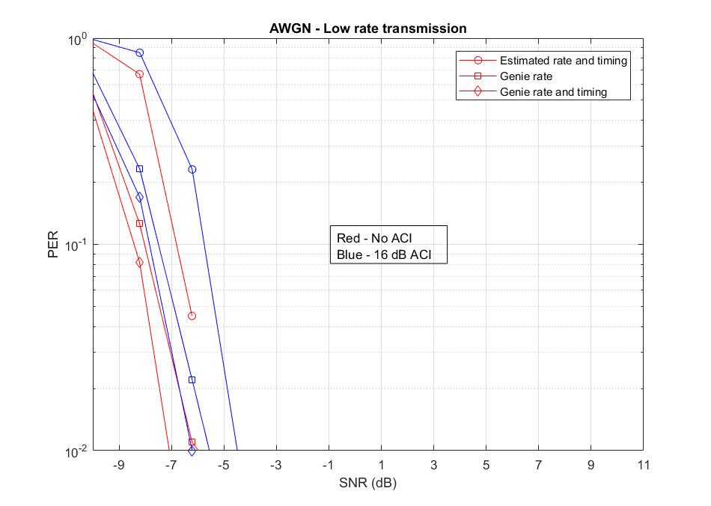
PER- Low Rate (S, S) Transmission (Proposal 1)
1.5 dB performance gap compared to genie Rate case
2 dB performance gap compared to genie Rate and Timing

Slide 14
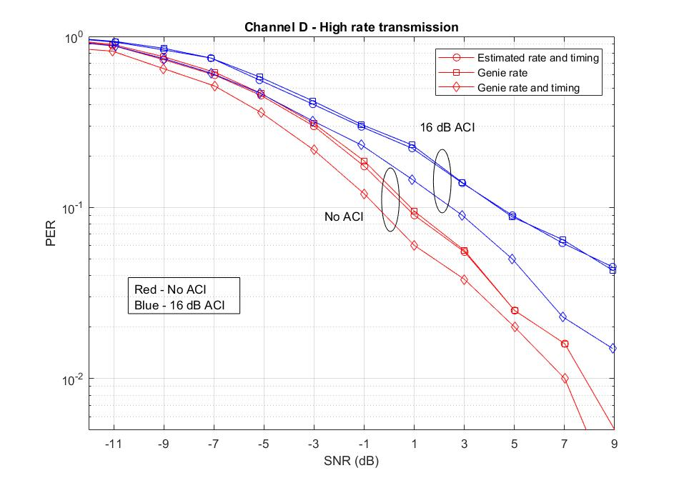
PER- High Rate S Transmission (Proposal 1)
64 us correlator is as good as the genie rate case (No performance gap)
1-2 dB dB performance gap compared to genie Rate and Timing

Slide 15
Conclusions of proposal 1: S and (S, S)
Repeated PN sequence with 16-bit (64 us) correlator is suited to differentiate two rates
1 dB Performance gap compared to genie rate case
No performance gap for high rate transmissions
Performance gap of 1 dB for low rate transmissions
2 dB Performance gap compared to genie rate and timing
Performance gap of 2 dB for high rate transmissions
Performance gap of 1 dB for low rate transmissions

Slide 16
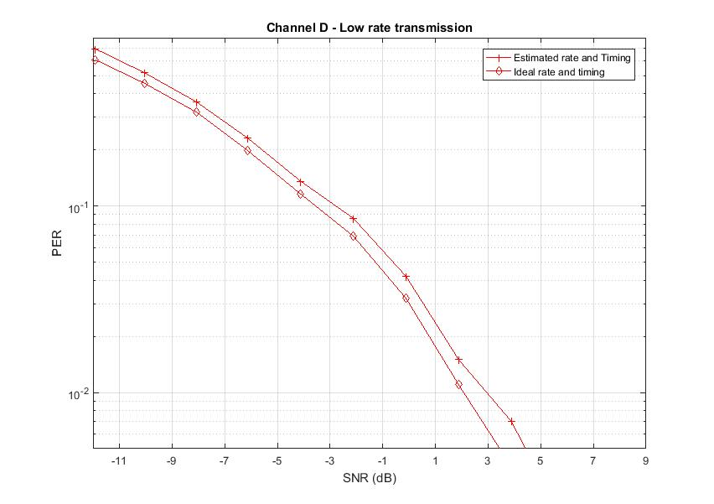
PER- Low Rate (S, S) Transmission (Proposal 2)
Performance relative to genie Rate and Timing
0.3 dB loss in AWGN and 0.6 dB loss in Channel D
Misclassification error is very small

Slide 17
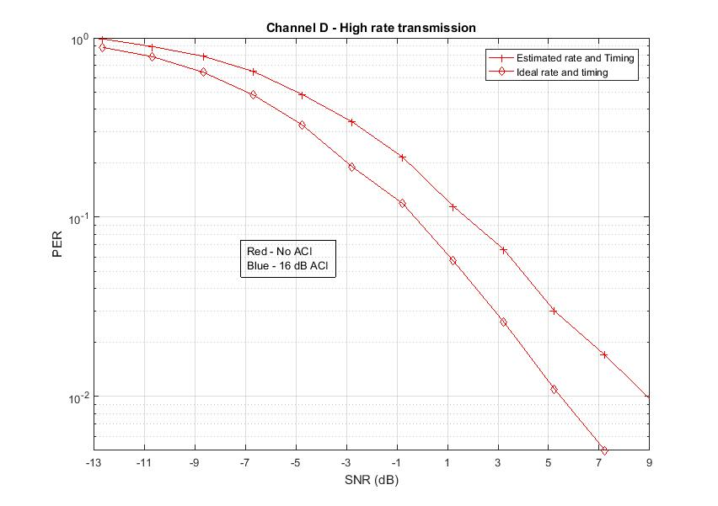
PER- High Rate $\overline{S}$ Transmission (S, S) is used for Lower Rate (Proposal 2)
Performance relative to genie Rate and Timing
1.3 dB loss in AWGN and 2 dB loss in Channel D
Misclassification error is very small

Slide 18
Conclusions of proposal 2: $\overline{S}$ and (S, S)
Use of complement sequence reduces misclassification rate
Small misclassification errors
0.3-0.6 dB loss compared to ideal timing and rate (low rate)
1.3-2 dB loss compared to ideal timing and rate (high rate)

Slide 19
Option 3: Single 31-bit sequence
24 µs
Legacy+WUR mark
Wake-up preamble
MAC header
Payload
FCS
Low Rate: S
0
31-bit PN seq.
128 µs
Higher Rate: $\overline{S}$
1
31-bit PN seq Complement.
128 µs

Slide 20
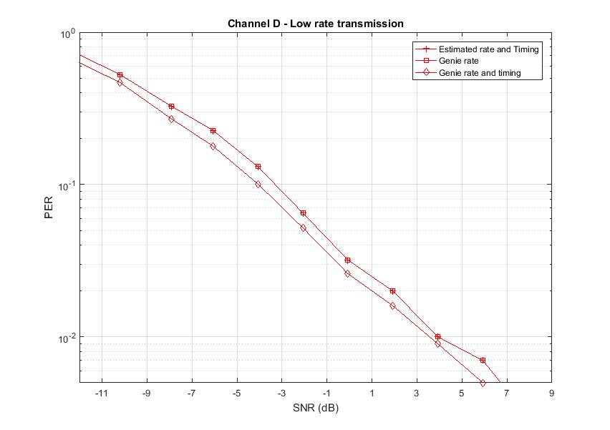
PER- Low Rate 31-bit PN Sequence Transmission
Performance relative to genie Rate and Timing
0.4 dB loss in AWGN and 0.8 dB loss in Channel D

Slide 21
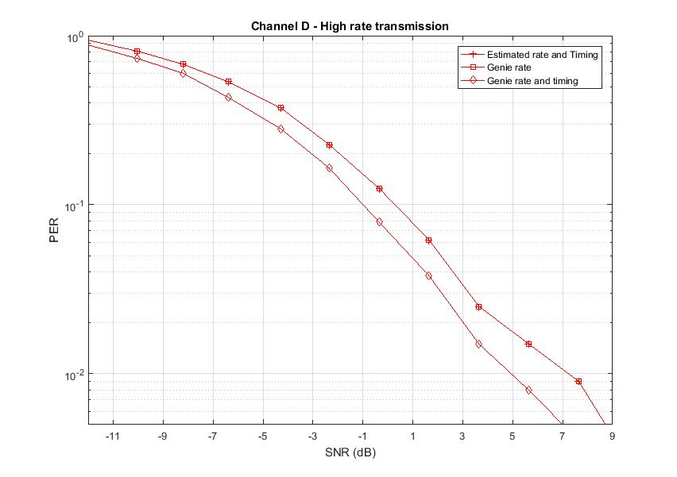
PER- High Rate: Complement of 31-bit of Low Rate
Performance relative to genie Rate and Timing
0.6 dB loss in AWGN and 1.3 dB loss in Channel D

Slide 22
Option 4: Single 15-bit sequence
24 µs
Legacy+WUR mark
Wake-up preamble
MAC header
Payload
FCS
Low Rate: S
0
15-bit PN seq.
64 µs
Higher Rate: $\overline{S}$
1
15-bit PN seq Complement.
64 µs

Slide 23
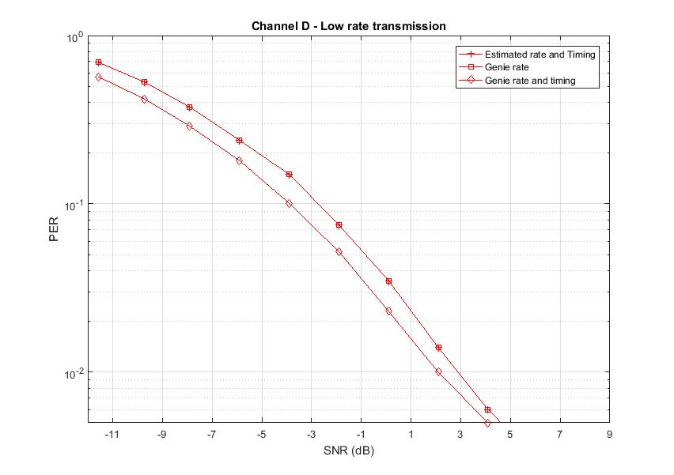
PER- Low Rate 15-bit PN Sequence Transmission
Performance relative to genie Rate and Timing
1 dB loss in AWGN and 1.2 dB loss in Channel D

Slide 24
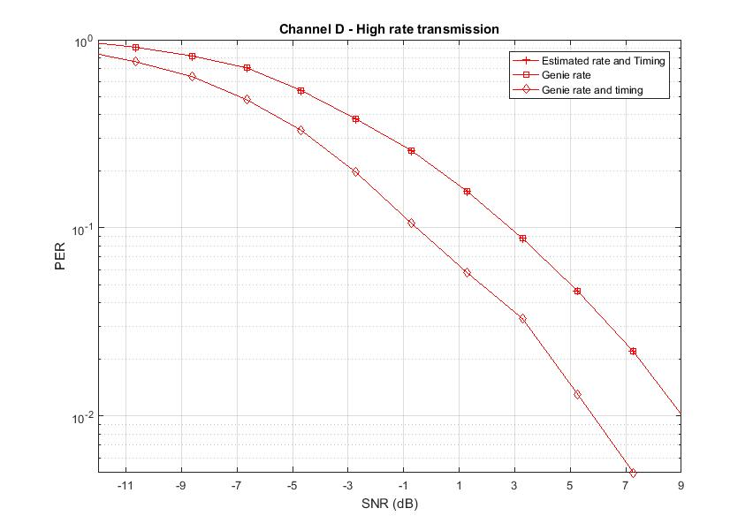
PER- High Rate: Complement of 15-bit of Low Rate
Performance relative to genie Rate and Timing
2 dB loss in AWGN and 4 dB loss in Channel D

Slide 25
Conclusions
Use of a structured preamble of (S, S) for low rate and S or $\overline{S}$ for high rate provides
Lower hardware complexity
Lower overhead at higher rate
Very good misclassification rate
Very good PER performance

Slide 26
References
[1] 17/0997r0 Preamble Options, IEEE 802.11 TGba, July 2017
[2] 17/1442r0 WUR Preamble Performance Study with Phase Noise and ACI, IEEE 802.11 TGba, September 2017
[3] 17/1355r1 WUR Preamble Evaluation, IEEE 802.11 TGba, September 2017
[4] 17/1345r5 11ba PHY Frame Format Proposal, IEEE 802.11 TGba, September 2017
[5] 17/1615r0 OOK waveform generation for high data rate, IEEE 802.11 TGba, November 2017

Slide 27
Backup

Slide 28
Detection Method for the Common Sequence Case: lower Rate
Correlating with the known 32-bit sequence results in three peaks:
0
15-bit PN seq.
0
15-bit PN seq.
Other received samples
Received samples prior to the preamble
no peak
0
15-bit PN seq.
0
15-bit PN seq.
Other received samples
Received samples prior to the preamble
0
15-bit PN seq.
0
15-bit PN seq.
1st Peak
Other received samples
0
Received samples prior to the preamble
the 2nd larger Peak
0
15-bit PN seq.
15-bit PN seq.
Other received samples
Received samples prior to the preamble
0
15-bit PN seq.
15-bit PN seq.
0
3rd Peak

Slide 29
Detection Method for the Common Sequence Case: Higher Rate
Correlating with the known sequence results in three peaks:
0
15-bit PN seq.
0
15-bit PN seq.
Other received samples
Received samples prior to the preamble
no peak
0
15-bit PN seq.
Other received samples
Received samples prior to the preamble
0
15-bit PN seq.
1st Peak
Other received samples
Received samples prior to the preamble
2nd Peak (same size)
0
15-bit PN seq.
Other received samples
15-bit PN seq.
0
Received samples prior to the preamble
no peak

Slide 30
Timing Error for Low Rate (S, S) Transmission– AWGN
SNR
Genie rate has better timing
Timing error less than 8 samples (2 us), > 99% of times
ACI

Slide 31
Timing Error for Low Rate (S, S) Transmission– Channel D
SNR
Genie rate has better timing
Timing error less than 8 samples (2 us), > 98% of times
ACI

Slide 32
Proposal 1: Timing Error for High Rate S – AWGN
Genie and 16-bit correlator has similar timing
Timing error less than 8 samples (2 us), > 98% of times

Slide 33
Proposal 1: Timing Error for High Rate S – Channel D
Genie and 16-bit correlator has similar timing
Timing error less than 8 samples (2 us), > 98% of times

Slide 34
Option 5: Preamble Sequence with Shorter OOK Symbol Duration
Use the same sequence, signal the lower rate by including two repetitions
20 µs
Legacy
Wake-up preamble
MAC header
Payload
FCS
Low Rate: 128 usec Preamble
0
15-bit PN seq.
0
15-bit PN seq.
4 us
4 us
High Rate: 64 usec Preamble
0
15-bit PN seq.
0
15-bit PN seq.
2 us
2 us

Slide 35
Rate and Timing estimate (Option 5)
Two correlators matched to two preamble sequences
32 bit (128 us) correlator
32 bit (64 us) correlator
Rate estimation
Find the maximum correlation peak at the output of two correlators
Whichever is higher, we declare it as corresponding rate
Timing estimation
If max correlation > threshold
Sync found
Timing = idx corresponding to the max correlation

Slide 36
Simulation parameters (Option 5)
Transmitter
Low rate transmissions
Preamble
Repetition of 15-bit PN seq
Bit duration: 4 us
Standard 4 MHz, 4 us OOK pulse
Data
Manchester [1 0 1 0], Bit duration: 4 us
Standard 4 MHz, 4 us OOK pulse
High rate transmissions
Preamble
Repetition of 15-bit PN seq
Bit duration: 2 us
4 MHz, 2 us OOK pulse generated using 32 pt FFT in 20 MHz
Data
Manchester [1 0], Bit duration: 2 us
4 MHz, 2 us OOK pulse generated using 32 pt FFT in 20 MHz
Receiver
First order analog 4 MHz LPF
ACI (pre-filter): 16 dB at 25 MHz spacing
SNR measured at 20 MHz Bandwidth

Slide 37
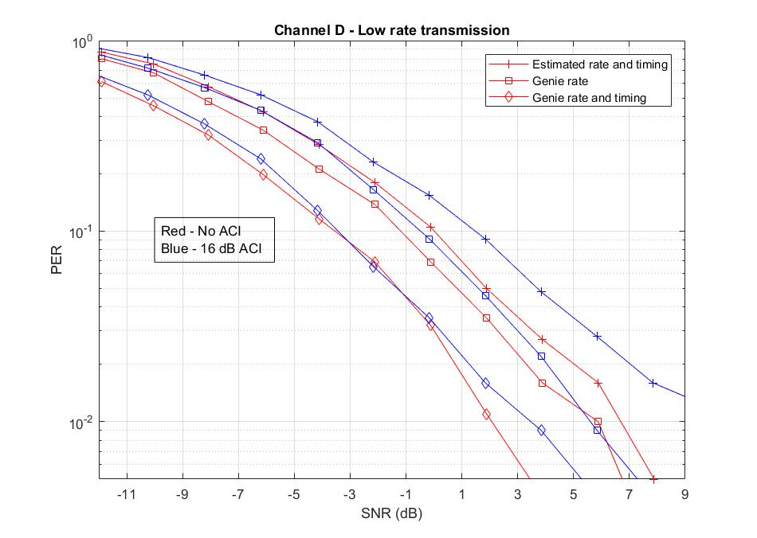
PER (Low rate transmissions)
3-4 dB performance gap from the genie rate and timing
2 us bit duration for preamble did not work well

