Slide 1
Follow-Up on WUR Discovery Frame and Discovery Channel
Date: 2017-11-08
Authors:
Name | Affiliations | Address | Phone | email
Guoqing li | Apple |  |  | Guoqing_li@apple.com
Oren Shani
Chris Hartman
Jarkko Kneck
Pokai Huang | Intel
Robert Stacey
Taewon Song | LG Electronics
Kaiying Lv | ZTE
Roger Marks | Huawei
Lily Yuping Li

Slide 2
Introduction
In 2017 Sept meeting, the group adopted Smart Scanning use cases into the Usage Model document[1][2], see next slide for details
In Smart Scanning, the WUR at the STA side scans for nearby APs for various purposes such as roaming and location measurements
In this contribution, we propose to define a WUR Discovery frame to carry the essential information for unassociated STAs to perform smart scanning
However, when an unassociated STA does not know which channel the Discovery frames are transmitted, it needs to scan the entire band which can increase the scan latency significantly before discovering new APs
Therefore, the concept of “Discovery Channel(s)” is proposed to use when transmitting these WUR Discovery frames (not mandatory but recommendation)

Slide 3
Usage Model : Smart Scanning
Sept 2017
Use case 1: Ultra-low power location scan
Mobile devices sometimes scan through multiple channels for nearby APs, and use the measured Wi-Fi signal strength for improved location services. Scanning on main radio consumes higher power than WUR radio. In addition, scanning on main radio has the risk of conflicting with regular data exchange.
In WUR-facilitated location scan, the mobile device scans through the channels using the WUR receiver, and uses the signal strength measured from WUR packets received from adjacent APs to provide additional information to the location services on the mobile device. In other words, some of the location scan on main radio can be offloaded to WUR radio.
Because WUR consumes much less power than main radio, WUR facilitated location scan provides an ultra-low power location scan mechanism.
Use case 2: Ultra low power roam scan
Mobile devices sometime scan for roaming purposes. These roam scan sometimes is triggered when link quality degrades. These roam scan takes time because the scan is typically done on multiple channels, and on each channel the device either conducts active scan during which it sends a probe request and typically stays awake until it receives a probe response, or passive scan during which it dwells on each channel for at least a Beacon interval to receive a Beacon. As a consequence, scanning through multiple channels introduces roaming latency and consumes power. Sometimes, it runs into conflict with regular data exchange.
In WUR-facilitated roam scan, the mobile device passively scans through multiple channels using WUR, and collects basic information about nearby APs. The collected info can be used to facilitate the devices’ roaming decisions.
Because WUR consumes much less power than main radio, WUR-facilitated roam scan provides an ultra-low power roam scan. In addition, due to the low power operation, WUR scan can be performed quite frequently in the background, and thus roaming information can be readily available whenever needed, i.e., it reduces roaming latency.

Slide 4
Information Needed in WUR Discovery Frame
For roaming scan, the STA need to know the band and channel used by the AP’s PCR so that it can switch directly to the particular channel to join the network
The STA also needs to know which AP is being discovered for better roaming decisions
For location scan, The STA only needs to know the AP’s identify in order to know which AP’s frame the measured RSSI is based on
Therefore, we propose to include the following information in WUR Discovery Frame
Transmitter ID
Main Radio operation channel: Operation Class + Channel number (2 octets total based on Operating Channel definition in baseline spec)

Slide 5
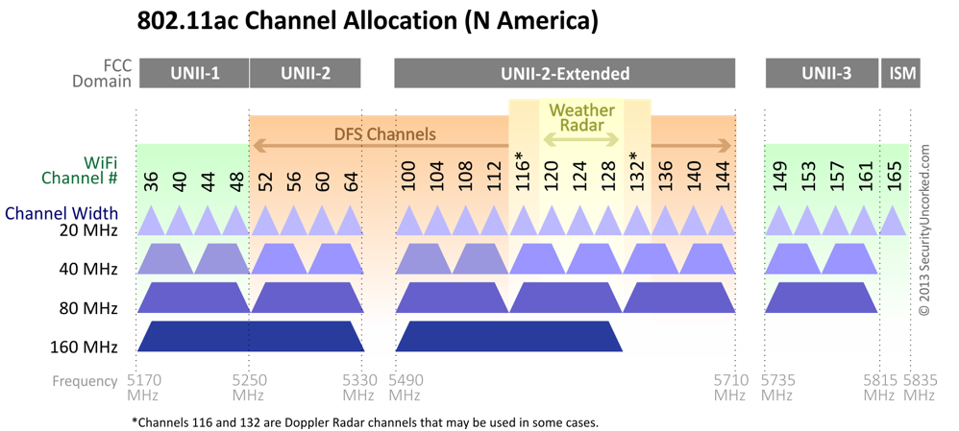
Scanning Latency Improvement
Take 5GHz as an example, there are 8 20MHz channels
Depending on the WUR frame interval, the overall scanning time can be quite significant
For example, if WUR discovery frame interval is 2s, then the worst case latency is 16s
Furthermore, if 802.11ba is allowed in other bands such as 900MHz, then there are even more channels to scan.
In addition, if 802.11ba defines more than one WUR channels in the future for each 20MHzs, then there are significant number of channels to scan through
20MHz
…
4MHz

Slide 6
Proposed Solution
We propose to define one or a few “Discovery channels” that a WUR transmitter is recommended to use to transmit WUR Discovery frames
A WUR AP can select one of the Discovery channels to sent out WUR Discovery frames

Slide 7
WUR Discovery Frame Interval on Discovery Channel
For Smart Scanning use case, since Wi-Fi user mobility is low, there is no need to send out WUR Discovery frames very frequently
In addition, since AP can randomly select one of the discovery channels to send out WUR Discovery frame, we do not expect WUR Discovery frames to cause congestion issue on the Discovery Channel

Slide 8
Summary
We propose to define a type of WUR frame called WUR Discovery frame for Smart Scanning
We also propose to define Discovery Channel concept for WUR transmitter to send out WUR discovery frames
Discovery channel concept is very similar to the Social channel concept in Neighbor Area Network standard
The use of Discovery/Social channel can significantly reduce the scanning latency for unassociated STAs in Smart Scanning use cases
WUR Discovery channels are recommended channels for WUR to to transmit WUR Discovery frame, i.e., not mandatory

Slide 9
Summary of existing contributions on Smart Scanning
[4-7] proposed further considerations to enhance the scanning performance
[4-6] proposed to allow PCR to advertise WUR scanning information to facilitate STA’s roaming scan
[7] proposed additional specific information such as compressed SSID carried in WUR discovery frame to facility STA’s roaming decisions
This contribution summarizes different scenarios these schemes apply and how to do basic and enhanced scanning using these mechanisms

Slide 10
Different Scanning Scenarios
Initial discovery/scanning based on known discovery channels
Example Scenario: after a user leaves home and drives on the road, the PCR should be turned OFF and the STA uses WUR to scan for possible new APs
When the user arrives at a location where Wi-Fi exists, the WUR needs to discover the existing AP quickly and start to associate to the new AP
[3] addresses the initial scanning scenario: defining a WUR discovery frame and defining a limited number of discovery channels allows the WUR to only scan these channels for Discovery frames to reduce the scanning latency
For example, if Discovery frame is sent once every 1s, and we define 3 discovery channels, then the worst case latency is reduced from 8s (19 20MHz channels in 5G including DFS and assume one WUR channel/20MHz) to 3s

Slide 11
Different Scanning Scenarios (cont.)
Scanning based on advertised discovery channels
[4-6] proposes that an AP may advertise WUR scanning info. As a result, after a user arrives at a location and associates with an AP, it can obtain more information from the PCR regarding the specific WUR operation used by the specific AP or SSID. The STA may store the discovery information and later recall it, even when PCR is ON
After obtaining such info, the STA can use WUR to perform targeted scan in the advertised discovery channel based on specific info such as compressed SSID.
For this purpose, WUR Discovery frame may carry partial SSID to enhance the scan [7]
Additional info to facilitate further optimization is TBD
[4-7] are enhancing the scan performance in this scenario, and the scanning latency can be reduced further from 3s to 1s

Slide 12
Straw Poll 1
Do you agree to define a type of WUR frame as WUR Discovery frame which includes the following information?
Transmitter ID
PCR operating channel
Other info is TBD

Slide 13
Straw Poll 2
Do you agree to recommend a few channels that WUR transmitter should use to transmit WUR Discovery frames?
The exact channels are TBD for the operating band

Slide 14
References
[1] 11-17-1386-06-00ba-examining-11ba-usage-models-for-mainstream-devices
[2] 11-17-0029-09-WUR-Usage-Model-Document
[3] 11-17-1608-ba-00-WUR-Discovery-Frame
[4] 17-1619r0-Consideration on WUR frame for fast scanning
[5] 17-1644r0 Further consideration on smart scanning usage model
[6[ 17-1681r0-BSS scanning through low power radio
[7] 17-1641r0 WUR frame format for smart scanning

