Slide 1
WUR Discovery Frame and Discovery Channel
Date: 2017-xx-xx
Authors:
Name | Affiliations | Address | Phone | email
Guoqing li | Apple |  |  | Guoqing_li@apple.com
Oren Shani
Chris Hartman
Jarkko Kneck
Pokai Huang | Intel
Robert Stacey

Slide 2
Introduction
In 2017 Sept meeting, the group adopted Smart Scanning use cases into the Usage Model document[1][2], see next slide for details
In Smart Scanning, the WUR at the STA side scans for nearby APs for various purposes such as roaming and location measurements
In this contribution, we propose to define a WUR Discovery frame to carry the essential information for unassociated STAs to perform smart scanning
However, when an unassociated STA does not know which channel the Discovery frames are transmitted, it needs to scan the entire band which can increase the scan latency significantly before discovering new APs
Therefore, we also propose to define “Discovery Channel(s)” which are recommended to use when transmitting these WUR Discovery frames

Slide 3

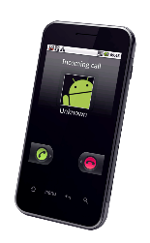
Usage Model : Smart Scanning
Sept 2017
Use case 1: Ultra-low power location scan
Mobile devices sometimes scan through multiple channels for nearby APs, and use the measured Wi-Fi signal strength for improved location services. Scanning on main radio consumes higher power than WUR radio. In addition, scanning on main radio has the risk of conflicting with regular data exchange.
In WUR-facilitated location scan, the mobile device scans through the channels using the WUR receiver, and uses the signal strength measured from WUR packets received from adjacent APs to provide additional information to the location services on the mobile device. In other words, some of the location scan on main radio can be offloaded to WUR radio.
Because WUR consumes much less power than main radio, WUR facilitated location scan provides an ultra-low power location scan mechanism.
Use case 2: Ultra low power roam scan
Mobile devices sometime scan for roaming purposes. These roam scan sometimes is triggered when link quality degrades. These roam scan takes time because the scan is typically done on multiple channels, and on each channel the device either conducts active scan during which it sends a probe request and typically stays awake until it receives a probe response, or passive scan during which it dwells on each channel for at least a Beacon interval to receive a Beacon. As a consequence, scanning through multiple channels introduces roaming latency and consumes power. Sometimes, it runs into conflict with regular data exchange.
In WUR-facilitated roam scan, the mobile device passively scans through multiple channels using WUR, and collects basic information about nearby APs. The collected info can be used to facilitate the devices’ roaming decisions.
Because WUR consumes much less power than main radio, WUR-facilitated roam scan provides an ultra-low power roam scan. In addition, due to the low power operation, WUR scan can be performed quite frequently in the background, and thus roaming information can be readily available whenever needed, i.e., it reduces roaming latency.

Slide 4
Information Needed in WUR Discovery Frame
For roaming scan, the STA need to know the band and channel used by the AP’s PCR so that it can switch directly to the particular channel to join the network
The STA also needs to know which AP is being discovered for better roaming decisions
For location scan, The STA only needs to know the AP’s identify in order to know which AP’s frame the measured RSSI is based on
Therefore, we propose to include the following information in WUR Discovery Frame
  Transmitter ID
  Main Radio operation channel: Operation Class + Channel number (2 octets total based on Operating Channel definition in baseline spec)

Slide 5
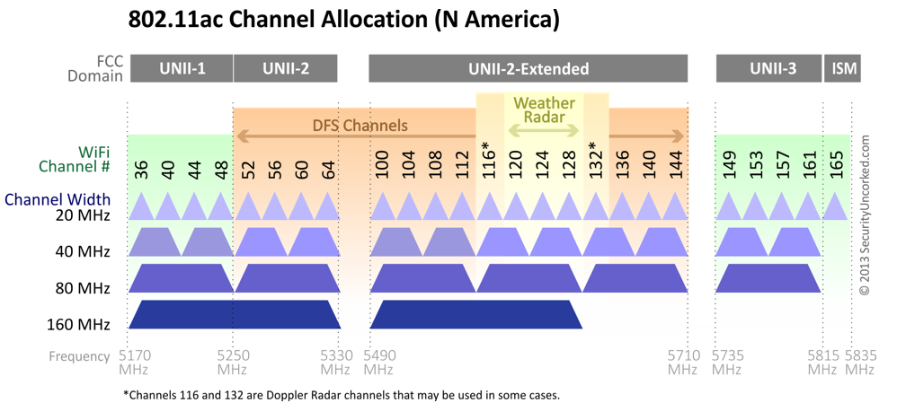
Scanning Latency Improvement
Take 5GHz as an example, there is at least 160MHz of BW to scan through
Depending on the channelization definition in 11ba, each STA needs to scan through many WUR channels in order to discovery new APs
The overall scanning time can be quite significant
  For example, if there is only one 4MHz channel in each regular 20MHz, then there are 8 WUR channels without DFS, and 19 channels with DFS
  This means the STA needs to scan 8 times or 19 times in 5GHz, and another 3 times in 2.4GHz
Furthermore, if 802.11ba is allowed in other bands such as 900MHz, then there are even more channels to scan.
In addition, if 802.11ba defines more than one WUR channels for each 20MHzs, then there are significant number of channels to scan through
20MHz
…
4MHz

Slide 6
Proposed Solution
We propose to define one or a few “Discovery channels” that a WUR transmitter is recommended to use to transmit WUR Discovery frames
A WUR AP can select one of the Discovery channels to sent out WUR Discovery frames

Slide 7
Scanning Latency Improvement
Compared to 19 channels to scan through, if a STA only scans two Discovery channels in 5GHz, then the scanning latency is reduced by almost 10 times

Slide 8
WUR Discovery Frame Interval on Discovery Channel
For Smart Scanning use case, since Wi-Fi user mobility is low, there is no need to send out WUR Discovery frames very frequently
In addition, since AP can randomly select one of the discovery channels to send out WUR Discovery frame, we do not expect WUR Discovery frames to cause congestion issue on the Discovery Channel

Slide 9
Summary
We propose to define a type of WUR frame called WUR Discovery frame for Smart Scanning
We also propose to define Discovery Channel concept for WUR transmitter to send out WUR discovery frames
  Discovery channel concept is very similar to the Social channel concept in Neighbor Area Network standard
  The use of Discovery/Social channel can significantly reduce the scanning latency for unassociated STAs in Smart Scanning use cases
WUR Discovery channels are recommended channels for WUR to to transmit WUR Discovery frame, i.e., not mandatory

Slide 10
Straw Poll 1
Do you agree to define a type of WUR frame as WUR Discovery frame which includes the following information?
  Transmitter ID
  Main radio operating channel: Operating Class and Channel Number

Slide 11
Straw Poll 2
Do you agree to define one or a few Discovery Channel(s) that WUR transmitter should use to transmit WUR Discovery frames?
  The exact Discovery channels are TBD for the operating band

Slide 12
References
[1] 11-17-1386-06-00ba-examining-11ba-usage-models-for-mainstream-devices
[2] 11-17-0029-09-WUR-Usage-Model-Document
[3] 11-17-xx-00-WUR-Discovery-Frame

