Slide 1
Ack and Block Ack handling for mmWave Distribution Network Use Case
Nov. 2017
Date: 2017-11-01
Name | Affiliation | Address | Phone | Email
Djordje Tujkovic | Facebook | 1 Hacker Way, Menlo Park, CA 94025, USA | +1-650-796-9812 | djordjet@fb.com
Nabeel Ahmed | Facebook | 1 Hacker Way, Menlo Park, CA 94025, USA | +1-650-739-9764 | nabeel@fb.com
Payam Torab | Facebook | 1 Hacker Way, Menlo Park, CA 94025, USA | +1-310-699-0510 | ptorab@fb.com
Praveen Gopala | Facebook | 1 Hacker Way, Menlo Park, CA 94025, USA | +1-650-460-9292 | gopalap@fb.com

Slide 2
Introduction
Nov. 2017
The mmWave Distribution Network usage model was introduced in [1]
Features to support the new usage model were introduced in [2]
  Pertinent to this presentation is the implicit Ack and Block-Ack delayed to a transmit opportunity (slots in [2]) allocated in the opposite direction
Scheduling in mmWave Distribution Networks was introduced in [3]
This presentation discusses performance issues related to scheduling of Ack and Block Ack frames using the TDD-SP allocations in [3]

Slide 3
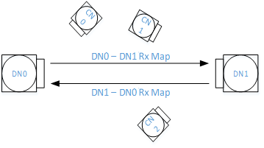
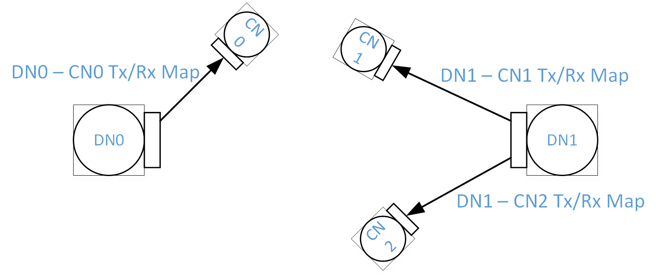
Background: Dynamic L2 Scheduling Support
Nov. 2017
Each DN exchanges Rx slot bitmaps with peer DN
  Exchange through KeepAlive messages (sent in both directions)
Each DN receives periodic uplink BW request messages from associated CNs
  Each CN sends its queue size (bytes) and traffic arrival rate (Mbps) through an Uplink BW request message
Each DN sends Tx/Rx slot bitmaps to associated CNs
  Sent within KeepAlive messages

Slide 4
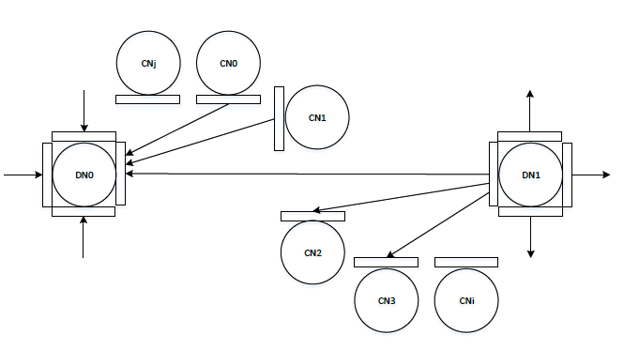
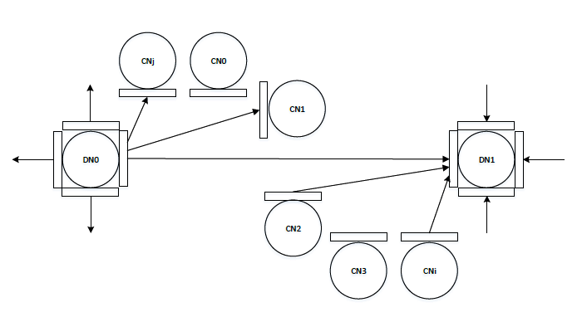
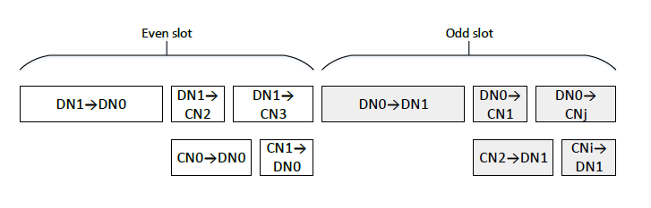
Background: Odd and Even Node Polarity
Nov. 2017
E
E
E
E
E
E
E
E
O
O
O
O
O
O
O
O
First TDD sub-frame
Second TDD sub-frame
Simultaneous
Even (E) nodes are transmitting (receiving) only in the first (second) TDD subframe
Odd (O) nodes are receiving (transmitting) only in first (second) TDD subframe
Intel

Slide 5
Delayed Acknowledgement
Nov. 2017
Simplex Tx and Rx TDD-SPs in [3] delay the Ack and Block-Ack frames to a TDD-SP (time slot) allocated in the opposite direction
  SIFS response time no longer holds
Allocating slots to Ack/Block Ack frames results in bandwidth compromise

Slide 6
Ack frames and traffic imbalance
Nov. 2017
Scenario: CNs with traffic in opposite directions
  Heavy flows for DN → CN1 (DL) and DN ← CN2 (UL)
  DL slots populated with DN → CN1 A-MPDUs
  UL slots populated with CN2 → DN A-MPDUs
“Reverse” slots needed for Ack frames
  Airtime efficiency dictates these slots to be few, and ideally, short (mostly used for Ack frames)
  Scheduling conflicts may spread the “Ack” slots, placing them far from their corresponding data slot(s)
  Separate traffic and Ack planning resulting in data slots in the reverse direction that come before “Ack” slots (see figure)
  Ack or Block Ack frames may not be the first frame received after transmitting data
Need to generalize “immediate response” with TDD use case
TDD subframe 200 µs
TDD subframe 200 µs
DL slots (DN → CN1,2) |  |  | UL slots (CN1,2 → DN)
DN → CN1 |  |  | CN2 → DN
 |  |  | CN2 → DN
Heavily populated with DN → CN1 slots
Ack frames may not be the first frames transmitted in the reverse direction due to scheduling conflicts
Heavily populated with CN 2→ DN slots
Slots allocated to acknowledgement frames for DN → CN1 A-MPDUs
(spread out in time and possibly shorter for lower overhead)

Slide 7
Delayed Acknowledgement
Nov. 2017
Simplex Tx and Rx TDD-SPs introduced in [3] result in implicit Ack and Block-Ack delayed to time slots allocated in the opposite direction
  SIFS response time no longer holds
Preference for unequal length slots
  Improves efficiency of slot packing for asymmetric UL/DL traffic
  Prevents stalling of Tx link when no corresponding Rx slot allocation for sending Ack or Block Ack available
Small slots for {Ack, Block Ack} frames improve efficiency
Dedicated “data-only” slots allow maximum packing
  Single A-MPDU, with all packing decisions
  Ack and Block Ack response timeout need to be generalized from SIFS
    Generalization of immediate acknowledgement

Slide 8
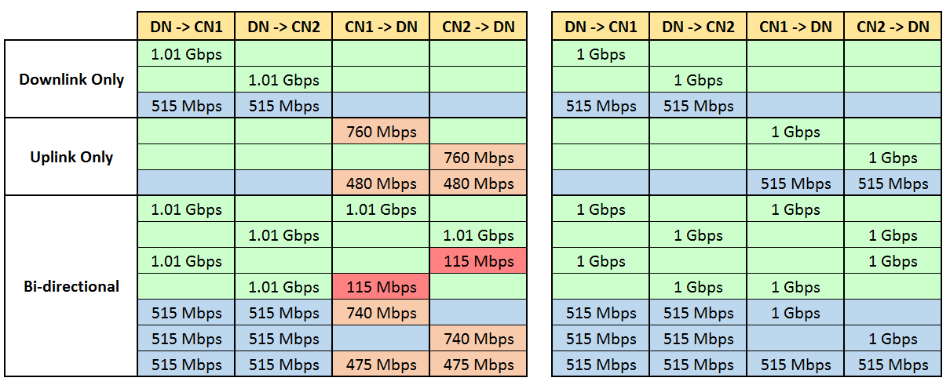
Example: Measured throughputs
Nov. 2017
Topology: DN to 2 CNs
UDP traffic (6500 byte packets, MCS 9 rates)
Indices 1, 2, 3, 4 designate bandwidth allocation units
Allocations change every 25.6 msec in response to traffic (including allocation boundaries)
Equal slots (shown for 1 TDD subframe)
(Data, Ack and Block Ack allowed everywhere)
Unequal slots (shown for 1 TDD subframe)
(Long slots for data*, short slots for Block Ack)
General 1 | General 1 | General 3
General 2 | General 2 | General 3
General 2 | General 2 | General 4
General 2 | General 2 | General 4
Data 1 | Data 1 | BA1
Data 2 | Data 2 | BA2
Data 3 | Data 3 | BA3
Data 4 | Data 4 | BA4
* Minus infrequent Ack frames

Slide 9
Summary of requirements
Nov. 2017
Two slot types relevant to Ack and Block Ack
  “Data-only” slots where only data frames are allowed
    No management or control frames
    To help A-MPDU/Block Ack processing with limited on-chip hardware queues that are serving many Block-Ack sessions (many CNs)
  “Regular” slots where all frame types are allowed
    Ack and Block Ack frame having the highest priority in regular slots
    Block Ack frame does not need to be the first frame transmitted in the slot, but if only one frame goes out it has to be the Block Ack frame.

Slide 10
References
Nov. 2017
[1] IEEE 802.11-17/1019r2 “mmWave Mesh Network Usage Model”
[2] IEEE 802.11-17/1321r0 “Features for mmW Distribution Network Use Case”
[3] IEEE 802.11-17/1323r2 ”Scheduling for mmWave Distribution Networks”

