Slide 1
TRN Subfield for Channel Aggregation
Doc.: IEEE 802.11-17/1600r1
Date: 2017-11-02
1

Slide 2
Motivation
Nov. 2017
Doc.: IEEE 802.11-17/1600r1
In 11ay D0.8, the TRN subfield is defined for MIMO BF training
For the i-th transmit chain, the TRN subfield is defined as
where
The number of TRN^{i}_{basic} in one TRN^{i} subfield is determined by the total number of transmit chains for both CB and CA
The overhead of TRN for CA is higher than for CB.
The number of transmit chains per channel for CA is half of the total number of transmit chains
TRN subfield is the basic element in TRN field and shall be transmitted repeatedly by P/M/N configuration
2
Jinnan Liu(Huawei)

Slide 3
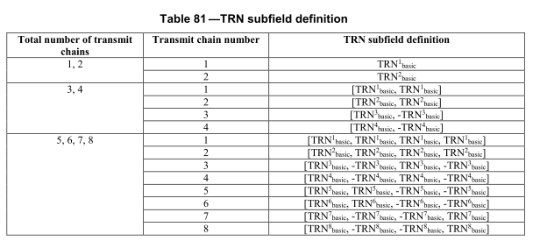
Issue for TRN Subfield
Nov. 2017
Doc.: IEEE 802.11-17/1600r1
The problem is the CA TRN subfield may contain more TRN_{basic} than the CB TRN subfield for the same # Tx chains per channel, which leads to low efficiency of CA TRN.
For CB, # Tx chains per channel = total # Transmit chains
For CA, # Tx chains per channel = ½ (total # Transmit chains )
For 2.16+2.16, 2 Tx chains per channel (N_{TX}=4), then the TRN subfield for CA is
For 2.16GHz, 2 Tx chains on single channel, the TRN subfield comprises only one
3
Jinnan Liu(Huawei)

Slide 4
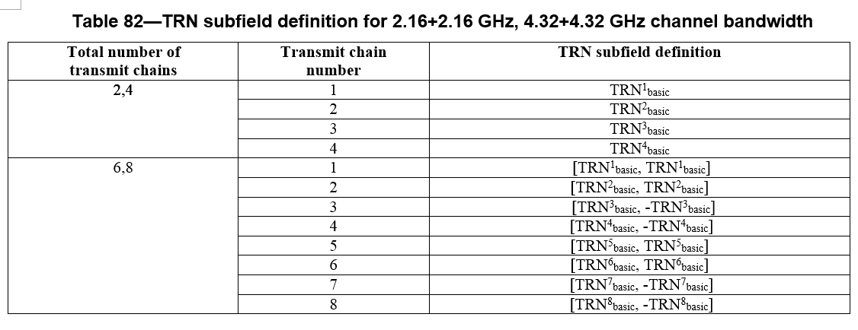
Proposed TRN Subfield for CA
Nov. 2017
Doc.: IEEE 802.11-17/1600r1
Add a new table (Table 82) for CA TRN subfield definition
The #TRN_{basic} for total #Transmit chain s 4,6,8 is reduced for CA
4
Jinnan Liu(Huawei)

Slide 5
Doc.: IEEE 802.11-17/1600r1
Conclusion
For the CA TRN subfield, we propose a shorter TRN subfield for CA to reduce the overhead of BF training or tracking .
5
Jinnan Liu(Huawei)

