Slide 1
TRN Subfield for Channel Aggregation
Doc.: IEEE 802.11-17/1600r0
Date: 2017-10-28
1

Slide 2
Motivation
Nov. 2017
Doc.: IEEE 802.11-17/1600r0
In 11ay D0.8, the TRN subfield is defined for MIMO BF training
  For the i-th transmit chain, the TRN subfield is defined as
  where
  The number of TRN^{i}_{basic} in one TRN^{i} subfield is determined by the total number of transmit chains for both CB and CA
The overhead of TRN for CA is higher than for CB.
  The number of transmit chains per channel for CA is half of the total number of transmit chains
  TRN subfield is the basic element in TRN field and shall be transmitted repeatedly by P/M/N configuration
2

Slide 3
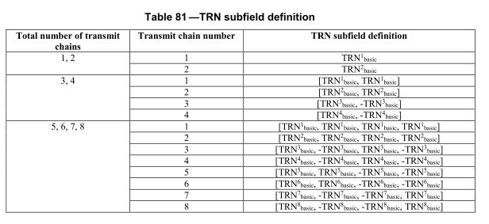
Issue for TRN Subfield
Nov. 2017
Doc.: IEEE 802.11-17/1600r0
The problem is the CA TRN subfield may contain more TRN_{basic} than the CB TRN subfield for the same # Tx chains per channel, which leads to low efficiency of CA TRN.
  For CB, # Tx chains per channel = total # Transmit chains
  For CA, # Tx chains per channel = ½ (total # Transmit chains )
For 2.16+2.16, 2 Tx chains per channel (N_{TX}=4), then the TRN subfield for CA is
For 2.16GHz, 2 Tx chains on single channel, the TRN subfield comprises only one
3
Huawei

Slide 4
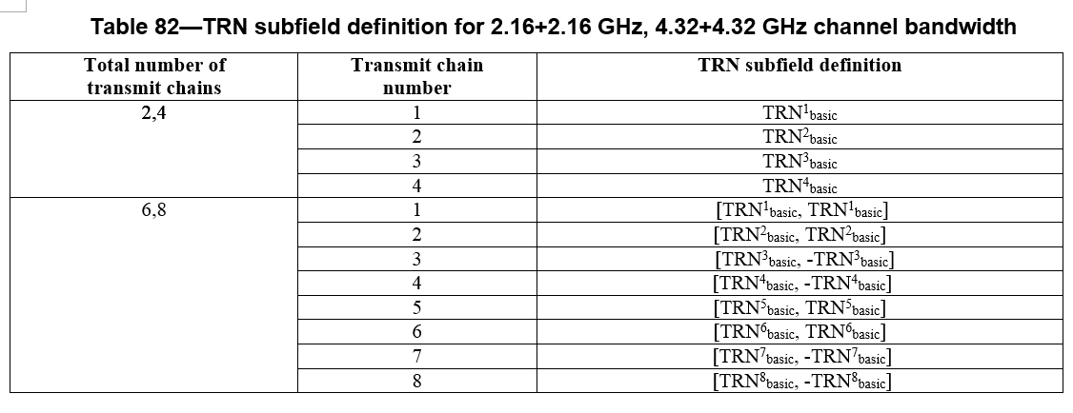
Proposed TRN Subfield for CA
Nov. 2017
Doc.: IEEE 802.11-17/1600r0
Add a new table (Table 82) for CA TRN subfield definition
  The #TRN_{basic} for total #Transmit chain s 4,6,8 is reduced for CA
4
Huawei

Slide 5
Doc.: IEEE 802.11-17/1600r0
Conclusion
For the CA TRN subfield, we propose a shorter TRN subfield for CA to reduce the overhead of BF training or tracking .
5
Huawei

