Slide 1
Initial Considerations for LC SG
Date: 2017-10-19
Author:

Slide 2
Outline
Coverage, Shadowing, and Mobility
LC Uplink
Lights Off
WiFi and LC
Data Throughput
Use Cases
Summary
References

Slide 3
Coverage, Shadowing, and Mobility
The transmission distance of visible light sources is limited and requires LOS for best SNR conditions to achieve high data rates. With an object or human blocking the LOS, the observed optical power degrades resulting in severe data rate reductions. User mobility thus introduces novel issues for LC as the SNR varies dramatically when the user moves within the cell. This effect may be minimized by distributing light sources so that high SNR is maintained throughout the cell [1, 2].
Hand-over between different LC APs needs to be ensured and addressed by LC SG

Slide 4
LC Uplink
LC with luminaires has predominantly broadcast (downlink) characteristics. A visible light uplink would be inefficient for portable devices which run on low power (batteries) and may also be considered inconvenient or unpleasant. To address this challenge, WiFi (RF) or infrared (IR) can be used for transmitting the uplink data.
Heterogeneous network management and reliable data recovery would need to be addressed by the LC SG.

Slide 5
Lights Off
LC applications based on LED lighting are more attractive in environments where the lights are always switched on, for instance, in industrial settings, public transport, or medical areas. Some low data rate transmission can be achieved by making the light emitted to be low enough so that human eyes perceive it as being switched off [3]. Integration of infrared LED chips into future LED luminaires would allow for continuous data flows when the lights are switched off [1, 4].
Heterogeneous network management and reliable data recovery would need to be addressed by the LC SG.

Slide 6
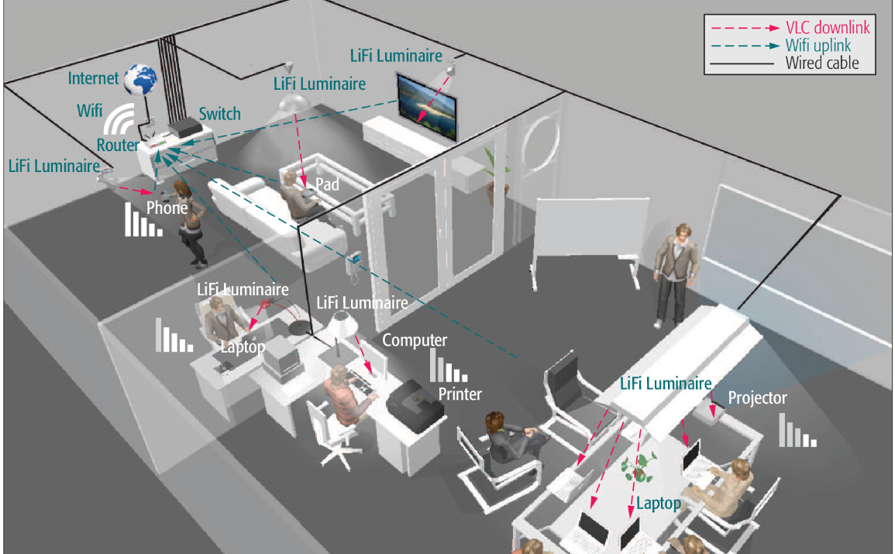
Offloading WiFi
Close integration of LC and WiFi technologies enables off-loading opportunities for the WiFi network. WiFi would serve more mobile users, while the stationary users will preferably be served by LC. Both technologies together can more than triple the throughput for individual users and yield a solution that can adequately address the need for enhanced indoor coverage [5].

Slide 7
LC Data Throughput
University of Oxford (maximum throughtput in laboratory conditions) [6] Bi-directional speed of 224 Gbps over ~ 3 m range and ${60}^{o}$ field of view angle
Fraunhofer Heinrich Hertz Institute, Berlin [4] Prototype based on commercially available low-cost hardware 200 Mbps @ 2 m and 60 cm diameter working area 100 Mbps @ 20 m (and narrow-beam optics)
University of Edinburgh (Laser Diodes) [7] 3.43 Gbps @ 2.88 m with 1 $m^{2}$ coverage 14 Gbps using RGB Laser Diodes 100 Gbps using WDM LD (with 36 parallel streams)
Disney Research, Zürich (EnLightning, Internet of Things) [8] Low-data-rate (600 bps) device-to-device with commercially available LED bulbs enhanced with photo-diodes and microcontrollers

Slide 8
LC Use Cases
Case | Data Rate (Mbps) | Coverage (m)
Enterprise | ~100x | ~3
Home | ~100x | ~3
Retail | ~1x – 100x | ~10
IoT | ~0.1x – 10x | ~20

Slide 9
Summary
Hand-over between different LC APs and WiFi APs needs to ensure continuous communications with fast transition times, comparable to or better than the ones used in WiFi roaming
Data throughput and latency time of LC links need to be comparable to or better than the ones used in WiFi links
Heterogeneous networks (LC+WiFi/IR) need to be considered by LC SG

Slide 10
References
[1] D. Karunatilaka et al., “LED based indoor visible light communications: State of the art,” IEEE Communications Surveys Tutorials, vol. 17, no. 3, pp. 1649–1678, 2015.
[2] P. H. Pathak, X. Feng, P. Hu, and P. Mohapatra, “Visible light communication, networking, and sensing: A survey, potential and challenges,” IEEE Communications Surveys and Tutorials, vol. 17, no. 4, pp. 2047–2077, 2015.
[3] Z. Tian, K. Wright, and X. Zhou, “The DarkLight rises : Visible light communication in the dark,” in Proceedings of the 22nd Annual International Conference on Mobile Computing and Networking. ACM, 2016, 2016, pp. 2–15.
[4] L. Grobe and A. Paraskevopoulos, “High-speed visible light Communication systems,” IEEE Communications Magazine, pp. 60–66, Dec. 2013.
[5] M. Ayyash et al., “Coexistence of WiFi and LiFi toward 5G: Concepts, opportunities, and challenges,” IEEE Communications Magazine, vol. 54, no. 2, pp. 64–71, 2016.
[6] A. Gomez et al., “Beyond 100-Gb/s indoor wide field-of-view optical wireless communications,” IEEE Photonics Technology Letters, vol. 27, no. 4, pp. 367–370, Feb 2015.
[7] D. Tsonev, S. Videv, and H. Haas, “Towards a 100 Gb/s visible light wireless access network,” Optics Express, vol. 23, no. 2, p. 1627, 2015.
[8] S. Schmid et al., “EnLighting: An Indoor Visible Light Communication System Based on Networked Light Bulbs,” in International Conference on Sensing, Communication and Networking (SECON), 2016, pp. 1–9.

