Slide 1
AANI SC Agenda
Date: 2017-11-09
Authors:

Slide 2
Abstract
Agenda for:
802.11 AANI SC
(Advanced Access Network Interface Standing Committee)
November 2017
Caribe Hotel and Convention Center, Orlando, FL, USA
Chair: Joseph Levy (InterDigital)
Vice Chair: Roger Marks (EthAirNet Associates)

Slide 3
Reminders and Rules
Call for Secretary
Reminders to attendees:
  Please record your attendance
  Please mute any noise making devices
  No recordings
AANI SC Operating Rules:
  Anyone present can vote, present, and make motions
  Participation in the AANI SC during a 802.11 F2F meeting counts towards 802.11 voting rights
  All technical motions must pass by a 75% majority

Slide 4
Agenda
Monday – PM1
Call for Secretary
Administrative: Reminders, Rules, Agenda, Guidelines, Resources, Participation, Approval of Minutes, Announcements
Background/Status
IEEE 5G and Beyond Technology Roadmap White Paper
Incoming Liaison Statements: NGMN LS on the NGMN “5G End-to-End Architecture Framework”
Contributions (if any)
Discussion on: IEEE 802 network enhancements for the next decade Industry Connections Activity (New 802.1 group to support the “IEEE “5G” Specification” activity)
Tuesday – PM1
Continue discussions on White Paper, Liaison Statements, and contributions (as necessary)
Thursday – AM2
Continue discussions on White Paper, Liaison Statements, and contributions (as necessary)
Report/Discussion on: NEND ICA: IEEE 802 network enhancements for the next decade Industry Connections Activity
Discussion on the Future of the AANI SC
Future Sessions Planning

Slide 5
Guidelines for IEEE-SA Meetings
All IEEE-SA standards meetings shall be conducted in compliance with all applicable laws, including antitrust and competition laws.
Don’t discuss the interpretation, validity, or essentiality of patents/patent claims.
Don’t discuss specific license rates, terms, or conditions.
  Relative costs, including licensing costs of essential patent claims, of different technical approaches may be discussed in standards development meetings.
    Technical considerations remain primary focus
Don’t discuss or engage in the fixing of product prices, allocation of customers, or division of sales markets.
Don’t discuss the status or substance of ongoing or threatened litigation.
Don’t be silent if inappropriate topics are discussed… do formally object.
---------------------------------------------------------------
If you have questions, contact the IEEE-SA Standards Board Patent Committee Administrator at patcom@ieee.org or visit http://standards.ieee.org/about/sasb/patcom/index.html
See IEEE-SA Standards Board Operations Manual, clause 5.3.10 and “Promoting Competition and Innovation: What You Need to Know about the IEEE Standards Association's Antitrust and Competition Policy” for more details.
This slide set is available
at https://development.standards.ieee.org/myproject/Public/mytools/mob/slideset.ppt

Slide 6
Resources – URLs
Link to IEEE Disclosure of Affiliation
  http://standards.ieee.org/faqs/affiliationFAQ.html
Links to IEEE Antitrust Guidelines
  http://standards.ieee.org/resources/antitrust-guidelines.pdf
Link to IEEE Code of Ethics
  http://www.ieee.org/web/membership/ethics/code_ethics.html
Link to IEEE Patent Policy
  http://standards.ieee.org/board/pat/pat-slideset.ppt
Notes:
September 2012

Slide 7
Participation in IEEE 802 Meetings
Participation in any IEEE 802 meeting (Sponsor, Sponsor subgroup, Working Group, Working Group subgroup, etc.) is on an individual basis
Participants in the IEEE standards development individual process shall act based on their qualifications and experience. (https://standards.ieee.org/develop/policies/bylaws/sb_bylaws.pdf section 5.2.1)
IEEE 802 Working Group membership is by individual; “Working Group members shall participate in the consensus process in a manner consistent with their professional expert opinion as individuals, and not as organizational representatives”. (subclause 4.2.1 “Establishment”, of the IEEE 802 LMSC Working Group Policies and Procedures)
Participants have an obligation to act and vote as an individual and not under the direction of any other individual or group. A Participant’s obligation to act and vote as an individual applies in all cases, regardless of any external commitments, agreements, contracts, or orders.
Participants shall not direct the actions or votes of any other member of an IEEE 802 Working Group or retaliate against any other member for their actions or votes within IEEE 802 Working Group meetings, see https://standards.ieee.org/develop/policies/bylaws/sb_bylaws.pdf section 5.2.1.3 and the IEEE 802 LMSC Working Group Policies and Procedures, subclause 3.4.1 “Chair”, list item x.
By participating in IEEE 802 meetings, you accept these requirements. If you do not agree to these policies then you shall not participate.
(Latest revision of IEEE 802 LMSC Working Group Policies and Procedures: http://www.ieee802.org/devdocs.shtml)

Slide 8
Approval of Minutes
Minutes from the September F2F Meeting in Hawaii, USA:
11-17/1458r1
Comments?
Objections to approving the minutes?

Slide 9
AANI SC Background
At the July 802 Plenary meeting in San Diego 802.11 passed a motion to form this standing committee [11-16/1057r1]
Liaison Statements Sent:
802.11 sent an LS (11-16/1101r10) to 3GPP RAN and SA (9/16)
802.11 sent an LS (11-16-/510r2) to 3GPP RAN2 (1/17)
802.11 sent an LS (11-16/1573r3) to 3GPP RAN (1/17)
802.11 sent an LS (11-17-0378r2) to 3GPP RAN2 (5/17)
802.11 sent an LS (11-16/1574r3) to 3GPP SA (5/17)
Liaison Statements Received:
3GPP RAN2 WG sent an LS (11-17/0315r0) (3/17)
3GPP RAN TSG sent an LS (11-17/0444r0) (3/17)
3GPP SA TSG sent an LS (11-17/0903r0) (6/17)

Slide 10
AANI Status
Incoming LS from 3GPP SA TSG (11-17/0903r0):
“Reply LS to IEEE 802.11 Requesting Status and Information on WLAN integration in 3GPP NextGen System”
Sent by 3GPP SA in reply to our LS (11-16/1574r3) to 3GPP SA (5/17):
“IEEE 802.11 Working Group Liaison Statement Requesting status and technical information on WLAN integration in 3GPP NextGen System.”
Contribution regarding the ongoing 3GPP work:
11-17/1064r0 – “Overview of 3GPP SA Next Generation System Documents
Reviewed the 3GPP SA Documents provided in the reply LS

Slide 11
IEEE 5G and Beyond Technology Roadmap White Paper
Intent of activity:
“IEEE is developing a technical community to foster exchange of ideas, sharing of research, setting of standards, and identification, development, and maturation of system drivers, system specifications, use cases, and supported applications”* for 5G and future generation of connectivity. As part of this process it has released the IEEE 5G AND BEYOND TECHNOLOGY ROADMAP WHITE PAPER.” *
* Quoted text is from: “IEEE 5G AND BEYOND TECHNOLOGY ROADMAP WHITE PAPER”.

Slide 12
IEEE 5G and Beyond Technology Roadmap White Paper
This paper claims to provide an IEEE view of “5G and future generations of connectivity”* that:
Considers all stakeholders
Is SDO (Standards Development Organization) neutral
My reading of the white paper does not support this claim:
The paper basically supports and echoes the 3GPP perspective on 5G and the future of connectivity.
3GPP nomenclature is used throughout (e.g. UE, NodeB, etc.)
Promotes the idea that 3GPP 5G and future generations will provide connectivity for all “envisaged future applications”*
Only mentions 802.11 in a section “6.4 3GPP-as-a-control-system” as a high capacity link that “cellular would be responsible to coordinate”*.
The white paper also does not provide discussion on the role that 802 technologies (802.1, 802.3 and 802.11) have had and currently have in networks, nor any significant discussion on the role of 802 technologies to provide future connectivity.
* Quoted text is from: “IEEE 5G AND BEYOND TECHNOLOGY ROADMAP WHITE PAPER”.

Slide 13
IEEE 5G and Beyond Technology Roadmap White Paper
STRAW Poll:
Should 802.11:
Take no action - (no response from 802.11)
Generate a response to this White Paper.
Generate text for inclusion in the White Paper, and then provide the comments to IEEE and IEEE 5G
Need More Information
Abstain
Chicago Style Voting (vote for as many of the above you want to):
1)3 2)4 3)8 4)3 5)7

Slide 14
NGMN LS on the NGMN Architecture Framework
802.11 has received an LS from NGMN: https://mentor.ieee.org/802.11/dcn/17/11-17-1569-00-0000-liaison-statement-from-ngmn-on-e2e-architecture.doc
The LS contains the NGMN document:
“5G End-to-End Architecture Framework”, v0.8.1, dated 2017-10-04 (https://www.ngmn.org/uploads/media/171006_NGMN_E2EArchFramework_v0.8.1_01.pdf)

Slide 15
NGMN LS on the NGMN
Quotes from the NGMN “5G End-to-End Architecture Framework”:
“6.1.1 Consistent User Experience across access networks
The 5G system shall support a consistent service experience across 3GPP and non-3GPP access networks, including in scenarios involving hand off between heterogeneous access technologies. The services may however have to be adapted to access specific characteristics for example in terms of QoS. Operationally a consistent service experience can be facilitated for example by adoption of a common set of procedures and functions for AAA, QoS, Policy, session continuity etc.”
“6.3.3. Wi-Fi Access Network
Among non-3GPP access technologies to be supported by 5G RAN is the 802.11 family, including current 802.11 releases (e. g. 802.11 ac and 802.11 ad) along with future releases (e. g. 802.11ax and 802.11ay). The 5G system shall provide provisions that ensure seamless access point integration, user access and mobility/flow management for Wi-Fi access technologies. This implies a need for automatic/SON-like solutions for fixed access management and orchestration.”

Slide 16
NGMN LS on the NGMN
802.11 Possible Actions Straw Poll:
802.11 should as generate a thank you reply LS (minimum action)
802.11 should generate reply comments supporting the NGMN framework
802.11 should request NGMN to provide additional input to 802.11 on how 802.11 can support the NGMN architecture framework, e.g. gap analysis
None of the above
Abstain
Chicago Style Voting (vote for as many of the above you want to):
1)15 2)8 3)17 4)0 5)2

Slide 17
Contributions
???

Slide 18
Status/Background: IEEE 802 network enhancements for the next decade Industry Connections Activity
IEEE 802 NEND ICA met on Tuesday, 11 July 19:00 to 21:00. ~ 150 attendees
The session was Chaired by Glenn Parsons (802.1 Chair).
The Agenda document/updated by the Chair 1-17/0001r1 (Note: All NEND ICA documents can/will be found on: mentor.ieee.org/802.1)
High level summary of the Meeting:
  The background and history leading to the NEND IC were reviewed by Chair
  The attendees introduced themselves and provided some comments on their areas of interest and/or their desired outcome for the IC activity.
  Many attendees indicated an interested in Industrial Networking/ Manufacturing Networking
  Two contributions were presented:
  Layer 2 network virtualization, Max Riegel (Nokia), 1-17/0002r0
  Wireless Communications in the Manufacturing Fields, Satoko Itaya (NICT), omniran-17/0054r1

Slide 19
Status/Background: IEEE 802 network enhancements for the next decade Industry Connections Activity
IEEE 802 NEND ICA will meet Tuesday November 7 19:30 to 21:30
There were no NEND ICA teleconferences since the last meeting.
Glenn Parsons is continuing to Chair this activity.
Glenn is seeking a Chair and technology/industry evangelists to move this work forward.
There is IEEE Staff support to aid in Industry outreach (established in offline discussions).
Open Issues:
Do we, as 802.11, want to participate in this activity?
Do we, as 802.11, have particular Industry interest we should be proposing/working?
Is there interest in reports on the activity of the NEND ICA (should I report on this activity to 802.11 at AANI SC meetings or 802.11 WG Plenaries)?

Slide 20
IEEE 802 network enhancements for the next decade Industry Connections Activity Contributions/Discussion
  Contributions ???
  Discussion ???

Slide 21
Agenda
Tuesday – PM1
Continue discussions on White Paper, Liaison Statements, and contributions (if any)

Slide 22
Agenda
Thursday – AM2
Continue discussions on Liaison Statements
Report/Discussion on: NEND ICA: IEEE 802 network enhancements for the next decade Industry Connections Activity
Discussion on 802.11 IMT-2020 Submission
Future Sessions Planning

Slide 23
Continue discussions on Liaison Statements
Draft Reply LS from 802.11 to NGMN LS on E2E Architectural Framework
https://mentor.ieee.org/802.11/dcn/17/11-17-1744-03-AANI-draft-reply-ls-from-802-11-to-ngmn-ls-on-e2e-architectural-framework.docx
Draft LS from 802.11 to IEEE 5G on the IEEE 5G Roadmap White Paper https://mentor.ieee.org/802.11/dcn/17/11-17-1750-03-AANI-draft-ls-from-802-11-to-ieee-ieee-5g-on-the-ieee-5g-roadmap-wp.docx

Slide 24
Report/Discussion on: NEND ICA
IEEE 802 Network Enhancements for the Next Decade Industry Connections Activity had a meeting on Tuesday (11/7) Evening 19:30-21:30.
Glenn Parsons (Ericsson) Chair agenda deck: 1-17-0005-01-Icne
Minutes from July meeting – updated: 1-17/0004r1
Documents: http://1.ieee802.org/802-nend/
Mailing List: http://listserv.ieee.org/cgi
Industrial Networking:
  “Radio Environment in Factories” -Satoko Itaya (NICT) 1-17/0010r0
  “Wired/Wireless Convergence for Factory IoT” -Kenichi Maruhashi (NEC) 1-17/0011r2
Future Data Centre Networks:
  "Baidu's Best Practice with Low Latency Networks“ 1-17/0008r2
  "Network (R)evolution -Challenges and Solutions From a Switching Silicon Perspective" -Carmi Arad (Marvell) 1-17/0009r0
  "The Lossless Network for the Data Center” & white paper -Paul Congdon (Huawei) 1-17/0006r1, 1-17/0007r1
Conference calls: 8am ET Dec 20th, Jan 10th, Feb 14th - will be cancelled if not agenda requests
Next F2F meeting at March 802 Plenary

Slide 25
Discussion on 802.11 IMT-2020 Submission (1/3)
At the 802.11 mid-week plenary meeting the following motion was agreed:
Invite AANI to prepare draft documents meeting the 31 Jan 2018 requirements for submission of 11 to ITU-R Working Party 5D as an IMT-2020 5G RIT and
Bring the documents for consideration and approval at the January IEEE 802.11 interim meeting.

Slide 26
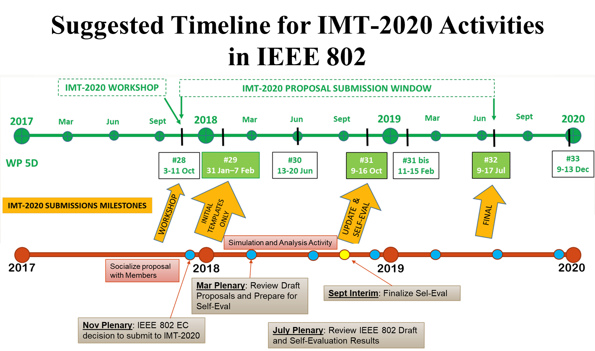
Discussion on 802.11 IMT-2020 Submission (2/3)
From “Tutorial - Use of 802.11 for 5G Millimeter Wave Systems” 11-17/1667r2

Slide 27
Discussion on 802.11 IMT-2020 Submission (3/3)
To address this goal:
Contributions are requested to progress this work
Also lead authors and/or editors for the submission document(s) are needed
The Chair has requested:
~Weekly teleconferences
Additional meeting sessions for the January meeting

Slide 28
Future Sessions Planning
Teleconference:
~Weekly on Mondays @ 10:00am ET on 11/20, 11/27, 12/4, 12/11, 12/18, 1/8
  Topics for discussion/contribution:
    802.11 IMT-2020 Submission
    3GPP Interworking
    NEND IC activity
14-19 January 2018 F2F, Irvine, CA, USA:
  Topics for discussion/contribution:
    802.11 IMT-2020 Submission
    3GPP Interworking
    NEND IC activity
  Goal – Complete draft 802.11 IMT-2020 Submission documents for approval at the January meeting
  Meeting time requested: 4 sessions - Monday PM1, Tues PM1, Wednesday PM2 and Thursday AM2 – TBC (note: requested 4 as needed, and 6 as desired)

Slide 29
References

