Slide 1
Hybrid Beamforming for SC and OFDM Transmission in 11ay
Date: 2017-09-25
Authors:

Slide 2
Introduction
TGay has agreed that 11ay will support hybrid Beamforming for SU-MIMO and MU-MIMO [1]
A study of the performance of hybrid Beamforming with the transmission and reception of EDMG Single Carrier Mode PPDUs has shown that [2] [3]:
  Hybrid Beamforming does not show any gains over analog Beamforming in a “balanced” transmission i.e. Ntx = Nrx = Nss.
  Hybrid Beamforming shows gains over analog Beamforming in an “unbalanced” transmission e.g. Ntx > Nss; Ntx = Nrx > Nss; Ntx > Nrx.
In this contribution, we show the performance of hybrid Beamforming with the transmission and reception of EDMG OFDM mode PPDUs.
We identify the design issues for hybrid Beamforming in both EDMG SC and OFDM modes necessary for specifying the feature in 802.11ay and propose a HBF protocol for 802.11ay.

Slide 3
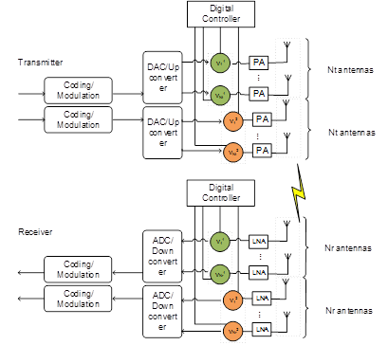
Hybrid Beamforming in 802.11ay
Hybrid beamforming has been proposed in 802.11ay to enable transmission of multiple streams for SU and MU-MIMO [1].
  It combines baseband beamforming with analog beamforming to improve performance
  It requires the transmitter architecture to allow for digital baseband Beamforming
Hybrid Beamforming Architecture
Analog Beamforming Architecture

Slide 4
Simulation Assumptions
Based on 11ay OFDM PHY [1]
  Channel bandwidth 2.64 GHz (512 DFT size)
Spatial and frequency mapping is given in the appendix
Modulation and coding is the same for all streams
MMSE receiver
Conference room (CR) scenario in 11ay/ad channel model [5]
  Subscenario: STA-AP
Detailed assumptions can be found in the appendix

Slide 5
Baseband Beamforming Methods
No Beamforming:
  Baseband precoder is set to identity, i.e. only analog beams used and N_{ss} columns of identity matrix as Beamforming matrix cross all antennas
  No channel knowledge needed at transmitter
Closed loop with Ideal Feedback:
  Use SVD-based Beamforming in the frequency domain for each subcarrier, i.e., per-tone BB Beamforming (no water filling)
  Full Channel State Information (CSI) knowledge at transmitter

Slide 6
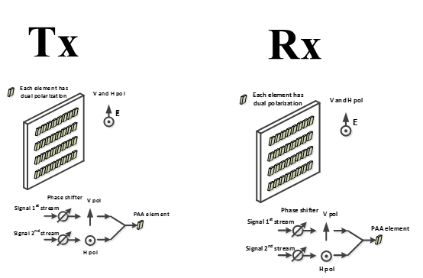
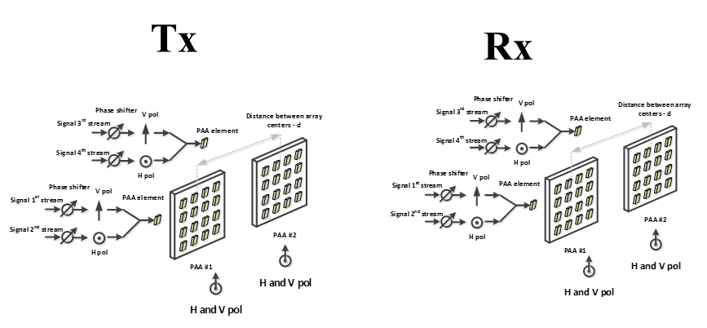
Simulated SU-MIMO Configurations
Beamforming implemented in all configurations
  Analog beamforming: Using phase shifter at each antenna to align Tx and Rx beams
  Digital beamforming: Spatial streams are precoded (as described in slide “Baseband Beamforming Methods”) and distributed to all antennas
Simulate Configuration #2 and #4 of the SU-MIMO configurations [5]
  #2: 2x2 channel, 1 PAA with dual polarization on each side
  #4: 4x4 channel, 2 PAAs with dual polarization on each side

Slide 7
Balanced: Conf #2, 2 Layers
For a balanced setup, i.e., 2x2 MIMO and 2 layers, BB Beamforming does not offer significant improvement

Slide 8
Unbalanced: Conf #4, 2 Layers
~1.5 dB
~2 dB
~1.5 dB
For an unbalanced setup, i.e., 4x4 MIMO and 2 layers, BB Beamforming improves the PER performance by 1.5-2 dB.

Slide 9
Observations
Performance trends of Hybrid Beamforming with an EDMG OFDM Mode PPDU are similar to that of an EDMG SC Mode PPDU [2][3]
Note that feedback required may be different for SC vs OFDM
  Single precoder per subcarrier in EDMG OFDM Mode PPDU (1 ≤ N ≤ number of subcarriers)
  Single precoder across bandwidth (N = 1), multiple precoders per tap in EDMG SC Mode PPDU
Need to define hybrid Beamforming in specification to accommodate both modes.

Slide 10
Protocol Definition

Slide 11
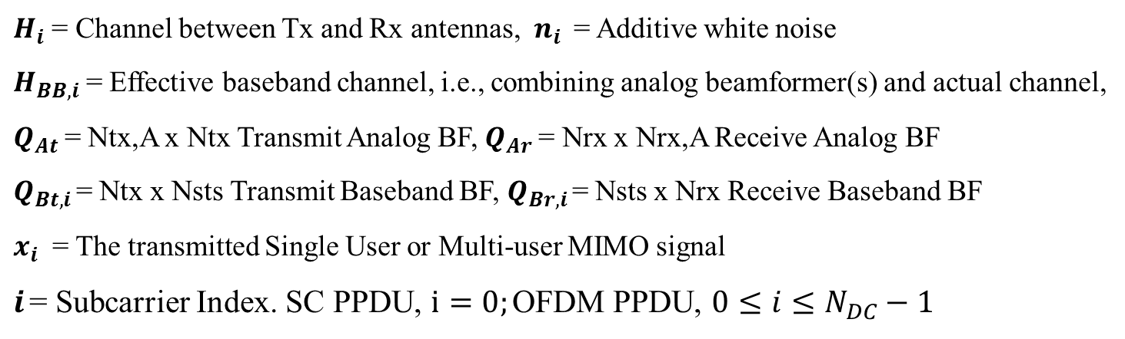
Hybrid Beamforming for SC and OFDM Modes
$Y={Q_{Br,i}Q}_{Ar}H_{i} Q_{At}Q_{Bt,i}x_{i}+n_{i} ;$ $H_{BB,i}$= $Q_{Ar}H_{i} Q_{At}$
$H_{i}$ = Channel between Tx and Rx antennas, $n_{i}$ = Additive white noise
$H_{BB,i}$= Effective baseband channel, i.e., combining analog beamformer(s) and actual channel,
$Q_{At}$= Ntx,A x Ntx Transmit Analog BF, $Q_{Ar}$= Nrx x Nrx,A Receive Analog BF
$Q_{Bt,i}$= Ntx x Nsts Transmit Baseband BF, $Q_{Br,i}$= Nsts x Nrx Receive Baseband BF
$x_{i}$ = The transmitted Single User or Multi-user MIMO signal
$i$= Subcarrier Index. SC PPDU, $i=0;$OFDM PPDU, $0≤i≤N_{DC}−1$
Hybrid Beamforming for EDMG SC Mode PPDU:
  Time Domain precoder (per tap) with feedback in time domain (either channel feedback or precoder feedback).
Hybrid Beamforming for EDMG OFDM Mode PPDU:
  Frequency Domain Precoder (per subcarrier(s)) with feedback in frequency domain (use 802.11n/ac based precoder feedback).

Slide 12
Capability Setting
  Update Beamforming capability field
The MU-MIMO supported field and Hybrid Beamforming and MU-MIMO Supported field shall be set to one to indicate that the STA supports the hybrid beamforming protocol during MU-MIMO transmission including the Hybrid beamforming protocol described in 10.38.9.2.5.
  If the MU-MIMO supported field is set to one, and the Hybrid Beamforming and MU-MIMO Supported field is set to zero, then the STA supports analog MU-MIMO beamforming only.
The SU-MIMO Supported field and Hybrid Beamforming and SU MIMO Supported field shall be set to one to indicate that the STA supports hybrid beamforming protocol during SU-MIMO transmission including the Hybrid beamforming protocol described in 10.38.9.2.5.
  If the SU-MIMO supported field is set to one, and the Hybrid Beamforming and SU-MIMO supported field is set to zero, then the STA supports analog SU-MIMO beamforming only.
B0 B4 | B5 | B6 | B7 | B8 | B9 | B10 | B11 B15
Requested BRP SC Blocks | MU-MIMO Supported | UL-MU-MIMO Supported | SU-MIMO Supported | Grant Required | Hybrid Beamforming and MU MIMO Supported | Hybrid Beamforming and SU MIMO Supported | Reserved
5 | 1 |  | 1 | 1 | 1 | 1 | 5

Slide 13
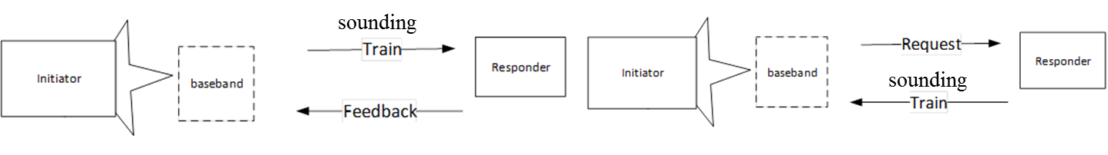
Proposed HBF Protocol Overview
  Supports digital baseband training and hybrid Beamforming information feedback for subsequent Hybrid Beamforming transmission
  Requires training and optional feedback before the hybrid Beamforming transmission
    Explicit: Acquire channel or precoder using feedback based on sounding.
    Implicit: Acquire channel using reciprocity. Requires no feedback
Explicit
Implicit

Slide 14
HBF Protocol Overview
  Performed after MIMO BF setup is completed for SU-MIMO and MU-MIMO.
SISO Phase
Explicit SU MIMO HBF protocol and transmission
SISO Phase
Explicit MU MIMO HBF protocol and transmission

Slide 15
HBF Protocol Details
  The Hybrid Beamforming Protocol comprises the following phases
    Announcement Phase (for Explicit and Implicit HBF protocol, Optional)
    Sounding Phase (for Explicit and Implicit HBF protocol)
    Feedback Phase (for Explicit HBF protocol only)
  On completion of the HBF protocol, HBF transmission can take place
Legend
Exp: Explicit
Imp: Implicit
I: Initiator

Slide 16
Announcement Phase
  Announcement phase indicates desire to start HBF protocol
    Similar to NDPA in 802.11n/ac [4]
  Used to set up the parameters of the STAs in the SU/MU-MIMO hybrid beamforming transmission : examples include
    STA(s) and antenna configuration
    Explicit/Implicit HBF protocol
    Type feedback desired and feedback parameters if needed
      e.g. time domain, frequency domain, channel, precoder

Slide 17
Sounding Phase
  Sounding Phase enables measurement of the baseband channel
  Can be implemented with multiple methods within current 11ay framework:
    BRP frame exchange:
      The BRP request may use the TRN field dimensions suitable for the antenna configuration in the announcement i.e. EDMG TRN Length field, P, M , N
    Beam Tracking procedure:
      DMG Header and EDMG Header-A are used to set up the TRN field dimensions for the antenna configuration in the Announcement

Slide 18
Feedback Phase
  Needed for explicit HBF protocol only.
  Feeds back HBF information needed by transmitter for HBF transmission.
  The hybrid Beamforming information may differ for SC vs OFDM PPDUs
    SC PPDU:
      Time domain information: precoder and/or channel
    OFDM PPDU :
      Frequency domain precoder information

Slide 19
HBF Transmission
  Transmitter uses HBF Information to
    (a) design digital precoder and send data
    (b) Send data (if information is the precoder)

Slide 20
Conclusion
Performance trends of Hybrid Beamforming with an EDMG OFDM Mode PPDU are similar to that of an EDMG SC Mode PPDU [2][3]
Feedback required may be different due to multiple precoders in an EDMG OFDM Mode PPDU (1 ≤ N ≤ number of subcarriers) vs a EDMG SC Mode PPDU (N = 1) in a frequency selective channel
We proposed the mechanisms needed to enable hybrid beamforming for both SC and OFDM PPDU modes in 802.11ay.

Slide 21
References
IEEE P802.11ay™/D0.5
L. Sun, et al, “Link Level Performance Comparisons of Open Loop, Closed Loop and Antenna Selection for SU-MIMO” 11-16/0911r1
K. Oteri et al, “Closed Loop SU-MIMO Performance with Quantized Feedback” 11-16/1446r0.
IEEE 802.11-2016
A. Maltsev, et al, “Channel models for IEEE 802 11ay”, IEEE doc. 11-15/1150r4
R. Maslennikov, et al, “Implementation of 60 GHz WLAN Channel Model,” IEEE doc. 11-10/0854r3.

Slide 22
Straw Poll
Do you agree to the following?
  The HBF protocol, defined as the protocol that supports digital baseband sounding and Hybrid Beamforming information feedback for subsequent Hybrid Beamforming transmission, shall have the following steps:
    Announcement (Optional if configuration has been previously set)
    Sounding
    Feedback (Optional if Implicit/Reverse HBF)
  Y/N/A

Slide 23
Straw Poll
Do you agree:
  To define Hybrid Beamforming as described in “11-17-1534-01-00ay-Comment Resolution on CIDs for Hybrid Beamforming - HBF Introduction” in the 802.11ay specification ? The document starts the resolution on CIDs (277, 435, 500, 547).
Y/N/A

Slide 24
Appendix

Slide 25
Channel parameters [5][6]
Channel bandwidth 2.64 GHz, center frequency 60.48 GHz
Channel model: Scenario: CR, Sub-scenario: STA-AP. STA is placed at a plane 2m below AP in the cubicle 1. Random rotation around z-axis between STA/AP.
For SU-MIMO configuration #2,
  TX/RX analog beamforming for both polarizations are based on the LOS direction
  Each PAA has 2x8 elements
  2x2 channel, 1 PAA with dual polarization, on each side, support up to 2 layers theoretically
For SU-MIMO configuration #4,
  TX/RX analog beamforming for both polarizations of PAA#i are based on the LOS direction between TX PAA#i ↔ RX PAA#i
  Each PAA has 2x8 elements
  2x2 channel, 1 PAA with dual polarization, on each side, support up to 4 layers theoretically
  Distance between center of PAAs 10cm

Slide 26
Mapping
Coded bits 1
Coded bits 2
…
Coded bits L
Coded symbols 1
Coded symbols 2
…
Coded symbols L
…
Layers
Streams
IFFT
IFFT
IFFT
IFFT
p/s
p/s
p/s
p/s
p/s
p/s
p/s
Antenna
ports
Baseband
precoding
OFDM
Symbols

Slide 27
Channel Frequency Response

