Slide 1
Distributed Scheduling
(Eliminating Need for Clustering)
Date: 2017-09-12
Authors:
Name | Affiliation | Address | Phone | Email
Kerstin Johnsson | Intel | 2200 Mission College Blvd Santa Clara, CA 95404 | +1 650 3870777 | kerstin.johnsson@intel.com

Slide 2
Abstract
This contribution proposes a distributed scheduling protocol that enables neighboring PCP/APs to establish and maintain non-overlapping control and data schedules quickly without clustering’s edge effects.
The protocol is robust to highly dynamic topologies with delay sensitive traffic and guarantees fair resource allocation among PCP/APs with overlapping coverage areas.

Slide 3
Distributed Scheduling Protocol
PCP/APs decode relevant beacons from neighboring PCP/APs to determine their schedules
PCP/APs schedule their fair share of SPs randomly over time periods in the following order:
  Unoccupied time periods
  CBAPs
  SPs of neighbors not complying with the DS protocol
PCP/APs schedule CBAPs randomly over any leftover time periods not occupied by neighbor beacons, taking care not to traverse the start of DS-compliant SPs.

Slide 4
Terminology
Relevant beacons = a neighbor beacon that contains scheduling info that impacts the PCP/AP’s scheduling decisions
Fair share
fair share of SPs = (BI length)/(# neighbors + 1) – (control messages)
Compliant SP = SP belonging to a neighbor that is complying with DS protocol
A neighbor’s DS compliance can be checked as follows:
  Does neighbor have DS bit set?
  Is neighbor using ≤ 50% of channel resources?
  Is neighbor scheduling orthogonally to my beacons and SP allocations?
AP1
…
B
B
B
B
…
AP2
…
B
B
…

Slide 5
System Level Simulations for Performance Comparison w/ 11ad
A fixed time unit of 1 slot = 1500 us is used for time progression in the SLS
All BSSs use same BI length = 60 slots, BTI length = 1 slot, and SP length = 1 slot
SLS environment is a 200x200m room that contains an increasing number of BSSs; BSSs are composed of 4 STAs dropped randomly 5-15 m from their AP
Channel model is a stochastic multipath over multiple rays (as specified in eval methodology for indoor scenarios)
  TX power is 15 dBm for all transmissions; control PHY uses an additional 15dB coding gain on top of data transmissions
Antenna gain is 7dBi for BF transmission (-10 dBi isolation), 0dBi for omni transmission
  There are 6 horizontal sectors one ach STA. There is no vertical sectorization.
  STAs always use correct beamforming configuration for data transmissions
STAs have bursty uplink traffic; APs have bursty downlink traffic to their STAs; Round Robin scheduling in both directions.

Slide 6
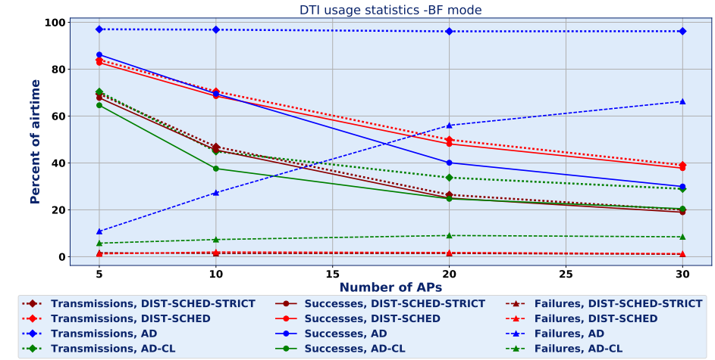
TX Usage, Successes, and Failures

Slide 7
Straw poll
Do you agree to include Distributed Scheduling in the specification as defined by the text in “11-17-1446-00-00ay-Distributed-Scheduling.docx”?
  Y/N/A

