Slide 1
Local MAC Addresses in the Overview and Architecture based on IEEE Std 802c
Date: 2017-09-13
Authors:
Name | Affiliations | Address | Phone | email
Roger Marks | EthAirNet Associates | Denver, CO, USA | 1-802-capable | roger@ethair.net

Slide 2
Abstract
IEEE Std 802c was approved by the IEEE-SA Standards Board on 15 June 2017, amending the IEEE 802 Overview and Architecture to specify Local Medium Access Control (MAC) Address Usage. This slide set summarizes the changes and implications. It also summarizes a new revision, prepared in coordination with 802c, of the relevant tutorial of the IEEE Registration Authority (IEEE RA).

Slide 3
The View from Silicon Valley
Dinesh: What are those devices? Those aren’t phones.
Gilfoyle: Look at that OUI prefix in these MAC addresses.
Richard: OK, so what are those?
Gilfoyle: Smart fridges. About 30,000 of them.
Silicon Valley (a fictional television comedy)
Season 4, Episode 10 (“Server Error”)
First aired on HBO, 2017-06-25

Slide 4
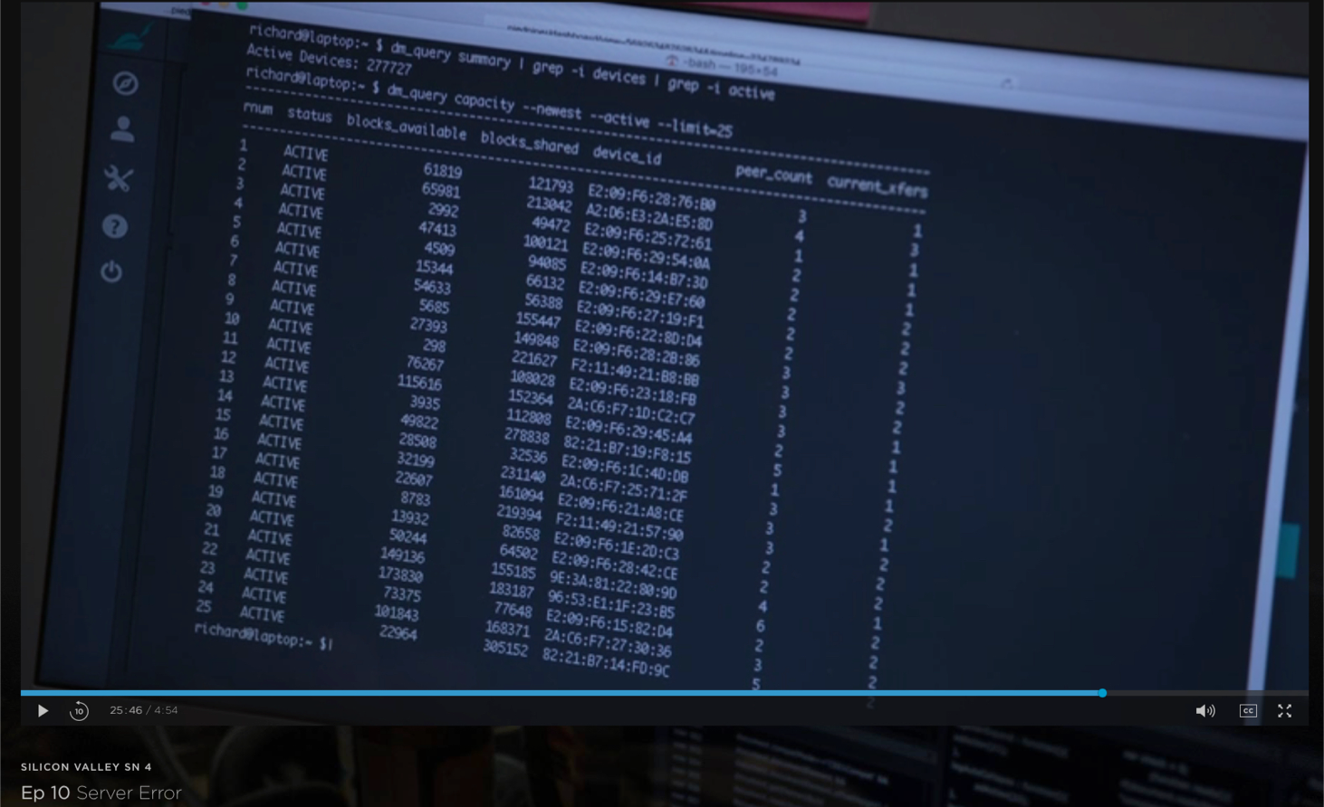
What Gilfoyle saw

Slide 5
What Gilfoyle saw
Is device_id a MAC addresses?
Are those OUI prefixes?
How was this data collected?
How could Gilfoyle recognize smart fridges?
Should we care?
How is 802c related?

Slide 6
IEEE Std 802c: Key Facts
IEEE Standard for Local and Metropolitan Area Networks: Overview and Architecture – Amendment 2: Local Medium Access Control (MAC) Address Usage
Standard approved: 2017-06-15; published 2017-08-25
802 pseudo-tutorial, 2014-11-03
802.1 Local Address Study Group, Nov 2014 - July 2015
PAR Authorized: 2015-06-11
PAR Revised: 2016-12-07 (to add maintenance issues)
Scope in brief:
provide an optional local MAC address space structure to allow multiple administrations to coexist
designate a range of local MAC addresses for protocols using a Company ID (CID) assigned by the IEEE Registration Authority
range of local MAC addresses will be designated for assignment by local administrators
a range of local MAC addresses for use by IEEE 802 protocols

Slide 7
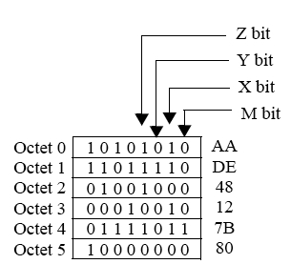
Local Address: Example
M bit (I/G bit): as before, 1 for multicast
X bit (U/L) bit: as before, 1 for local
Y and Z bits: new designations

Slide 8
SLAP
Structured Local Address Plan (SLAP): An optional standardized specification for the use of local medium access control (MAC) address space entailing the use of
Extended Local Identifier (ELI),
Standard Assigned Identifier (SAI), and
Administratively Assigned Identifier (AAI)
addresses in specific disjoint ranges.

Slide 9
Assignment Protocols
An address assignment protocol assigning local MAC addresses to devices on a LAN should ensure uniqueness of those addresses.
When multiple address assignment protocols operate on a LAN without centralized administration, address duplication is possible, even if each protocol alone is designed to avoid duplication, unless such protocols assign addresses from disjoint address pools.
Administrators who deploy multiple protocols on a LAN in accordance with the SLAP will enable the unique assignment of local MAC addresses within the LAN as long as each protocol maintains unique assignments within its own address subspace.

Slide 10
SLAP Quadrants
SLAP quadrant | Y bit | Z bit | ZYXM | second hex digit | SLAP local identifier type | SLAP local identifier
01 | 0 | 1 | 1010 | A | Extended Local | ELI
11 | 1 | 1 | 1110 | E | Standard Assigned | SAI
00 | 0 | 0 | 0010 | 2 | Administratively Assigned | AAI
10 | 1 | 0 | 0110 | 6 | Reserved | Reserved
“A” for AAI and “E” for ELI would have been nice, but prior IEEE RA assignments put ELI in the “A” quadrant.
 | Y = 0 | Y = 1
Z = 0 | AAI | Reserved
Z = 1 | ELI | SAI

Slide 11
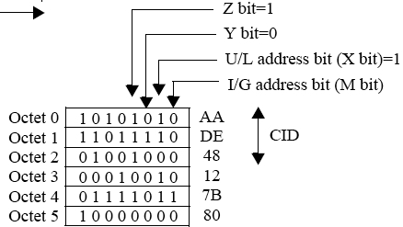
ELI: Extended Local Identifier
second hex digit = A
like an EUI, but with a Company ID (CID) instead of an OUI
CID has X = 1 (local space).
IEEE Registration Authority (RA) assigns CIDs, all in SLAP 01
CID predates 802c
802c reserves 4 CIDs for the local administrator

Slide 12
AAI: Administratively Assigned Identifier
AAI: Administratively Assigned Identifier
second hex digit = 2
Administrators who wish to assign local MAC addresses in an arbitrary fashion (for example, randomly) and yet maintain compatibility with other assignment protocols operating under the SLAP on the same LAN may assign a local MAC address as AAI.
Reserved quadrant can be used like AAI, with reservations:
second hex digit = 6
may be administratively used and assigned in accordance with the considerations specified for AAI usage, without effect on SLAP assignments. However, administrators should be cognizant of possible future specifications… that would render administrative assignment incompatible with the SLAP.

Slide 13
SAI: Standard Assigned Identifier
second hex digit = E
Specification of the use of the SAI quadrant for SLAP address assignments is reserved for the standard forthcoming from IEEE P802.1CQ.
An SAI is assigned by a protocol specified in an IEEE 802 standard.
Multiple protocols for assigning SAI may be specified within various IEEE 802 standards. Coexistence of such protocols may be supported by restricting each to assignments within a subspace of SAI space.
In some cases, an SAI assignment protocol may assign the SAI to convey specific information. Such information may be interpreted by receivers and bridges that recognize the specific SAI assignment protocol, as identified by the subspace of the SAI. The functionality of receivers and bridges that do not recognize the protocol is not affected.

Slide 14
P802.1CQ
IEEE Standard for Local and Metropolitan Area Networks: Multicast and Local Address Assignment
PAR authorized: 2016-02-05
Scope: This standard specifies protocols, procedures, and management objects for locally-unique assignment of 48-bit and 64-bit addresses in IEEE 802 networks. Peer-to-peer address claiming and address server capabilities are specified.
Need: Currently, global addresses are assigned to most IEEE 802 end station and bridge ports. Increasing use of virtual machines and Internet of Things (IoT) devices could exhaust the global address space. To provide a usable alternative to global addresses for such devices, this project will define a set of protocols that will allow ports to automatically obtain a locally-unique address in a range from a portion of the local address space. Multicast flows also need addresses to identify the flows. They will benefit from a set of protocols to distribute multicast addresses. Peer-to-peer address claiming and address server capabilities will be included to serve the needs of smaller (e.g. home) and larger (e.g. industrial plants and building control) networks.
Progress so far: little

Slide 15
Address Block Sizes (48-bit addresses)
second hex digit | address type | Admin | Block Size | Subdivision | Subdivision Block Size
..00 (0,4,8,C) | EUI-48 | IEEE RA | 2⁴⁶ ≈ 7.0*10¹³ | MA-L (OUI) | 2²⁴ ≈ 1.7*10⁷
 |  |  |  | MA-M | 2²⁰ ≈ 1.0*10⁶
 |  |  |  | MA-S | 2¹² ≈ 4.1*10³
..01 (2,6,A,E) | all local unicast |  | 2⁴⁶ ≈ 7.0*10¹³
1010 (A) | ELI | IEEE RA | 2⁴⁴ ≈ 1.8*10¹³ | CID | 2²⁴ ≈ 1.7*10⁷
1110 (E) | SAI | IEEE 802 | 2⁴⁴ ≈ 1.8*10¹³
0010 (2) | AAI |  | 2⁴⁴ ≈ 1.8*10¹³
0110 (6) | Reserved |  | 2⁴⁴ ≈ 1.8*10¹³
How many is is 2⁴⁶?
IEEE manages EUI-48 space to support unique identification of hardware anywhere in the world for 100 years.
The SLAP gives IEEE 802 a space one quarter of that size to exploit for a LAN!

Slide 16
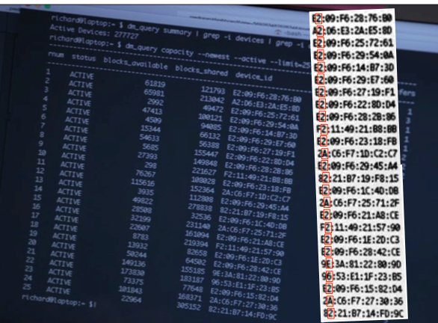
Did Gilfoyle see OUIs?
The device_id looks like a 48-bit MAC address.
Second hex digits: 2, 6, A, E
local MAC addresses
all 4 SLAP types
These are not EUI-48s.
There are no OUIs here.

Slide 17
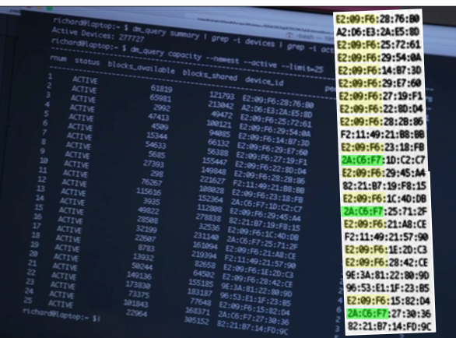
Did Gilfoyle see CIDs?
Six-digit prefixes are apparent.
Prefix 2A-C6-F7 looks like a CID
not in public CID registry
other prefixes are not CIDs
It seems that Gilfoyle saw, as the smart-fridge prefix, E2-09-F6, in the AAI quadrant.
15 of the 25 devices
[unclear how he counted 30,000]
Outside the ELI/CID quadrant, six-digit prefixes are not standard.

Slide 18
Could Gilfoyle detect smart fridges?
In general, the MAC address is not forwarded past an IP router.
However, it could be tracked and passed by a device on the LAN, and then be entered into a database.
Devices could be programmed to send their addresses.
Smart-fridge could potentially be identified by OUI, if the EUI was assigned under a specific smart-fridge OUI.
Local addresses are not global and not normally permanent.
Smart-fridge addresses would typically not be identified by CID.
CID is not definitively tied to the host hardware.
For example, CID may identify an assignment protocol.
It’s feasible for the manufacturer to assign an address to a device as an ELI using a manufacturer’s registered CID
extension bits could be static or dynamic

Slide 19
Would a fridge maker use an ELI?
Fridge manufacturer could register a CID and assign MAC address as an ELI
could specify informative subfields
e.g. could encode model number or serial number
This might be useful.
for example, a smart home hub might be able to discover the fridge solely from its address
But it may also be dangerous
fridge may be susceptible to attack based on characteristics inferred from its address

Slide 20
Is fridge detection a good idea?
MAC addresses are visible on the LAN, and could be tracked outside the LAN.
This could lead to a privacy violation.
But it could offer opportunities
Gilfoyle took advantage of a property of an address
Other addresses can have other special properties
Network management takes advantage of known addresses
If we keep informative addresses separate from flat (e.g. random) addresses, then we can support both types on the LAN.
If we don’t keep them separate, then we may see collisions.

Slide 21
IEEE 802 is SLAP Happy
The SLAP offers:
organizations a block of ~17M addresses for innovative ELI uses
IEEE 802 a block of ~ 1.8*10¹³ addresses for innovative SAI uses
administrators a block of ~ 1.8*10¹³ addresses to do what they want while avoiding collision with ELI and SAI users
The SAI block is a huge opportunity for IEEE 802!
Let’s use it!

Slide 22
Annex 1: IEEE RA Tutorial –
Guidelines for Use of EUI, OUI, CID

Slide 23
IEEE RA Tutorial –
Guidelines for Use of EUI, OUI, CID
IEEE Registration Authority assigns OUIs, CIDs, etc.
Provides tutorials on identifiers and policies:
http://standards.ieee.org/develop/regauth/tut
Tutorial on EUI (referenced in IEEE Std 802):
Guidelines for Use of Extended Unique Identifier (EUI), Organizationally Unique Identifier (OUI), and Company ID (CID)
Published August 2017, in coordination with 802c
Supersedes:
Guidelines for Use Organizationally Unique Identifier (OUI) and Company ID (CID)
Guidelines for 48-Bit Global Identifier (EUI-48)
Guidelines for 64-bit Global Identifier (EUI-64)

Slide 24
Guidelines for Use of EUI, OUI, CID –
more details
Published August 2017
http://standards.ieee.org/develop/regauth/tut/eui.pdf
Covers local addresses, SLAP, CID, and ELI
Clarifies other policies; notably (unrelated to local addressing) regarding the multicast bit:
The assignee of an OUI or OUI-36 is exclusively authorized to assign group MAC addresses, with I/G=1, by extending a modified version of the assigned OUI or OUI-36 in which the M bit is set to 1. Such addresses are not EUIs and do not globally identify hardware instances, even though U/L=0.
The assignee of a CID may assign local group MAC addresses by extending a modified version of the assigned CID by setting the M bit to 1 (so that I/G=1). The resulting extended identifier is an ELI.

Slide 25
Annex 2: Non-permanent Addresses

Slide 26
Non-permanent Addresses
IEEE 802 is most familiar with permanent addresses
Local addresses are typically not permanent
they may be assigned during use
Need to consider the ramifications

Slide 27
Some Address Features
Uniqueness
most fundamental property
local (on the LAN), or universal
relevant to identity
Permanence/Longevity
relevant to trackability
relevant to management
Structure and Information content
Does the address convey information beyond identity?
Can address convey location (e.g., IP)
other possibilities

Slide 28
Some Assignment Protocols
Stateful (per IETF)
typically server-based
example: DHCP
Stateless (per IETF)
IPv6 “Stateless Address Autoconfiguration” (SLAAC)
could be based on IEEE EUI
requires Duplicate Address Detection (DAD)
claiming
device claims an address by announcement, but:
may probe first for addresses in use
may check afterwards for collisions
P802.1CQ PAR mentions “peer-to-peer address claiming and address server capabilities”

Slide 29
Example: IPv4
IPv4 address can be globally routable
IPv4 address can be local
IPv4 address is hierarchical, with two components:
prefix: identifies network or subnet
host identifier: identifies interface
hierarchy provides for routing by network, not by address
802 local addressing could support this approach

Slide 30
View from IETF: IPv6
For ideas on possible protocols, consider IETF.
• IPv6 unicast address (128 bits) includes:
- subnet prefix (n bits, typically 64)
- interface ID (IID) (128-n bits, typically 64)
used to identify interfaces on a link
formerly encouraged creation from IEEE EUI (e.g. RFC 4291)
RFC 7136: various new forms of IIDs have been defined: including temporary addresses [RFC4941], Cryptographically Generated Addresses (CGAs) [RFC3972] [RFC4982], Hash-Based Addresses (HBAs) [RFC5535] …

Slide 31
IETF: Temporary Addresses
SLAAC = “Stateless Address Autoconfiguration”
RFC 4941: Privacy Extensions for SLAAC in IPv6
Sept. 2007
…for interfaces whose interface identifier is derived from an IEEE identifier. Use of the extension causes nodes to generate global scope addresses from interface identifiers that change over time, even in cases where the interface contains an embedded IEEE identifier. Changing the interface identifier (and the global scope addresses generated from it) over time makes it more difficult for eavesdroppers and other information collectors to identify when different addresses used in different transactions actually correspond to the same node.

Slide 32
Semantically Opaque Interface Identifiers
RFC 7217
Apr. 2014
temporary addresses can be challenging.... from a network-management point of view, they tend to increase the complexity of event logging, troubleshooting, enforcement of access controls, and quality of service.... some organizations disable the use of temporary addresses even at the expense of reduced privacy… may also result in increased implementation complexity
…Interface Identifier changes when the host moves from one network to another. This method is meant to be an alternative to generating Interface Identifiers based on hardware addresses (e.g., IEEE LAN Media Access Control (MAC) addresses), such that the benefits of stable addresses can be achieved without sacrificing the security and privacy of users.

Slide 33
IETF CGA
CGA = “Cryptographically Generated Address”
RFC 3972
March 2005
interface identifier is generated by computing a cryptographic one-way hash function from a public key and auxiliary parameters. The binding between the public key and the address can be verified by re-computing the hash value and by comparing the hash with the interface identifier. Messages sent from an IPv6 address can be protected by attaching the public key and auxiliary parameters and by signing the message with the corresponding private key. The protection works without a certification authority or any security infrastructure.
includes collision count field based on duplicate address detection

Slide 34
Example: CGA and Privacy can coexist
On a LAN, some devices strive for privacy
may use a randomized address
On a LAN, some devices may not value privacy but put value on other features, such as verification
example: access points should be easily found
address may be structured for meaning
Both types of devices should be able to coexist
random addresses should stay out of assigned space
receiver can then determine the type of address and respond accordingly

Slide 35
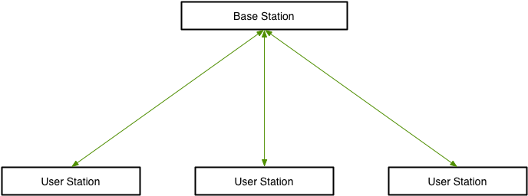
CGA/Privacy Coexistence

Slide 36
CGA/Privacy Coexistence

Slide 37
CGA/Privacy Coexistence

Slide 38
CGA/Privacy Coexistence

Slide 39
CGA/Privacy Coexistence

Slide 40
CGA/Privacy Coexistence

Slide 41
Summary
The local address space is huge and valuable.
The IEEE RA’s CID give companies a chance to innovate
SLAP supports ELIs based on CID
802 standards should not step on any company’s ELIs
SLAP specifies a reserved quadrant
802 standards should not step on it
SLAP specifies an AAI quadrant
802 standards should use the AAI quadrant in any way
SLAP offers a 44 bit SAI quadrant to IEEE 802 to exploit.
802 standards should put SAI to use in an orderly fashion.
Let’s ensure protocol coexistence for best success.
Please participate in development of P802.1CQ.

