Slide 1
UP mapping
Date: 2017-09-04
Authors:

Slide 2
Abstract
Today’s Quality of Service support in packet based networks relies on edge devices marking packets
  Differentiated Service Code Points (DSCP) [2] used with Internet Protocol (IP) [1] is a “trust and honor” system
  Intermediate “middle boxes” should not alter the marking
DSCP consists of 6 b
802 User Priorities (UPs) indicated by 3 b
  Mapping between DSCP and UP needed
  Most implementations map DSCP’s three Most Significant Bits (MSBs) to 802 UPs
The current mapping in 802.11-2016 fails to serve DSCP marked Voice over IP (VoIP) packets through Access Category Voice (AC_VO)

Slide 3
UP mapping in 802.11-2016
802.11-2016 follows 802.11D-2004 [6] for definition of UPs
  Because of IEEE 802’s legacy UP 0 has higher priority than UPs 1 and 2
  Non-QoS bridges default to UP 0 → Best Effort
UP | AC | AC alternative
1 | BK | BK
2 | BK | BK
0 | BE | BE
3 | BE | BE
4 | VI | A_VI
5 | VI | VI
6 | VO | VO
7 | VO | A_VO

Slide 4
QoS mapping [4]
IPv4 example
  Deprecated “Precedence” [1] equals three Most Significant Bits (MSBs) of DSCP [2]
DSCP ∈ [0 … 63]
1:1 mapping
  DSCP (6 b) → UP (3 b)

Slide 5
Voice over IP [4]
VoIP calls consist of
  Audio
  Signaling
Audio is latency & loss sensitive
  Special marking of IP packets
DSCP setting for packets carrying audio [3]
  Expedited Forwarding (EF)
DSCP(EF) = 101110₂
  101110₂ = 46₁₀
101110₂ >> 3 = 101₂
  101₂ = 5₁₀
UP (5₁₀) = AC Video (!)
  Mismatch between VoIP DSCP & 802.11 UP

Slide 6
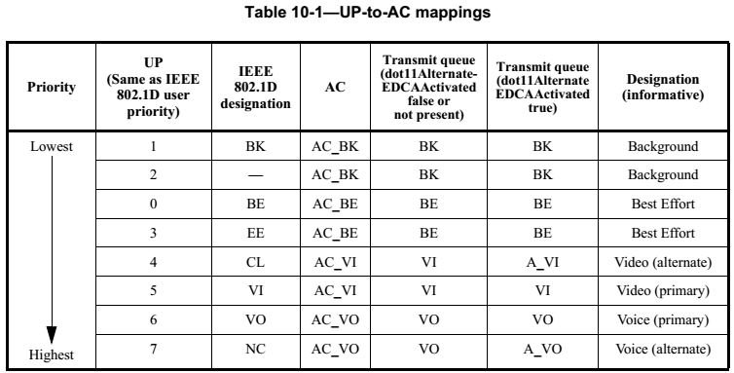
Current UP to AC mapping
802.11D-2004 [6] applied for current mapping
802.11aa introduces further differen­tiation for Voice and Video (alternative queues)
3 MSB [DSCP(101110)] = 101₂
  101₂ = 5₁₀ → DSCP(EF) mapped to VI

Slide 7
A well known issue …
“Cisco Unified Wireless QoS Tech Note
  […] DSCP Recommendation—Due to the fact that more and more vendors use 802.1p-like markings over the air rather than the original 802.11e table (that is, voice is sent as 5 UP instead of 6), Cisco now recommends to trust DSCP end-to-end in order to avoid confusion and mismatches. DSCP also offers more values and choices, is more resilient to native VLANs, and is therefore more reliable to be preserved throughout the network.” [8]
“ExpressRoute and QoS in Skype for Business Online
  […] It is important to note that there is a mismatch in the priority coding for IEEE 802.1p and WMM. The 802.1p the PCP value for voice is 5, however, in the standard equivalence mapping to WMM, PCP 5 is translated to Access Category 2, the WMM access category for video (AC_VI). If possible you should override that mapping so that PCP 5 translates to Access Category 1, or simply avoid using voice and video on the same Wi-Fi network until the Wi-Fi Alliance addresses this issue.” [9]

Slide 8
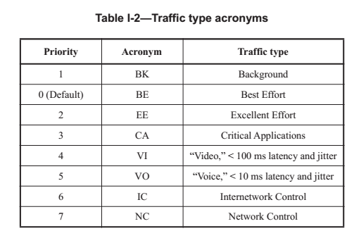
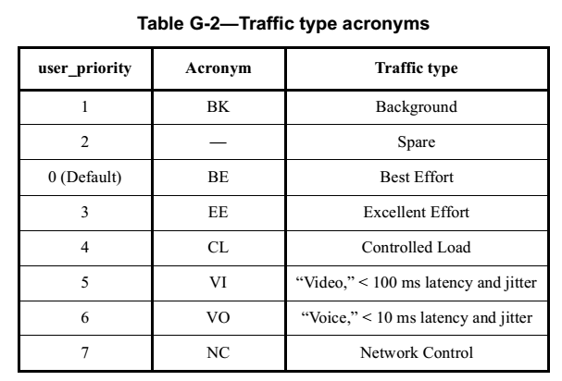
802.1D vs. 802.1Q
802.1D-2004, “Media Access Control (MAC) Bridges” [10]
802.1Q-2014, “Bridges and Bridged Networks” [9]

Slide 9
Why is 802.1Q-2014 different?
Already 802.1Q-2011 [7] introduces text in the right column
  IEEE 802 is fully aware of the interaction between DSCP and UP
Unfortunately, 802.11 has not investigated this issue so far
“This discussion of traffic types, and the suggested association of each with a priority value, differs from […] Annex G of IEEE Std 802.1D-2004 and prior revisions of that standard. […] this annex better aligns with current practice; in particular, Voice is associated with priority 5, matching the setting of the relevant bits for Expedited Forwarding (EF) in the DSCP […] for IP”
“Standards for DSCPs are believed to be the prime reference for use of priority by end stations […].”

Slide 10
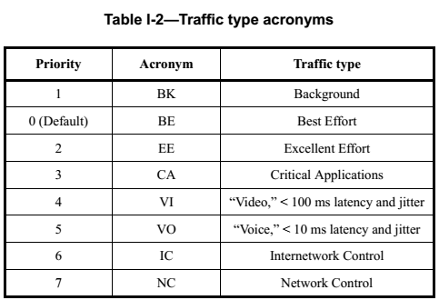
Necessary modifications
Order of Priorities must be modified
  New: Catego­rization of UP 2 is higher than UP 0
Internetwork and network control have higher priority than Voice
Voice UP mapping to UP 5 coherent with IP DSCP marking
  Requires re-mapping of Video UP

Slide 11
Permutation of UPs
Old UP | AC (old) | New UP | AC
1 | BK | 1 | BK
2 | BK | 0 | BE
0 | BE | 2 | BK
3 | BE | 3 | BE
4 | VI | 4 | VI
5 | VI | 5 | VI
6 | VO | 6 | VO
7 | VO | 7 | VO
Old UP | AC (old) alternative | New UP | AC alternative
1 | BK | 1 | BK
2 | BK | 0 | BE
0 | BE | 2 | BK
3 | BE | 3 | BE
4 | A_VI | 4 | A_VI
5 | VI | 5 | VI
6 | VO | 6 | VO
7 | A_VO | 7 | A_VO

Slide 12
Rational of proposed modification
Consistency with 802.1Q
  Comply with general 802 architecture
Consistency with widely used DSCP marking
  Dominant or sole source of QoS marking
Consider increasing importance of VoIP over WLAN
  E.g. “Wi-Fi calling”
Today, 802.11aa alternative queues seldom or never used
  No harm by introducing modifications
802.11 mostly used as final hop technology
  No Internetwork and network control messages exchanged
No two background categories needed
Coexistence: limit impact to existing (legacy) implementations
New UP | AC | AC | AC alternative | AC alternative
1 | BK | BK | BK | BK
0 | BE | BE | BK | BE
2 | BK | BE | BK | BE
3 | BE | VI | BE | A_VI
4 | VI | VI | A_VI | VI
5 | VI | VO | VI | VO
6 | VO | VO | VO | VO
7 | VO | VO | A_VO | A_VO

Slide 13
Minimizing modifications
Blue marking indicates unmodified settings
UPs 5 to 7 mapping to AC_VO
  Internetwork and network control fulfill similar tasks like 802.11 management frames
  Without QMF (802.11ae) all management frames map to AC_VO
  Consistency for video except for seldom used alternative queue
  UP 2 (Excellent effort) mapping to AC_BE
With four queues [5] recommends supporting Network Control, Voice, Critical Applications, and Best Effort
  Deviation because importance of Video and 802.11’s dominant use as edge technology (no network control, see before)
UP | AC (old) | AC | AC (old) alternative | AC alternative
1 | BK | BK | BK | BK
0 | BE | BE | BE | BE
2 | BK | BE | BK | BE
3 | BE | VI | BE | A_VI
4 | VI | VI | A_VI | VI
5 | VI | VO | VI | VO
6 | VO | VO | VO | VO
7 | VO | VO | A_VO | A_VO

Slide 14
Conclusion
The use of 802.11 has evolved and the UP marking in 802.11 did not keep up with recent advancements
Past decisions impact today’s use of 802.11
  Compare to previous debates about Ethertype encapsulation (EPD) used by the vast majority of 802 networks and Logical Link Control (LLC) Protocol Discrimination (LPD) used in 802.11
The proposed modifications do not impact existing devices
IP DSCP is the only reliable, widely used source of QoS marking
Today’s mismatch between 802.11 ACs and IP DSCP marking needs to be overcome
  The UP mapping is broken already today, no need to stick and comply with a known, wrong mapping
  The problem is only getting worse if 802.11 maintains its status quo
  Industry already applies workarounds
    Even worse, recommendations to “avoid using voice and video on the same Wi-Fi network”
  There is no legacy compatible solution that keeps the existing, wrong mapping while simultaneously complying with IP DSCP marking
Currently, 802.11 harms itself when serving the VoIP market

Slide 15
References
IETF, “Internet Protocol,” IETF RFC 791
K. Nichols et al., “Definition of the Differentiated Services Field (DS Field) in the IPv4 and IPv6 Headers,” IETF RFC 2474
J. Babiarz et al., “Configuration Guidelines for DiffServ Service Classes,” IETF RFC 4594
G. R. Hiertz, F. Mestanov, B. Hart, and S. Coffey, “Efficiency enhancement for 802.11ax,” IEEE 802.11 submission 11-15/871r3
IEEE, “IEEE Standard for Local and metropolitan area networks—Bridges and Bridged Networks,” IEEE 802.1Q-2014
IEEE, “IEEE Standard for Local and metropolitan area networks—Media Access Control (MAC) Bridges,” IEEE 802.1D-2004
IEEE, “IEEE Standard for Local and metropolitan area networks—Media Access Control (MAC) Bridges and Virtual Bridged Local Area Networks ,” IEEE 802.1Q-2011
N. Tate and N. Darchis, “Cisco Unified Wireless QoS Tech Note,” July 2015. [Online]. Available: https://www.cisco.com/c/en/us/support/docs/wireless-mobility/voice-over-wireless-lan-vowlan/116056-technote-qos-00.html
Microsoft, “ExpressRoute and QoS in Skype for Business Online,” [Online]. Available: https://support.office.com/en-us/article/20c654da-30ee-4e4f-a764-8b7d8844431d

