Slide 1
Polarization in IEEE 802.11ay
Date: 2017-09-08

Slide 2
Introduction
Polarization effects have great impact on the millimeter wave propagation and may be used to improve the 11ay system performance
However, there is still a question how to exploit and describe polarization effects in the IEEE 802.11ay: explicit introduction of polarization in information elements, properties and feedback, or without it.
To answer that questions we will overview polarization antenna techniques and spatial processing algorithms which may be used to improve system performance

Slide 3
Phased antenna arrays with respect to polarization properties
Type I: single polarization array with single RF chain
  Basic configuration, array with same polarization (horizontal, vertical, left/right circular)
Type II: dual polarization array with two RF chains
  May be treated as two independent Type I antenna arrays with orthogonal polarization, combined at the same point of space
  Can be used both for polarization synthesis/polarization alignment and polarization-based STBC
Type III: dual polarization array with single RF chain
  Can realize polarization synthesis/alignment at the TX/RX sides
  Require special antenna polarization control
Note: Modular antenna arrays (MAA) May be constructed from elementary arrays (types I,II,III) and treated as number of independent arrays

Slide 4
Standard impact
As long as each antenna with fixed polarization has its own RF chain, the system may treat antenna polarization property as channel propagation property. Therefore, for type I and II antennas polarization properties do not needed to be introduced in standard explicitly
      Transmissions over different polarizations considered as transmission over spatial channels (spatial diversity may come from polarization or angular separation, without difference from system point of view).
For type III antennas, with single RF chain and adjustable polarization, the polarization properties should be controlled by system and thus this procedure should be described in the standard.
  For polarization control in type III antenna we need to know polarization capabilities, we need to indicate which polarization is used to organize measurements and feedback
Before the decision making, the potential gains of polarization alignment for type III antennas should be investigated and compared with other techniques

Slide 5
Type III antenna array in Std.
Type III array with polarization adjustment and single RF part may be efficiently used for polarization alignment of the TX polarization to fit RX one , and vice-versa.
  Implementation of polarization alignment procedure requires changes/additions to the 802.11ay spec
However, type III array may be used in the Antenna Selection regime – the array can be consequently set up to vertical, horizontal, or even some pre-defined rotated polarizations (for example 0°, 90°, ±45°) and the best options can be selected via standard antenna selection procedure
  Such usage of type III array may have some performance degradation in comparison with perfect (continuous) polarization alignment but with the minimal changes in the spec will be required (Antenna selection exists in 11d)
Implementation point of view
System/Spec point of view

Slide 6
Polarization synthesis/alignment cases
Polarization synthesis/ alignment can be done with
  Type III arrays (dual-polarized with single RF chain)
  Type II arrays (dual-polarized with two RF chains)
  Two type I arrays with orthogonal polarizations placed closely
Dual polarized arrays can transmit at max power for all range of polarization angles
Two orthogonal arrays cannot transmit at full (double) power for all polarization angles
  Dual-polarized array, 10 dBm power
  Two single-polarized arrays, 10 dBm power each

Slide 7
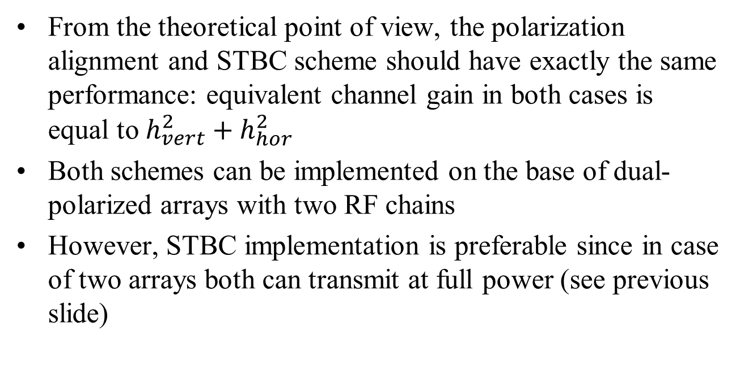
Polarization alignment vs. STBC
From the theoretical point of view, the polarization alignment and STBC scheme should have exactly the same performance: equivalent channel gain in both cases is equal to $h_{vert}^{2}+h_{hor}^{2}$
Both schemes can be implemented on the base of dual-polarized arrays with two RF chains
However, STBC implementation is preferable since in case of two arrays both can transmit at full power (see previous slide)

Slide 8
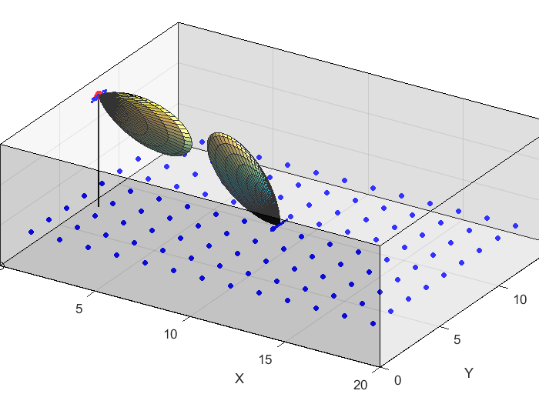
Hotel Lobby scenario 2x1 system simulations
Channel: 802.11ay model, Hotel lobby scenario (LOS / NLOS)
TX: dual-polarized 2x8 antenna array
  10 dBm power (total), ~17 dBi gain
RX: single-polarization 2x8 array
  Uniform RX positions
  Fixed 45° elevation, (0°, 90°, 180°, 270°) azimuth, random self-rotation
Beamforming procedure:
  Enhanced-SLS based: TX-RX sector scan and best sector pair selection
  33 sectors per array, ([-75°:15°:75°] elevation, [-45 °,0 °,45 °] azimuth)
Baseband processing: SISO or Alamouti STBC

Slide 9
Polarization modes performance comparison
Typical situation was considered in all simulations: polarization-capable AP and simple vertically polarized antenna at the STA
For comparison purposes, different antenna arrays configurations at the AP were considered, but the total power is fixed to 10 dBm for all antenna configurations
Single polarization (V-V, H-V, Circular-V)
  Simple implementation
  May give unpredictable loss in case of misalignment
  Stable 3dB degradation for Circular-Vertical case
Polarization alignment method: H,V adjustment at the TX so the resulting signal polarization at the RX will coincide with RX antenna polarization
  Suitable for type III antennas
  Eliminate polarization rotation losses
2x1 STBC (Alamouti scheme)
  Robust transmission scheme, require two RF chains
Antenna selection
  Best (in terms of signal power) antenna/polarization is selected
  Correspond to type III array usage in antenna selection mode

Slide 10
Performance of different polarization schemes
Polarization alignment and STBC has the same performance, due to our assumptions of equal TX power
Robust circular polarization has 3 dB degradation
Antenna selection between H and V (implementable with type III without spec impact) has only ~1 dB degradation in comparison with optimal solutions.
The selection between H, V and two 45° polarizations provide less than 0.5 dB loss.

Slide 11
Polarization modes: summary
Basic antenna array solution with single fixed polarization per RF chain does not require spec changes.
Phased antenna array with adjustable polarization and single RF chain does require spec changes for implementation of the optimal polarization alignment scheme: polarization capabilities fields, feedback, etc.
But this configuration in Antenna Selection mode (selection between pre-defined polarizations) with less than 0.5-1dB degradation in comparison with optimal alignment without changes to the spec.
Dual-polarized antenna array with two RF chains may be used for Alamouti-STBC mode transmission, which have same performance as optimal polarization alignment, and also does not require additional polarization description in the Spec.
Two arrays with orthogonal polarizations should be used for STBC rather than polarization alignment, due to more efficient total TX power usage.

Slide 12
Polarization and Beamforming
In the simulations full TX sector sweep were performed for each antenna polarization and the best TX/RX sector selected.
  For considered case of several (N_{tx}) polarization at the TX and single (vertical) polarization at the RX that means that SLS is repeated for each polarization/antenna: N_{tx} times
  In case of several polarizations at the TX and RX, theoretically the number of sweeps should be N_{tx} * N_{rx}
In practice, however, the squared overhead increase can be avoided:
  For Type I and II array at the RX, with number RF chains equal to the number of antenna polarizations, the receive polarization training can be performed simultaneously at the RX
  For Type III array at the RX in the polarization selection mode (slide 5), training of different antenna polarizations can be done in consecutive BTIs, if there is not enough TRN-R units in current BTI
  In addition, implementation-specific procedures may be used to reduce overhead on the base of polarization-beamforming relations.

Slide 13
Impact of polarization on beamforming study
To evaluate impact of polarization effects on the beamforming results, simulation assumptions as in slide #9 were used
  802.11ay model, Hotel lobby scenario (LOS / NLOS),
  2x8 PAAs, Full sector level sweep beamforming
  33 pre-defined sectors: [-75°:15°:75°] elevation, [-45 °,0 °,45 °] azimuth
  Random RX orientation (azimuth and self-rotation)
Vertical and horizontal at the TX, vertical at the RX
Beamforming polarization degradation evaluated
  Best sector is selected for V-V and H-V transmission for each STA position and orientation
  The received power for V-V transmission evaluated for two cases:
    Beamforming were based on V-V sector sweep (best sector)
    Beamforming were based on H-V sector sweep (best sector for H-V transmission)
  So, the impact of polarization on the BF results were estimated

Slide 14
Impact of polarization on beamforming results
  It can be seen that for LOS (basic scenario), the beamforming can be performed for any polarization, the resulting signal power will be almost the same, except very low SNR range
  For NLOS scenario, (where reflection power depends on polarization) the mismatch of TX polarization during BF phase and TX polarization during transmission phase lead to 2-3 dB performance degradation

Slide 15
Beamforming and polarization: summary
For baseline case when number of RF chains equal to number of antenna polarizations, the RX may receive the TRN-R training for all polarizations simultaneously, and evaluate the best RX sector for all polarizations in one BTI.
For type III arrays with single RF and several possible polarizations, RX may perform SLS for different polarizations in the several BTIs (without overhead on system level)
The result of SLS (selected sector and resulting signal strength) for LOS case is almost same for all polarizations, even for the Hotel Lobby scenario, with many reflections involved.
For NLOS case, performing SLS on one polarization and usage for another one may lead to 2-3 dB degradation
So, the BF results are robust enough for any combination of polarizations and thus, the AP may use only one preferred polarization for beamforming, with following polarization selection (great overhead reduction)

Slide 16
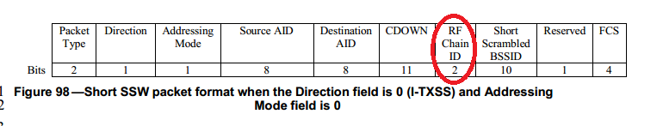
Conclusions
Dual polarized antenna arrays may be used in the Standard without explicit polarization description
  Dual-pol, two RF chains – STBC, same performance as ideal alignment
  Dual-pol, single RF – as Antenna Selection, less than 0.5-1 dB degradation in comparison with ideal alignment.
The number of RF chains always less or equal to the number of antennas
  802.11ad: N_{RF}=1, N_{Ant} used for antenna selection
  802.11ay base N_{Ant}=N_{RF}
  802.11ay special case of several dual-polarized antennas: N_{ant}≥N_{RF}
The sector scan and channel measurements should be performed by antennas, not the RF chains, so we propose to
  Change “RF Chain ID” wherever it appears (Short SSW field, for example Sect 30.9.1.1 Draft) to DMG Antenna ID
  Increase number of assigned bit to 3, for 8 streams/8 antennas support

Slide 17
Straw Poll
Do you agree with proposals to:
  Change “RF Chain ID” wherever it appears (Short SSW field, for example) to DMG Antenna ID
  Increase number bits, assigned from DMG Antenna ID in SSW and Shord SSW from 2 to 3, for 8 streams/8 antennas support

Slide 18
Backup

Slide 19
Polarization shcemes comparison
Hotel lobby, NLOS

Slide 20
Open area scenario simulations
Channel: 802.11ay model,
Open area scenario (LOS / NLOS)
TX: dual-polarized 2x8 antenna array
  10 dBm power (total), ~17 dBi gain
RX: single-polarization 2x8 array
  Uniform RX positions within sector
  Fixed 45° elevation, (0°, 90°, 180°, 270°) azimuth, random self-rotation
Beamforming procedure:
  Enhanced-SLS based: TX-RX sector scan and best sector pair selection
  33 sectors per array
Baseband processing: SISO or Alamouti STBC

Slide 21
Simulation results

