Slide 1
Power Save Delivery for 11ay
Authors:
Name | Affiliations | Address | Phone | email
Oren Kedem | Intel |  |  | oren.kedem@intel.com
Cheng Chen | Intel |  |  | cheng.chen@intel.com
Carlos Cordeiro | Intel |  |  | carlos.cordeiro@intel.com
Solomon Trainin | Qualcomm |  |  | strainin@qti.qualcomm.com

Slide 2
Motivation and Purpose
QoS traffic like Voice/Video requires short periodic service.
(Typical use case for Voice Traffic is 20-50KB every 20ms).
Spec should allow STA to support Voice/Video while maintain power save.
11ac addressed this use case with U-APSD mechanism that is commonly supported by most of Wi-Fi chip vendors.
11ay should enable the STA to save power while delivering Voice/Video traffic.
Contribution is a proposal for a suggested improvement on existed 11ad Triggered Unscheduled Power Save mechanism to address the above

Slide 3
11ad Power Save Mechanisms
Scheduled Power Save
  STA and PCP/AP communicate a Wakeup Schedule of cycling between awake BIs and doze BIs.
  Enable PS cycles in granularity of BIs (>100ms) hence is not suitable for short time doze states.
Unscheduled Power Save
  STA informs the PCP/AP on entering and exiting PS by completing a successful frame exchange with the “Power Management” subfield in the Frame Control field.
  Involved with major overhead to communicate PS transitions, hence not suitable for short time Doze states.
Scheduled Allocations
  PCP/AP allocate dedicated SP for STA QoS traffic.
  SP Allocation is not always guaranteed. Not suitable for CBAP Only (most AP’s link access scheme).
Above 11ad PS mechanisms are not suitable for STA PS while delivering QoS Traffic.

Slide 4
11ac U-APSD Overview
STA designates one or more of its ACs to be trigger-enabled ACs (i.e. U-APSD, Unscheduled-Automatic Power Save Delivery).
STA may configure the AP to use U-APSD Via Association procedure or alternatively by sending an ADDTS request per AC.
STA using U-APSD shall have the Power Management bit in the frame control field set to 1 for buffering to take place at the AP.
STA send unicast QoS-Data/Null frames while in PS-mode which triggers the AP to send the STA its BU.
AP sends the BU to STA immediately after the Trigger frame
STA must remain awake as long as data is still available.

Slide 5
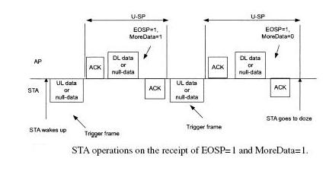
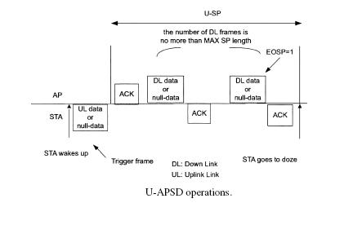
U-APSD Link Access
The Max SP Length subfield indicates the maximum number of BUs the STA is prepared to receive during any SP triggered by the STA.
AP is required to send to the STA all the BU on the respective Triggered Enabled AC, per the Maximum BU the STA is able to receive in every SP

Slide 6
11ad Triggered Unscheduled PS
11ad supports the Triggered Unscheduled Power Save
  A STA that has used unscheduled power save to enter Power Save may acquire TXOP and grant the AP/PCP a Reverse Direction.
  The AP/PCP use the offered RDG to transmit the BUs to the STA.
  While in this scheme, STA resides in Power Save state. Hence there is no Power Save transition overheads (i.e. sending frame with PM=0).
  11ay can utilize Triggered Unscheduled the same as U-APSD Trigger frame and enable 11ay to save power while delivering VOIP traffic

Slide 7
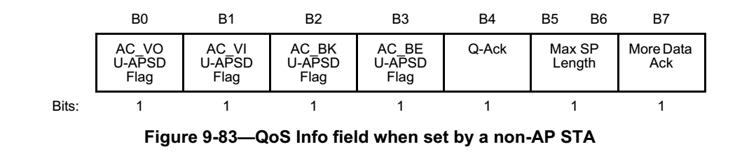
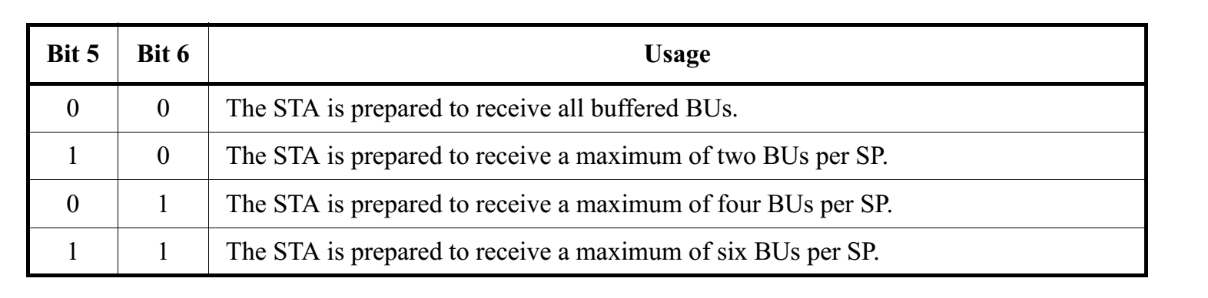
U-APSD QoS Info Field
MAX SP Length allow limited options to indicated the maximum MPDUs
QoS-Info field doesn’t provide the EDMG flow control needs hence 11ay is required to define new IE.

Slide 8
Triggered Unscheduled PS vs. U-APSD
In order to support power Save mode while delivering QoS traffic, PCP/AP should negotiate on the serviced AC.
 | 11ay | 11ac
AC and buffering definition | New “Triggered Unscheduled Parameters IE” | U-APSD “QoS Info field” is not suitable for 11ay flow control needs
Negotiation Agreement | Association Req/Rsp and PSC Req/Rsp | Association Req/Rsp or ADDTS Req/Rsp
Triggering Method | Triggered Unscheduled PS procedure as STA trigger frame | Any QoS-Data or Qos-Null for every Max SP length frame

Slide 9
11ay - QoS Triggered Unscheduled IE
QoS Triggered Unscheduled IE
 | Element ID | Length | QoS-TU Parameters | QoS-TU Max MPDU Size
Octets : | 1 | 1 | 1 | 2
QoS-TU Parameters field
 | B0 B3 | B4 | B5 | B6 | B7
 | QoS-TU Max A-MPDU Length Exponent | QoS-TU AC_VO Flag | QoS-TU AC_VI Flag | QoS-TU AC_BK Flag | QoS-TU AC_BE Flag
Bits : | 4 | 1 | 1 | 1 | 1
QoS-TU ACs Flag subfields indicate that the corresponding AC is QoS Triggered Unscheduled enabled
QoS-TU Max A-MPDU Length Exponent subfield indicates the maximum A-MPDU size of buffered BUs the STA is prepared to receive during QoS Unscheduled PS triggered by the STA.
QoS-TU Max MPDU Size subfield indicates the maximum number of buffered BUs (MPDUs) the STA is prepared to receive during QoS Unscheduled PS triggered by the STA.

Slide 10
Proposed Flow - Negotiation phase

Slide 11
Proposed Flow – Data Delivery

Slide 12
Straw poll
Do you agree to incorporate the changes in “11-17-1416-00-00ay-Power Save Delivery for 11ay.docx” (U-APSD extension for EDMG) into the draft? ”?

Slide 13
Backup

