Slide 1
Simple multiplexing of Wake-Up Signals
Date: 2017-09-11
Authors:

Slide 2
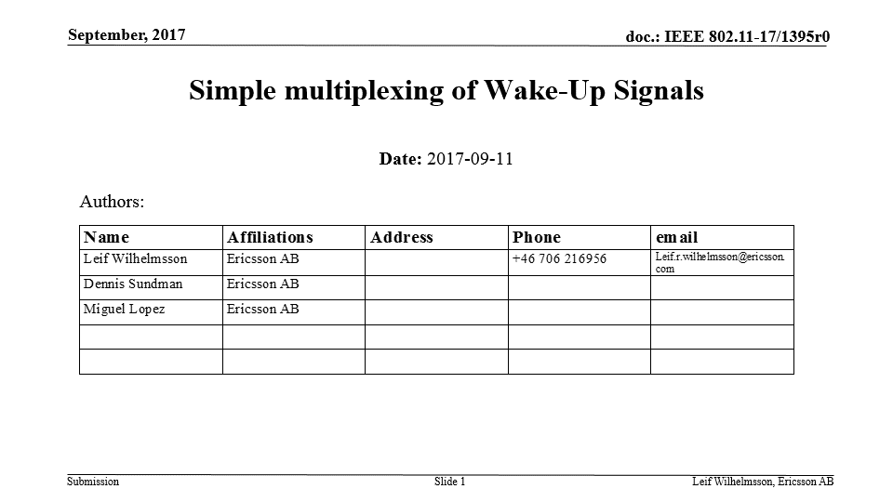
Abstract
In e.g. [1] it has been suggested to multiplex wake-up signals (WUS) in frequency
Multiplexing in frequency leads to harder requirement on the channel selective filter (CSF) as the distance to the adjacent channel by necessity is decreased for one or more WUS
The harder requirement on CSF is also reflected in [2] where the order of the CSF is 2 without multiplexing but 5 with multiplexing
In [3], it is agreed that the Manchester coded symbol rate could vary. With this feature, it is in this presentation shown that several WUSs can easily be multiplexed in a way completely transparent for the WUR with no need to increase the complexity of the CSF

Slide 3
Outline
Motivation
Illustration of the idea
A simple note
Conclusions
Straw polls

Slide 4
Motivation
Addressing more than one WUR with a WUS may be done on MAC layer using group addresses or on the PHY layer by multiplexing WUSs
It has been discussed to multiplex WUSs on the PHY layer by means of FDM, but this comes at an implementation cost in terms of more complex CSF
In this contribution we propose to instead perform the multiplexing in the code domain, which is in particularly simple as it has been agreed that Manchester coding should be used

Slide 5
Illustration of the idea
4us
250 kb/s
time
0
0
1
1
1
1
0
0
500 kb/s
time
0
1
1
0
1
0
0
1
1
0
By selecting Manchester coded signal that differ a factor of 2 (4,8,…) the signals will be perfectly orthogonal as long as the signals are properly aligned at the transmitter, illustrated in some detail on next page
This means that the only cost associated with multiplexing is that the transmitted energy is shared between WUS. How multiplexing is only used when the link budget admits it, just as the highest data rate only is used when the link budget allows for it…

Slide 6

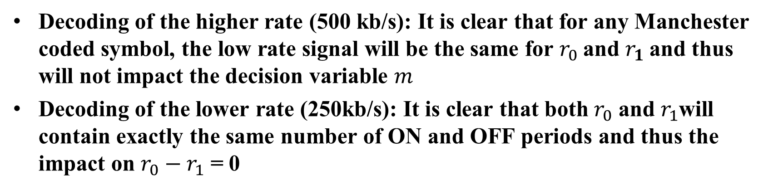


Illustration of the idea
$$r_{0}$$
$$r_{1}$$
4us
250 kb/s
time
0
0
1
1
1
1
0
0
Manchester metric:
$$m=r_{0}−r_{1}$$
500 kb/s
time
0
1
1
0
1
0
0
1
1
0
Decoding of the higher rate (500 kb/s): It is clear that for any Manchester coded symbol, the low rate signal will be the same for $r_{0}$and $r_{1}$and thus will not impact the decision variable $m$
Decoding of the lower rate (250kb/s): It is clear that both $r_{0}$ and $r_{1}$will contain exactly the same number of ON and OFF periods and thus the impact on $r_{0}−r_{1}$ = 0

Slide 7
A simple note
The orthogonality is obtained by using different symbol rates
It is still possible to have multiplexed WUS with the same data rate, as one may simply add a forward error correcting code to the WUS with higher symbol rate
As an example, two 250 kb/s WUS could be obtained with
  One uncoded 250 ksymbol/s
  One rate ½ coded 500 ksymbol/s

Slide 8
Conclusions
A simple means to multiplex WUSs on the PHY was presented
The multiplexing is done in the “code domain”, exploring that Manchester coded symbols of different rates easily can be made orthogonal
Compared to multiplexing using FDM, the proposed approach has no impact on the radio implementation e.g. in terms of filter requirements
The multiplexing can be made transparent for the different WURs, and can thus be an optional feature

Slide 9
Straw Poll
Do you believe multiplexing of WUSs is something that should be considered as, a potentially optional, feature in 802.11ba?
Y/N/A:

Slide 10
Straw Poll
Do you believe multiplexing of WUSs as described in this presentation is a good alternative or complement to multiplexing using FDM?
Y/N/A:

Slide 11
References
11-17/0028r0 “On waking-up multiple WUR stations”, Jianhan Liu et al.
11-17/0188r9 “TGba Simulation scenarios and evaluation methodology document”, Shahrnaz Azizi et al.
11-17/0575r3 “Specification Framework for TGba”, Po-Kai Huang

