Slide 1
Discussion of possible BCCs for WUR
Date: 2017-09-12
Authors:

Slide 2
Abstract
Using the 802.11 BCC for WUR has been proposed [1]
Concerns has been expressed regarding the decoding complexity [2]
In this contribution we discuss two means to address this complexity concern:
  Using a less complex code and study performance impact
  Using a systematic code to allow for implementations without a Viterbi decoder

Slide 3
The codes under consideration
The 802.11 rate ½ code
  Const. length 7, polynomial = [133, 171], nr. memory elements 6
A lower complexity rate ½ code
  Const. length 4, polynomial = [17, 13], nr. memory elements 3
  This is the BLE long range code
Systematic versions of the two above codes
  Wi-Fi: Constraint length 7, polynomial = [1, 171/133]
  BT: Constraint length 4, polynomial = [17/13, 1]

Slide 4
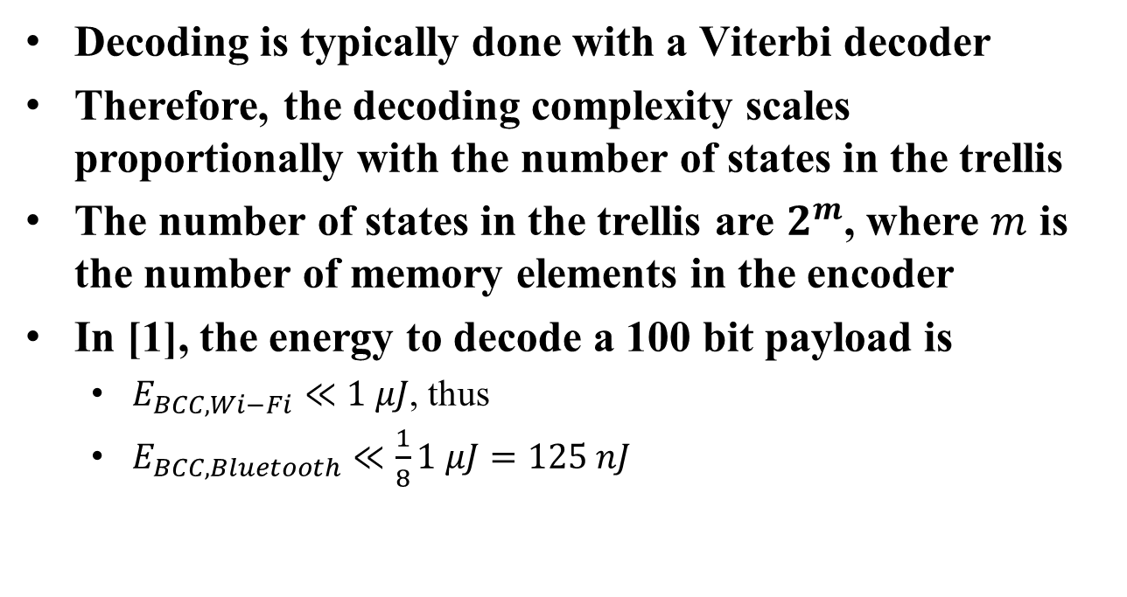
Decoding complexity
Decoding is typically done with a Viterbi decoder
Therefore, the decoding complexity scales proportionally with the number of states in the trellis
The number of states in the trellis are $2^{m}$, where $m$ is the number of memory elements in the encoder
In [1], the energy to decode a 100 bit payload is
  $E_{BCC, Wi−Fi}≪1 μJ$, thus
  $E_{BCC, Bluetooth}≪\frac{1}{8}1 μJ=125 nJ$

Slide 5






Systematic vs Non-Systematic Codes
For systematic codes, the information bits are part of the code word
  Ex. non-systematic Ex. systematic
The receiver may read the message without using a convolutional decoder
Output: $\{y_{11},$ $y_{12}$…}
Output: $\{x_{1},$ $x_{2}$…}
Input: $\{x_{1},$ $x_{2},$…}
Input: $\{x_{1},$ $x_{2},$…}
Output: $\{y_{21},$ $y_{22}$…}
Output: $\{y_{21},$ $y_{22}$…}

Slide 6
Simulation Results
5 dB
The lower complexity code performance is about 0.3 dB worse than the Wi-Fi code in TGnB and TGnD
The systematic versions of all codes perform identically to the non-systematic codes in terms of PER

Slide 7
Straw Poll
Do you support to have a BCC for the 62.5 kbps mode of the WUR?
Y/N/A: 14/21/15

Slide 8
References
[1] Steve Shellhammer and Bin Tian, “WUR Data Rates,” IEEE 802.11-17/0990r2, July 2017
[2] Eunsung Park et al., “Symbol Structure,” IEEE 802.11-17/1347r1, Sept. 2017

