Slide 1
Blank GI choices under Timing Errors
Date: 2017-09-12
Authors:
Name | Affiliation | Address | Phone | Email
Junghoon Suh | Huawei |  |  | junghoon.suh@huawei.com
Jia Jia
Osama Aboul-Magd
Ross Jian Yu

Slide 2
Background
  Analysis on Blank GI impact to ISI and Intra Symbol Interference was presented in [1]
    Two types of Blank GI based Waveform Coding (WFC) were presented
    Analysis was done according to the perfect timing assumption which may be achieved by the WUR preamble
The impact of timing error to the Blank GI based Waveform Coding (WFC) is examined

Slide 3
Four Waveform Coding Designs
L-LTS occupied for middle 13 tones to generate the waveform
  Taking 64 point IFFT may generate the 20 MHz sampling rate based 64 samples
  Pre-pending the copy of the last 16 samples to the 64 samples generated above may create the 4 usec long, 20 MHz sampling rate based 80 samples
  To apply the 80 samples of waveform to make the various WFC, leave those samples corresponding to the ON portion of the WFC and purge the samples corresponding to the OFF portion and Blank GI portion of the WFC.
  WFC I : No CP
0us 2us 4us
0us 2us 4us
Information “0”
Time dispersion
ISI area
Information “1”

Slide 4
WFC II: A blank energy GI with 0.8us duration is placed before transmitting each of the 3.2us symbol. The GI is removed at RX before performing symbol detection.
WFC III: A blank energy GI with 0.8us duration is placed before each of the 1.2us ON and OFF portion in a Symbol. The GI is removed at RX before performing symbol detection.
Blank
Blank
0us 0.8us 2.4us 4us
0us 0.8us 2.4us 4us
Information “1”
Information “0”
Blank
GI
ON
Blank
GI
OFF
Blank
GI
OFF
Blank
GI
ON
0us 0.8us 2.0us 2.8us 4us
0us 0.8us 2.0us 2.8us 4us
Information “1”
Information “0”

Slide 5
WFC IV: A blank energy GI with 0.4us duration is placed before each of the 1.6us ON and OFF portion in a Symbol. The GI is removed at RX before performing symbol detection.
Blank
GI
ON
Blank
GI
OFF
Blank
GI
OFF
Blank
GI
ON
0us 0.4us 2.0us 2.4us 4us
0us 0.4us 2.0us 2.4us 4us
Information “1”
Information “0”

Slide 6
Power Allocation to the different WFC:
TX power is constrained with the PSD Limit by the regulation
Equal symbol energy is assumed for WFC I, II, III and IV
  TX power is boosted per each i (In-Phase ) and q (Quadrature-Phase) sample by
  E.g., for WFC I, II, III, and IV, the following power boost per each i and q samples need to be applied
  where 2, 2.5, 3.33 correspond to 4us/2us, 4us/1.6us, 4us/1.2us, respectively.

Slide 7
Simulation
20 MHz sampling rate based
Packet size, 100 bits, and Data rate, 250 Kbps vs 62.5 Kbps
When TX power is limited by the PSD regulation
  Power allocation in previous slide applies
AWGN
  20 MHz signal is added with AWGN
  4 Tap FIR LPF at the RX is applied @ 4 MHz BW and 20 MHz sampling rate
Chan D
  Over-sampled to 100 MHz and TX filter applied @ 4MHz BW and 100 MHz Sampling rate for the rejection of aliases
  After Chan D is applied, AWGN is added
  Down-convert the signal (Noise added and Channel passed) to 20 MHz sampling rate based signal (filtering @ 4MHz BW and 100 MHz Sampling rate and then decimate it to 20 MHz)
  (Down-convert the signal and Noise separately to compute the 20 MHz BW based SNR)
  4 Tap FIR LPF at the RX is applied @ 4 MHz BW and 20 MHz sampling rate
Timing error considered
  ‘k samples delayed’ means the detection window is k samples more delayed than the actual symbol boundary
  ‘k samples advanced’ means the detection window is k samples ahead of the actual symbol boundary
SNR is measured after the RX filtering is done

Slide 8
Simulation setting for 62.5 Kbps
WFC I: BCC applied with the following WFC [3]
0us 4us 8us
0us 4us 8us
Information “0”
Information “1”
WFC III: BCC applied with the following WFC
Blank
GI
ON
Blank
GI
OFF
Blank
GI
OFF
Blank
GI
ON
0us 0.8us 4.0us 4.8us 8us
0us 0.8us 4.0us 4.8us 8us
Information “1”
Information “0”
  TX power is boosted per each i (In-Phase ) and q (Quad-Phase) sample by
, respectively for WFC I and WFC III.

Slide 9
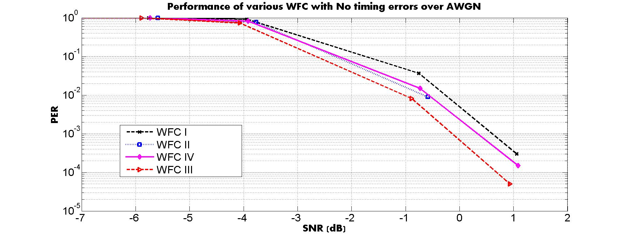
Performance of different WFC with No Timing Errors over AWGN
SNR = P_{received} - P_{noise} , Noise Figure not considered

Slide 10
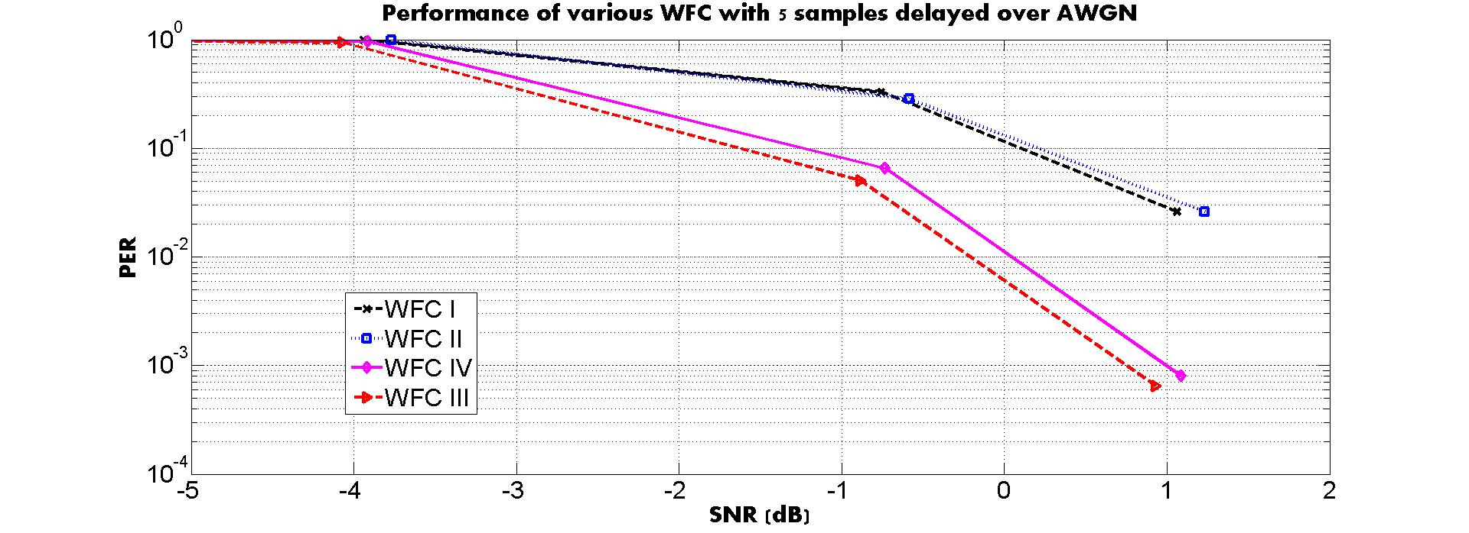
Performance of different WFC with 5 samples delayed over AWGN
SNR = P_{received} - P_{noise} , Noise Figure not considered

Slide 11
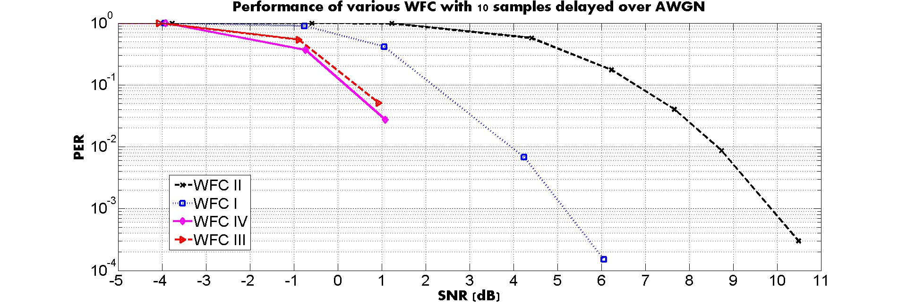
Performance of different WFC with 10 samples delayed over AWGN
SNR = P_{received} - P_{noise} , Noise Figure not considered

Slide 12
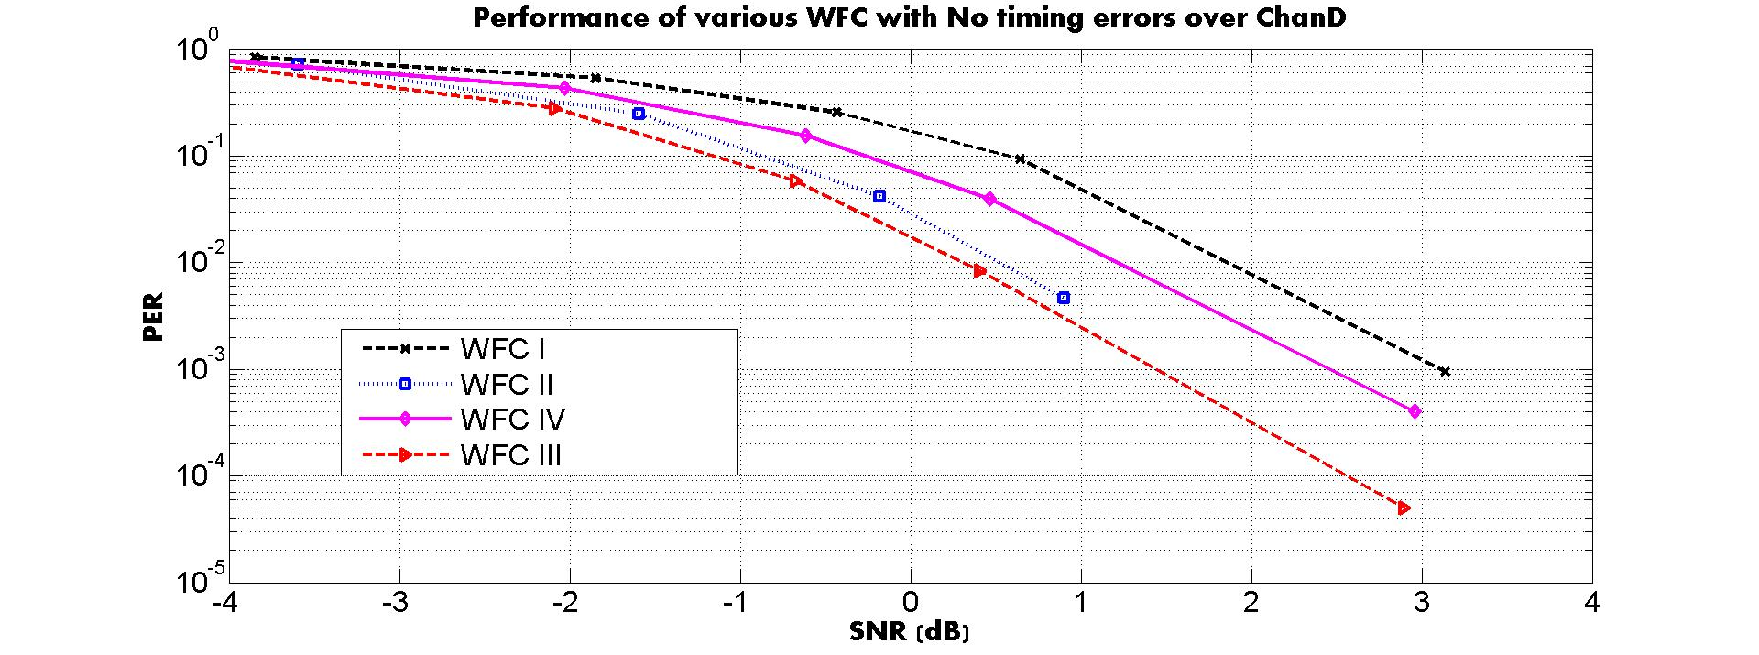
Performance of different WFC with No Timing Errors over Chan D
SNR = P_{received} - P_{noise} , Noise Figure not considered

Slide 13
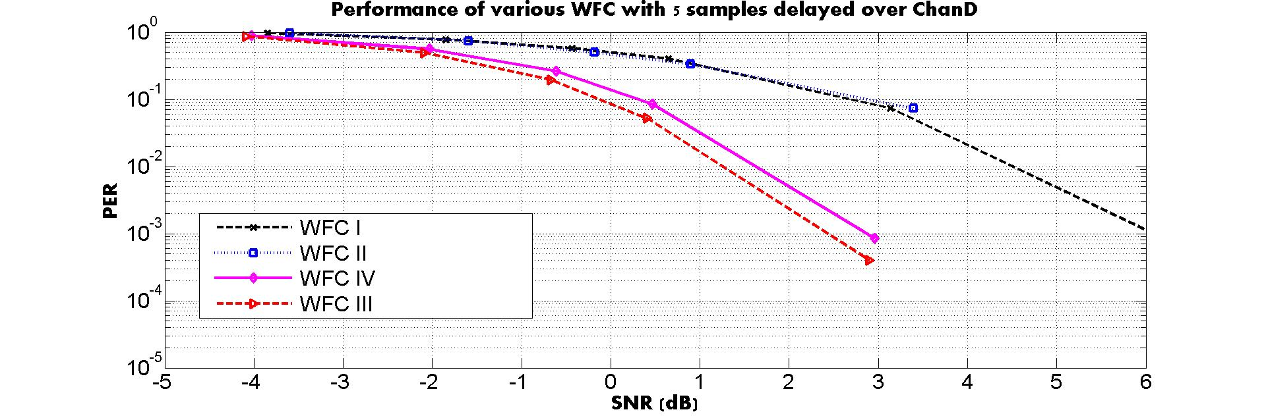
Performance of different WFC with 5 samples delayed over Chan D
SNR = P_{received} - P_{noise} , Noise Figure not considered

Slide 14
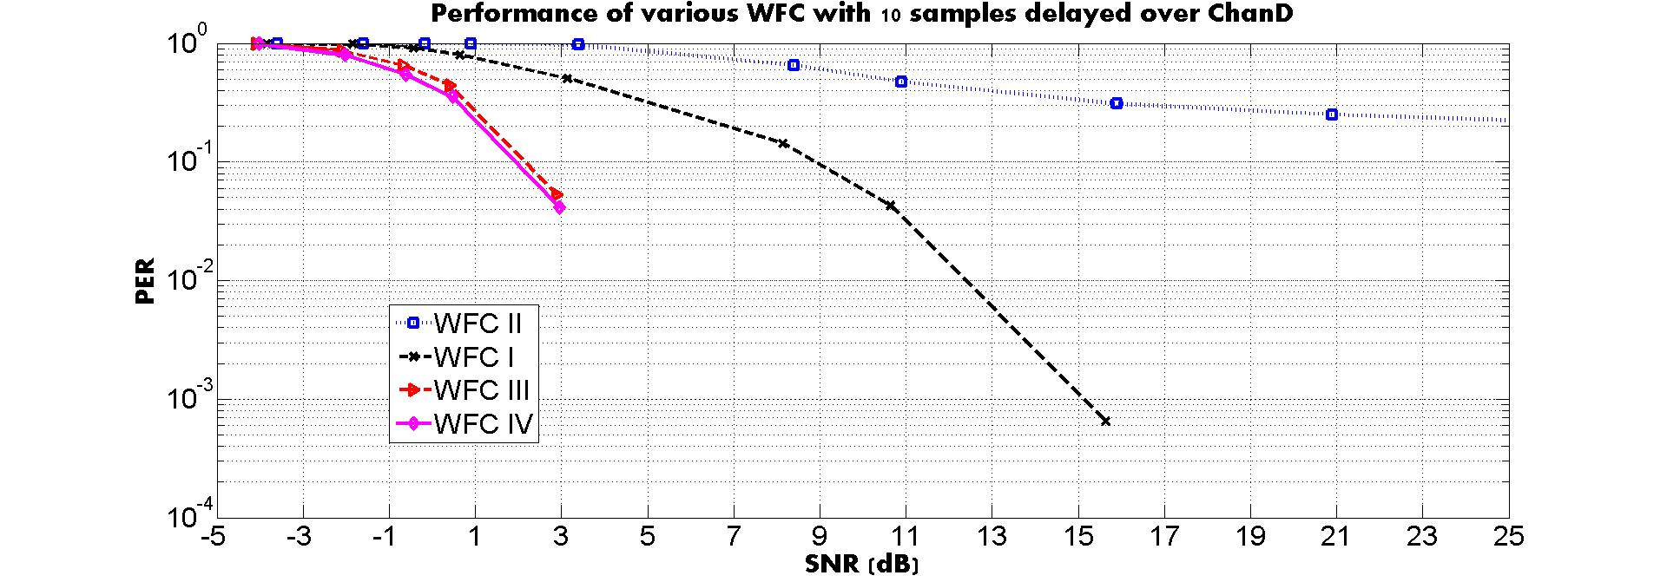
Performance of different WFC with 10 samples delayed over Chan D
SNR = P_{received} - P_{noise} , Noise Figure not considered

Slide 15
PSD Limit by the Regulation and Data rates
There are PSD limits for 5 GHz band across the world, including FCC, China, and ETSI regulation
There are PSD limits for 2.4 GHz band in ETSI and China, but no PSD limit for 2.4 GHz band in FCC [2]
  Only the limit in Total TX power for 2.4 GHz band in FCC
  The TX power for 2.4 GHz band in the US market is limited by the Power Amplifier (Hardware limit) → The gain of Blank GI becomes limited by the PA limit of TX power for 2.4 GHz, only in the US market
Blank GI is effective for the data rate, 250 Kbps and beyond
  However, with Blank GI, there is no cost even for the low data rate both in Performance and RX Power Consumption when the PSD limit is applicable

Slide 16
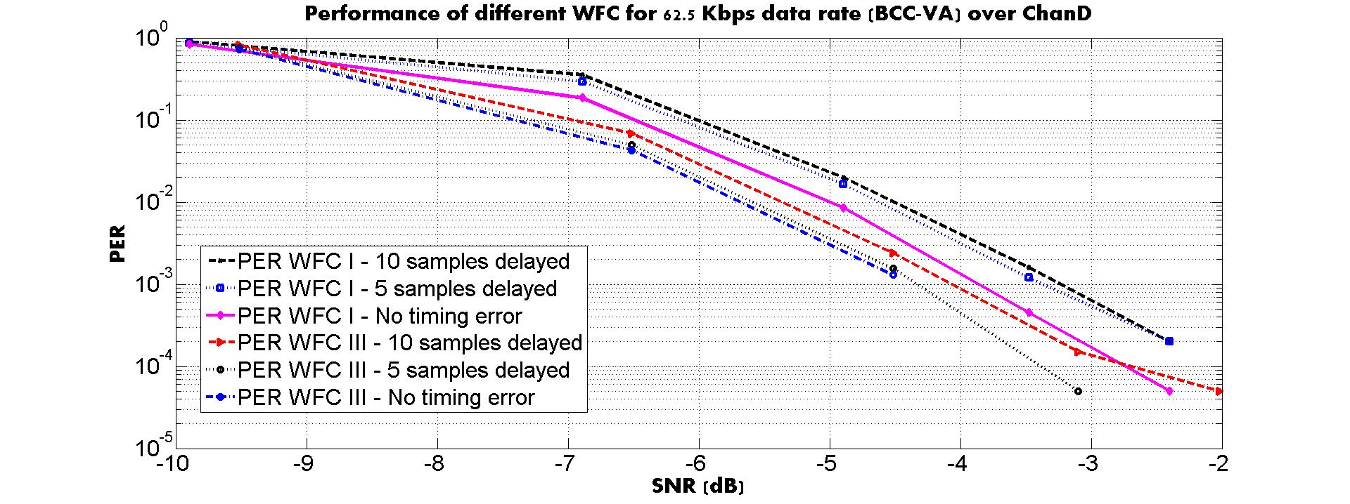
Performance of different WFC over Chan D for 62.5 Kbps (BCC-VA)
SNR = P_{received} - P_{noise} , Noise Figure not considered

Slide 17
WUR Capabilities Element
Higher Rate TBD
WFC I
WFC Type is indicated
through the Capabilities
notification on the
MR association
Rate indication (Method & Size TBD)
in WUR-PHY header
250 Kbps
(2 ~ 3 dB better when PSD limit available)
62.5 Kbps
WFC III
Format TBD
WUR Capabilities element format
Element ID
Length
WUR Capabilities
Info
Octets:
1
1
TBD
WUR Capabilities element are exchanged on the main radio (MR) association
Capabilities bit(s) may set to support WFC I, WFC III, or both.
When both of WFC I and III are supported, additional indication is necessary
  In the WUR PHY header on a frame by frame basis
  Indication of WFC type using Action frame (less dynamic than in the PHY header)
Capabilities bit(s) may also include the supported data rate capabilities

Slide 18
Conclusion
Performance of BGI based WFC with Timing Errors is examined
  WFC II and III show the best when no timing errors occur
  WFC III still shows the best when the timing errors occur
WFC III shows the best with the various timing errors considered
Blank GI is proposed as an optional feature, targeted for the market where the PSD limit is applicable
  Capability may be exchanged during the main radio or WUR Beacon frame, but open for any proposal
  Blank GI is effective for the data rate, 250 Kbps and beyond, consistent 2~3 dB gain against WFC I over Chan. D
  However, the Blank GI doesn’t cost any performance loss or power consumption even for the low data rate, 62.5 Kbps

Slide 19
Reference
[1] Huawei “17/969r0 Analysis on the Impact of Blank GI to ISI”, IEEE 802.11 TGba, July 2017, Berlin, Germany
[2] Qualcomm “17/365r0 Regulations and Noise Figure – Impact on SNR”, IEEE 802.11 TGba, Mar 2017, Vancouver, Canada
[3] Qualcomm “17/670r0 Data Rates and Coding”, IEEE 802.11 TGba, May 2017, Daejeon, South Korea

Slide 20
Appendix
Performance of WFC I, II, III, and IV with various timing errors – 20 MHz sampling rate based
  AWGN
  Chan D

Slide 21
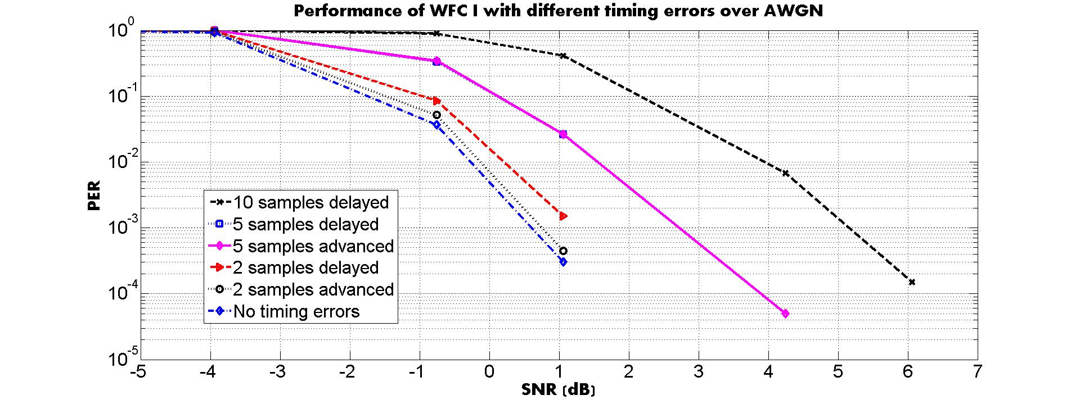
WFC I - AWGN
SNR = P_{received} - P_{noise} , Noise Figure not considered

Slide 22
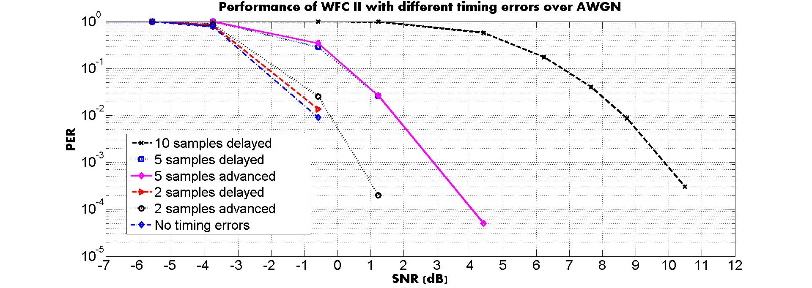
WFC II – AWGN
SNR = P_{received} - P_{noise} , Noise Figure not considered

Slide 23
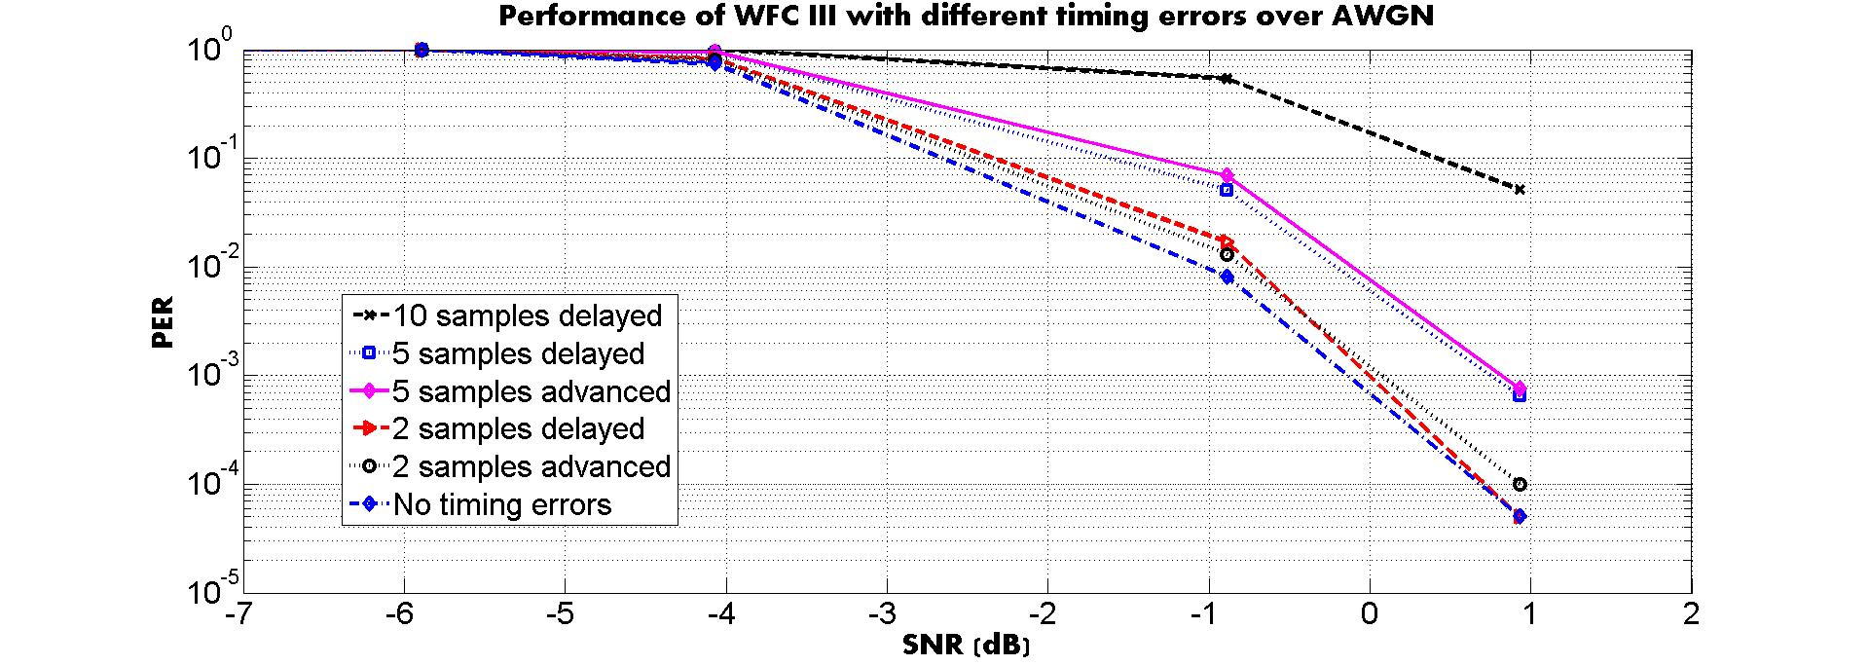
WFC III – AWGN
SNR = P_{received} - P_{noise} , Noise Figure not considered

Slide 24
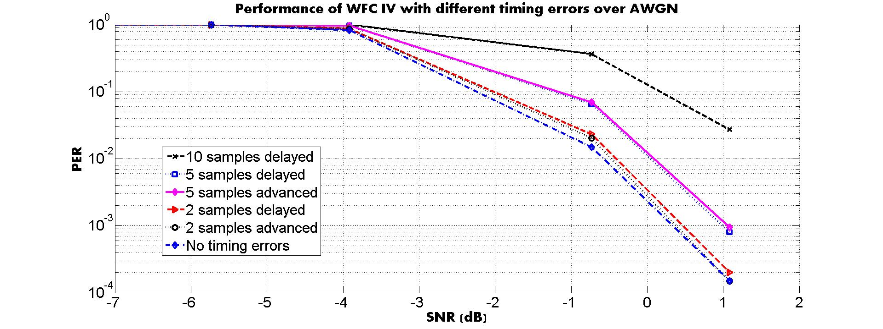
WFC IV – AWGN
SNR = P_{received} - P_{noise} , Noise Figure not considered

Slide 25
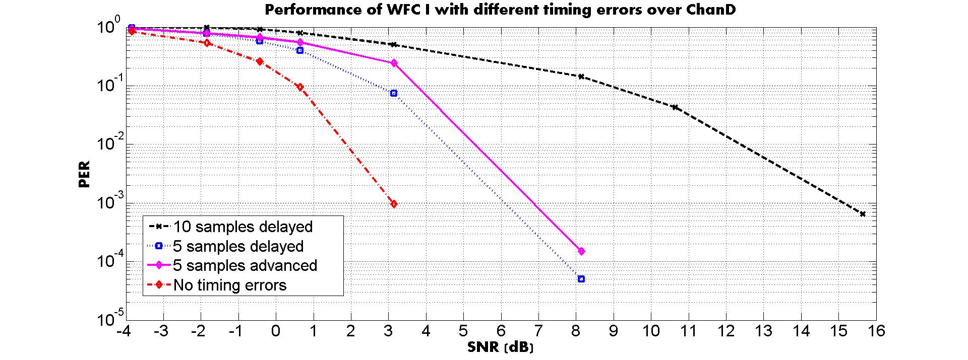
WFC I – Chan D
SNR = P_{received} - P_{noise} , Noise Figure not considered

Slide 26
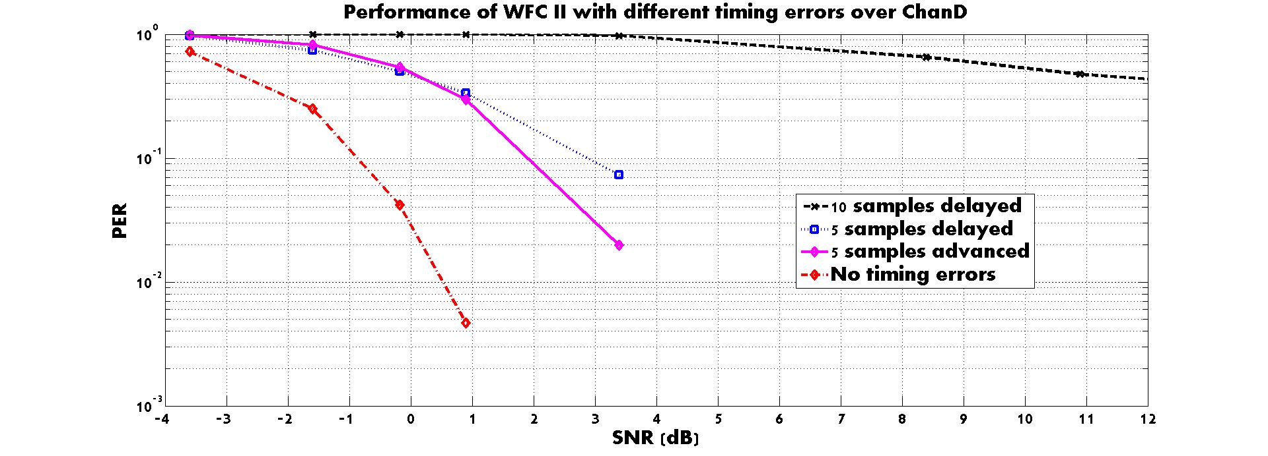
WFC II – Chan D
SNR = P_{received} - P_{noise} , Noise Figure not considered

Slide 27
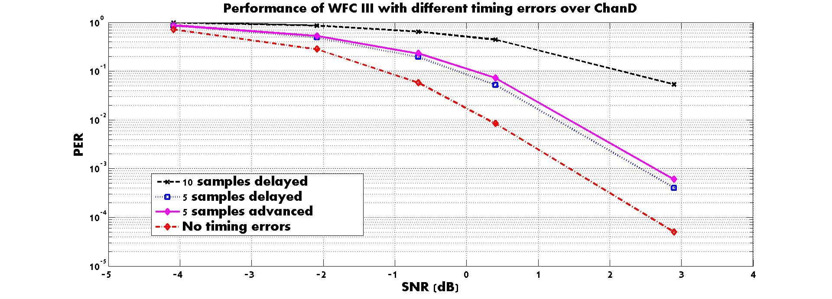
WFC III – Chan D
SNR = P_{received} - P_{noise} , Noise Figure not considered

Slide 28
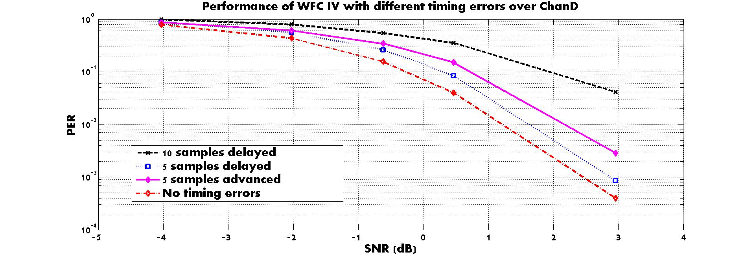
WFC IV – Chan D
SNR = P_{received} - P_{noise} , Noise Figure not considered

