Slide 1
WUR Preamble Bit Duration
Date: 2017-09-10
Authors:

Slide 2
Abstract
In another presentation [1], we showed the performance of several preamble designs
In all those designs the bit duration in the preamble was 4 µs
Here we consider the effect of a shorter preamble bit duration, while keeping the total preamble duration fixed
This allows us to use a longer MLS bit sequence
Here we focus on the maximal length sequence (MLS) design
We consider both probability of detection and timing accuracy

Slide 3
Preamble Designs Considered
Design #1
  4 µs Preamble Bit Duration
  32 bit MLS
Design #2
  2 µs Preamble Bit Duration
  64 bit MLS
Design #3
  1 µs Preamble Bit Duration
  128 bit MLS
All three designs have a duration of 128 µs

Slide 4

Simulations
Simulations were preformed just as in the earlier presentation
Probability of false alarm was set at $10^{−2}$, just as before
SNR is measured with a 20 MHz bandwidth, just as before
Simulated in AWGN, Channel Model D, and UMi

Slide 5
Probability of Miss-Detection – AWGN

Slide 6
Timing Error Metric #1 – AWGN

Slide 7
Timing Error Metric #2 – AWGN

Slide 8
Probability of Miss-Detection – Model D

Slide 9
Timing Error Metric #1 – Model D

Slide 10
Timing Error Metric #2 – Model D

Slide 11
Probability of Miss-Detection – UMi

Slide 12
Timing Error Metric #1 – UMi

Slide 13
Timing Error Metric #2 – UMi

Slide 14
Target SNR Levels
Earlier Data Field simulations [2] for 62.5 kb/s data rate
Design | Data Rate (kb/s) | 10%-PER SNR (dB) AWGN | 10%-PER SNR (dB) Model D
Repetition Code & Manchester Code | 62.5 | -9.3 | -2.9
BCC & Manchester Code | 62.5 | -12.3 | -5.3

Slide 15
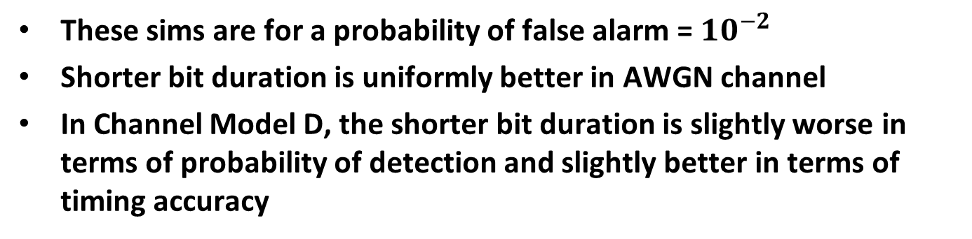
62.5 kb/s – Repetition Code & Manchester Code
 | AWGN @ -9 dB SNR |  |  | Model D @ -3 dB SNR
 | P(Miss Detection) | Timing Error 95 Percentile (µs) | Timing Error Percent > 1 µs | P(Miss Detection) | Timing Error 95 Percentile (µs) | Timing Error Percent > 1 µs
32bits/4µs | 0.009 | 0.5 | 0.007 | 0.071 | 0.25 | 0.006
64bits/2µs | 0.010 | 0.25 | 0.0007 | 0.089 | 0.25 | 0.002
128bits/1µs | 0.001 | 0.25 | 0.00007 | 0.097 | 0.25 | 0.002
These sims are for a probability of false alarm = $10^{−2}$
Shorter bit duration is uniformly better in AWGN channel
In Channel Model D, the shorter bit duration is slightly worse in terms of probability of detection and slightly better in terms of timing accuracy

Slide 16
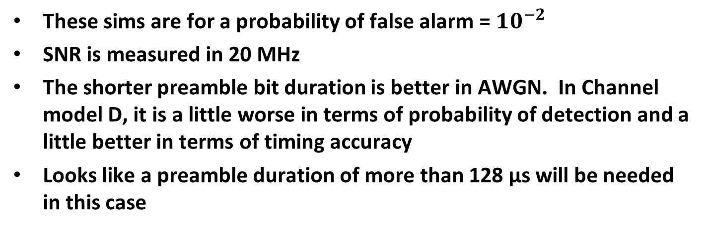
62.5 kb/s – BCC & Manchester Code
 | AWGN @ -12 dB SNR |  |  | Model D @ -5 dB SNR
 | P(Miss Detection) | Timing Error 95 Percentile (µs) | Timing Error Percent > 1 µs | P(Miss Detection) | Timing Error 95 Percentile (µs) | Timing Error Percent > 1 µs
32bits/4µs | 0.71 | 1.75 | 0.086 | 0.14 | 0.5 | 0.010
64bits/2µs | 0.74 | 1.25 | 0.051 | 0.17 | 0.25 | 0.003
128bits/1µs | 0.58 | 0.25 | 0.021 | 0.17 | 0.25 | 0.003
These sims are for a probability of false alarm = $10^{−2}$
SNR is measured in 20 MHz
The shorter preamble bit duration is better in AWGN. In Channel model D, it is a little worse in terms of probability of detection and a little better in terms of timing accuracy
Looks like a preamble duration of more than 128 µs will be needed in this case

Slide 17
Longer Preamble
The 128 µs preamble does not work well for the 62.5 kb/s using BCC & Manchester code design
We consider a 256 µs preamble and see how it works at the SNR level for the BCC & Manchester code design
We consider three preamble designs
Design #1
  64 bit MLS with 4 µs Preamble Bit Duration
Design #2
  128 bit MLS with 2 µs Preamble Bit Duration
Design #3
  256 bit MLS with 1 µs Preamble Bit Duration

Slide 18
Probability of Miss-Detection – AWGN

Slide 19
Timing Error Metric #1 – AWGN

Slide 20
Timing Error Metric #2 – AWGN

Slide 21
Probability of Miss-Detection – Model D

Slide 22
Timing Error Metric #1 – Model D

Slide 23
Timing Error Metric #2 – Model D

Slide 24
Probability of Miss-Detection – UMi

Slide 25
Timing Error Metric #1 – UMi

Slide 26
Timing Error Metric #2 – UMi

Slide 27
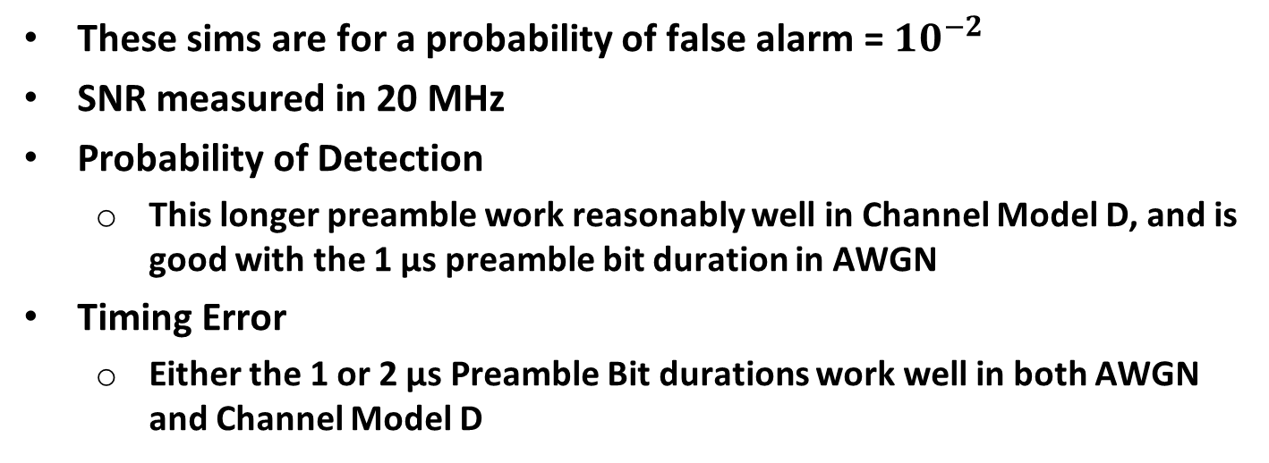
62.5 kb/s – BCC & Manchester Code
 | AWGN @ -12 dB SNR |  |  | Model D @ -5 dB SNR
 | P(Miss Detection) | Timing Error 95 Percentile (µs) | Timing Error Percent > 1 µs | P(Miss Detection) | Timing Error 95 Percentile (µs) | Timing Error Percent > 1 µs
64bits/4µs | 0.18 | 0.75 | 0.0260 | 0.08 | 0.25 | 0.0066
128bits/2µs | 0.20 | 0.25 | 0.0066 | 0.10 | 0.25 | 0.0020
256bits/1µs | 0.08 | 0.25 | 0.0014 | 0.11 | 0.25 | 0.0015
These sims are for a probability of false alarm = $10^{−2}$
SNR measured in 20 MHz
Probability of Detection
  This longer preamble work reasonably well in Channel Model D, and is good with the 1 µs preamble bit duration in AWGN
Timing Error
  Either the 1 or 2 µs Preamble Bit durations work well in both AWGN and Channel Model D

Slide 28
Conclusions
The use of a shorter Preamble Bit Duration and a corresponding longer MLS, always performs better in AWGN
In channel Model D, there is sometimes a tradeoff between Probability of Miss Detection and Timing Error, when choosing the duration of the Preamble Bit Duration
A preamble duration of 128 µs looks like it will work well for the 62.5 kb/s using Repetition Coding and Manchester Coding
To support the 62.5 kb/s using BCC and Manchester coding would require going to a preamble duration of 256 µs, or possibly longer

Slide 29
References
Steve Shellhammer, Bin Tian, and Lochan Verma, “WUR Preamble Evaluation,” IEEE 802.11-17/1355r0, September 2017
Steve Shellhammer and Bin Tian, “Data Rates and Coding,” IEEE 802.11-17/670r0, May 2017

