Slide 1
Considerations on PAPR of Wake Up Packet
Date: 2017-09-11
Authors:
Name | Affiliation | Address | Phone | Email
Yujin Noh | Newracom | 9008 Research Dr. Irvine, CA 92618 |  | yujin.noh at newracom.com
Minho Cheong |  |  |  | minho.cheong at newracom.com

Slide 2
Background (1/2)
Four options on 13-subcarrier sequence to generate 4us OOK waveform for payload part of wake-up packet were suggested [1]
Option 1 : [1,1,1,-1,-1,-1,0,-1,1,-1,-1,1,-1]
Option 2 : [1,-1,1,-1,-1,1,0,-1,-1,1,1,1,1] * (1+j)/sqrt(2)
Option 3 : [1,-1,1,1,1,1,0,1,-1,-1,1,1,-1]
Option 4 : [-1,-1,-1,1,1,-1,0,-1,-1,-1,1,-1,1]
Option 5 : none of the above
Op1/Op2/Op3/Op4/Op5/A : 8/10/2/1/17/3
Given outcomes from discussion and SP, it seems to be early to determine the sequence for OOK signal.

Slide 3
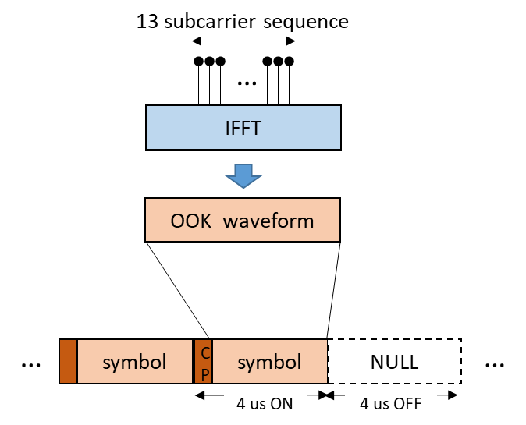
Background (2/2)
Considering that OOK waveform can be generated reusing 802.11 OFDM transmitter [2], PAPR of wake-up packet needs to be carefully taken into account.
Since subcarriers are added with IFFT operation, OFDM signal is well-known to have possibly high PAPR.
PAPR reduction is important in reducing implementation cost of Tx Power Amplifier and Rx receiver dynamic range related function blocks.

Slide 4
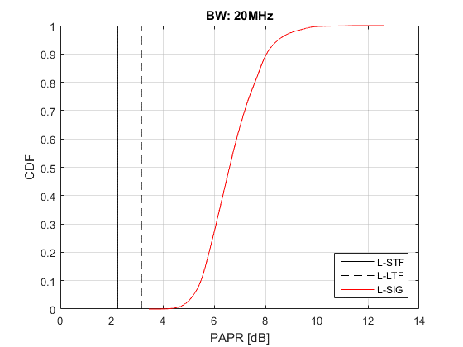
General Design Requirements for PAPR (1/2)
In order to maximally utilize the dynamic range of TX PA, worst PAPR across the entire PPDU should be minimized.
L-STF and L-LTF has been designed to have lower PAPR.
PAPR of L-SIG appears to be a bottleneck eventually.
L-SIG has not been optimized to have low PAPR because RATE field and LENGTH field are used for RX to calculate the length of PPDU.
According to [1], PAPR of payload part of wake-up packet seems to easily design to have lower PAPR than that of L-SIG.
Therefore, PAPR of L-SIG should be optimized.
PAPR metric in Appendix

Slide 5
General Design Requirement for PAPR (2/2)
In order to have reasonable PAPR of “A” OFDM symbol, just relying on implementation-dependent sequence may not be recommended.
PAPR of preamble part is out of scope in this document.
PAPR of payload part is recommended to have an equivalent or smaller PAPR compared to PAPR of L-SIG.
Some well-known sequences are shown later for its acceptable PAPR and simplicity to generate.

Slide 6
L-SIG PAPR optimization
At an glance, it seems to be difficult to optimize PAPR of L-SIG.
Not much bit fields which we can use for PAPR optimization
Out-of-the-box idea on L-SIG for PAPR optimization
Contents which we can actually use in L-SIG
RATE field, LENGTH field, etc.
Multiple pairs of RATE and LENGTH field could indicate the same PPDU length. So, we should use this kind of flexibility in order to reduce the PAPR further
With PPDU length as 120 us, (RATE, LENGTH) in L-SIG can indicate (0, 71), (4, 293) or (5, 446)
Extra edge tones at both side of L-SIG
Four extra edge tones (-28, -27, 27 and 28) could be used to reduce L-SIG PAPR

Slide 7
Contents in L-SIG
20 us
4 × N_{SYM} us
L-STF
L-LTF
L-SIG
A
preamble part of WUP
payload part of WUP
For the 3rd party STAs,
Given RATE and LENGTH field in L-SIG, the 3rd party STAs calculate the PPDU length of the wake-up packet for protection.
For wake-up radio,
Since it can not decode L-SIG correctly, contents in L-SIG are not meaningful.
Any combination of (RATE, LEGNTH) does not any impact on the detection/decoding the narrow part of wake-up packet.

Slide 8
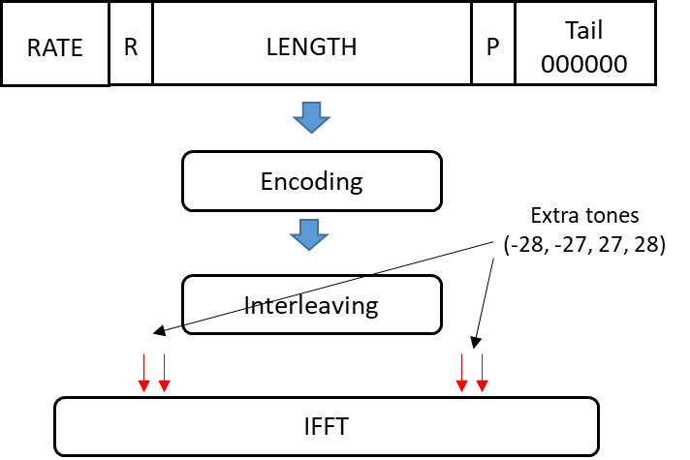
How to use extra tones on edge side for L-SIG PAPR optimization
Extra tones are mapped to both edge of L-SIG in the frequency domain and not jointly encoded with L-SIG contents.
For an HE PPDU, the 4 subcarriers added to the L-SIG are transmitted for channel estimation for HE-SIG-A and HE-SIG-Bs.
The number of data subcarriers in HE-SIG-A and HE-SIG-B is increased by 4 in each 20MHz sub-channel.
Since legacy devices do not expect or process the extra edge tones, they shouldn’t interfere with L-SIG reception
The extra tones can be filled with a predetermined sequence that is determined by the contents of the L-SIG to have low PAPR

Slide 9
Optimized L-SIG for PAPR Reduction
In [3], estimated payload size of WUR beacon frame could be between 244 us and 316 us. More details in Appendix.
E.g.) Given PPDU length of WUR beacon with 276 us, L-SIG can provide lower PAPR (3.85dB)
PPDU Length [us] | Rate | R | L-Length [Byte] | PAPR [dB] | Extra Tones
276 | 3 | 0 | 572 | 3.8527 | 0 | -1 | 0 | 1
284 | 6 | 0 | 1560 | 3.5937 | 1 | -1 | 1 | 1

Slide 10
Observation on length of Wake-up packet
The wake-up packet should be designed for a limited set of usages, and each function requires fixed amount of control information.
E.g.) WUR beacon frame is targeted to 1) maintain synchronization and 2) keep stable connection with AP.
E.g.) Original purpose of wake-up packet is to focus on waking up the main radio.
It is likely to have a specific PPDU length in accordance with its usage.
For example, two or three types of PPDU are defined with different rates and its own purpose.
E.g) WUR beacon with low rate may have the length of L_{BEACON} us.
E.g) WUP to wake up the main radio with low/high rate may have the length of L_{LOW} / L_{HIGH} us

Slide 11
“A” PAPR Optimization
20 us
4 × N_{SYM} us
L-STF
L-LTF
L-SIG
A
preamble part of WUP
payload part of WUP
For “A” OFDM symbol, SFD reads R.3.1.A: A 20 MHz non-HT preamble is prepended in any WUR PPDU, including L-STF, L-LTF and L-SIG fields. A 20 MHz OFDM symbol, with tone spacing 312.5 kHz and BPSK, and of duration 4 us, is present immediately after the L-SIG field and right before the narrow band portion of any WUR PPDU.
In [4], “A” OFDM symbol could be any other BPSK modulated 20MHz OFDM symbol.
A sequence by implementation dependent could result in high PAPR for wake-up packet.
In order to reduce PAPR of wake-up packet, PAPR of “A” should not be higher than worst PAPR across the entire PPDU (PAPR of L-SIG).

Slide 12
Payload PAPR Optimization (1/4)
20 us
4 × N_{SYM} us
L-STF
L-LTF
L-SIG
A
preamble part of WUP
payload part of WUP
The 13 subcarrier sequence to generate 4us OOK waveform for payload part of wake-up packet has not decided whether to have DC tone at the center.
SFD says R.3.3.A: When a single band is used for transmission of wake-up packet, the OOK waveform of wake-up packet is generated by using contiguous 13 subcarriers with the subcarrier spacing of 312.5 kHz
– The center subcarrier is TBD
Firstly, I did computer search for the sequences with minimum PAPR in both cases.
Case 1 : DC tone inserted / Case 2: DC tone not inserted
Then, some well-known sequences with acceptable PAPR are shown as an alternative.

Slide 13
Payload PAPR Optimization (2/4)
The sequences which require minor modification (nulling the value at the center) are chosen to be used for two cases in common as examples.
Its range of PAPR is around 2-3dB.
It seems to be overdesigned compared to PAPRs of other portion of the entire PPDU
Case 1 |  |  |  |  |  |  |  |  |  |  |  |  |  | Case 2
PAPR | sequence |  |  |  |  |  |  |  |  |  |  |  |  | PAPR | sequence
2.062682 | -1 | 1 | -1 | -1 | 1 | -1 | 0 | -1 | -1 | -1 | 1 | 1 | 1 | 2.690943 | -1 | 1 | -1 | -1 | 1 | -1 | 1 | -1 | -1 | -1 | 1 | 1 | 1
2.062582 | -1 | 1 | -1 | -1 | 1 | -1 | 0 | -1 | -1 | -1 | 1 | 1 | 1 | 2.534147 | -1 | 1 | -1 | -1 | 1 | -1 | -1 | -1 | -1 | -1 | 1 | 1 | 1
2.062582 | -1 | -1 | -1 | 1 | 1 | 1 | 0 | 1 | -1 | 1 | 1 | -1 | 1 | 2.534147 | -1 | -1 | -1 | 1 | 1 | 1 | 1 | 1 | -1 | 1 | 1 | -1 | 1
2.062582 | -1 | -1 | -1 | 1 | 1 | 1 | 0 | 1 | -1 | 1 | 1 | -1 | 1 | 2.690943 | -1 | -1 | -1 | 1 | 1 | 1 | -1 | 1 | -1 | 1 | 1 | -1 | 1
2.062582 | 1 | 1 | 1 | -1 | -1 | -1 | 0 | -1 | 1 | -1 | -1 | 1 | -1 | 2.690943 | 1 | 1 | 1 | -1 | -1 | -1 | 1 | -1 | 1 | -1 | -1 | 1 | -1
2.062582 | 1 | 1 | 1 | -1 | -1 | -1 | 0 | -1 | 1 | -1 | -1 | 1 | -1 | 2.534147 | 1 | 1 | 1 | -1 | -1 | -1 | -1 | -1 | 1 | -1 | -1 | 1 | -1
2.062582 | 1 | -1 | 1 | 1 | -1 | 1 | 0 | 1 | 1 | 1 | -1 | -1 | -1 | 2.534147 | 1 | -1 | 1 | 1 | -1 | 1 | 1 | 1 | 1 | 1 | -1 | -1 | -1
2.062582 | 1 | -1 | 1 | 1 | -1 | 1 | 0 | 1 | 1 | 1 | -1 | -1 | -1 | 2.690943 | 1 | -1 | 1 | 1 | -1 | 1 | -1 | 1 | 1 | 1 | -1 | -1 | -1
2.193824 | 1 | 1 | 1 | 1 | 1 | -1 | 0 | -1 | 1 | 1 | -1 | -1 | 1 | 3.189696 | 1 | 1 | 1 | 1 | 1 | -1 | 1 | -1 | 1 | 1 | -1 | -1 | 1
2.193824 | 1 | 1 | 1 | 1 | 1 | -1 | 0 | -1 | 1 | 1 | -1 | -1 | 1 | 3.301042 | 1 | 1 | 1 | 1 | 1 | -1 | -1 | -1 | 1 | 1 | -1 | -1 | 1
2.193824 | -1 | -1 | -1 | -1 | -1 | 1 | 0 | 1 | -1 | -1 | 1 | 1 | -1 | 3.301042 | -1 | -1 | -1 | -1 | -1 | 1 | 1 | 1 | -1 | -1 | 1 | 1 | -1
2.193824 | -1 | -1 | -1 | -1 | -1 | 1 | 0 | 1 | -1 | -1 | 1 | 1 | -1 | 3.189696 | -1 | -1 | -1 | -1 | -1 | 1 | -1 | 1 | -1 | -1 | 1 | 1 | -1

Slide 14
Payload PAPR Optimization (3/4)
ZC sequences are defined as samples of a complex exponential function as below
Well-known sequence as CAZAC (Constant Amplitude and Zero AutoCorrelation) sequence in 3GPP LTE.
Properties of CAZAC sequence in time domain provide good performance for synchronization and cell search.
Still provide comparable PAPR of payload part in frequency domain compared with PAPR of L-SIG
Root index between 1 to (N_{ZC} -1)
Length of the sequence
for N_{ZC} integer even
for N_{ZC} integer odd

Slide 15
Payload PAPR Optimization (4/4)
E.g.1) use one sequence for two cases (even regardless of assigned RU position)
E.g.2) use cyclic shifted sequence in accordance with assigned RU position.
Case 1
E.g.1) -6 ≤ k ≤ 6
Case 1 |  | Case 2
u | PAPR | u | PAPR
6 | 3.646 | 1 | 2.383
10 | 3.722 | 12 | 2.467
7 | 3.806 | 6 | 3.911
3 | 3.898 | 7 | 4.057
1 | 4.377 | 4 | 4.233
12 | 4.594 | 9 | 4.269
8 | 5.130 | 2 | 4.762
5 | 5.155 | 10 | 4.820
2 | 5.477 | 3 | 4.828
11 | 5.638 | 11 | 4.858
9 | 5.859 | 8 | 5.701
4 | 5.917 | 5 | 5.942
Case 2
where N_{ZC} =13 (odd/prime number)
1 ≤ u ≤ N_{ZC} -1
➔ u = 6 provides comparable PAPR for payload part
Case 1
Case 2
where RU is assigned at [a, a+1, …, a+N_{ZC}-1]
N_{ZC} =13 (odd/prime number)
1 ≤ u ≤ N_{ZC} -1
➔ u providing comparable PAPR may be changed depending on the RU location

Slide 16
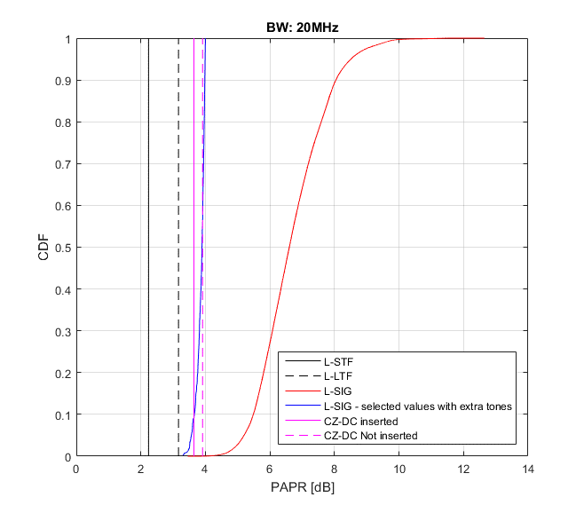
Overall PAPR over entire Wake-up packet
L-STF : 2.2394 dB
L-LTF : 3.1658 dB
L-SIG with predetermined extra tones
Extra tones could be +1, -1, +j, -j, 0
Given PPDU length, R is also selected 1 or 0 depending on Rate and Length field.
When there is no combination (Rate, Length, R) fit for PPDU length, overhead (4 or 8 bytes) could be considered.
A with PAPR equivalent or less than PAPR of L-SIG
Payload part
ZC sequence : u = 6 : 3.636 dB (DC inserted) and 3.911 dB (DC not inserted) where 6 ≤ k ≤ 6 from e.g. 1

Slide 17
Summary
This document has observed options to improve PAPR of each OFDM symbol for wake-up packet.

Slide 18
Reference
[1] 11-17/0964r4 Signal Bandwidth and Sequence for OOK Signal Generation
[2] 11-17/0084r0 High Level PHY design
[3] 11-17/0343r3 WUR Beacon
[4] 11-17/0647r4 WUR Legacy Preamble Design

Slide 19
Appendix

Slide 20
PAPR metric
99.9% PAPR
Oversample rate: 8
0.8 us GI considered as part of the OFDM symbol.

Slide 21
Overhead of WUR Beacon [3]
Assume 250 kbps
Payload (this is just an example)
MAC Header:
Packet Type: 4 bits
AP ID: 24 bits
Frame Body:
TSF: 24 bits
Other fields: TBD
Elements in the Current Beacon: Not applicable
FCS: 8 bits
Without TSF, the length is 144 us. With TSF, the length is 240 us.
264 + 4·α (where α bits for TBD and preamble part of wake-up packet

Slide 22
Examples for 4 extra tones
PPDU Length [us] | Rate | R | L-Length [Byte] | PAPR [dB] | Extra Tones
244 | 4 | 0 | 659 | 3.8640 | -1 | 1 | 1 | -1
244 | 1 | 1 | 248 | 3.8808 | -1 | -1 | -1 | -1
248 | 5 | 0 | 1016 | 3.7471 | 0 | -1 | 0 | 0
248 | 7 | 0 | 1527 | 3.9580 | 0 | 0 | -1 | 1
252 | 7 | 1 | 1556 | 3.9167 | -1 | -1 | -1 | 1
256 | 7 | 0 | 1584 | 3.7691 | -1 | 0 | 1 | 0
256 | 5 | 1 | 1053 | 3.8162 | 0 | 1 | 1 | 1
260 | 3 | 0 | 536 | 3.9143 | 1 | 0 | -1 | 0
260 | 4 | 1 | 708 | 3.9316 | 1 | 0 | 0 | 0
268 | 5 | 0 | 1105 | 3.9718 | -1 | -1 | -1 | -1
276 | 3 | 0 | 572 | 3.8527 | 0 | -1 | 0 | 1
276 | 3 | 1 | 564 | 3.8076 | 0 | 1 | 1 | -1
284 | 6 | 0 | 1560 | 3.5937 | 1 | -1 | 1 | 1
288 | 7 | 1 | 1779 | 3.7894 | -1 | 0 | -1 | -1
292 | 5 | 0 | 1220 | 3.5766 | 1 | 0 | -1 | -1
300 | 0 | 0 | 205 | 3.9182 | -1 | 1 | 0 | -1
300 | 6 | 1 | 1664 | 3.8944 | 0 | -1 | 1 | 1
300 | 7 | 1 | 1884 | 3.8784 | 0 | 1 | -1 | 1
308 | 0 | 0 | 212 | 3.9102 | -1 | -1 | 0 | 1
308 | 4 | 0 | 849 | 3.6020 | 1 | 1 | -1 | 0
308 | 1 | 1 | 317 | 3.5129 | 0 | 0 | 0 | 0
312 | 6 | 1 | 1742 | 3.8675 | -1 | 1 | -1 | 1
316 | 5 | 0 | 1316 | 3.8175 | -1 | 1 | -1 | 1
Extra tones on top of the predetermined contents in L-SIG provide lower PAPR ( < 4dB)

