Slide 1
Scheduling for mmWave Distribution Networks
Date: 2017-09-12
Name | Affiliation | Address | Phone | Email
Carlos Cordeiro | Intel |  |  | carlos.cordeiro@intel.com
George Cherian | Qualcomm |  |  | gcherian@qti.qualcomm.com
Oren Kedem | Intel |  |  | oren.kedem@intel.com
Solomon Trainin | Qualcomm |  |  | strainin@qti.qualcomm.com
Carlos Aldana | Intel |  |  | carlos.h.Aldana@intel.com

Slide 2
Outline
mmWave network [1] concepts review
  Network topology
  TDD timing
  Scheduling and assignment
Scheduling proposal
  Overall scheduling framework
  SP with TDD channel access
  TDD slot structure
  Bitmap assignment

Slide 3
Outline
mmWave network [1] concepts review
  Network topology
  TDD timing
  Scheduling and assignment
Scheduling proposal
  Overall scheduling framework
  SP with TDD channel access
  TDD slot structure
  Bitmap assignment

Slide 4
mmWave network [1] concepts
Network Topology
Network in [1][3] consists of two types of nodes
  DN (Distribution Node)
  CN (Client Node)
A DN sector may connect to up to 2 DNs and up to 256 CNs
A CN may connect to a single DN
For example:
CN0
CN2
DN0
DN1
CN1
CN3

Slide 5
mmWave network [1] concepts
TDD Timing
Time Periods | Typical Duration | Description
Slot | 66us | Unidirectional. Can be either TX slot or RX slot.
Frame | 400us | Consists of one transmit subframe and one receive subframe. Determines the granularity with which rate adaptation is run.
Superframe | 1.6ms | Events in a network are tied to superframes.
BWGD | 25.6ms | The schedule is determined for each slot over a BWGD period.
BWGD 0
BWGD 1
……
Superframe 0
Superframe 1
……
Superframe 15
Example
Frame 0
Frame 1
Frame 2
Frame 3
Slot 0
Slot 1
Slot 2
Slot 3
Slot 4
Slot 5
TX Slots
RX Slots

Slide 6
mmWave network [1] concepts
Scheduling and Assignment
A bitmap is used to indicate whether a node is scheduled in a TX or RX slot
The bitmap information is sent by each DN to its neighbor DNs and associated CNs in unicast messages like:
  Keepalive messages
  Association Response

Slide 7
Outline
mmWave network [1] concepts review
  Network topology
  TDD timing
  Scheduling and assignment
Scheduling proposal
  Overall scheduling framework
  SP with TDD channel access
  TDD slot structure
  Bitmap assignment

Slide 8
Scheduling proposal: design philosophy
This contribution proposes a scheduling structure for the mmWave network described in [1][3]
Goal is to build as much as possible on 11ad/ay scheduling, but introduce changes to accommodate new requirements.
The key design ideas are:
  Build on top of the existing 11ad/ay scheduling for backwards compatibility.
  Reduce scheduling overhead.

Slide 9
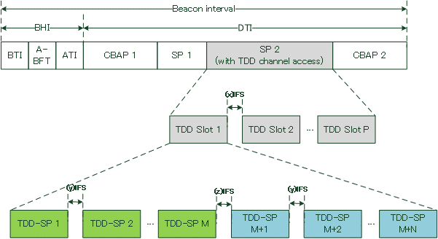
Scheduling proposal: overall scheduling structure (1/2)
AP (DN) scheduling
TDD slot scheduling
E.g., for TX
E.g., for RX
Terminology Mapping
This Presentation | Use case
TDD-SP | Slot (66us)
TDD Slot | Frame (400us)
SP with TDD channel access | Bandwidth grant (25.6ms)
Access assignment to STAs (CNs, DNs)

Slide 10
Scheduling proposal: overall scheduling structure (2/2)
The SP allocation, slot structure, and assignment of TDD-SPs to STAs change on a very different time scale.
  Therefore, we need to decouple the scheduling by defining different signaling.
We propose to address the scheduling in the following 3 levels:
  Use ESE to schedule SP allocation with TDD channel access. This part is included in broadcast messages like Beacon for coexistence with legacy devices.
  Define a new IE to describe the slot structure within the SP with TDD channel access. This part is included in unicast messages, but can also be included in broadcast messages for better coexistence with 11ad/ay devices.
  Define a new IE to address the access assignment between STAs and TDD-SPs. This part is included in unicast messages like Announce frame.

Slide 11
Scheduling proposal:
SP with TDD Channel Access (1/3)
Define a new type of SP with TDD channel access to be dedicated to mmWave distribution networks where the AP and STAs can communicate
  New type of SP allocation, scheduled by the legacy Extended Schedule element (ESE) and will have a unique indication bit so that it can be differentiated from the conventional SP.
  Propose to use 1 of the 4 reserved bits in the Allocation Control subfield in Extended Schedule element when the Allocation Type subfield is 00 (i.e., a SP allocation) to indicate the allocated SP is the new type dedicated to distribution of the mmWave network use case.
  In this new type of SP, TDD slot scheduling structure that is dedicated to addressing the distribution mmWave use case and the associated channel access rules are used.
Subfields | Allocation ID | Allocation Type | Pseudo-static | Truncatable | Extendable | PCP Active | LP SC Used | SP with TDD Channel Access | Reserved
Bits | 4 | 3 | 1 | 1 | 1 | 1 | 1 | 1 | 3
Proposed change to Extended Schedule element.

Slide 12
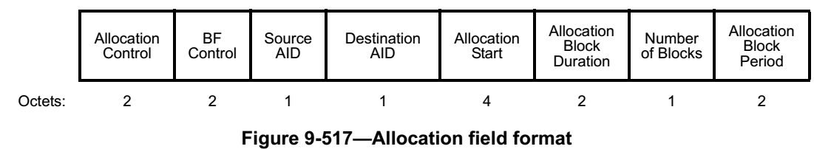
Scheduling proposal:
SP with TDD Channel Access (2/3)
The maximum allocation block duration for a SP is 32.767 ms
However, an AP may want to allocate up to the whole DTI (1024ms minus BTI) with one or more of this new type of SP
To solve this issue, we can use the Number of Blocks and Allocation Block Period subfields existent in the ESE
E.g., for the typical use case configuration, they can be set to:
  Allocation Block Duration = ~25.6ms
  Number of Blocks = ~39
  Allocation Block Period = ~25.6ms
(=0)
(=0)

Slide 13
Scheduling proposal:
SP with TDD Channel Access (3/3)
End result:
This approach:
  Incurs the lowest possible overhead, since it uses a single 15 octets Allocation field
  Is backwards compatible, i.e., can be understood by 11ad devices which then helps with coexistence, parsing, power saving, etc.
As for the guard time between allocations, it can be redefined if adjacent SPs have the SP with TDD Channel Access field equal to 1
  This won’t impact legacy devices.
Beacon interval = 1024ms
BTI
SP
(with TDD channel access)
SP
(with TDD channel access)
SP
(with TDD channel access)
…
SP
(with TDD channel access)
BTI
SP
(with TDD channel access)
…

Slide 14
Scheduling proposal: TDD slots
The new type of SP with TDD channel access consists of several identical TDD slots, each of which including consecutive TDD-SPs that are dedicated to transmissions with the STAs.
  The number of TDD-SPs in each TDD slot can be configured, as well as the duration of each specific TDD-SP.
Channel access within a TDD-SP is the same as the 11ad/11ay SP channel access.
Need to define a new TDD Slot Structure IE to describe the specific structure of each TDD slot

Slide 15
Scheduling proposal:
TDD Slot Structure IE (1/2)
TDD Slot Structure IE
  It is included in the Announce frame and can be included in the Beacon to address the slot scheduling structure.
    Including in the DMG Beacon is desirable for coexistence among 11ay devices and adds only ~6usec to the DMG Beacon time.
  The transmission of this IE is only applicable for an 11ay device and automatically indicates that the scheduling is for the new mmWave distribution network usage model.

Slide 16
Scheduling proposal: TDD Slot Structure IE (2/2)
Proposed TDD Slot Schedule Control field.
Subfields | Bits | Definition
Number of TDD-SPs per TDD Slot | 4 | Value denoted as M
IFS(Y) Duration | 4 | Duration of IFS Y in in usec
IFS(X-Y) Duration | 2 | Difference between IFS X and Y in usec
IFS(Z-Y) Duration | 2 | Difference between IFS Z and Y in usec
Allocation ID | 4 | ID from SP allocation
Allocation Block Duration Validity | 1 | 0 = Indicates unlimited across consecutive BIs if adjacent allocations have TDD-SP=1 1 = Indicates duration is same as the SP
Reserved | 7
Proposed TDD Slot Structure IE format.
Fields | Octets
Element ID | 1
Length | 1
Element ID Extension | 1
TDD Slot Schedule Control | 3
Allocation Block Duration | 2
TDD Slot Schedule | M
Proposed TDD Slot Schedule field format.
Subfields | Bits | Definition
TDD-SP 1 Duration | 8 | Duration of TDD-SP 1 in usec
…… | ……
TDD-SP M Duration | 8 | Duration of TDD-SP M in usec

Slide 17
Scheduling proposal:
example of DMG Beacon for Distributed Network
Set the type and duration, parsed by 11ad/11ay and intended for interoperability and coexistence
Set the TDD-SP structure and duration, parsed only by 11ay to extract the slot structure
Inclusion in beacon is optional
2 octets | 2 octets | 6 octets | 8 octets | 3 octets | 2 octets | 6 octets | 1 octet | 17 Octets | 10-24 Octets
Frame Control | Duration | BSSID | Time Stamp | Sector Sweep | Beacon Interval | Beacon Interval Control | DMG Parameters | Extended Schedule element | TDD Slot Structure element
4 octets
FCS
Present in all DMG Beacon frames
Type = SP
SP w TDD Cannel Access = 1
Source STA = Dest STA = 0
Allocation Block Duration = ~25.6ms
Number of Block = ~39
Allocation Block Period = ~25.6
# TDD-SPs = 6
Duration (all) = 66us
~6usec TX time
~6usec TX time

Slide 18
Scheduling proposal:
Access Assignment
The access protocol of TDD-SPs for the STAs behaves like a master-slave one.
  A STA is only allowed to communicate with the AP in a TDD-SP where it is assigned, which will be indicated by the access assignment.
In each assigned TDD-SP, the traffic is always in a single direction (TX or RX).
A new TDD Bitmap Schedule IE is defined to address this signaling (see next slide).

Slide 19
Scheduling proposal:
TDD Bitmap Schedule IE (1/2)
Define a new TDD Bitmap Schedule IE to indicate the access assignment along with the access type for a STA in the corresponding TDD-SP.
Assigning TDD-SP(s) to a STA is done by a unicast transmission to the STA
  Using a management frame (e.g., Announce frame)

Slide 20
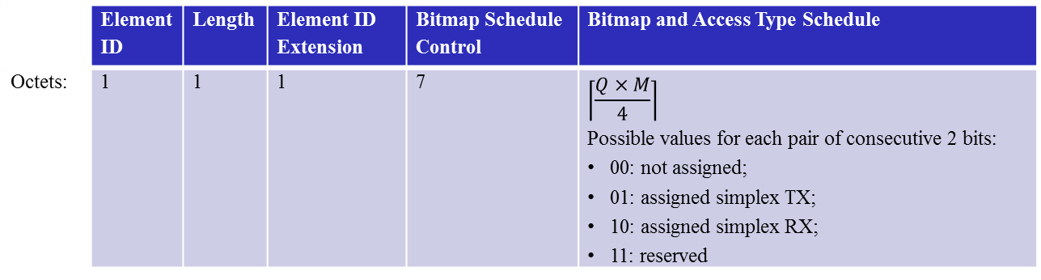
Scheduling proposal:
TDD Bitmap Schedule IE (2/2)
 | Element ID | Length | Element ID Extension | Bitmap Schedule Control | Bitmap and Access Type Schedule
Octets: | 1 | 1 | 1 | 7 | $$\left\lceil \frac{Q×M}{4}\right\rceil$$ Possible values for each pair of consecutive 2 bits: 00: not assigned; 01: assigned simplex TX; 10: assigned simplex RX; 11: reserved
 | Channel Aggregation | BW | TDD Slot Start Time | Number of TDD Slots in the Bitmap | Allocation ID | Reserved
Bits: | 1 | 8 | 32 | 10 (value denoted as Q) | 4 | 1
The TDD Slot Start Time subfield indicates the lower order 4 octets of the TSF timer at the start of the first effective TDD Slot for such bitmap to take effect.
The Number of TDD Slots in the Bitmap subfield indicates the number of TDD Slots in the Bitmap following the TDD Slot Start Time.

Slide 21
Example of the bitmap schedule
Consider an example where a DN sends the TDD Bitmap Schedule IE to 3 associated CNs.
CN1
CN0
DN
CN2
 | TDD-SP 1 (TX) | TDD-SP 2 (TX) | TDD-SP 3 (TX) | TDD-SP 4 (RX) | TDD-SP 5 (RX) | TDD-SP 6 (RX)
Access type and Assignment | DN→CN0 Simplex | DN→CN1 Simplex | DN→CN2 Simplex | CN0→DN Simplex | CN0→DN Simplex | CN2→DN Simplex
Bitmap in the IE from DN to CN0 | 10 | 00 | 00 | 01 | 01 | 00
Bitmap in the IE from DN to CN1 | 00 | 10 | 00 | 00 | 00 | 00
Bitmap in the IE from DN to CN2 | 00 | 00 | 10 | 00 | 00 | 01

Slide 22
Conclusions
This contribution proposes a scheduling framework to address the requirements described in [1]
  Use ESE to schedule SP allocations with TDD channel access.
  Define a new TDD Slot Structure IE to describe the structure of the SP with TDD channel access.
  Define a new TDD Bitmap Schedule IE to address the access assignment within the SP.
Benefits of the proposal
  Minimal changes to spec by reusing the existing SP concept.
  Backward compatible with 11ad/ay by using ESE for the allocation of SP with TDD channel access.
  Low scheduling overhead.

Slide 23
References
[1] IEEE 802.11-17/1019r2 “mmWave Mesh Network Usage Model”
[2] IEEE 802.11ay D0.5
[3] IEEE 802.11-17/1321r0 “Features for mmW Distribution Network Use Case”

Slide 24
Straw poll
Do you agree with the general scheduling approach proposed in this presentation to address the mmWave distribution network use case [1]?
  Yes
  No
  Abstain

