Slide 1
CToA Protocol Analysis
Date: 2017-09-10

Slide 2
Abstract
This presentation analyzes two aspects of the CToA protocol:
  Positioning accuracy:
    Theoretical measurement model error analysis
    Geometric-theoretical error analysis
    Performance in presence of biased measurements
  Unmanaged operation of the CToA network:
    Requires no scheduling protocol (either among bSTAs or clients RX/TX) .

Slide 3
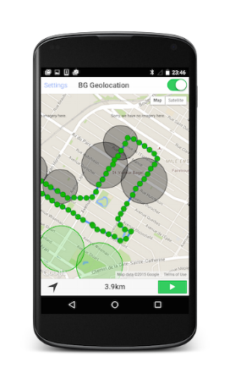
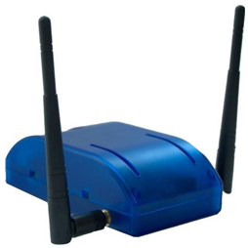


Recap: CToA Network Entities
CToA Broadcasting Station = bSTA
CToA client Station = cSTA
TAG
TX (broadcast) + RX of measurement messages
Asynchronous
RX – only
TX – only
(broadcast, asynchronous)

Slide 4
COMPARATIVE POSITIONING ACCURACY analysis

Slide 5
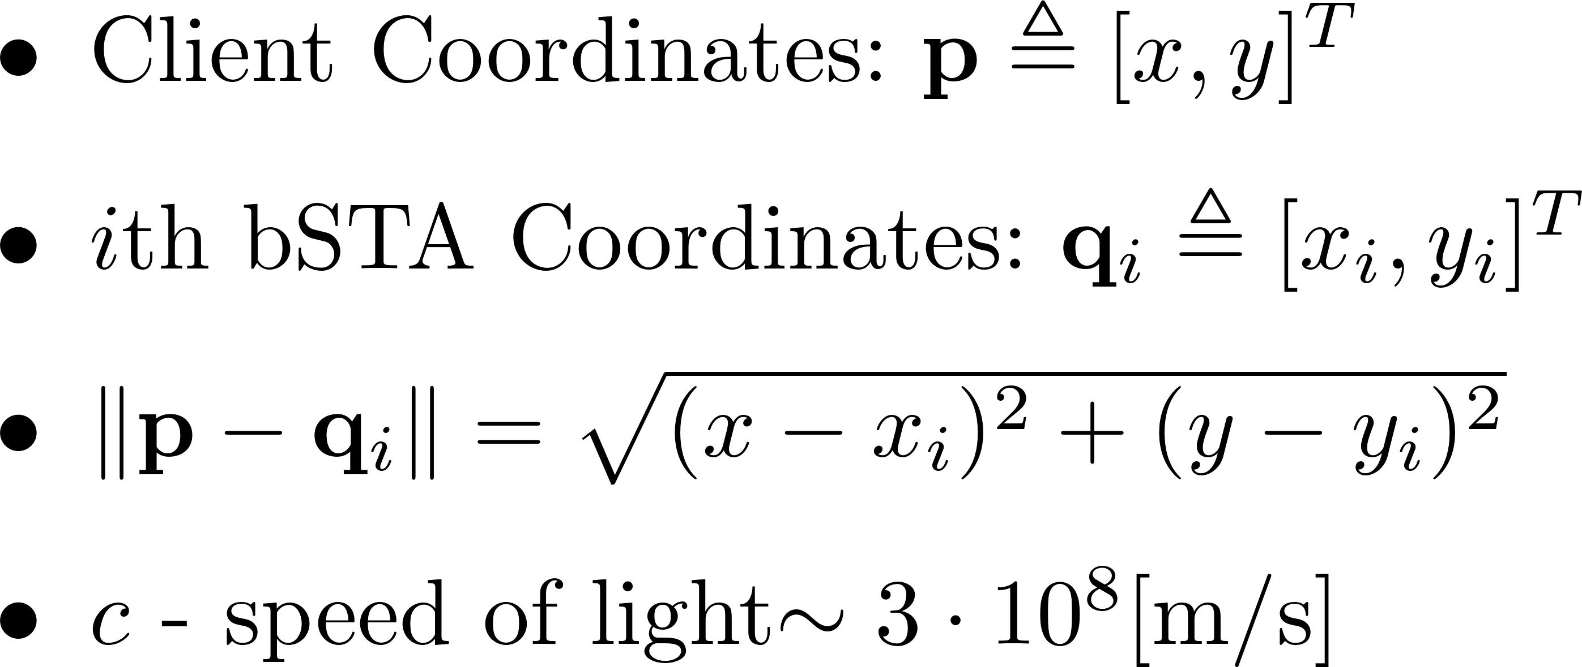
Comparative Performance Analysis
Theoretical measurement model error analysis
Geometric-theoretical error analysis
Performance in presence of biased measurements
Most of the details are presented in [1]
Notation:

Slide 6
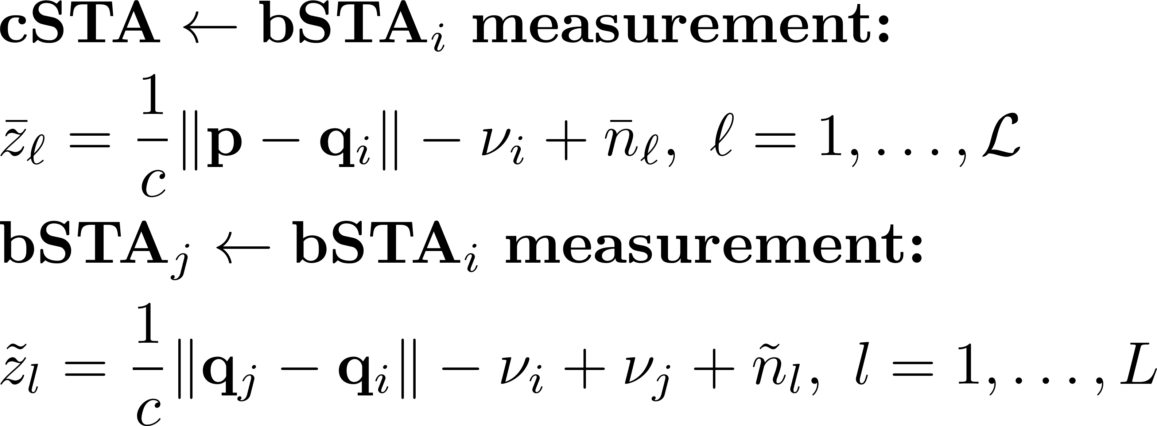
CToA Measurements Model
To obtain a “1st Fix” the cSTA has to jointly solve the position and clock offsets vector.

Slide 7
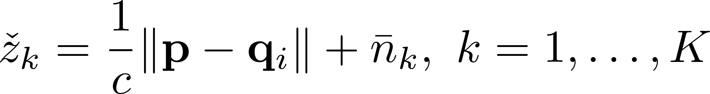
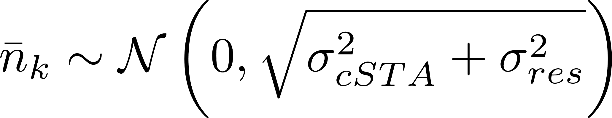

CToA with Kalman Filter Converged
With KF converged, all the clock offsets are known up to a residual estimation error:
The noise level associated with the measurement may be modeled as:
  denotes the std of the KF’s residual estimation error of the clock offsets
CToA accuracy in this mode is trilateration/RTT-like geometry equivalent.

Slide 8
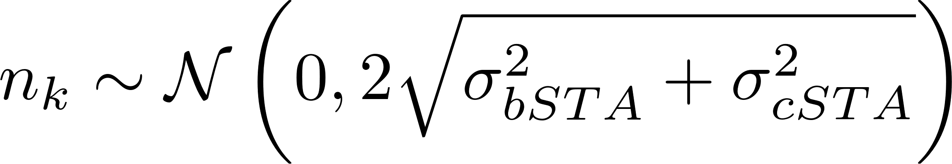
RDToA
The observed time difference measurement is defined as [2]:
The noise level associated with the measurement may be modeled as:
Multilateration (hyperbolic) geometry

Slide 9
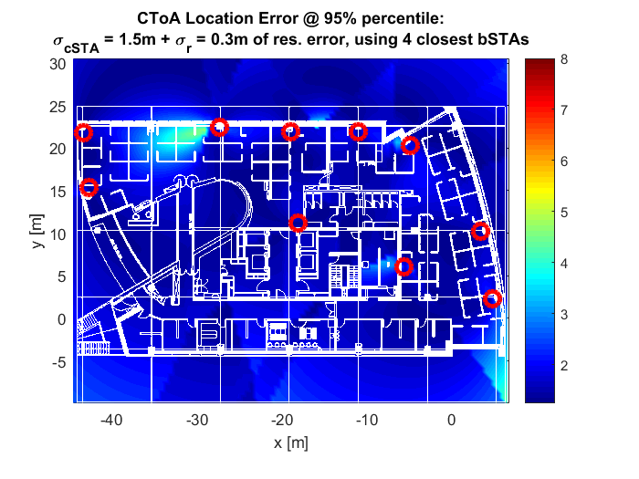
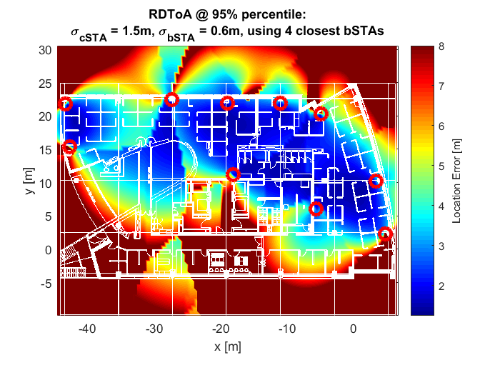
Geometric-Theoretical
Positioning Accuracy in an Indoor Environment
“Heat-map” depicts 95% positioning errors evaluated using theoretical 2D error-covariance (evaluated using Cramér Rao lower bound /CRLB).
Method details can be found in [1]

Slide 10
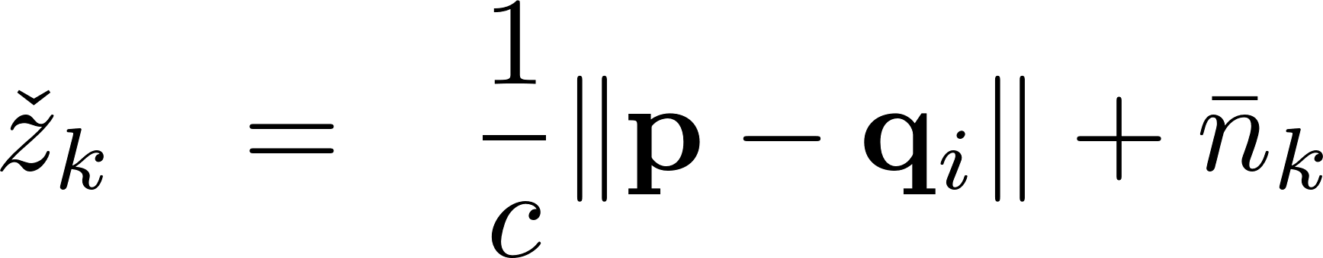
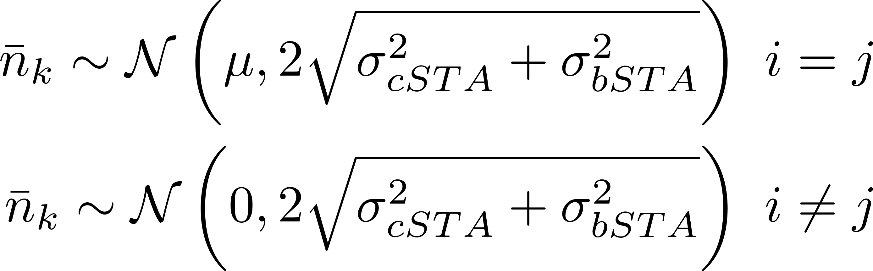
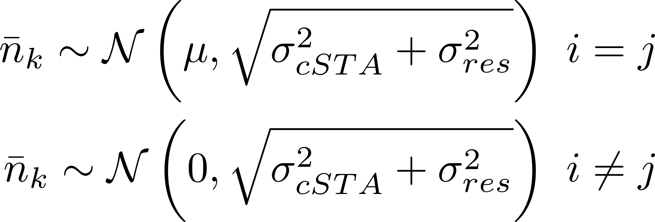
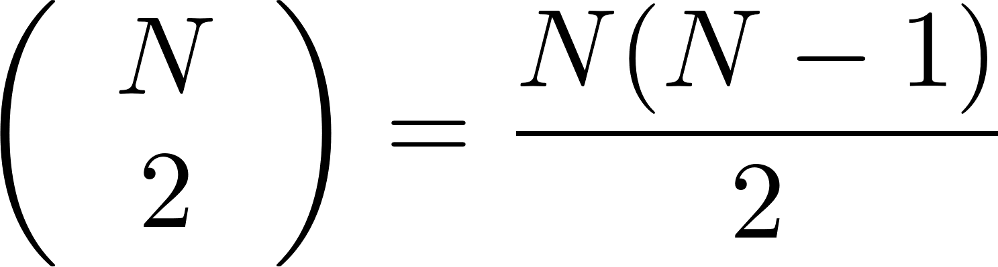
Positioning Accuracy with Biased Measurements
For a given network of N bSTAs, RDToA can measure up to:
non-recurring, differential ranges.
Assuming there are N bSTAs, then while with CToA only 1 measurement becomes biased, with RDToA (N-1) measurements are affected.
  Namely, all the differential range measurements involving the “biased” bSTA.

Slide 11
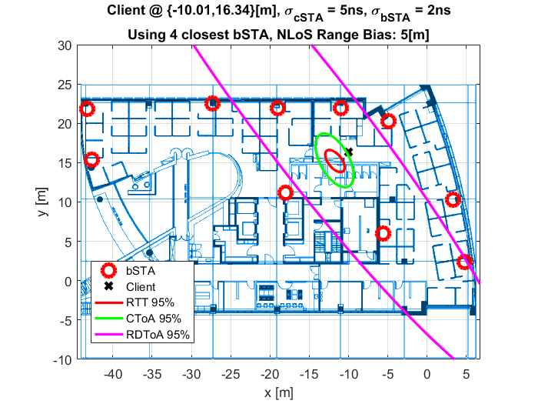
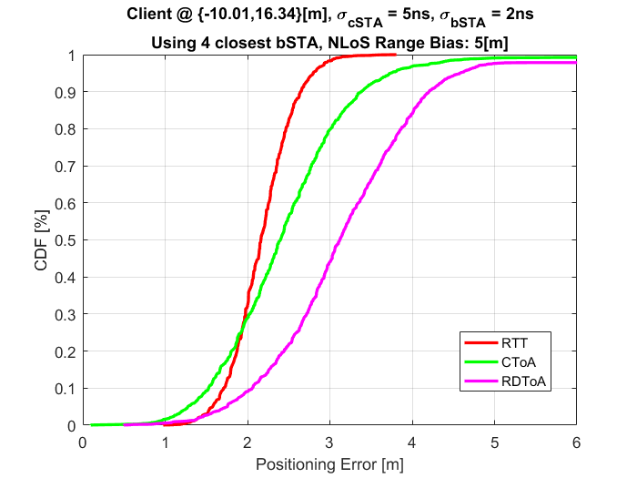
Positioning Accuracy with Biased Measurements – cont’d
Client estimates position using 4 closet bSTA
Client has NLoS with 1 bSTA => measurement bias (5m NLoS bias)

Slide 12
CToA
Unmanaged Operation

Slide 13
General Assumptions for CToA Network
In worst-case scenario the bSTA may be implemented as a standard 802.11 AP
  Each AP has a “native” channel – used for data exchange with associated STAs.
    Need to be always available, and if not, announce it in advance.
  Optionally, bSTAs act as dedicated “FTM responder-like” STAs.
CToA RX events are asynchronous
Every bSTA broadcasts measurement messages @ 3-5Hz
Each bSTA is assumed to first scan the medium to detect prior CToA broadcast activity.

Slide 14
Potential Protocol:
“RX Collection of CToA Measurement Messages”
The AP learns the periodicity of CToA measurement messages broadcast by other AP/bSTAs.
The AP announces to its associated STAs on a “non-availability” period
The AP switches to neighbor bSTA channels and receives (“collects”) their CToA measurement messages.
Since the bSTAs are asynchronous, the AP may need to switch many times every second => high overhead and low availability on its native channel.

Slide 15
The Solution: “TX Sweep”
Instead of running “RX collection” use a “TX distribution” approach:
  “Bundle” all off-channel transactions into a single, contiguous window in time.
    Less than 1ms out of a 200ms CToA meas. messages broadcast interval (@5Hz)
  Off-channel activity is independently scheduled by each AP.
  Enables the AP to announce its off-channel timing at low frequency (3-5Hz or even lower).

Slide 16
Off-Channel Timing Optimization
bSTA TX CToA meas. messages on every active channel, RX CToA meas. messages only on its native channel
The bSTA broadcasts two types of CToA measurements messages:
  “Short” (only w/ ToD, w/o LMR) are broadcast on every channel, other than “native AP channel”
    Enables neighbor bSTAs to measure ToA
  “Long” (w/ ToD & LMR) only on “native AP channel”
    LMR is only relevant for the cSTAs to estimate their position.
  bSTA listens for neighbor bSTA broadcasts (and regular uplink traffic) on its native channel.
If a particular channel is busy, it may be skipped for the current window, and attempted again next time.
A cSTA collecting CToA meas. messages should be able to collect LMR from all bSTAs within ~200-330ms (depending on the broadcast rate).

Slide 17
bSTA “TX Sweep”
2 bSTAs broadcast

Slide 18
General Assumptions for CToA Client NW-Centric (E.g., Asset Tracking)
bSTA protocol in NW-centric mode is identical to client-centric
  Enables bSTA to concurrently support client-centric & NW-centric applications
Client may be unassociated with any AP.
Client broadcasting protocol is similar to bSTA broadcast protocol
Provided that the client (e-Tag):
  Broadcasts the ToD of its meas. messages.
  Broadcasts meas. messages frequently enough (according to its XTAL stability) – e.g. @ 3-5Hz.
Then, each individual meas. message is captured by a different bSTA at a different time, and yet the positioning server would still be able to estimate the e-Tag’s position.
  No scheduling between the bSTAs is required.
TX-sweep duty cycle depends on application requirements.
  Could vary from seconds to minutes (or more).
A CToA e-Tag is like a “mobile” bSTA
(just never broadcasting LMR)
TAG

Slide 19
CToA Client/eTag in NW-Centric Mode –
TX Sweep
TAG

Slide 20
SUMMARY & conclusions

Slide 21
Conclusions
Theoretical and practical performance of CToA is similar to RTT:
  Once KF is converged, clock offsets are known up to a residual error
CToA is more robust to biased measurements than RDToA.
CToA can be implemented over an unmanaged, asynchronous network of bSTAs, which may be implemented as part of a standard 802.11 AP.
  No scheduling protocol between bSTAs is required.
  Similar scheme is used for both client and NW-mode, where clients operating in NW-mode act like “mobile bSTA”.

Slide 22
References
[1] IEEE 802.11-17-1387R0 CToA Whitepaper
[2] IEEE 802.11-2016 – Annex P.3

Slide 23
Thank you for your attention!

Slide 24
BACKUP SLIDES

Slide 25
802.11az NDPA Data –
Event Log Mandatory Data
The table contains logging of events (TX or RX) from the past X seconds.
ToD / ToA field includes a 48bit counter of the measured ToD/ToA time-stamp in [ps]
  Format similar to REVmc FTM
  Ensures a low-rate wrap-around (once every 281.47s)
Per each transmitted packet:
  Packet ID (PID)
  NDP time of departure (ToD)
  TX MAC (own MAC)
Per each received packet:
  Packet ID (PID)
  NDP time of arrival (ToA)
  NDP time of departure (ToD)
  TX MAC
  RX MAC (own MAC)
bSTA event log:
PID | (TX or RX) MAC | ToD / ToA
{16 bit} | {48 bit} | {48 bit}

Slide 26
CToA MAC-Level Overhead Analysis
Parameter | Value
#bSTA RX direct "A" | 4
#Neighbor bSTA published "N" | 0
[Broadcasts/sec] per bSTA "B" | 3
Event log window [sec] "W" | 1
ToD entries (self broadcast) "M1" | 3
ToA + ToD entries (RX direct) "M2" | 24
#Entries in event log table (#measurements) | 27
Data per broadcast [Kbit] "D" | 5.3
Data rate consumed per bSTA [Kbit/s] | 16.0
An event log table entry = 1 measurement
#Entries in event log table: M1+M2
  M1 = (N+1)*W*B
  M2= A*(N+1)*W*B
Data per broadcast: D = (M1*112bit+M2*208bit)/1000 [Kbit]
Data rate consumed per bSTA = D*B
 | PID | TX/RX MAC | ToD / ToA | Total
ToD -only | 16 bit | 48 bit | 48 bit | 112 bit
ToD+ToA | 16 bit | 2*48 bit | 2*48 bit | 208 bit

Slide 27
CToA PHY Level Overhead
Parameter | Duration | Repetitions | Total
NDPA | 188µs* | 1 | 188µs*
SIFS | 16µs | 1 | 16µs
L-STF | 8µs | 2 | 16µs
L-LTF | 8µs | 2 | 16µs
L-SIG | 4µs | 2 | 8µs
VHT-SIG-A | 8µs | 1 | 8µs
VHT-STF | 4µs | 1 | 4µs
VHT-LTF | 4µs | 4⁺ | 16µs
Total |  |  | 272µs
* Assuming 40MHz/117 subcarriers, BSPK modulation, incl. 168bit of fixed NDPA overhead
⁺ N_{tx} = 4
NDPA Frame format
NDP Frame format

