Slide 1
Collaborative Time of Arrival (CToA)
Date: 2017-09-10

Slide 2
Presentation Outline
What is CToA?
The CToA Basics
Position estimation using CToA
CToA Simulation Performance
Summary & Conclusions

Slide 3
WHAT IS CToA?

Slide 4
What is Collaborative Time of Arrival (CToA)?
Scalable geolocation method that leverages on Wi-Fi fine timing measurement (FTM) capabilities.
Two concurrent modes of operation:
  Client mode – “GPS-like”, client self positioning
    Unlimited number of clients, navigating indoors/outdoors simultaneously.
    Client only receives => ensures client privacy
    Client initiated, centric & terminated.
  Network mode – large scale asset tracking, analytics
    Server can track a large number of clients simultaneously
      limited only by the server’s computational capacity
    Client only transmits sporadically to enable the NW to estimate its position
    Designed for “thin client” (e.g. smart tag/e-Tag) => low power, minimal HW resources
    Network initiated, centric & terminated

Slide 5
What is Collaborative Time of Arrival (CToA)? – cont’d
Broadcast-based transmission of timing measurement messages.
  No retransmissions => robust, simple interop.
An unmanaged network => no scheduling protocol is required.
Designed to work with units with cheap/low-quality crystal oscillators (XO)
The material included in this presentation is also described in a whitepaper available online

Slide 6
THE CTOA basics

Slide 7
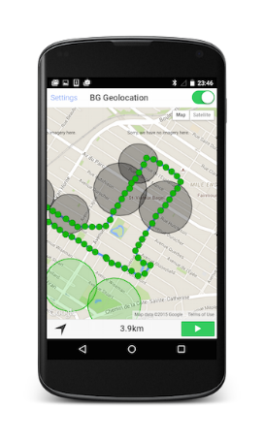
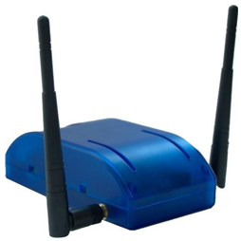
CToA Network Entities
Client-Mode
CToA Broadcasting Station = bSTA
TX + RX of meas. messages
CToA client Station = cSTA
RX – only of meas. messages

Slide 8
CToA bSTA Operation Principles
Each bSTA is an independent, network detached unit.
  Could also be implemented as part of a standard 802.11 AP.
The bSTAs are unsynchronized.
Each bSTA periodically broadcasts CToA measurement message, and measures and announces the ToD of that message.
Each bSTA receives the CToA measurement message transmitted by its neighbor bSTA and measures the ToA of that message.
Each bSTA publishes its ToA & ToD measurements of its neighbor bSTAs measurement messages.

Slide 9
CToA cSTA Operation Principles
CToA cSTA – only receive, and do not need to transmit
Similar to bSTA, each cSTA listens to the measurement messages and measures their ToA.
The cSTA collects the ToA & ToD measured & published by the bSTAs.
The cSTA uses all the information to calculate its own position.

Slide 10
CToA Proposed Protocol
CToA measurement message reuses the VHTz NDPA-SIFS--NDP sequence.
  Similar to SU ranging frame format, only without the response
Frames supported by legacy 802.11ac/VHT STAs.
Notes:
LCI = location configuration information
NDPA is used for announcing on NDP arrival, payload is used for ToD, LMR and LCI.
NDP is used for ToA estimation.

Slide 11
CToA Messaging Sequence:
Client-Mode

Slide 12


CToA Network Entities
Network-Centric Mode
TAG
CToA Broadcasting Station = bSTA
TX + RX of meas. messages
cSTA/e-Tag
TX – only of meas. messages

Slide 13
CToA cSTA/e-Tag Operation Principles
Simple 802.11 STA:
  Low cost; low computation and memory requirements.
  Power-conscious device; minimized OTA activity.
  Supports only a limited subset of waveforms and frame formats (e.g., NDPA, NDP, discovery frames).
Transmissions are infrequent
  Large variance in client position refresh rate (second/s to minutes)
Only broadcasts CToA measurement messages (incl. ToD)
  Does not need to receive bSTA (or other) broadcasts
  Does not need to make any timing measurements

Slide 14
CToA Messaging Sequence:
Network-Mode

Slide 15
CLIENT Position estimation
USING CToA

Slide 16
The Data a cSTA Needs for
Estimating its Location
  For every CToA message broadcast by bSTA#n there is:
    1 × ToD
    Up to (M-1) × ToA by bSTA
    Up to 1 × ToA by cSTA
  The bSTA LCI is broadcast periodically by the bSTA
  The cSTA collects multiple sets of broadcast timing measurements (1 × ToD & M × ToA)
    Each measurement is provided in local timing of either bSTA or cSTA.
  Using this data the cSTA estimates its position

Slide 17
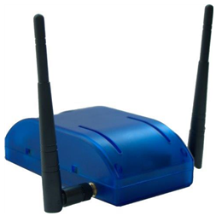

CToA Protocol Example
bSTA#1
MAC 10:01
bSTA#3
MAC 10:03
bSTA#2
MAC 10:02
cSTA
MAC 55:55
Notes:
Network of unsynchronized bSTAs, placed at locations known to clients.

Slide 18
CToA Protocol Example
PID = Packet ID
TXMAC = MAC address of the transmitter
RXMAC = MAC address of the receiver
ToD = Time of Departure (transmission)
ToA = Time of Arrival (reception)
PID | TXMAC | ToD | RXMAC | ToA
bSTA#1
MAC 10:01
PID | TXMAC | ToD | RXMAC | ToA
bSTA#3
MAC 10:03
bSTA#2
MAC 10:02
PID | TXMAC | ToD | RXMAC | ToA
cSTA
MAC 55:55
PID | TXMAC | ToD | RXMAC | ToA
Notes:
The protocol is based on timing measurements of broadcast transmissions.
The measurements are logged in tables independently managed by each unit.

Slide 19
CToA Broadcast from bSTA#1
PID | TXMAC | ToD | RXMAC | ToA
1551 | 10:01 | 199678
bSTA#1
MAC 10:01
bSTA#3
MAC 10:03
bSTA#2
MAC 10:02
cSTA
MAC 55:55

Slide 20
CToA Broadcast from bSTA#1
bSTA#1
MAC 10:01
PID | TXMAC | ToD | RXMAC | ToA
1551 | 10:01 | 199678 | 10:02 | 329673
bSTA#3
MAC 10:03
bSTA#2
MAC 10:02
PID | TXMAC | ToD | RXMAC | ToA
1551 | 10:01 | 199678 | 10:03 | 341006
cSTA
MAC 55:55
PID | TXMAC | ToD | RXMAC | ToA
1551 | 10:01 | 199678 | 55:55 | 128679

Slide 21
CToA Broadcast from bSTA#2
bSTA#1
MAC 10:01
PID | TXMAC | ToD | RXMAC | ToA
2322 | 10:02 | 392609
1551 | 10:01 | 199678 | 10:02 | 329673
bSTA#3
MAC 10:03
bSTA#2
MAC 10:02
cSTA
MAC 55:55

Slide 22
CToA Broadcast from bSTA#2
PID | TXMAC | ToD | RXMAC | ToA
2322 | 10:02 | 392609 | 10:01 | 243455
1551 | 10:01 | 199678
bSTA#1
MAC 10:01
bSTA#3
MAC 10:03
bSTA#2
MAC 10:02
cSTA
MAC 55:55
PID | TXMAC | ToD | RXMAC | ToA
2322 | 10:02 | 392609 | 55:55 | 175670
1551 | 10:01 | 199678 | 10:02 | 329673
1551 | 10:01 | 199678 | 55:55 | 128679

Slide 23
CToA Broadcast from bSTA#3
bSTA#1
MAC 10:01
bSTA#3
MAC 10:03
bSTA#2
MAC 10:02
PID | TXMAC | ToD | RXMAC | ToA
3356 | 10:03 | 426709
1551 | 10:01 | 199678 | 10:03 | 341006
cSTA
MAC 55:55

Slide 24
CToA Broadcast from bSTA#3
PID | TXMAC | ToD | RXMAC | ToA
3356 | 10:03 | 426709 | 10:01 | 310478
2322 | 10:02 | 392609 | 10:01 | 243455
1551 | 10:01 | 199678
bSTA#1
MAC 10:01
bSTA#3
MAC 10:03
bSTA#2
MAC 10:02
cSTA
MAC 55:55
PID | TXMAC | ToD | RXMAC | ToA
3356 | 10:03 | 426709 | 55:55 | 210998
1551 | 10:01 | 199678 | 10:03 | 341006
2322 | 10:02 | 392609 | 55:55 | 175670
1551 | 10:01 | 199678 | 10:02 | 329673
1551 | 10:01 | 199678 | 55:55 | 128679

Slide 25
CToA Broadcast from bSTA#1
PID | TXMAC | ToD | RXMAC | ToA
1552 | 10:01 | 332566
3356 | 10:03 | 426709 | 10:01 | 310478
2322 | 10:02 | 392609 | 10:01 | 243455
1551 | 10:01 | 199678
bSTA#1
MAC 10:01
bSTA#3
MAC 10:03
bSTA#2
MAC 10:02
cSTA
MAC 55:55

Slide 26
CToA Broadcast from bSTA#1
bSTA#1
MAC 10:01
PID | TXMAC | ToD | RXMAC | ToA
1552 | 10:01 | 332566 | 10:02 | 439578
2322 | 10:02 | 392609
1551 | 10:01 | 199678 | 10:02 | 329673
bSTA#3
MAC 10:03
bSTA#2
MAC 10:02
PID | TXMAC | ToD | RXMAC | ToA
1552 | 10:01 | 332566 | 10:03 | 341006
3356 | 10:03 | 426709
1551 | 10:01 | 199678 | 10:03 | 341006
cSTA
MAC 55:55
PID | TXMAC | ToD | RXMAC | ToA
1552 | 10:01 | 332566 | 55:55 | 266578
3356 | 10:03 | 426709 | 10:01 | 310478
2322 | 10:02 | 392609 | 10:01 | 243455
3356 | 10:03 | 426709 | 55:55 | 210998
1551 | 10:01 | 199678 | 10:03 | 341006
2322 | 10:02 | 392609 | 55:55 | 175670
1551 | 10:01 | 199678 | 10:02 | 329673
1551 | 10:01 | 199678 | 55:55 | 128679

Slide 27
How Does the cSTA Solves it Position?
5 unknown parameters: x, y, ν₁, ν₂, ν₃ (clock offsets)
bSTA#1
MAC 10:01
bSTA#3
MAC 10:03
bSTA#2
MAC 10:02
indirect measurements:
Dependent on: ν₁, ν₂, ν₃
cSTA direct measurements:
Dependent on: x, y, ν₁, ν₂, ν₃
cSTA
MAC 55:55
PID | TXMAC | ToD | RXMAC | ToA
1552 | 10:01 | 332566 | 55:55 | 266578
3356 | 10:03 | 426709 | 10:01 | 310478
2322 | 10:02 | 392609 | 10:01 | 243455
3356 | 10:03 | 426709 | 55:55 | 210998
1551 | 10:01 | 199678 | 10:03 | 341006
2322 | 10:02 | 392609 | 55:55 | 175670
1551 | 10:01 | 199678 | 10:02 | 329673
1551 | 10:01 | 199678 | 55:55 | 128679
PID | TXMAC | ToD | RXMAC | ToA
1552 | 10:01 | 332566 | 55:55 | 266578
3356 | 10:03 | 426709 | 10:01 | 310478
2322 | 10:02 | 392609 | 10:01 | 243455
3356 | 10:03 | 426709 | 55:55 | 210998
1551 | 10:01 | 199678 | 10:03 | 341006
2322 | 10:02 | 392609 | 55:55 | 175670
1551 | 10:01 | 199678 | 10:02 | 329673
1551 | 10:01 | 199678 | 55:55 | 128679

Slide 28
Ideal Case:
No Clock Drift between Measurements (1)
Assuming there is no clock drift between measurements, then the cSTA may estimate its position via trilateration.
The following derivation is a GNSS-like solution, with the distinction that for M bSTAs there are M unknown clock offsets
  In GNSS, as the entire network is synchronized, there is only 1 unknown clock offset.
We shall assume a simplistic, noise (error)-free case of 3 bSTA and 1 cSTA.

Slide 29
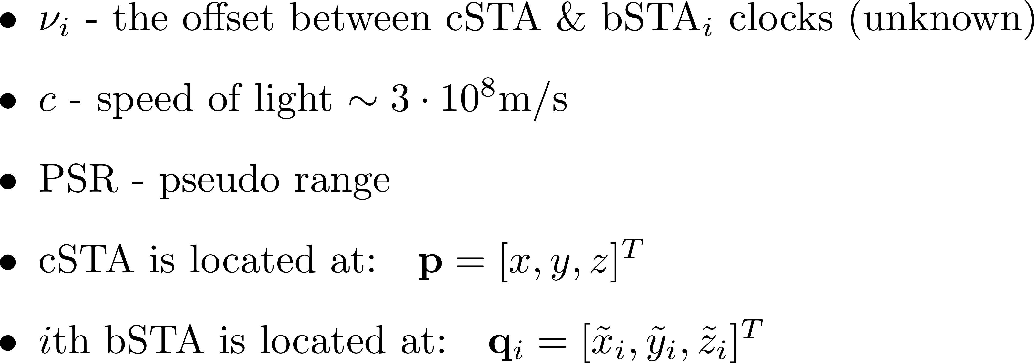
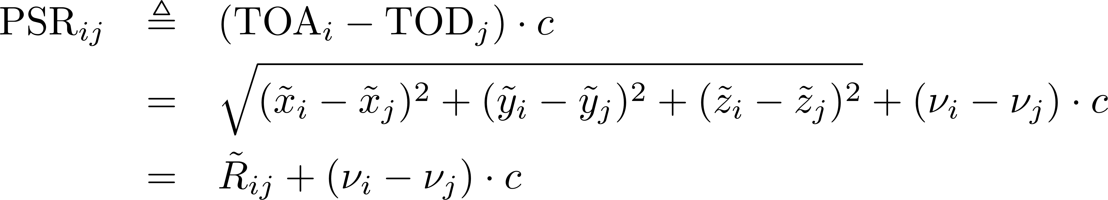
Ideal Case:
No Clock Drift between Measurements (2)
Notes:
The solution to the position coordinates is embedded in a set of nonlinear equations.
This can be solved either via grid-search methods (see ref. [1]), or via gradient search methods – as described in the following example.

Slide 30
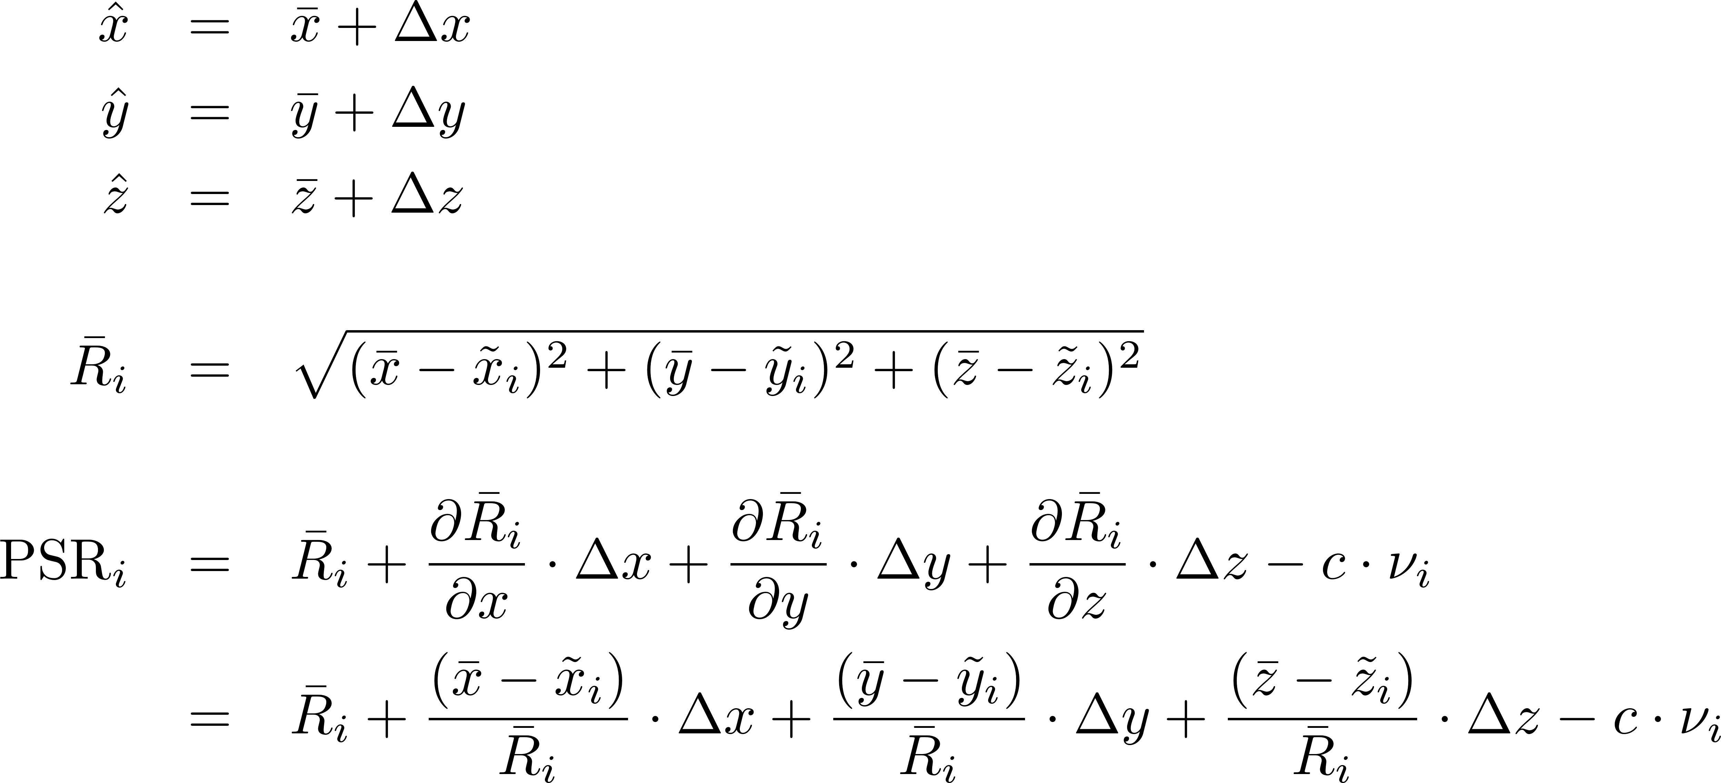
Ideal Case:
No Clock Drift between Measurements (3)

Slide 31
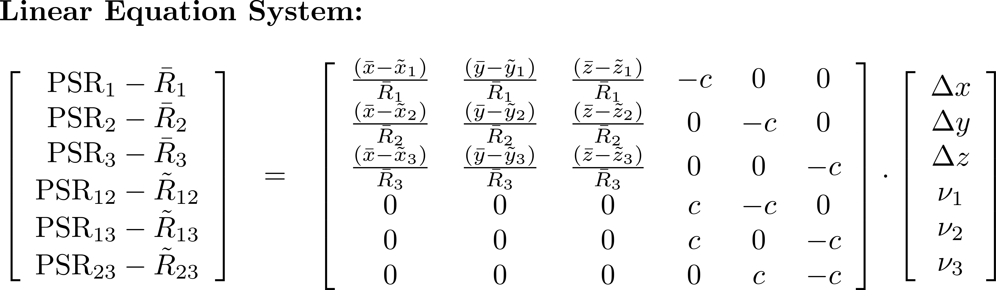
Ideal Case:
No Clock Drift between Measurements (4)
Notes:
Obviously, if there are more measurements (equations) than unknowns, the solution is obtained via LS.

Slide 32
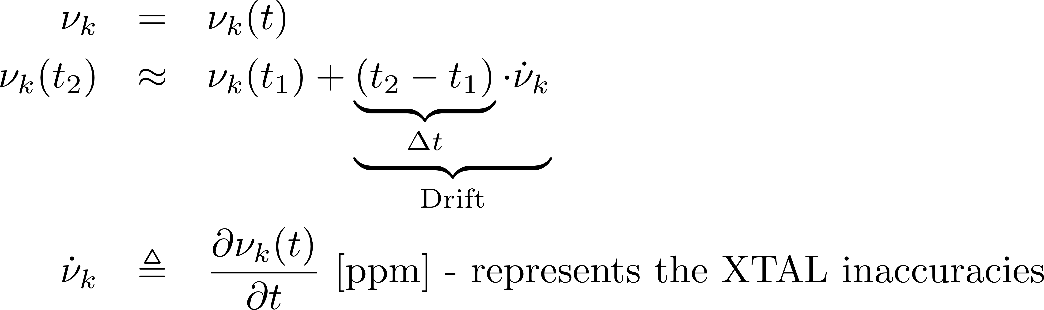
The Reality: Coping with Clock Drifts
In practice, since bSTAs use cheap XTALs, it should be assumed that there is substantial clock drift between the measurement events:
Clock drift of 1ppm translates to into a timing error of 1ns every 1ms.
  Two CToA meas. messages, which were transmitted by the same bSTA, 3ms apart, will introduce an accumulated error of 1m, or ~1500m if 25ppm XOs are used and messages are broadcast @ 5Hz periodicity!
To solve this, the cSTA also tracks the clock drift of each bSTA using a Kalman Filter (KF).
Typically, 2-3 broadcasts/sec per bSTA are sufficient in XO-based platforms for tracking the clock drifts.

Slide 33
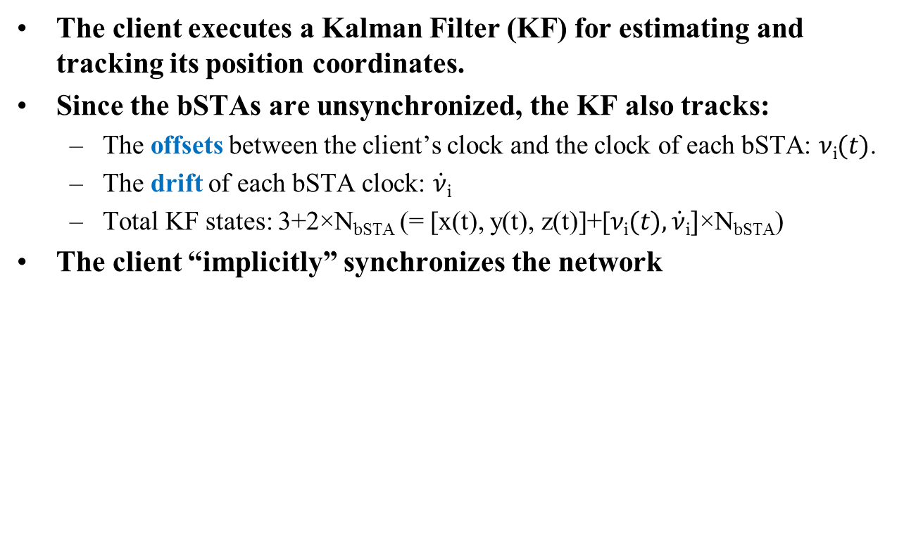
Client Position Estimation
The client executes a Kalman Filter (KF) for estimating and tracking its position coordinates.
Since the bSTAs are unsynchronized, the KF also tracks:
  The offsets between the client’s clock and the clock of each bSTA: $ν$_{i}$(t)$.
  The drift of each bSTA clock: $\dot{ν}$_{i}
  Total KF states: 3+2×N_{bSTA} (= [x(t), y(t), z(t)]+[$ν\text{i}(t),\dot{ν}\text{i}]$×N_{bSTA})
The client “implicitly” synchronizes the network

Slide 34
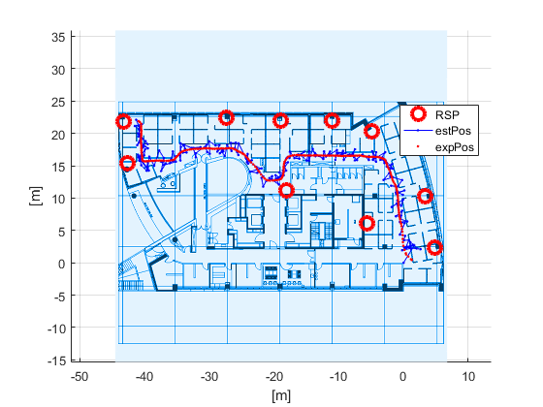
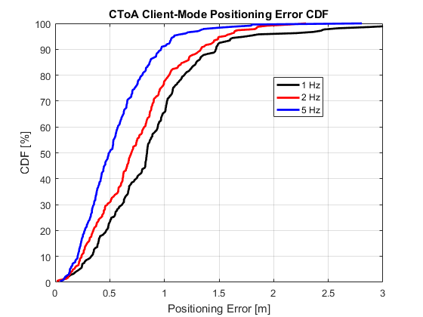
CToA – System Performance Example
Typical floor office
95%
bSTA
Est.
Act.
~1.0m
Simulation is based on skewed-clock generation (no channel model is assumed)
  Clocks were generated with an accuracy of ±10ppm with Gaussian-distributed clock noise with zero mean and standard deviation of 1e-9 (1 ppb)
Real trajectory estimated using light detection and ranging (LIDAR) system.

Slide 35
SUMMARY & conclusions

Slide 36
Summary & Conclusions
Two concurrent modes of operation:
  Client mode – “GPS-like”, client self positioning
    Unlimited number of clients
    Maintains clients’ privacy
  Network mode – large scale asset tracking, analytics
    Simple 802.11 STA-based e-Tag clients
Based on broadcasting of timing measurement messages.
  No retransmissions => robust, simple interop.
Designed to work with units with cheap/low-quality crystal oscillators (XO)
Accuracy is equivalent to REVmc-based FTM.

Slide 37
References
IEEE 802.11-17-1387R0 CToA Whitepaper

Slide 38
Thank you for your attention!

