Slide 1
AANI SC Agenda 24 August 2017 Teleconference
Date: 2017-08-24
Authors:

Slide 2
Abstract
Agenda for:
802.11 AANI SC (Advanced Access Network Interface Standing Committee)
August 24 2017
Teleconference
Chair: Joseph Levy (InterDigital)
Vice Chair: Roger Marks (EthAirNet Associates)

Slide 3
Reminders and Rules
Call for Secretary
Reminders to attendees:
Please send an e-mail to the Chair, Vice Chair, and/or Secretary (joseph.levy@interdigital.com, r.b.marks@ieee.org) to register your attendance
Please mute when not speaking
No recordings
AANI SC Operating Rules:
Anyone present can vote, present, and make comments

Slide 4
Agenda
Call for Secretary
Administrative: Reminders, Rules, Agenda, Guidelines, Resources, Participation, Announcements
Background/Status
Continue Discussion on: 11-17/1242r0 – “Strategies to Maximize Adoption of 802.11 in 5G Networks”, Chuck Lukaszewski (Aruba, a HPE Company) – which was presented at last week’s teleconference
Future Sessions Planning

Slide 5
Guidelines for IEEE-SA Meetings
All IEEE-SA standards meetings shall be conducted in compliance with all applicable laws, including antitrust and competition laws.
Don’t discuss the interpretation, validity, or essentiality of patents/patent claims.
Don’t discuss specific license rates, terms, or conditions.
Relative costs, including licensing costs of essential patent claims, of different technical approaches may be discussed in standards development meetings.
Technical considerations remain primary focus
Don’t discuss or engage in the fixing of product prices, allocation of customers, or division of sales markets.
Don’t discuss the status or substance of ongoing or threatened litigation.
Don’t be silent if inappropriate topics are discussed… do formally object.
---------------------------------------------------------------
If you have questions, contact the IEEE-SA Standards Board Patent Committee Administrator at patcom@ieee.org or visit http://standards.ieee.org/about/sasb/patcom/index.html
See IEEE-SA Standards Board Operations Manual, clause 5.3.10 and “Promoting Competition and Innovation: What You Need to Know about the IEEE Standards Association's Antitrust and Competition Policy” for more details.
This slide set is available at https://development.standards.ieee.org/myproject/Public/mytools/mob/slideset.ppt

Slide 6
Resources – URLs
Link to IEEE Disclosure of Affiliation
http://standards.ieee.org/faqs/affiliationFAQ.html
Links to IEEE Antitrust Guidelines
http://standards.ieee.org/resources/antitrust-guidelines.pdf
Link to IEEE Code of Ethics
http://www.ieee.org/web/membership/ethics/code_ethics.html
Link to IEEE Patent Policy
http://standards.ieee.org/board/pat/pat-slideset.ppt
Notes:
September 2012

Slide 7
Participation in IEEE 802 Meetings
Participation in any IEEE 802 meeting (Sponsor, Sponsor subgroup, Working Group, Working Group subgroup, etc.) is on an individual basis
Participants in the IEEE standards development individual process shall act based on their qualifications and experience. (https://standards.ieee.org/develop/policies/bylaws/sb_bylaws.pdf section 5.2.1)
IEEE 802 Working Group membership is by individual; “Working Group members shall participate in the consensus process in a manner consistent with their professional expert opinion as individuals, and not as organizational representatives”. (subclause 4.2.1 “Establishment”, of the IEEE 802 LMSC Working Group Policies and Procedures)
Participants have an obligation to act and vote as an individual and not under the direction of any other individual or group. A Participant’s obligation to act and vote as an individual applies in all cases, regardless of any external commitments, agreements, contracts, or orders.
Participants shall not direct the actions or votes of any other member of an IEEE 802 Working Group or retaliate against any other member for their actions or votes within IEEE 802 Working Group meetings, see https://standards.ieee.org/develop/policies/bylaws/sb_bylaws.pdf section 5.2.1.3 and the IEEE 802 LMSC Working Group Policies and Procedures, subclause 3.4.1 “Chair”, list item x.
By participating in IEEE 802 meetings, you accept these requirements. If you do not agree to these policies then you shall not participate.
(Latest revision of IEEE 802 LMSC Working Group Policies and Procedures: http://www.ieee802.org/devdocs.shtml)

Slide 8
AANI SC Background
At the July 802 Plenary meeting in San Diego 802.11 passed a motion to form this standing committee [11-16/1057r1]
Liaison Statements Sent:
802.11 sent an LS (11-16/1101r10) to 3GPP RAN and SA (9/16)
802.11 sent an LS (11-16-/510r2) to 3GPP RAN2 (1/17)
802.11 sent an LS (11-16/1573r3) to 3GPP RAN (1/17)
802.11 sent an LS (11-17-0378r2) to 3GPP RAN2 (5/17)
802.11 sent an LS (11-16/1574r3) to 3GPP SA (5/17)
Liaison Statements Received:
3GPP RAN2 WG sent an LS (11-17/0315r0) (3/17)
3GPP RAN TSG sent an LS (11-17/0444r0) (3/17)
3GPP SA TSG sent an LS (11-17/0903r0) (6/17)

Slide 9
AANI Status – Related to 3GPP SA
Incoming LS from 3GPP SA TSG (11-17/0903r0):
“Reply LS to IEEE 802.11 Requesting Status and Information on WLAN integration in 3GPP NextGen System”
Sent by 3GPP SA in reply to our LS (11-16/1574r3) to 3GPP SA (5/17):
“IEEE 802.11 Working Group Liaison Statement Requesting status and technical information on WLAN integration in 3GPP NextGen System.”
Contributions regarding the ongoing 3GPP work:
11-17/1064r0 – “Overview of 3GPP SA Next Generation System Documents Related to Non-3GPP Access to the 5G Core Network

Slide 10
Review of Teleconferences
July 27, 9am EDT - Canceled
August 3, 9am EDT - Canceled
August 10 , 9am EDT - Canceled
August 17 - 12:00 noon EDT – Completed - minutes 11-17/1257r1
August 24, 9am EDT - Today
August 31, 9am EDT
September 7, 9am EDT

Slide 11
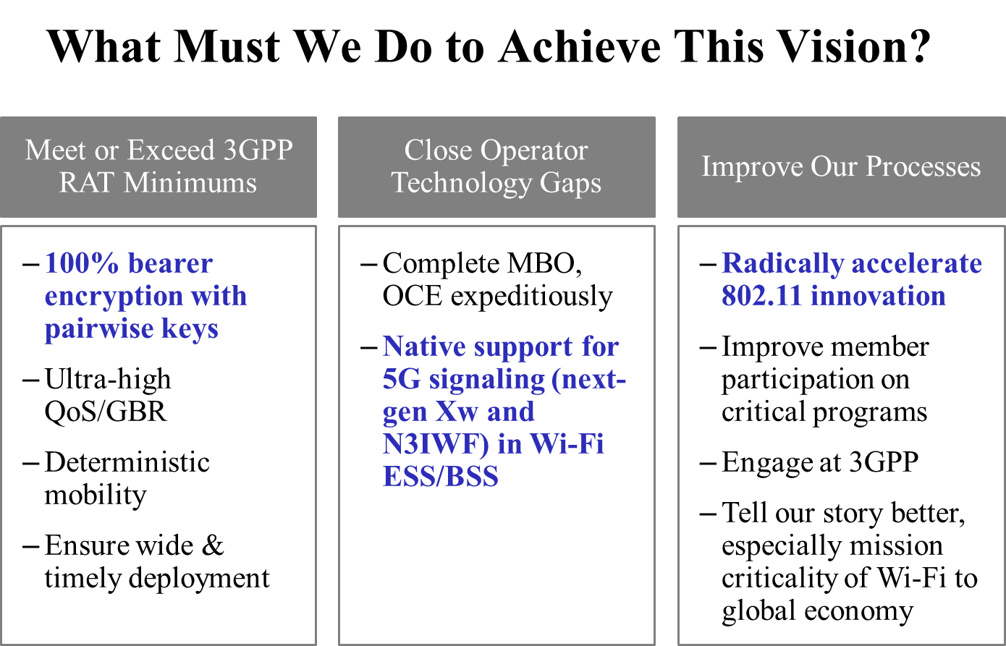
Continue Discussion on 11-17/1242r0
11-17/1242r0 - Strategies to Maximize Adoption of 802.11 in 5G Networks, Chuck Lukaszewski (Aruba, a HPE Company)
For Discussion:
Will 802.11 capabilities meet 3GPP RAT minimums?
Does security need improvement?
Are additional QoS/GBR capabilities needed?
Are controlled/predictable hand-overs needed (mobility)?
Are there Operator technology gaps?
Should we look in to speeding up the 802.11 process?
Slide 15 from 11-17/1242r0

Slide 12
Future Sessions Planning
Teleconference:
August 31, 9am EDT - Contributions?
September 7, 9am EDT - Contributions?
Topics for discussion/contribution:
NEND IC activity
3GPP Interworking
10-15 September 2017 F2F, Waikoloa Village, Kona, HI, USA - Goals:
Contributions on SA/802.11 interworking: 2G/3G/4G
Contributions on SA/802.11 or RAN/802.11 interworking or related 5G/nextGen
Continue discussions on NEND IC and report of NEND IC activity.
Generate a 802.11 contribution(s) for NEND IC activity
Meeting time: 2 sessions - Monday PM1 and Thursday AM2

Slide 13
References
A guide/summary of the AANI SC activity and documents can be found on the ieee.802.org: http://www.ieee802.org/11/Reports/aani_update.htm
All AANI SC documents are available on Mentor: https://mentor.ieee.org/802.11/documents?is_dcn=DCN%2C%20Title%2C%20Author%20or%20Affiliation&is_group=AANI

