Slide 1
Scalable Location Protocol
Date: 2017-08-30
Authors:

Slide 2
Summary
In this presentation we are outlining a practical realization of transmissions between anchor stations such as to enable a client station to calculate its location while only listening to these transmissions.
We realizing this localization method by to the maximum extent reusing ranging functionality anyways being standardized for 802.11az such as to minimize the extra functionality required to realize scalable location.

Slide 3
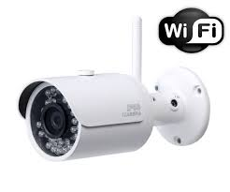
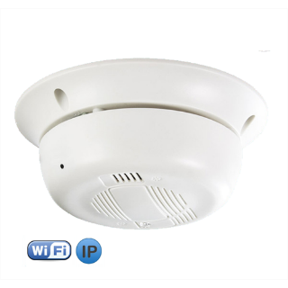


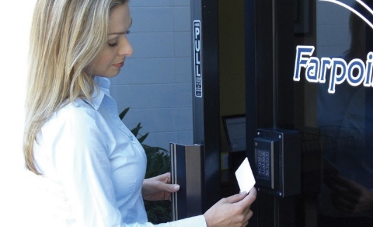
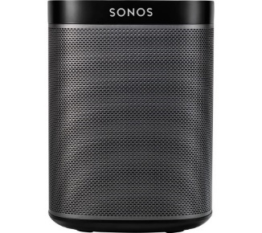
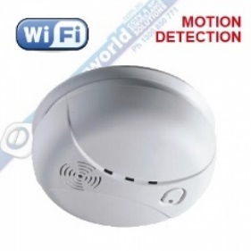


Fixed Wi-Fi Devices
Any venue is likely to contain a large number of fixed Wi-Fi devices. We can use these devices to facilitate scalable location.

Slide 4
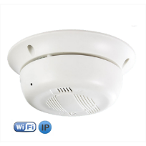

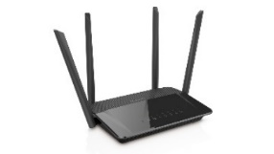

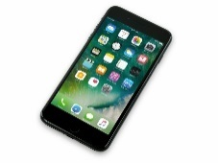

Client Centric Scalable Location
Example Scenario
Anchor Client
Anchor Client
Client to be located
Access Point
Anchor Client
Access Point

Slide 5
Example Frame Exchange Protocol

Slide 6
Reuse Ranging Protocol
Reuse ranging protocol
Can use SU or MU ranging
MU ranging has the inherit benefit of being scheduled
  Facilitates clients listening to transmissions
  No need to add new protocol for the scheduling of the ranging

Slide 7
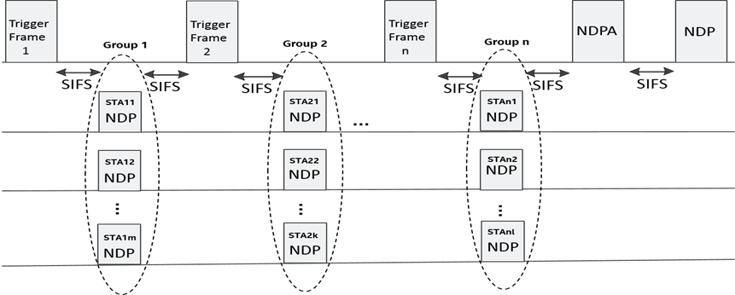
TGaz SFD UL MU Ranging Sounding

Slide 8
MU ranging with Extra Frame Exchanges
Green arrows – Regular ranging frame exchanges
Trigger
Frame
Trigger
Frame
Trigger
Frame
NDPA
NDP
AP Station
Anchor Client
NDP
Anchor Client
NDP
Anchor Client
NDP
Note: No new transmissions or protocol required. It is simply up the anchor stations to listen to the NDP transmissions, calculate their TOA and report them.
Blue arrows – Extra ranging exchanges

Slide 9
MU Ranging Operation
Green arrows - Already planned exchanges in a single MU ranging operation
Anchor
Client
Anchor
Client
AP
Blue arrows – More possible exchanges in a single MU ranging operation
Anchor
Client
In one shot we can communicate with all other STAs!

Slide 10
Example Protocol with MU Ranging
Access point
Anchor Client 1
Anchor Client 2
Negotiation and assignment to periodic measurement interval
iFTM request
iFTM (response)
MU Poll
MU Poll Response
MU Poll Response
Unencrypted measurement in periodic measurement interval
Trigger Frame
UL NDP
UL NDP
DL NDPA
DL NDP
Unencrypted measurement feedback
AP Meas. Feedback
Unencrypted reverse measurement feedback - Proposed optional
AS Meas. Feedback
AS Meas. Feedback

Slide 11
Client Location Calculation

Slide 12
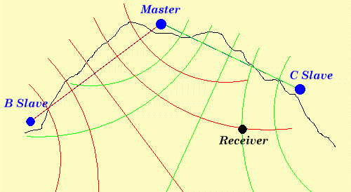
TDOA - Hyperbolic Navigation
Recap from [3]:
Source: http://asadahmedansari6395.blogspot.ca/2016_04_01_archive.html

Slide 13
Propagation paths and time stamps
Recap from [3]:
Illustrating timing diagram showing double sided feedback of time-stamps:
Anchor Client
Client
to be located
AP
UL MU NDP
t1
t2
t5
t3
DL NDP
t4
‘AP to STA feedback’
t2, t3
t6
t1, t4
‘STA to AP feedback’
- optional

Slide 14
Double-Sided Differential Distance Calculation
Recap from [3]:
The client listens to the exchanges between the AP and the anchor client and records the time t5 when it receives the UL MU NDP from the fixed client and the time t6 when it receives the DL NDP from the AP.
The client also listens to the relayed t2 and t3 from the AP and the relayed t1 and t4 in the feedback from the anchor client.
The differential distance between the client and the AP vs. the anchor client can now be calculated as follows:
  D_01 = [t6 – t5 – (t3 – t2 + T_12)] * c
  Using T_01 = [(t4 – t1) – (t3 – t2)]/2
  We get D_01 = [t6 – t5 – (t3 – t2 + 0.5*t4 – 0.5*t1 – 0.5*t3 + 0.5*t2)]*c
  Or finally:
Note that the above expression for the differential distance D_12 does not depend on the ToF, T_12, between the AP and the anchor client. Thus this method of calculating D_12 is insensitive to LOS obstructions between the AP and the anchor client.
D_12 = [t6 – t5 – 0.5*t3 + 0.5*t2 – 0.5*t4 + 0.5*t1]*c
Or just use single sided differential distance calculation [3].

Slide 15
Differential Distance Location Estimation Calculations
In two dimensions with three anchors:
R_{ij}
Unknowns:
Client coordinates x₀,y₀
2 unknowns
Anchor 1
Anchor 2
t₁
DTOF₁₂ = t6 – t5 – 0.5*t3 + 0.5*t2 – 0.5*t4 + 0.5*t1
t₂
t₄
t₃
Client
(x₀,y₀)
t₅
t₆
Equations:
Differential ToF equations
  DToF₁₂ = (R₀₁-R₀₂)/c
  DToF₁₃ = (R₀₁-R₀₃)/c
  DToF₂₃ = (R₀₂-R₀₃)/c
3 equations, non-linear
R₀₂(x₀,y₀)
See Appendix A for how to solve for location!
Anchor 3
(x₃,y₃)

Slide 16
Client Listening

Slide 17
Client Listening
Client listens to ranging exchanges
AP announcement of the ranging schedule can facilitate the clients listening
  Knows when and where to listen

Slide 18
Ranging Schedule

Slide 19
Schedule Content
Recap from [3]:
Two levels of schedule complexity:
  AP conveys scalable ranging operations in its own channel
  AP conveys scalable ranging operations also for neighboring APs channels
Content:
  Times of ranging
  Ranging format parameters (e.g. number of antennas)
  Anchor Clients LCI information
Additional content for neighboring APs operations:
  BSS channels and bandwidths
  Clock mappings

Slide 20
Schedule Conveying
For example:
  Periodically broadcast in an APs beacons
  Counter in every beacon to count down to presence schedule

Slide 21
Protocol to Add

Slide 22
Protocol Aspects to Add
Bit in iFTM request indicating desire for unencrypted ranging and is willingness to share LCI
Protocol for periodic announcement of scalable location ranging schedule
Optional:
  Bit in iFTM request indicating desire for double sided ranging measurement feedback
    And the extra frames for the reverse ranging measurement feedback
    This double sided feedback also have uses other than for scalable location
  ToA feedback from extra listening opportunities in MU ranging
Only limited additions needed!

Slide 23
Conclusions

Slide 24
Conclusions
Any venue is likely to contain a large number of fixed Wi-Fi clients
Can use such ‘Anchor Clients’ to enable scalable location
Use regular ranging protocol to provide time-stamped transmissions to use for client location
Minimal additions required to protocol for regular ranging

Slide 25
Appendix A:
Calculation of Client Location

Slide 26
TDOA - Hyperbolic Navigation
Source: http://asadahmedansari6395.blogspot.ca/2016_04_01_archive.html

Slide 27
Propagation paths and time stamps
Illustrating timing diagram showing double sided feedback of time-stamps:
Anchor Client
Client
to be located
AP
UL MU NDP
t1
t2
t5
t3
DL NDP
t4
‘AP to STA feedback’
t2, t3
t6
t1, t4
‘STA to AP feedback’
- optional

Slide 28
Double-Sided Differential Distance Calculation
The client listens to the exchanges between the AP and the anchor client and records the time t5 when it receives the UL MU NDP from the fixed client and the time t6 when it receives the DL NDP from the AP.
The client also listens to the relayed t2 and t3 from the AP and the relayed t1 and t4 in the feedback from the anchor client.
The differential distance between the client and the AP vs. the anchor client can now be calculated as follows:
  D_01 = [t6 – t5 – (t3 – t2 + T_12)] * c
  Using T_01 = [(t4 – t1) – (t3 – t2)]/2
  We get D_01 = [t6 – t5 – (t3 – t2 + 0.5*t4 – 0.5*t1 – 0.5*t3 + 0.5*t2)]*c
  Or finally:
Note that the above expression for the differential distance D_12 does not depend on the ToF, T_12, between the AP and the anchor client. Thus this method of calculating D_12 is insensitive to LOS obstructions between the AP and the anchor client.
D_12 = [t6 – t5 – 0.5*t3 + 0.5*t2 – 0.5*t4 + 0.5*t1]*c
Or just use single sided differential distance calculation [3].

Slide 29
Differential Distance Location Estimation Calculations
In two dimensions with three anchors:
R_{ij}
Unknowns:
Client coordinates x₀,y₀
2 unknowns
Anchor 1
Anchor 2
t₁
DTOF₁₂ = t6 – t5 – 0.5*t3 + 0.5*t2 – 0.5*t4 + 0.5*t1
t₂
t₄
t₃
Client
(x₀,y₀)
t₅
t₆
Equations:
Differential ToF equations
  DToF₁₂ = (R₀₁-R₀₂)/c
  DToF₁₃ = (R₀₁-R₀₃)/c
  DToF₂₃ = (R₀₂-R₀₃)/c
3 equations, non-linear
R₀₂(x₀,y₀)
Solve for location, e.g. with Newton iterations – described in following slides.
Anchor 3
(x₃,y₃)

Slide 30
Newton’s method for solving non-linear equation
Solve equation:
x
x₁
x₃
x₂
etc.

Slide 31
Solving of non-linear system of equations
Non linear system of equations:
- solve for x*
Use Newton’s method for multiple variables:
Linearization:
where
Over-determined non-linear system of equation to solve for Δx:
Least squares solution for iterative step:
Iterate according to:

Slide 32
Our derivatives
To simplify the equations, measure time in light seconds - the distance light travels in one second.

Slide 33
Iterative solution for client position (x₀,y₀)
Step calculation. LS solution to:
Note: Time in units of light seconds
Iterations:

Slide 34
References
[1] “Client Positioning using Timing Measurements between Access Points”, Erik Lindskog, Naveen Kakani, Raja Banerjea, Jim Lansford and Jon Rosdahl, IEEE 802.11-13/0072r1.
[2] “A Low Overhead Receive Only Wi-Fi Based Location Mechanism”, Erik Lindskog, Hong Wan, Raja Banerjea, Naveen Kakani and Dave Huntingford, Proceedings of the 27th International Technical Meeting of The Satellite Division of the Institute of Navigation (ION GNSS+ 2014), Tampa, Florida, September 2014, pp. 1661-1668.
[3] “Passive Location”, Erik Lindskog, Naveen Kakani and Ali Raissinia, IEEE 802.11-17/0417r0.

Slide 35
Thank You!

