Slide 1
1st Vice Chair Report - Sept 2017 - Waikoloa
Date: 2017-09-11
Authors:

Slide 2
Abstract
Agenda Items for 1st Vice Chair -
M3.3 II Other WG meeting plans
M3.4 II Meeting room locations
M3.5 II Next meeting reminder
M3.6 II Meeting registration
M3.7 II Recording attendance
M3.8 II File server
M3.9 II Breakfast, breaks, Social logistics
Friday:
F3.1.1 II Straw Poll of membership regarding this meeting location
F3.1.2 DT Future venues status and discussion

Slide 3
Monday– 802.11 Opening Plenary
802.11 First Vice Chair Report

Slide 4
M3.3 Other WG meeting plans
802.11 802.15 802.16 802.18 802.19 802.21 802.24
Treasurer Report: 11-17/1265r0
Patent policy (in IEEE-SA bylaws), patent policy (slide set), and antitrust guidelines

Slide 5
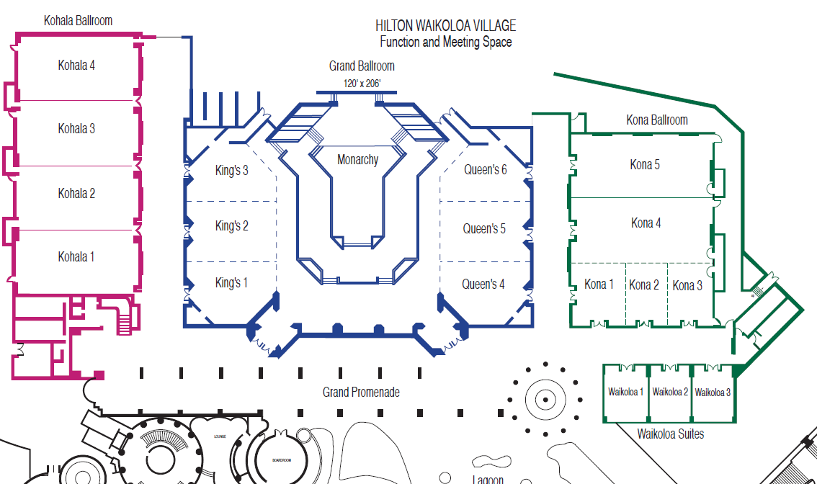
M3.4 Meeting Room Locations

Slide 6
Online Calendar Schedule
The WG meetings can also be added to your calendar.
Go to : http://schedule.802world.com
Select Calendar Integration:
http://schedule.802world.com/ics/directory
This application exports meetings in .ics format, which can be subscribed to from your favorite calendar application.
802.11 WG meeting calendar is here: http://schedule.802world.com/ics/show?group=11
Other WGs and the 802 EC calendar are also available.
Note: the schedule on this calendar will be updated as will IMAT.

Slide 7
M3.5 Next meeting reminder
802 Plenary: 5-10 November 2017 –
Caribe Hotel and Convention Center, Orlando, Florida
802 Wireless Interim: 14-19 January 2018
Hotel Irvine, Irvine, CA, USA

Slide 8
M3.6 II Meeting registration
Primary Working Group
Total Registration: 273 100%
802.11 217 79%
802.15 40 15%
802.16 1 0%
802.18 3 1%
802.19 6 2%
802.21 6 2%
802.22 Not meeting this week
802.24 0 0%
As of 9 Sept 2017

Slide 9
M3.7 Recording attendance
It is a requirement that attendees record their participation at an 802.11 session and declare their affiliation. This record is usually made using the IMAT attendance system.
If you wish to participate without recording attendance, send an email per session to the WG 2nd vice chair declaring your participation and affiliation. You cannot gain or maintain 802.11 voting membership using this method.
You must record 75% attendance of required 802.11 slots in a session for that session to count towards gaining or maintaining 802.11 voting membership
You need a single IEEE-SA web account
The IEEE SA web account requires a working email address
do not remove your email address from the account
Use the email address associated with that web account when registering attendance
If you change email addresses, update the web account, don’t create a new web account, or your membership status may not be calculated properly
Record attendance using this URL: IMAT.IEEE.ORG/

Slide 10
M3.8 Local File Document Server information
WORKING GROUP DOCUMENTS Local Repository Accessed online at http://ieee802.linespeed.io/
Obtain Document Number and posting of documents: https://mentor.ieee.org/802.11/documents

Slide 11
Network Assistance
Linespeed Events Network Information Page:
http://ieee802.linespeed.io/
NETWORK HELP DESK
Network Help is available for attendees experiencing difficulties accessing the meeting network.
WIRED CAFÉ
Please report any disruption of service in the café to Linespeed staff.
Located in the Grand Promenade north of the Registration Desk

Slide 12
M3.10 FOOD & BEVERAGE
Breakfast 07:15 to 08:30
Morning Coffee/Tea 10:00 to 11:00
Lunch Service 12:00 to 13:30
Afternoon Coffee/Tea/Snacks 15:00 to 16:00
Served at Lagoon Lanai
For Registered Attendees Only

Slide 13
M3.9 II Social Event
Registered attendees and their guests are invited to attend a casual networking reception at the Lagoon Lanai.
Wednesday 13 Sept 2017
6:30 pm - 8:30 pm
Tickets are not required.
Please wear your name badge
Pick-up Guest badges at Registration Desk.
Hosted Bar for first hour

Slide 14
802.11 Mid-Week Plenary
Agenda Items:
2.5 – Announcements
5.1 – Room Change Reports

Slide 15
2.5 II Announcements
Reminder about Social Tonight
at Lagoon Lanai
Wednesday 13 Sept 2017
6:30 pm - 8:30 pm
Tickets are not required.
Please wear your name badge
Pick-up Guest badges at Registration Desk.
Hosted Bar for first hour

Slide 16
W5.1 Room Change Requests
Cancel:
Add:

Slide 17
802.11 WG Closing Plenary
Agenda Items:
3.1.1 – Straw Poll
3.1.2 -- Future venues status and discussion

Slide 18
F3.1.1 -Straw Poll regarding this meeting location
Straw Poll:
How many people would like to come back to this venue?
Yes -
No –
Like the Social –
Disliked the Social –
Did not go to Social –

Slide 19
F3.1.2: Future Venue Insight
Future 802 Wireless Interims:
Jan 2018 Hotel Irvine, Irvine, CA, USA
May 2018 Marriott Warsaw, Poland
Sept 2018 Hilton Waikoloa Village, Kona, HI, USA

Slide 20
F3.1.2: Future Venue Insight
Future 802 Plenary Sessions:
Nov 5-10 2017 Caribe Hotel and Convention Center – Orlando, FL
March 4-9, 2018 Hyatt Regency O'Hare, Rosemont, Illinois, USA
July 8-13, 2018 Manchester Grand Hyatt, San Diego, CA, USA
November 11-16, 2018 Marriott Marquis Queen's Park, Bangkok, Thailand
March 10-15, 2019 Hyatt Regency Vancouver and Fairmont Hotel Vancouver, Vancouver, Canada
July 14-19,2019 Austria Congress Centre, Vienna, Austria
November 10-15, 2019 Hilton Waikoloa Village, Kona, HI, USA

Slide 21
References
Plenary Meeting Status File: EC-16/66r1
https://mentor.ieee.org/802-ec/dcn/16/ec-16-0066-00-00EC-802-plenary-future-venue-contract-status.xlsx
802 Executive Secretary Report: EC-17/0122r0
https://mentor.ieee.org/802-ec/dcn/17/ec-17-0122-00-00EC-executive-secretary-agenda-items-july-2017-plenary.pptx

