Slide 1
AANI SC Agenda
Date: 2017-09-11
Authors:

Slide 2
Abstract
Agenda for:
802.11 AANI SC (Advanced Access Network Interface Standing Committee)
September 2017
Hilton Waikoloa Village, Kona, HI, USA
Chair: Joseph Levy (InterDigital)
Vice Chair: Roger Marks (EthAirNet Associates)

Slide 3
Reminders and Rules
Call for Secretary
Reminders to attendees:
Please record your attendance
Please mute any noise making devices
No recordings
AANI SC Operating Rules:
Anyone present can vote, present, and make motions
Participation in the AANI SC during a 802.11 F2F meeting counts towards 802.11 voting rights
All technical motions must pass by a 75% majority

Slide 4
Agenda
Monday – PM1
Call for Secretary
Administrative: Reminders, Rules, Agenda, Guidelines, Resources, Participation, Approval of Minutes, Announcements
Background/Status
Review of Teleconferences
Incoming Liaison Statements (if any)
Contributions (if any)
Discussion on: IEEE 802 network enhancements for the next decade Industry Connections Activity (New 802.1 group to support the “IEEE “5G” Specification” activity)
Thursday – AM2
Contributions (if any)
Discussion on: IEEE 802 network enhancements for the next decade Industry Connections Activity (New 802.1 group to support the “IEEE “5G” Specification” activity)
Future Sessions Planning

Slide 5
Guidelines for IEEE-SA Meetings
All IEEE-SA standards meetings shall be conducted in compliance with all applicable laws, including antitrust and competition laws.
Don’t discuss the interpretation, validity, or essentiality of patents/patent claims.
Don’t discuss specific license rates, terms, or conditions.
Relative costs, including licensing costs of essential patent claims, of different technical approaches may be discussed in standards development meetings.
Technical considerations remain primary focus
Don’t discuss or engage in the fixing of product prices, allocation of customers, or division of sales markets.
Don’t discuss the status or substance of ongoing or threatened litigation.
Don’t be silent if inappropriate topics are discussed… do formally object.
---------------------------------------------------------------
If you have questions, contact the IEEE-SA Standards Board Patent Committee Administrator at patcom@ieee.org or visit http://standards.ieee.org/about/sasb/patcom/index.html
See IEEE-SA Standards Board Operations Manual, clause 5.3.10 and “Promoting Competition and Innovation: What You Need to Know about the IEEE Standards Association's Antitrust and Competition Policy” for more details.
This slide set is available at https://development.standards.ieee.org/myproject/Public/mytools/mob/slideset.ppt

Slide 6
Resources – URLs
Link to IEEE Disclosure of Affiliation
http://standards.ieee.org/faqs/affiliationFAQ.html
Links to IEEE Antitrust Guidelines
http://standards.ieee.org/resources/antitrust-guidelines.pdf
Link to IEEE Code of Ethics
http://www.ieee.org/web/membership/ethics/code_ethics.html
Link to IEEE Patent Policy
http://standards.ieee.org/board/pat/pat-slideset.ppt
Notes:
September 2012

Slide 7
Participation in IEEE 802 Meetings
Participation in any IEEE 802 meeting (Sponsor, Sponsor subgroup, Working Group, Working Group subgroup, etc.) is on an individual basis
Participants in the IEEE standards development individual process shall act based on their qualifications and experience. (https://standards.ieee.org/develop/policies/bylaws/sb_bylaws.pdf section 5.2.1)
IEEE 802 Working Group membership is by individual; “Working Group members shall participate in the consensus process in a manner consistent with their professional expert opinion as individuals, and not as organizational representatives”. (subclause 4.2.1 “Establishment”, of the IEEE 802 LMSC Working Group Policies and Procedures)
Participants have an obligation to act and vote as an individual and not under the direction of any other individual or group. A Participant’s obligation to act and vote as an individual applies in all cases, regardless of any external commitments, agreements, contracts, or orders.
Participants shall not direct the actions or votes of any other member of an IEEE 802 Working Group or retaliate against any other member for their actions or votes within IEEE 802 Working Group meetings, see https://standards.ieee.org/develop/policies/bylaws/sb_bylaws.pdf section 5.2.1.3 and the IEEE 802 LMSC Working Group Policies and Procedures, subclause 3.4.1 “Chair”, list item x.
By participating in IEEE 802 meetings, you accept these requirements. If you do not agree to these policies then you shall not participate.
(Latest revision of IEEE 802 LMSC Working Group Policies and Procedures: http://www.ieee802.org/devdocs.shtml)

Slide 8
Approval of Minutes
Minutes from the July F2F Meeting in Berlin, Germany: 11-17/1093r1
Comments?
Objections to approving the minutes?
Minutes from Teleconferences:
August 17 - 12:00 noon EDT - 11-17/1257r1
Comments?
Objections to approving the minutes?
August 24, 9am EDT – 9:00 noon EDT - 11-17/1284r0
Comments?
Objections to approving the minutes?

Slide 9
AANI SC Background
At the July 802 Plenary meeting in San Diego 802.11 passed a motion to form this standing committee [11-16/1057r1]
Liaison Statements Sent:
802.11 sent an LS (11-16/1101r10) to 3GPP RAN and SA (9/16)
802.11 sent an LS (11-16-/510r2) to 3GPP RAN2 (1/17)
802.11 sent an LS (11-16/1573r3) to 3GPP RAN (1/17)
802.11 sent an LS (11-17-0378r2) to 3GPP RAN2 (5/17)
802.11 sent an LS (11-16/1574r3) to 3GPP SA (5/17)
Liaison Statements Received:
3GPP RAN2 WG sent an LS (11-17/0315r0) (3/17)
3GPP RAN TSG sent an LS (11-17/0444r0) (3/17)
3GPP SA TSG sent an LS (11-17/0903r0) (6/17)

Slide 10
AANI Status
Incoming LS from 3GPP SA TSG (11-17/0903r0):
“Reply LS to IEEE 802.11 Requesting Status and Information on WLAN integration in 3GPP NextGen System”
Sent by 3GPP SA in reply to our LS (11-16/1574r3) to 3GPP SA (5/17):
“IEEE 802.11 Working Group Liaison Statement Requesting status and technical information on WLAN integration in 3GPP NextGen System.”
Contribution regarding the ongoing 3GPP work:
11-17/1064r0 – “Overview of 3GPP SA Next Generation System Documents Reviewed the 3GPP SA Documents provided in the reply LS

Slide 11
Review of Teleconferences
July 27, 9am EDT - Canceled
August 3, 9am EDT - Canceled
August 10 , 9am EDT - Canceled
August 17 - 12:00 noon EDT
August 24, 9am EDT
August 31, 9am EDT - Canceled
September 7, 9am EDT - Canceled

Slide 12
Continue Teleconference Discussion on 11-17/1242r0 (1/2)
For Discussion:
Any comments/discussion on this vision of “Success”?
How should we engage with 3GPP?
Actively review and discuss 3GPP supplied information and provide 802.11 input to 3GPP
Wait for 3GPP to ask 802.11 to provide input/specification changes
Do nothing and allow 3GPP to define 802.11 interface(s) to 3GPP
11-17/1242r0 - Strategies to Maximize Adoption of 802.11 in 5G Networks, Chuck Lukaszewski (Aruba, a HPE Company)
Slide 14 from 11-17/1242r0

Slide 13
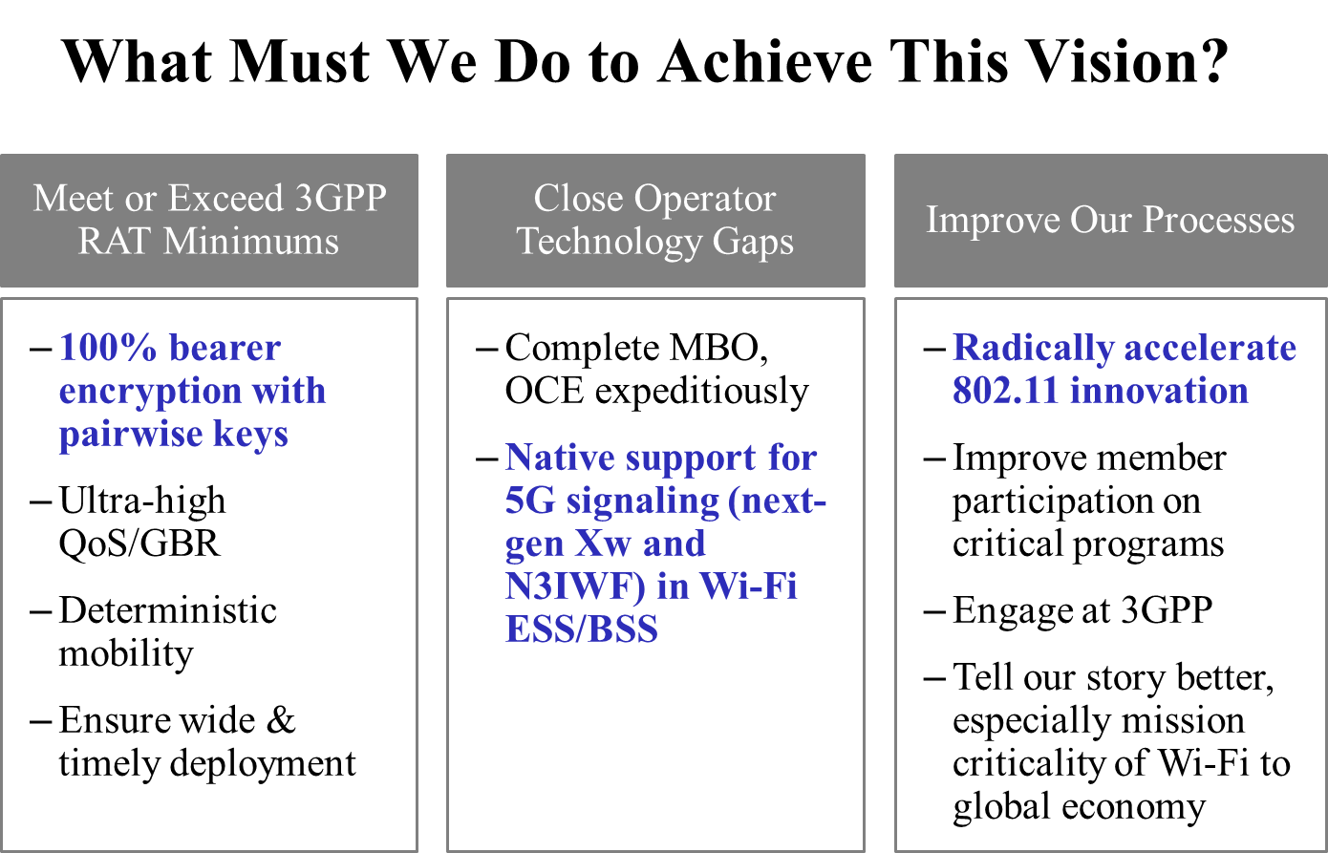
Continue Teleconference Discussion on 11-17/1242r0 (2/2)
11-17/1242r0 - Strategies to Maximize Adoption of 802.11 in 5G Networks, Chuck Lukaszewski (Aruba, a HPE Company)
For Discussion:
Will 802.11 capabilities and functionalities meet/exceed 3GPP RAT minimums?
Does security need improvement?
Are additional QoS/GBR capabilities needed?
Are controlled/predictable hand-overs needed (mobility)?
Are there Operator technology gaps?
Should we look in to speeding up the 802.11 process?
Slide 15 from 11-17/1242r0

Slide 14
Contributions
???

Slide 15
Status/Background: IEEE 802 network enhancements for the next decade Industry Connections Activity
IEEE 802 NEND ICA met on Tuesday, 11 July 19:00 to 21:00. ~ 150 attendees
The session was Chaired by Glenn Parsons (802.1 Chair).
The Agenda document/updated by the Chair 1-17/0001r1 (Note: All NEND ICA documents can/will be found on: mentor.ieee.org/802.1)
High level summary of the Meeting:
The background and history leading to the NEND IC were reviewed by Chair
The attendees introduced themselves and provided some comments on their areas of interest and/or their desired outcome for the IC activity.
Many attendees indicated an interested in Industrial Networking/ Manufacturing Networking
Two contributions were presented:
Layer 2 network virtualization, Max Riegel (Nokia), 1-17/0002r0
Wireless Communications in the Manufacturing Fields, Satoko Itaya (NICT), omniran-17/0054r1

Slide 16
Status/Background: Future: IEEE 802 network enhancements for the next decade Industry Connections Activity
IEEE 802 NEND ICA will meet F2F at 802 Plenary meetings. Therefore the next F2F meeting will be Tuesday November 7 19:00 to 21:00 at Caribe Hotel and Convention Center, Orlando, FL, USA.
There will be NEND ICA teleconferences, it is likely these will be monthly, the dates and times of these meetings are currently TBD.
Glenn Parsons will continue to Chair this activity until a Chair can be found.
Glenn is seeking a Chair and technology/industry evangelists to move this work forward.
There is IEEE Staff support to aid in Industry outreach (established in offline discussions).
Does 802.11 want to participate in this activity, do we have particular Industry interest?
Is anyone interested in participating/contributing to this active?

Slide 17
IEEE 802 network enhancements for the next decade Industry Connections Activity Contributions/Discussion
Contributions ???
Discussion
Present a 802.11 contribution(s) for NEND IC activity: A 802.11 perspective on ?????

Slide 18
Agenda
Thursday – AM2
Continued Contributions (if any)
Discussion on: IEEE 802 network enhancements for the next decade Industry Connections Activity (New 802.1 group to support the “IEEE “5G” Specification” activity)
Future Sessions Planning

Slide 19
Contributions
???
Discussion

Slide 20
IEEE 802 network enhancements for the next decade Industry Connections Activity – Contributions/Discussion
Contributions ???
Discussion
Present a 802.11 contribution(s) for NEND IC activity: A 802.11 perspective on ?????

Slide 21
New Business
Any other business?

Slide 22
Future Sessions Planning
Teleconference:
How many teleconferences should we plan between now and the November?
?????
Topics for discussion/contribution:
NEND IC activity
3GPP Interworking
5-10 November 2017 F2F, Orlando, FL, USA:
Goals:
Contributions on current SA/802.11 interworking: 2G/3G/4G
Contributions on SA/802.11 or RAN/802.11 interworking or related 5G/nextGen topics
Discuss and address any LSs received
Continue discussions on NEND IC and report of NEND IC activity.
Present a 802.11 contribution(s) for NEND IC activity: A 802.11 perspective on ?????
2 sessions on Monday PM1 and Thursday AM2 (to be confirmed)

Slide 23
References

