Slide 1
MU-MIMO Power Save for 11ay
Date: 2017-08-30
Authors:

Slide 2
Abstract
This contribution proposes a power save scheme for EDMG STAs involved in DL MU-MIMO operation.

Slide 3
Motivation
DL MU-MIMO is an enhancement feature in 11ay relative to 11ad.
This contribution proposes a power save scheme for EDMG STAs involved in DL MU-MIMO operation.

Slide 4
MU-MIMO transmission and acknowledgement flow in 11ac
The MU-MIMO transmission and acknowledgement flow defined in 11ac is as follows:
To create a MU PPDU, the MAC forms A-MPDUs for each of the recipient STAs.
The PPDU duration is determined by the longest encoded A-MPDU.
The A-MPDUs for each STA is padded such that each A-MPDU occupies the same number of symbols.
The PCP/AP gets the BAs of the STAs in the following way:
At most one STA is set to “Implicit Block Ack Request”, and sends the BA immediately after SIFS time of the end of MU-PPDU.
All the other STAs are set to “Block Ack”, and wait for a BA solicitation before responding with a BA.

Slide 5
An example of MU-MIMO transmission and acknowledgement flow
SIFS
SIFS
SIFS
SIFS
SIFS
Preamble
A-MPDU (STA 1, implicit BAR)
PCP/AP
A-MPDU (STA 2, block ack)
A-MPDU (STA 3, block ack)
BAR
BAR
pad
STA 1
BA
STA 2
BA
STA 3
BA
MU-MIMO TXOP

Slide 6
Proposed MU-MIMO power save scheme
For an EDMG STA that is involved in MU-MIMO transmission, it can go to PS mode during two time periods:
First period: From the time of detecting the EOF field in its individual A-MPDU (i.e, it does not need to wait for the padding data transmission), to the time of wake up before its corresponding BAR/BA exchange with the initiator.
Second period: From the time of successfully sending back the BA, to the end of the current MU-MIMO transmission.
In order to perform this, each STA needs to know:
Its order of the BA/BAR exchange with the PCP/AP initiator, so that each STA knows when it should wake up to receive the BAR addressed to it.

Slide 7
Proposed ordered BAR/BA exchange
Currently except for the STA with implicit BAR, all other STAs do not know when they will receive the BAR from the PCP/AP, and therefore have to power on and wait continuously until it hears the BAR from the PCP/AP.
We propose that instead of doing this BAR solicitation in a random order, we perform it in an agreed order. In this way, each STA knows its specific order of BAR/BA exchange.
The BAR/BA order shall be the same as the AIDs appear in the group description present in the EDMG Group ID Set element corresponding to this MU group.
This ordered BAR/BA exchange sequence enables each STA to know when it should wake up to receive the corresponding BAR frame addressed to it.

Slide 8
SIFS
SIFS
SIFS
SIFS
SIFS
Preamble
A-MPDU (STA 1, implicit BAR)
PCP/AP
A-MPDU (STA 2, block ack)
BAR
for STA 3
A-MPDU (STA 3, block ack)
BAR
for STA2
pad
STA 1
BA
STA 2
BA
STA 3
BA
MU-MIMO TXOP

Slide 9
Missing BAR/BA
If the BAR transmitted by the initiator to a responder is missing
The responder shall keep awake and wait until it receives the BAR addressed to it or to the end of TXOP, whichever comes first.
If the BA transmitted by a responder STA is missing
If the initiator does not receive the BA transmitted by a responder, it can retransmit the BAR. If it decides to retransmit the BAR within the current TXOP, it shall retransmit it immediately in the original sequence order.
After transmitting the BA, a responder STA shall wait for an additional AckTimeout interval.

Slide 10
Proposed MU-MIMO power save
SIFS
SIFS
SIFS
SIFS
SIFS
Preamble
A-MPDU (STA 1, implicit BAR)
PCP/AP
A-MPDU (STA 2, block ack)
A-MPDU (STA 3, block ack)
BAR
BAR
pad
Power save for STA 1
STA 1
BA
STA 2
Power save for STA 2
BA
Power save
for STA 2
STA 3
Power save for STA 3
BA
MU-MIMO TXOP

Slide 11
Calculating the feasible power save periods
Each responder STA needs to calculate its feasible PS periods. This involves the calculation of the transmission time of the BAR/BA exchanges between other initiator-responder pairs.
However, one STA is not able to know 1) the MCS value used by the other STAs for transmitting the BA; 2) the BAR/BA size for other STAs.
If one STA miscalculates the feasible PS periods, it may miss the corresponding BAR frame addressed to it.
In order to ensure STAs will not miss its corresponding BAR/BA exchange with the initiator, we therefore propose that each STA shall estimate its feasible PS periods assuming other initiator-responder pairs:
1) BAR/BA is of the shortest size.
2) use highest MCS value allowed to perform the BAR/BA exchange.

Slide 12
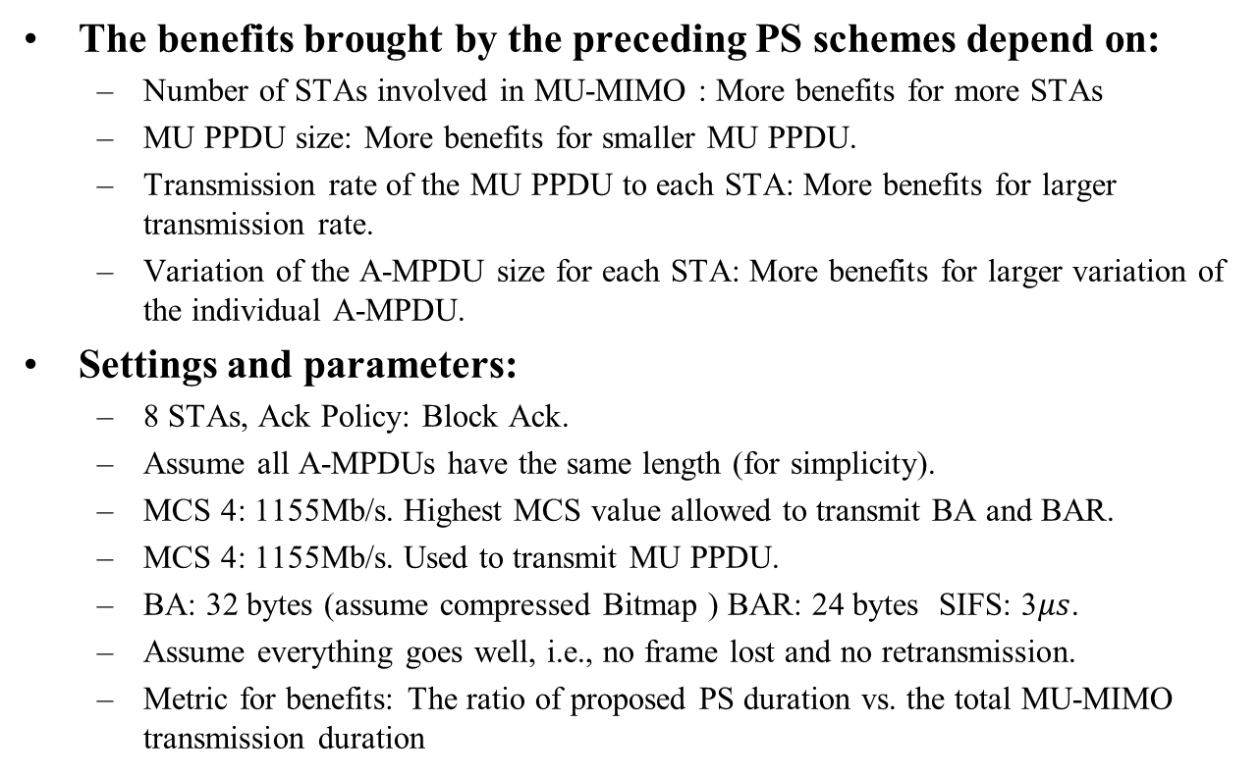
Power save benefits
The benefits brought by the preceding PS schemes depend on:
Number of STAs involved in MU-MIMO : More benefits for more STAs
MU PPDU size: More benefits for smaller MU PPDU.
Transmission rate of the MU PPDU to each STA: More benefits for larger transmission rate.
Variation of the A-MPDU size for each STA: More benefits for larger variation of the individual A-MPDU.
Settings and parameters:
8 STAs, Ack Policy: Block Ack.
Assume all A-MPDUs have the same length (for simplicity).
MCS 4: 1155Mb/s. Highest MCS value allowed to transmit BA and BAR.
MCS 4: 1155Mb/s. Used to transmit MU PPDU.
BA: 32 bytes (assume compressed Bitmap ) BAR: 24 bytes SIFS: 3$μs$.
Assume everything goes well, i.e., no frame lost and no retransmission.
Metric for benefits: The ratio of proposed PS duration vs. the total MU-MIMO transmission duration

Slide 13
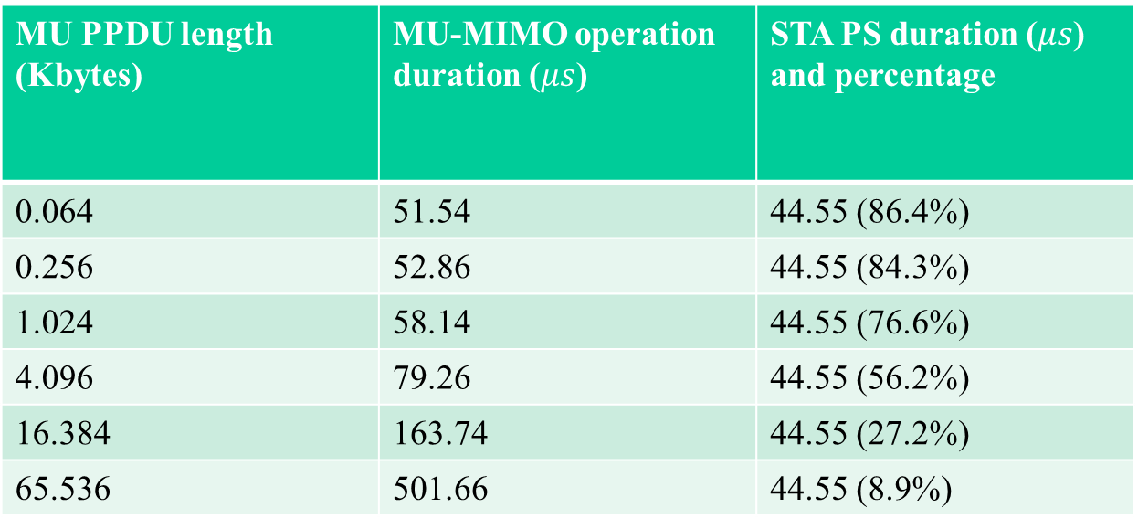
Power save benefits analysis
MU PPDU length (Kbytes) | MU-MIMO operation duration ($μs$) | STA PS duration ($μs$) and percentage
0.064 | 51.54 | 44.55 (86.4%)
0.256 | 52.86 | 44.55 (84.3%)
1.024 | 58.14 | 44.55 (76.6%)
4.096 | 79.26 | 44.55 (56.2%)
16.384 | 163.74 | 44.55 (27.2%)
65.536 | 501.66 | 44.55 (8.9%)

Slide 14
Conclusions
Proposed a power save schemes for EDMG STAs involved in MU-MIMO operation.
The benefits brought by the proposed schemes are evaluated and analyzed, and it shows that with small A-MPDU size, the benefits are significant.

Slide 15
Straw Poll
Do you agree to include the text proposed in [11-17-1215-00-00ay-draft-text-for-mu-mimo-power-save-for-11ay.docx] into the 802.11ay draft spec?

Slide 16
References

