Slide 1
Measurement Report Feedback in 11az
Date: 2017-05-30

Slide 2
Abstract
Till now the group discussed the negotiation and channel measurement mechanisms.
We had some discussion on the measurement reporting but no agreement has yet been formed.
This submission reviews the design considerations of different technical approaches for the location measurement reporting (LMR).

Slide 3
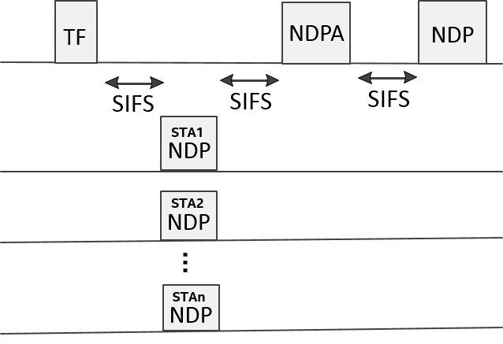
Recap – SU and MU Measurement Sequences
IEEE TGaz has agreed (SFD) on the following channel sounding sequence
SU scenario: MU scenario:
In the following slides we’ll use either the SU or MU measurement sequence to demonstrate considerations of Location Measurement Reporting, in most cases similar considerations exists for the other case (MU or SU respectively).

Slide 4
Location Measurement Reporting Considerations
Measurement report type (ToD, ToA vs. Ch. State) has a fundamental impact on protocol design:
ToD requires HW support and is fairly simple to design (low risk)
ToA requires algorithm support which may implemented in FW or SW:
First generation (REVmc FTM) SW implementation (i.e. non-tight scheduling) was assumed. This resulted in an additional unused measurement exchange per fix (i.e. per FTM burst instance) i.e. sub-optimal power and medium usage (<30%).
This compromise was acceptable for first generation where the algorithm for TOA required proofing in field conditions.
2nd generation is coming 4-5 years after and a FW/HW implementation can be considered resulting in a more power and medium efficient protocol.
Resulting ToA

Slide 5
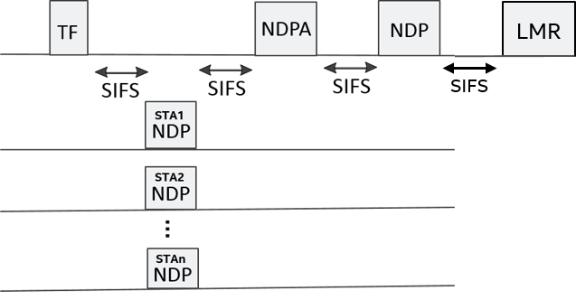
LMR Considerations (cont’d) – MU ToA
Unlike SU, MU puts a higher bar on AP side as it needs to attend larger number of STAs.
So likely to require higher computation power, or simplified results to meet the same scheduling constraints.
Resulting
ToA 1..n

Slide 6
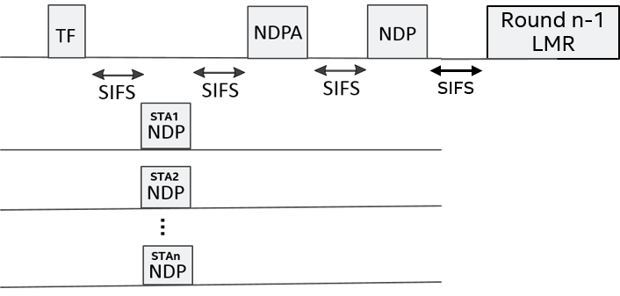
LMR Considerations (cont’d) – MU ToA
A staggered approach for ToA (results of round n are provided in round n+1) can mitigate this limitation.
Its still computation intensive (PWR and scalability at AP side).
Introduces a delay to client STA, which may be harmful to some applications (drones).
Additional PWR and scheduling constraints to client STA (less power optimal).
Can remain in SW (may increase product cost).
Resulting
ToA 1..n round n

Slide 7
LMR Considerations (cont’d) – MU ToA
A staggered approach for ToA does not necessarily means that a STA can measure round n+1 when measurement results are available.
A separate TWT for measurement and LMRs can be developed but may have PWR implications on client STAs due to sub optimal AP implementations.
Resulting
ToA 1..n round n

Slide 8
LMR Considerations (cont’d) – SU ToA
Similar to MU scenario, a staggered approach for ToA (results of round n are provided in round n+1) can reduce the computation load at responder side :
SU is client STA triggered, but staggered approach can still be supported by having the AP indicate its latency during negotiation (i.e. when should the client STA comeback for the results).
Resulting
ToA of round n-1
Resulting
ToA of round n
Comeback time

Slide 9
LMR Considerations (cont’d) – SU CSI
An intermediate approach to ToA reporting is to report a partial computation of the ToA for example a Channel State Info (CSI) like reporting:
This approach substantially mitigates the negative effect of staggered ToA (client PWR and jitter/latency).
It substantially avoids the need for unique 11az HW/computation intensive TOA support of immediate approach.
It is much more computation distributed, thus prevents a computation bottleneck of either staggered or immediate.
Report is kept to be very similar to information available internally (i.e. Channel estimates).
On the down side it less medium efficient than the other approaches, but still more efficient than the REVmc method.
Resulting CSI of same round

Slide 10
What about AoA and AoD LMRs?
Same principals presented in this deck can be applied to angular measurements.
It is left to future time to explore the best method for angular LMR reporting, once greater visibility of angular technique and protocol is agreed on.

Slide 11
Backup

Slide 12
Comparison between different LMR options
LMR Options | Pros | Cons
Immediate LMR of ToA | High efficiency in medium usage Low latency | Dedicated hardware for ToA computation
Staggered LMR with delayed ToA | Can be calculated using SW No need for dedicated hardware Reduced computation intensity | Introduce a delay to the LMR Scheduling constraint Additional memory to store the CSI/ToA information
Immediate LMR with CSI | Distributed computation Reduce the computation burden on the AP/responder side | Large overhead in medium usage Additional memory to buffer CSI

Slide 13
Analysis of CSI Feedback Medium Usage (1)
Ng=16, Bitwidth=20bits/tone, 4xLTF, single stream, MCS0 (BPSK, 1/2) for CSI feedback
Bandwidth (MHz) | MIMO Configuration | Overhead (us)
40 | 4x2 | 484/16*20*8/(484*0.5)*14.4=288
 | 8x2 | 484/16*20*16/(484*0.5)*14.4=576
80 | 4x2 | 996/16*20*8/(996*0.5)*14.4=288
 | 8x2 | 996/16*20*16/(996*0.5)*14.4=576
160 | 4x2 | 1992/16*20*8/(1992*0.5)*14.4=288
 | 8x2 | 1992/16*20*16/(1992*0.5)*14.4=576

Slide 14
Analysis of CSI Feedback Medium Usage (2)
Ng=16, Bitwidth=20bits/tone, 4xLTF, single stream, MCS4 (16QAM, 3/4) for CSI feedback
Bandwidth (MHz) | MIMO Configuration | Overhead (us)
40 | 4x2 | 484/16*20*8/(484*3)*14.4=48
 | 8x2 | 484/16*20*16/(484*3)*14.4=96
80 | 4x2 | 996/16*20*8/(996*3)*14.4=48
 | 8x2 | 996/16*20*16/(996*3)*14.4=96
160 | 4x2 | 1992/16*20*8/(1992*3)*14.4=48
 | 8x2 | 1992/16*20*16/(1992*3)*14.4=96

