Slide 1
Analog and Baseband Beam Tracking in 802.11ay
Date: 2017-07-10
Authors:

Slide 2
Introduction
In [1], an agreement was made to enable mechanisms that support tracking of the baseband channel for SU-MIMO and MU-MIMO hybrid beamforming in 802.11ay
  Motion #195:
    Do you agree to include mechanisms that support tracking of the baseband channel for SU-MIMO and MU-MIMO hybrid beamforming in 802.11ay ?
    Yes/No/Abstain: 9/3/11
In this contribution, we define the protocol and signaling needed to enable both analog and baseband beam tracking for 802.11ay. This includes:
  The different types of beam tracking:
    DMG, EDMG: Analog (EDMG:A), EDMG: baseband (EDMG:B)
  The training signals
  The feedback
  The use cases
We also show associated spec text to enable the elements mentioned above

Slide 3
Beam Tracking
Beam tracking enables an initiator or responder track the change in its beams without the need for the signaling and overhead of a BRP procedure.
The signaling for beam tracking is sent in the DMG BRP packet header fields or EDMG header-A fields either in a standalone frame or piggy-backed on other transmitted frames.
In 802.11ad, three beam tracking schemes are defined [3]:
  Initiator Receive Beam Tracking
  Initiator Transmit Beam Tracking
  Responder Receive Beam Tracking

Slide 4
Beam Tracking Types in 802.11ad
In 802.11ad beam tracking may be one of three types:
Initiator Receive Beam Tracking: The initiator sends a request to the responder and the responder sends a tracking packet to enable the initiator estimate its receive beams
Initiator Transmit Beam Tracking: The initiator sends a training packet to the receiver and the receiver feeds back the desired feedback
Responder Receive Beam Tracking: The initiator sends a training sequence to the responder and requests that it track its receive beams.

Slide 5
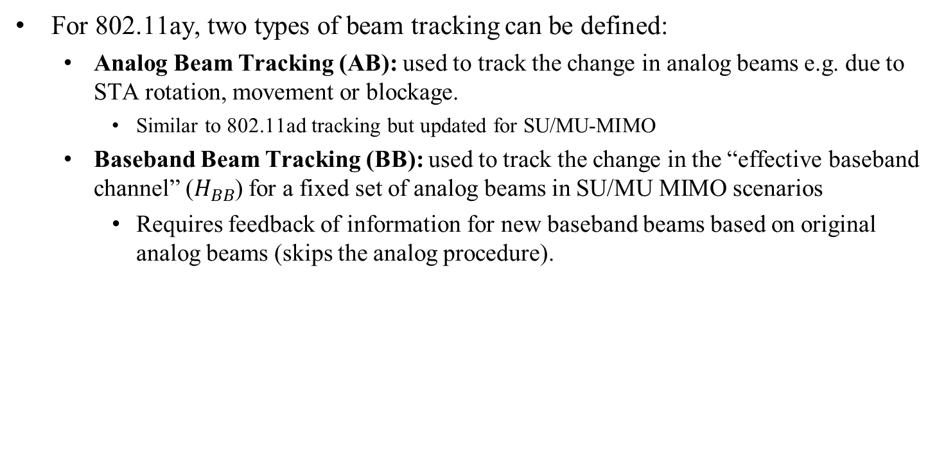

Beam Tracking for 802.11ay
For 802.11ay, two types of beam tracking can be defined:
  Analog Beam Tracking (AB): used to track the change in analog beams e.g. due to STA rotation, movement or blockage.
    Similar to 802.11ad tracking but updated for SU/MU-MIMO
  Baseband Beam Tracking (BB): used to track the change in the “effective baseband channel” ($H_{BB}$) for a fixed set of analog beams in SU/MU MIMO scenarios
    Requires feedback of information for new baseband beams based on original analog beams (skips the analog procedure).
$Y={F_{Br}F}_{Ar}H F_{At}F_{Bt}x+n ;$ $H_{BB}$=$F_{Ar}H F_{At}$
H = MIMO channel; H_{BB} = effective baseband MIMO channel
F_{Ar} , F_{At} = Analog beamformer; F_{Bt ,}F_{Br} = Baseband beamformer

Slide 6
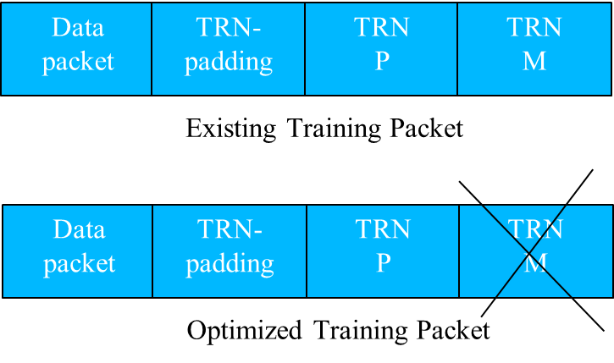
Baseband Tracking
Can estimate baseband channel efficiently by eliminating additional TRN fields in TRN packet for Initiator Transmit Beam Tracking (defined with EDMG_TRN_M).
  EDMG_TRN_M and EDMG_TRN_N fields are reserved while only EDMG_TRN_P field and EDMG_TRN_LEN fields are defined

Slide 7
Steps for Beam Tracking in 802.11ay
Setup
  Indicate if analog beam (AB) or baseband beam (BB) tracking request : (AB or BB)
  Indicate type of TRN packet and EDMG_TRN_length
    Define EDMG_P, EDMG_M and EDMG_N if applicable
Training (for BB)
    Set baseband precoder to a fixed orthogonal matrix e.g. Identity matrix
    Transmit TRN units (T and P sub-units only)
Indicate Feedback type required (default or explicitly signaled)
    Best Beam(s), SNR(s): (AB only)
    Channel Feedback or hybrid beamforming feedback (TBD): (AB or BB)

Slide 8
Beam Tracking Specification

Slide 9
Beam Tracking Specification
The beam tracking specification needs to define the following:
  TXVECTOR/RXVECTOR settings: Defines a parameter used for the specific beam tracking type
  Packet Signaling between STAs: Communicates the beam tracking parameters set in TXVECTOR/RXVECTOR between STAs
    DMG: BRP packet header
    EDMG / EDMG (B) : BRP packet header + EDMG Header-A
  Training : Enables the measurement
    DMG: AGC + TRN Units
    EDMG:A / EDMG:B : TRN Units (EDMG_TRN_length, T, P, M and N)
  Feedback (case dependent): Enables feedback of the beam tracking measurements if required
    The feedback type is the same as last feedback type if previously requested.
    If the feedback type has never been requested, explicitly request for feedback.

Slide 10
Current Beam Tracking Specification
DMG [3]
EDMG [2]

Slide 11
Updated Beam Tracking Specification
EDMG with Analog/Baseband Tracking

Slide 12
Updated TRN-Packet Definition
Initiator Receive Beam Tracking : TRN-R packet
If EDMG_BEAM_TRACKING_TYPE parameter in the RXVECTOR is Baseband Beam Tracking, the baseband beamformers at the initiator and responder should be set to a predetermined orthogonal matrix, e.g., the identity matrix, during the transmission of the appended TRN-R subfields only and the measurement at the initiator is based on the appended TRN-R packets.
Initiator Transmit Beam Tracking : TRN-T packet
If the EDMG_BEAM_TRACKING_TYPE parameter in the TXVECTOR is Baseband Beam Tracking, then EDMG_TRN_LEN TRN units are appended to the data packet (each with EDMG_TRN_P TRN subfields) and are transmitted using the same AWV as the preamble and data field of the packet. The baseband beamformer for the initiator and responder should be set to a predetermined orthogonal matrix, e.g., the identity matrix, during the transmission of the appended TRN-T subfields only and the measurement is based on the appended TRN-T subfields.

Slide 13
Updated Feedback
The feedback type shall be the same as the feedback type in the last BRP frame that was transmitted from the initiator to the responder with TX-TRN-REQ equal to 1.
If the responder has never received a BRP frame from the initiator with TX-TRN-REQ equal to 1, and
- If BEAM_TRACKING_REQUEST parameter in the RXVECTOR is Beam Tracking Requested, or if EDMG_BEAM_TRACKING_REQUEST parameter in the RXVECTOR is Beam Tracking Requested and EDMG_BEAM_TRACKING_TYPE is Analog Beam Tracking, the responder shall respond with all subfields of the FBCK-TYPE field equal to 0 and set the BS-FBCK field to the index of the TRN-T subfield that was received with the best quality.
- If EDMG_BEAM_TRACKING_REQUEST parameter in the RXVECTOR is Beam Tracking Requested and EDMG_BEAM_TRACKING_TYPE is Baseband Beam Tracking, the initiator shall include a FBCK-REQ in a DMG Beam Refinement element as in 9.4.2.130 and request for the feedback needed. The responder shall respond with the requested feedback.

Slide 14
Updated Use Cases
A beam tracking initiator may transmit to the beam tracking responder a PPDU requesting transmit beam tracking if at least one of the following conditions is met:
— The time duration since the last PPDU it transmitted to the beam tracking responder that requested transmit beam tracking is greater than dot11BeamTrackingTimeLimit plus BRPIFS.
— A BRP frame with the channel measurement feedback from the beam tracking responder has been received.
In addition, a beam tracking initiator or beam tracking responder may request baseband beam tracking if at least one of the following conditions is met:
The performance of the system is degraded in a hybrid beamforming transmission and the requestor would like to re-estimate the baseband beams as part of the link adaptation procedure
The requestor did not request for detailed baseband beam information as part of the MIMO setup procedure. In this case, the analog beams have been identified but the information to design the baseband beams is still needed.

Slide 15
Conclusion
Beam Tracking in 802.11ay has been discussed.
  The beam tracking for hybrid beamforming in 802.11ay may be :
    Analog Beam tracking
    Baseband Beam tracking
Signaling and Procedures for both Analog and Baseband Beam tracking in 802.11ay are proposed.

Slide 16
References
[1] K. Oteri et. al., “Further Discussion on Beam Tracking for 802.11ay” IEEE doc. 11-17/0426r2, March 2017
[2] IEEE P802.11ay™/D0.3, January 2017
[3] IEEE Std 802.11-2016, December 2016
[4] K. Oteri et. al., “Protocols for Hybrid Beamforming in 802.11ay”, IEEE doc. 11-17/0429r3, January 2017
[5] A. Maltsev, et al, “Channel models for IEEE 802 11ay”, IEEE doc. 11-15/1150r8
[6] K. Oteri et. al., “Draft Text for Analog and baseband Beam Tracking in 802.11ay” IEEE doc. 11-17/1097r0, July 2017

Slide 17
Straw Poll
Do you agree:
  to the changes in the specification draft as described in IEEE 802.11-17/1097r0 to define Beam Tracking and its associated signaling and procedures?

Slide 18
Appendix
Signaling and Packet Exchange for Beam Tracking in 802.11ad and 802.11ay

Slide 19
Initiator Receive Beam Tracking (DMG)

Slide 20
Initiator Receive Beam Tracking (EDMG:A)

Slide 21
Initiator Receive Beam Tracking (EDMG:B)

Slide 22
Initiator Transmit Beam Tracking (DMG)

Slide 23
Initiator Transmit Beam Tracking (EDMG:A)

Slide 24
Initiator Transmit Beam Tracking (EDMG:B)

