Slide 1
Optional MCS 12 and 13 Definitions
Date: 2017-07-10
Authors:

Slide 2
Abstract
Additional information on Optional SC MCS 12 and 13 using 8PSK is presented

Slide 3
Outline
Motivation
Background
Proposed new constellations and code rates
Simulation Results
Summary
Straw Polls

Slide 4
Motivation (1)
60 GHz backhaul applications will benefit from greater range
Backhaul typically uses highly directional antennas
Resulting channel has few reflections and therefore low inter-symbol interference
Range is limited by available transmit power and required receiver SNR
Friis Equation and the definition of receiver signal-to-noise ratio
Combine and solve for range, R, as a function of SNR and transmitter power

Slide 5
Motivation (2)
Combined Equation
Range is limited by the square root of the ratio of available transmit power to required SNR at the receiver
By using 8 PSK instead of 16 QAM for MCS 12 and 13, we can greatly increase this ratio

Slide 6
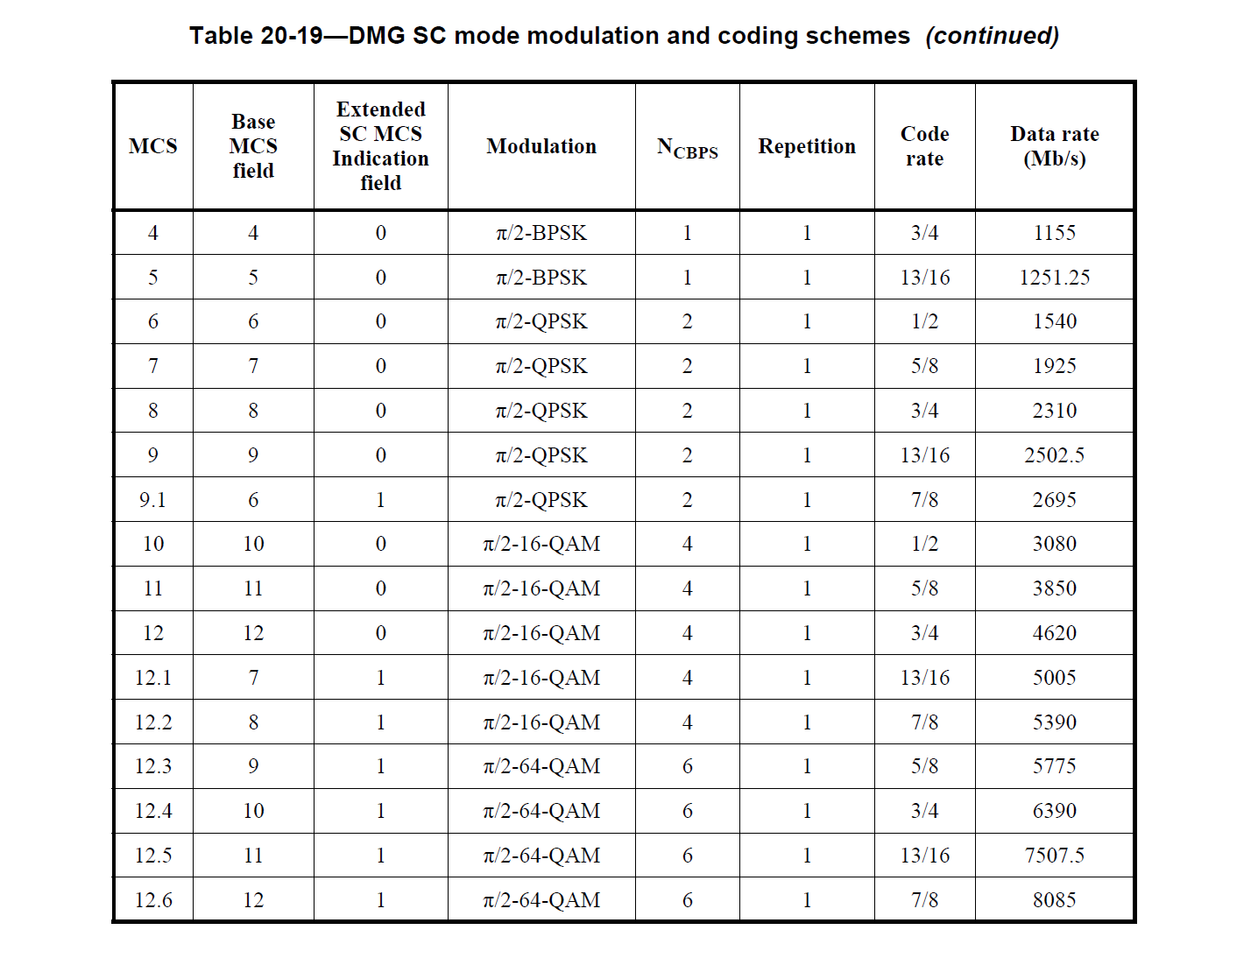
Background (1)
802.11ad contains moderate rate MCS modes with 16 QAM constellations
QAM modulation will increase the peak to average ratio of transmitted signals relative to PSK modulations
A given transmit power amplifier can send QAM at a lower power than PSK

Slide 7
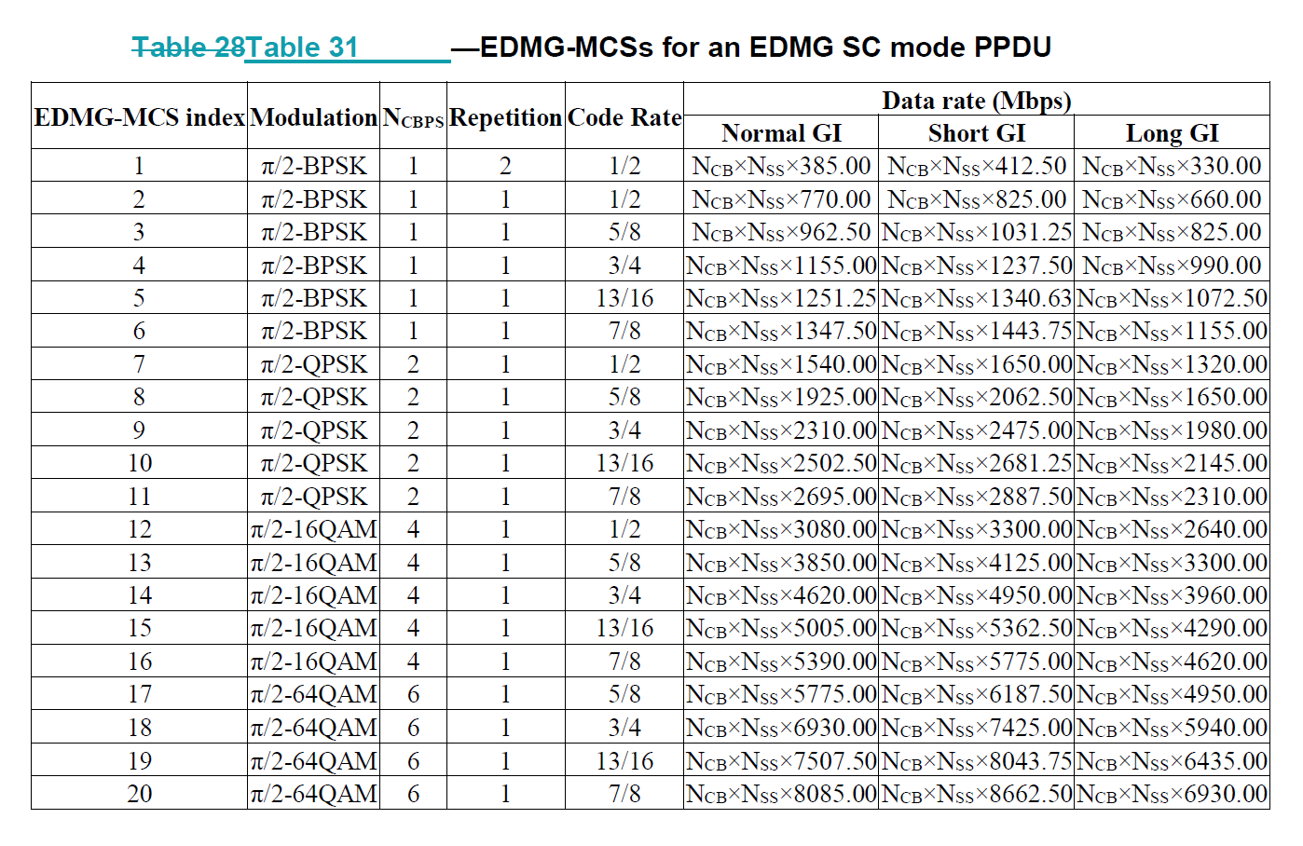
Background (2)
Similar MCS entries are in the 802.11ay draft
For MCS12 and MCS13, 8PSK with rate 2/3 and rate 5/6 codes will achieve the same PHY rate

Slide 8
Background (3)
For a given constellation, the peak power is the power of the constellation point at the greatest distance from the origin (center). The average power is the mean over all constellation points.
Circular constellations, such as 8 PSK have a peak power equal to the average power. Thus, their peak-to-average power ratio (PAPR) is minimized
16 QAM PAPR = 18/10 = 2.55 dB
8 PSK PAPR = 1/1 = 0.0 dB
16 QAM PAPR = 18/10 = 2.55 dB
8 PSK PAPR = 1/1 = 0.0 dB

Slide 9
Background (4)
Transmission through practical pulse shaping filters will increase the resulting PAPR of PSK signals, however, they will still be less than 16-QAM signals that pass through the same filter
Compression of QAM signals in non-linear components, such as mmwave power amplifiers, low noise amplifiers, and mixers, will also have greater impact on QAM signals than it will on PSK signals
Compression tends to reduce the minimum distance between outer constellation points and increases the average EVM (error vector magnitude)
Since bit error rate is a function of minimum distance, the bit error rate will be increased

Slide 10
Background (5)
16QAM constellation after distortion created with the Rapp Model in the 802.11ay Evaluation Methodology

Slide 11
Background (6)
Even at a higher average output power, the 8PSK constellation is more tolerant of amplifier distortion

Slide 12
MCS 12 and 13 with 8PSK (1)
8 PSK constellations with higher code rates can be employed instead of QAM constellation with lower code rates
MCS 12: 8 PSK with a rate 2/3 code instead of 16-QAM with rate ½ code
Rate 2/3 code is generated by shortening the 802.11ad rate ¾ LDPC code
On encoding, pad 168 zero bits to fill the codeword
Do not transmit pad bits
No new LDPC code is needed
Apply pi/2 phase shift per symbol to 8PSK the same way we do for existing modulations in 802.11ay

Slide 13
MCS 12 and 13 with 8PSK (2)
MCS 13 – 8 PSK with rate 5/6 code instead of 16QAM with rate 5/8
Shorten the draft 802.11ay rate 7/8 code to rate 5/6 by padding with zeros to fill the information part of the codeword
Padded zeros are not transmitted
New LDPC code matrices are not needed
Shortening code words is already a part of 802.11ad

Slide 14
MCS 12 Simulation Results
MCS 12 PER with 4096 byte packets, phase noise, and PA distortion. EVM = -19 dB
10 iterations on LDPC decoder
8 PSK requires 0.6 dB greater SNR at 1% PER
8 PSK TX power is 4.0 dB higher
Net gain of 3.4 dB or 48% greater range

Slide 15
MCS 13 Simulation Results (1)
MCS 13 PER with 4096 byte packets, phase noise, and PA distortion. EVM = -20 dB
10 iterations on LDPC decoder
8 PSK requires 2.1 dB greater SNR at 1% PER
8 PSK TX power is 4.3 dB higher
Net gain of 2.2 dB or 29% greater range

Slide 16
MCS 13 Simulation Results (2)
Reducing TX EVM (with more backoff)
EVM = -22 dB
8 PSK requires 1.8 dB greater SNR at 1% PER
10 iterations on LDPC decoder
8 PSK TX power is 4.6 dB higher
Net gain of 2.8 dB or 38% greater range

Slide 17
Summary
8 PSK has been evaluated using the phase noise, PA models, and EVM targets for 802.11ay and 802.11ad
Range increases of 29% to 48% are possible with MCS12 and MCS13 using 8 PSK instead of 16 QAM
Existing 802.11ad / 802.11ay LDPC codes can be shortened to achieve the rate 2/3 and rate 5/6 codes required for 8 PSK
No new encoder / decoder
We propose optional MCS12 and MCS13 using these techniques for 802.11ad

Slide 18
Draft Text
Draft text is in preparation.

Slide 19
Backup

Slide 20
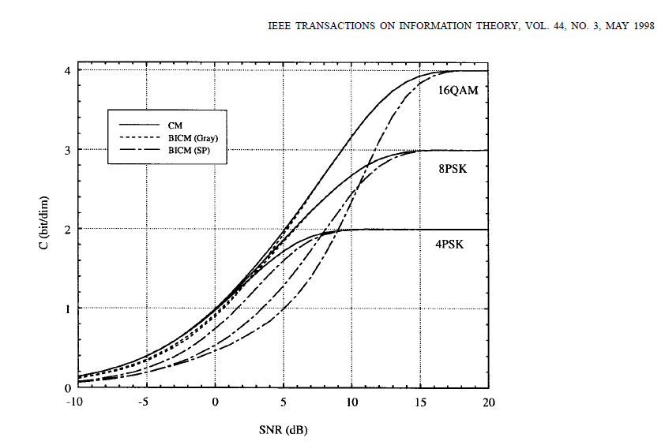
AWGN Channel Capacity Comparison
From “Bit-Interleaved Coded Modulation” by G. Caire, G. Taricco, and Ezio Biglieri
MCS13 (2.5 bits per symbol)
MCS12 (2 bits per symbol)

