Slide 1
LB225 CR 27.13 (Link Adaptation)
Date: 2017-07-09
Authors:

Slide 2
11ax D1.0 Comment of Clause 27.13 (1/2)
CID | Commenter | P.L | Clause | Comment | Proposed Change
4786 | Alfred Asterjadhi | 198.61 | 27.13 | This subclause seeems incomplete. Please complete it in terms of expected norm behavior at RX, at TX, etc. | As in comment
5916 | James Yee | 199.01 | 27.3 | The text refers to "The HE-MCS subfield of the MFB subfield of HE link adaptation field" but there is no MFB subfield defined in the HE Link Adaptation field. The overall description of the HE Link Adaptation procedure is unclear. | Please clarify.
6032 | Jarkko Kneckt | 199.01 | 27.13 | The use of HE-MCS subfield in link adaptation is very loosely defined. It is not clear how the AP and the STA use the link adaptation information. | Please provide some more details how the link adaptation is used by the non-AP STA and the AP. Please describe how to recommended MFB should be used by the transmitter and the receiver. Especially it is interesting to know how non-AP STA can use link adaptation for Triggered transmissions.
6107 | Jian Yu | 198.61 | 27.13 | Link adaptation using the HE variant HT Control field part lacks details | Add the details
7891 | Mark RISON | 198.60 | 27.13 | This just has a statement on how to set the HE MCS subfield. Everything else is missing (setting of caps for solicited, unsolicited, expected behaviour at TX and at RX, etc.) | Add all the missing LA/MFB detail

Slide 3
11ax D1.0 Comment of Clause 27.13 (2/2)
CID | Commenter | P.L | Clause | Comment | Proposed Change
8529 | Robert Stacey | 199.01 | 27.13 | It is not clear what the receiving side (AP/STA) is expected to do with the HE-MCS / NSS values in this A-control | Need a description for receiver sode behavior in response to this A-control field (similarly to section 27.8, which details what is expected from the receiving side to do with the OMI A-control field values)
9738 | Yongho Seok | 199.03 | 27.13 | "The transmission properties, RU_ALLOCATION, DCM, NUM_STS, FEC_CODING, BEAMFORMED, BEAM_CHANGE, and STBC, are determined by the RXVECTOR of the PPDU used to estimate recommended MFB." Is the recommended MFB for a solicited link adaptation? Or, is it for an unsolicited link adaptation? Please clarify it. | As per comment.
9955 | Young Hoon Kwon | 199.60 | 27.13 | There's no description on how link adaptation using the HE variant HT Control field works. For example, it is not clear when to send the feedback, how to figure out the reference frame for the measurement, etc. Further clarification is needed. | As in the comment.
10145 | yujin noh | 198.60 | 27.13 | complete HE link adaptation operation in sub-clause 27.13 if needed | As in the comment.

Slide 4
Current Status [1]
HE Link adaption (HLA) control has only minimum subfields for link adaptation
Lack of details of HE link adaptation protocols
Many fields required for LA are undefined yet

Slide 5
Summary
Constraints
Only 26 bits are allocated to HE link adaptation in A-control
HT and VHT have 30 bits
HLA design considerations
HLA MFB should cover HE only feature information, such as
OFDMA RU
DCM
Different PPDU formats, HE_SU, HE_MU, HE_EXT_SU, HE_TRIG
MFB requester should be able to send request to collect MFB information
For a specific RU and BW
MFB responder should be able to
Respond to/postpone/decline the MFB request
Send unsolicited MFB responding to sounding
Send unsolicited MFB during regular frame exchange
In this presentation, we propose an HLA A-control field design for link adaptation in HE

Slide 6
HE Link Adaptation Proposal (1/5)
Three types of LA control
HLA MFB Request: To request MFB
Solicited HLA MFB: MFB to respond a MFB request
Unsolicited HLA MFB:
Two bits are used to identify the LA control type
MRQ
Unsolicited MFB

Slide 7
HE Link Adaptation Proposal (2/5)
HLA Request
B0 | B1 | B2-B4 | B5-B12 | B13-B14 | B15-B25
Unsolicited MFB (=0) | MRQ (=1) | MFSI | RU | BW | Reserved
1 | 1 | 3 | 8 | 2 | 11
Subfield | Bit width | Description | Notes
Unsolicited MFB | 1 | Indication of unsolicited MFB
MRQ | 1 | To request HLA MFB
MFSI | 3 | MRQ sequence identifier
RU | 8 | Indentify the RU requires MFB
BW | 2 | RU’s BW

Slide 8
HE Link Adaptation Proposal (3/5)
Solicited HLA MFB
B0 | B1 | B2-B4 | B5-B7 | B8-B11 | B12 | B13-B18 | B19-B25
Unsolicited MFB (=0) | MRQ (=0) | MFSI | NSS | HE-MCS | DCM | SNR | Reserved
1 | 1 | 3 | 3 | 4 | 1 | 6 | 7
MFB
Subfield | Bit width | Description | Notes
Unsolicited MFB | 1 | Indication of unsolicited MFB
MRQ | 1 | To request HLA MFB
MFSI | 3 | MRQ sequence identifier
NSS | 3 | Recommended NSS
HE-MCS | 4 | Recommended HE MCS
DCM | 1 | If HE MCS is DCM
SNR | 6 | Average SNR of the requested RU | -10 dB ~ 53 dB as HT/VHT LA

Slide 9
HE Link Adaptation Proposal (4/5)
For unsolicited HLA, parameters of measured PPDU are required to feedback as well as MFB to help the receiver making better judgment. Thus, MFB needs adjustment to add PPDU information parameters.
Unsolicited HLA MFB OPTION 1
Remove SNR in MFB (save 6 bits for PPDU information)
B0 | B1-B3 | B4-B7 | B8 | B9-B16 | B17-B18 | B19 | B20 | B21 | B22-B25
Unsolicited MFB (=1) | NSS | HE-MCS | DCM | RU | BW | Coding | TxBF | PPDU Format | Reserved
1 | 3 | 4 | 1 | 8 | 2 | 1 | 1 | 2 | 3
MFB
Subfield | Bit width | Description | Notes
Coding | 1 | Coding type of the measured PPDU | BCC or LDPC
TxBF | 1 | If beamformed of the measured PPDU
PPDU format | 2 | PPDU format of the measured PPDU | Indication of four HE PPDU formats

Slide 10
HE Link Adaptation Proposal (5/5)
Unsolicited HLA MFB OPTION 2
Reduced SNR length (6 to 5)
Integrate RU and BW. Use 8 bits to indicate all possible combinations [Table 28.4 in D1.3 ]
B0 | B1-B3 | B4-B7 | B8-12 | B13-B20 | B21-B22 | B23 | B24 | B25
Unsolicited MFB (=1) | NSS | HE-MCS | DCM | SNR | RU/BW | Coding | TxBF | PPDU Format
1 | 3 | 4 | 1 | 5 | 8 | 1 | 1 | 2
MFB
Subfield | Bit width | Description | Notes
RU/BW | 8 | RU and BW information of PPDU under estimation | Integrate RU and BW. Extra decoding complexity is required
SNR | 5 | Average SNR of requested RU | 0 dB ~ 31 dB (Smaller range)
Note: For unsolicited MFB, since there is no more space to report RU/BW information of the measured PPDU,
the MFB shall be estimated from tones the same as or within the tone plan of the reported RU.

Slide 11
Straw Poll 1
Do you support to define HLA control field with three types, HLA request, HLA solicited MFB and HLA unsolicited MFB?
Y/N/A

Slide 12
Straw Poll 2
Do you support to define HLA request as the format on page 7?
Y/N/A

Slide 13
Straw Poll 3
Do you support to define HLA solicited MFB as the format on page 8?
Y/N/A

Slide 14
Straw Poll 4
Which unsolicited HLA MFB option do you prefer?
Option1
Option 2

Slide 15
References
Draft P802.11ax_D1.3
P802.11 2016

Slide 16
Backup

Slide 17
Discussion
SNR field is reduced from 6 bits (VHT/HT LA) to 5 bits
-10~53 dB SNR range in VHT/HT is somehow out of operating SNR
How to calculate SNR is TBD or may not be necessary to be defined in the spec.
HE MCS (4-bit)
0~11 correspond to non-DCM MCS 0~11
12~15 may correspond to DCM MCS 0~3

Slide 18
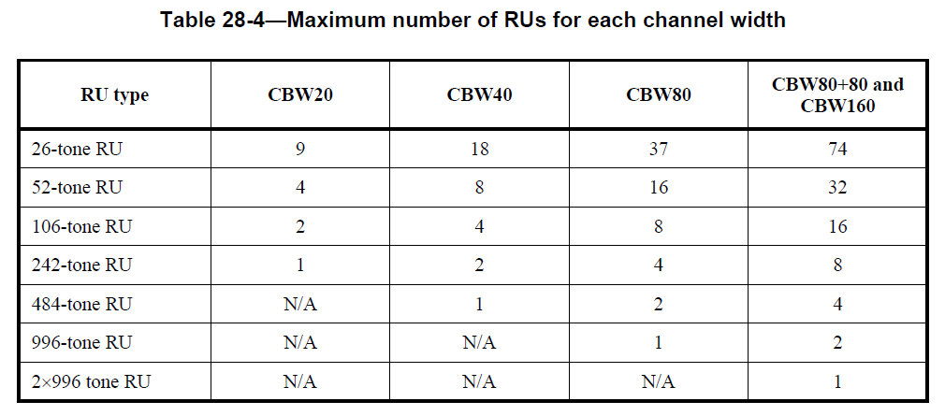
Discussion
BW/RU integration to 8 bits
254 entries

