Slide 1
802.11ba Architecture Discussion
Date: 2017-07-07
Authors:

Slide 2
Abstract
This presentation is an outline of considerations to lead a discussion between TGba and ARC SC, on any adjustments/additions needed to 802.11 architecture to support 802.11ba.
The intention is not to “solve” the 11ba architecture, but to inform TGba members of architecture concepts that are of potential concern, and more importantly to inform the ARC SC members of TGba’s concepts so we can jointly understand if there are any new architectural concepts.

Slide 3
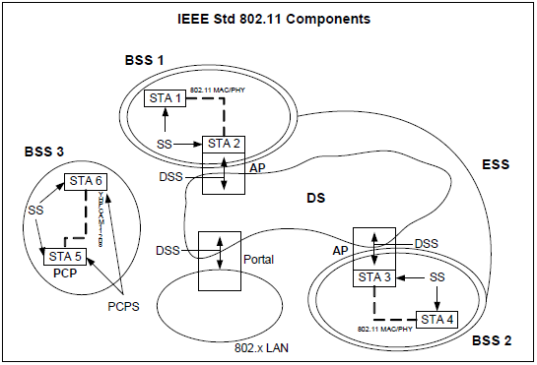
Current 802.11 architecture concepts
A STA is part of a BSS (or IBSS, MBSS, …)

Slide 4
Current 802.11 architecture concepts
A STA typically has a single MAC, single PHY, and Mgmt

Slide 5
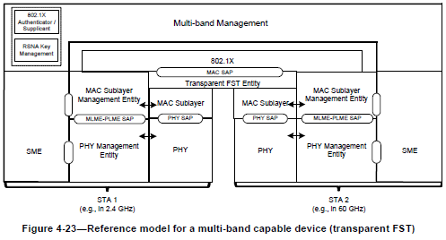
Current 802.11 architecture concepts
There are devices with more than one PHY:
An “AP device” (a box people tend to call an “AP”) typically has multiple PHYs (different bands). These are separate STAs, that happen to be collocated. Interaction between them is out of scope for 802.11. (Effectively, it is via the DS, just like non-collocated APs.)
802.11ad added the concept of FST, and a multi-band device. These, again, contain multiple STAs, but with Management and an optional Transparent FST Entity interconnection that is within 802.11 scope.

Slide 6
Current 802.11 architecture concepts
There is no “STA” with more than one PHY
A “STA” is a singly addressable instance of a MAC and PHY

Slide 7
Questions/topics for TGba
Is the WUR an independent PHY?
Is the WUR an independent MAC?
Is the WUR always physically collocated with an 802.11 AP or STA?
Does the WUR have an address? Or, does it “share” the collocated STAs address?
Does the WUR MAC connect to/integrate with the 802.11 MAC?
OR… Does the WUR ‘wake’ the device, and the device contains independent WUR and an 802.11 MAC/PHY, and some ‘host function’ between them?
Perhaps related/duplicate: Does the introduction of the WUR impact the behavior of a collocated/integrated STA’s MAC/PHY?

Slide 8
More advanced questions/topics for TGba
Does a WUR associate to a BSS?
If yes, the same BSS as any collocated/integrated STA, or a separate ‘overlay’ BSS of WUR devices?
Does the WUR work with all 802.11 PHYs e.g. a, b, g, n, ac, ad, ah, ax, ay?
Does the WUR work with mesh STAs? IBSS? OCB?

