Slide 1
Variable signal bandwidth of the wake-up signal for enhanced WUR performance
Date: 2017-07-10
Authors:

Slide 2
Abstract
In [1] it is high-lighted that a 4 MHz wake-up signal will suffer about 7dB in allowed TX power, when the limit is set by PSD
From a power consumption point of view, it may be beneficial to have smaller bandwidth. However the loss in link budget is huge
Here we propose to allow the wake-up signal to be sent with a suitable bandwidth which can be used to obtain a optimum sensitivity-power consumption trade-off
The WUR may also select the bandwidth of the channel selective filter independent of the signal bandwidth
The idea can be seen as a special case of what was presented in [2], but without concurrent transmission of data

Slide 3
Outline
Recap of link budget considerations
Motivation
Simulated sensitivity as a function of signal bandwidth
  Simulation set-up
  Performance in AWGN
  Performance in Frequency selective channels
WUR implementation aspects and other observations
Conclusions
Straw polls

Slide 4
Recap of link budget considerations
In [1], it is emphasized that a 4 MHz WUS will suffer 4 or 7 dB in allowed TX power due to regulatory requirements (different for different bands)
It has also been agreed that it is reasonable to assume that the noise figure is 8 dB higher for the WUR
In addition, it was shown in [3], that the loss in frequency diversity for a 4 MHz signal compared to a 20 MHz channel easily can be a few dB

Slide 5
Motivation
To compensate for the relatively small bandwidth, the data rate has to be reduced
  Leading to longer wake-up packets
  To some extent leading to increased complexity (harder synchronization and FEC decoding)
Here it is proposed to instead increase the bandwidth of the signal when needed (“Link adaptation”)
This means a corresponding increase in range, but with no cost in WUR power consumption as the large bandwidth only is used when needed

Slide 6
Motivation – Illustration of the idea
Frequency
IFFT
4 MHz
8 MHz
16 MHz
The power of the WUS is boosted by allocating more sub-carriers to the WUS.
The smallest BW corresponds to the 13 sub-carriers first proposed in [7]
Of course, the idea only makes sense if the required sensitivity for a wideband signal is not degraded too much

Slide 7
Model for receiver processing
-
CSF
Env. Det.
ADC
4
correlator
|
.
|
LPF
ADC runs at 4x oversampling relative WUS symbol rate
Correlator (coeff. +/-1) operating on signal with DC bias
Manchester coding used, so no need to estimate the decision threshold DC
CSF selected to signal BW +/- 500 kHz

Slide 8
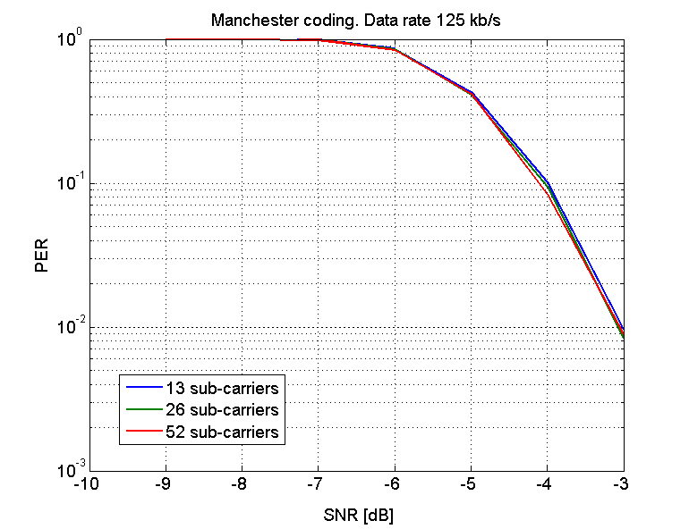
Simulations – AWGN channel – without CSF
If no channel selective filter (CSF) is used, the bandwidth of the signal does not matter in terms of required SNR
The noise bandwidth is the same and the data rate is the same

Slide 9
Simulations – AWGN channel – with CSF
With a CSF, a smaller signal bandwidth will, however, also allow for correspondingly less noise at the envelope detector input
As can be seen, the gain is about 1 dB for a 2x (3 dB) decrease of the bandwidth.

Slide 10
Simulations – Explanation
CSF
Env. Det.
|
.
|
LPF
The reason why increasing the (noise) bandwidth of the CSF does not decrease the performance correspondingly is due to the LPF in the detector
The LPF still removes part of the noise power, although the signal is passed through a non-linear component
The BW of the LPF is determined by the data rate, not by the signal bandwidth, and is here 150 kHz

Slide 11
Link budget comparison – Example
4 MHz, 13 sub-carriers
16 MHz, 52 sub-carriers
TX = 16 dBm
TX = 22 dBm
Max PL = 112 dB
Max PL = 108 dB
Noise floor = -86 dBm
C/N = -6 dB
C/N = -4 dB
RX sens. = -92 dBm
RX sens. = -90 dBm
NF = 15 dB
kTB = -101 dBm

Slide 12
Simulations – Frequency selective channels

Slide 13
Simulations – Frequency selective channels
For an AWGN channel of roughly 4 dB was seen in terms of range.
For a frequency selective channel, the diversity gain from using a larger bandwidth will significantly increase this gain
For TGnB and TGnD and a PER of 10%, the sensitivity is rougly independent of bandwidth, and the gain in range thus proportional to TX power
For 1% PER which may be a more reasonable requirement for fixed installations, the gain in range is on the order of 8-10 dB

Slide 14
Additional benefits
The sync becomes simpler, and with a shorter syncword the efficiency is increased
Even if one can meet the sensitivity requirement by coding and repetition, the improvement obtained by wide BW is always on top of this, and sync is not helped by repetition or FEC. In addition repetition and coding implies that the packet duration is increased

Slide 15
WUR implementation aspects
Changing the bandwidth of an analog filter (keeping all other parameters the same) is easily done by shifting in/out components or changing bias levels. There are no issues related to switching time…
If a wideband WUS is used, a WUR with good channel conditions may still use a CSF with a small BW in order to save power => For multicast/broadcast, receivers can decide autonomously what BW to use if WUS is transmitted with a large BW
Since the BW of the filter can be selected independent of the signal bandwidth, a smaller bandwidth may also allow for a lower order filter still meeting ACI requirements

Slide 16
Other observations - Relation to FDM transmission
Frequency
4 MHz
4 MHz
4 MHz
16 MHz
In [9] it has been proposed to allow for transmission of several WUSs by means of FDM
One may, potentially, see this as a generalization of the proposal with a varying bandwidth as illustrated in the figure above, with all 4 MHz channel carrying identical OOK signals

Slide 17
Other observations
A gain of, say, 6 dB can of course be used in other ways than increasing the range. Some examples are:
Increase the data rate a factor of 4
Increase the noise factor by 6 dB in the WUR

Slide 18
Conclusions
In this contribution it is suggested to take advantage of the properties of the wake-up signal properties that the bandwidth of the signal and the symbol rate are independent
The bandwidth of the transmitted signal may be increased without any modification needed in the WUR
If the bandwidth of the CSF in the WUR is increased, say a factor of 4, gains of 4 dB or more can be obtained

Slide 19
Straw Poll
Do you support to add to the SFD that the wake-up signal may be transmitted using different bandwidths, e.g. depending on sensitivity requirements for the WURx?
Y/N/A: 0/0/0

Slide 20
Straw Poll
Do you support to add to the SFD that the device with the WUR can request the wake-up signal to be transmitted with the maximum bandwidth?
Y/N/A: 0/0/0

Slide 21
References
S. Shellhammer and B. Tian, “Regulations and noise figure - Impact on SNR”, IEEE 802.11-17/0365r0.
L. Wilhelmsson and M. Lopez, “Concurrent transmission of data and a wake-up signal in 802.11ax,” IEEE 802.11-17/0094r1.
L. Wilhelmsson, “Simulated WUR performance in frequency selective channels,” IEEE 802.11-17/0662r0.
S. Shellhammer and B. Tian, “Data rates and coding”, IEEE 802.11-17/0670r0.
E. Park et al., “OOK signal bandwidth for WUR,” IEEE 802.11-17/0665r3.
S. Azizi et al, “Simulation scenario and evaluation methodology,” IEEE 802.11-17/0188r5.
M. Park et al., “Low-power wake-up receiver (LP-WUR) for 802.11,” IEEE 802.11-15/1307r1
J. Liu et al., “On waking-up multiple WUR stations,” IEEE 802.11-17/0028r0

Slide 22
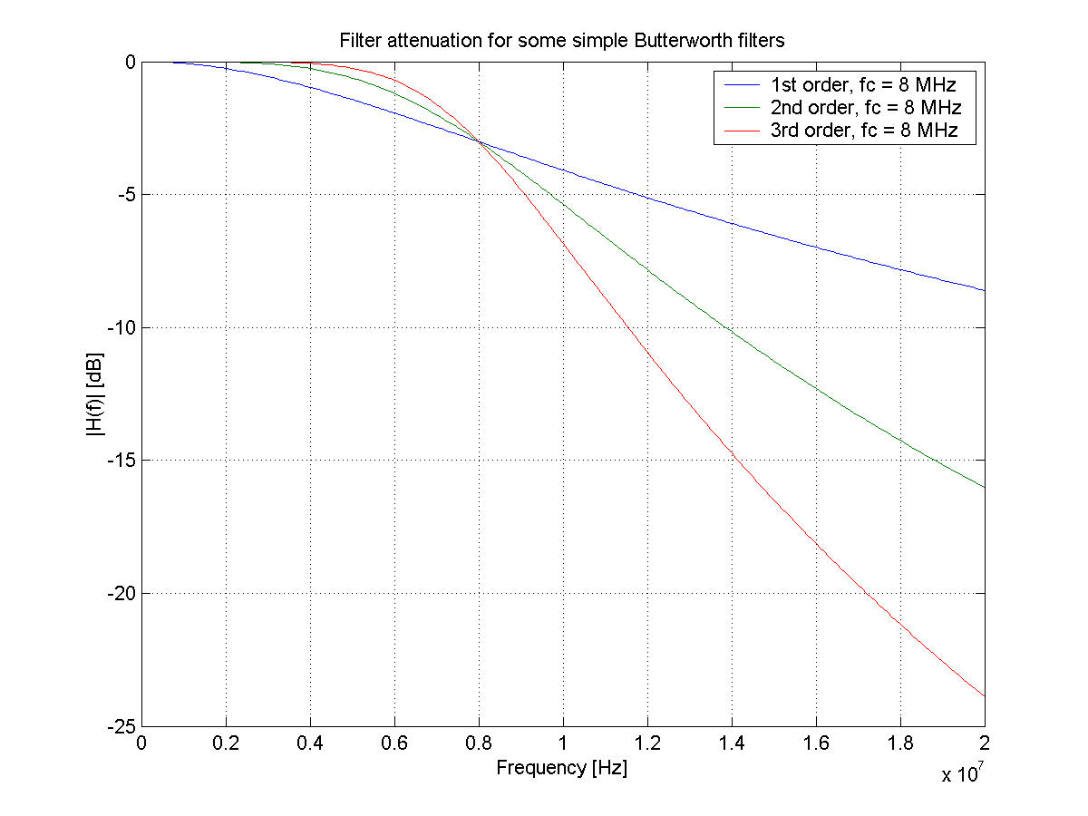
Simple ACI calculation
The requirement on ACI is C/I = -16 dB to be the same as for MCS0 for the main radio
When BCC is used, but no repetition, we need C/N = -8 dB
=> The CSF need to suppress the ACI by 8 dB
A 2nd order filter suffice for the 16 MHz bandwidth

