Slide 1
Broadcasting on WLAN
Date: 2017-07-11
Authors:

Slide 2
Abstract
This presentation describes a proposal of broadcasting on WLAN.

Slide 3
Motivation
Many people need common information at specific locations, such as
  Explanation at a tourist attraction,
  Timetable at a train station, or
  Floor plan at a shopping mall.
We call them “local information” in this presentation.
People who need local information currently do the following steps.
  Connect to the Internet.
  Search web sites.
  Follow a link to get local information.
This consumes bandwidth because
  Each user consumes bandwidth and
  Search traffic is a overhead.
Broadcasting local information on WLAN can reduce per user bandwidth and improve user experience.

Slide 4
Broadcasting Service on WLAN
WLAN is a suitable medium for local broadcasting service, but it is not used.
  Radio wave is suitable for broadcasting based on its nature.
    Anyone can listen in the range.
  Frequently changed information, such as vacant space at a parking lot, can be reflected in real time.
  IEEE802.11 WLAN has broadcast mechanism (group address)
  Unlicensed
  Locality
  Low cost
Currently used broadcasting service on WLAN, such as YouTube Live, Facebook Live
  Application layer broadcasting
  It is composed of many independent unicast streams in a single BSS.
    The occupied bandwidth is proportional to the number of participating users.
  The current model suffices if users are distributed world-wide, but works highly inefficiently when they are located in a small area.

Slide 5
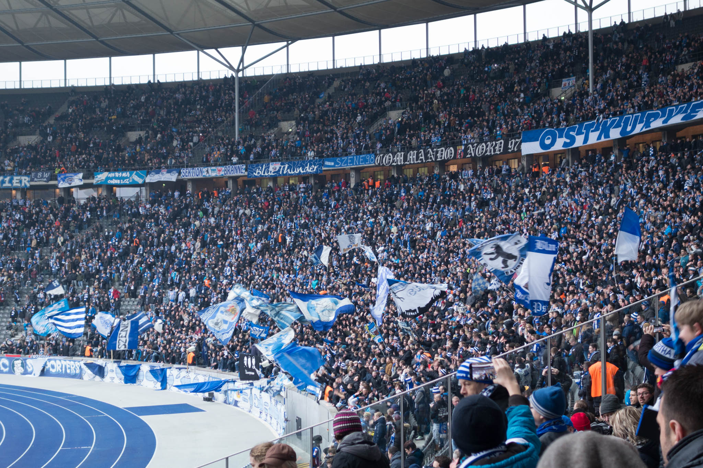

Use Case 1 (Audio Guidance)
AP
Train
STA
Anyone in stadium, museum, zoo or tomorrow’s river cruise, who has a smartphone can listen audio guidance/comments without additional hardware.
Multiple logical channels can be used. Multilingual broadcasting can be supported on a single radio channel.
Of course, any type of data can be broadcast, such as video, text, HTML…

Slide 6
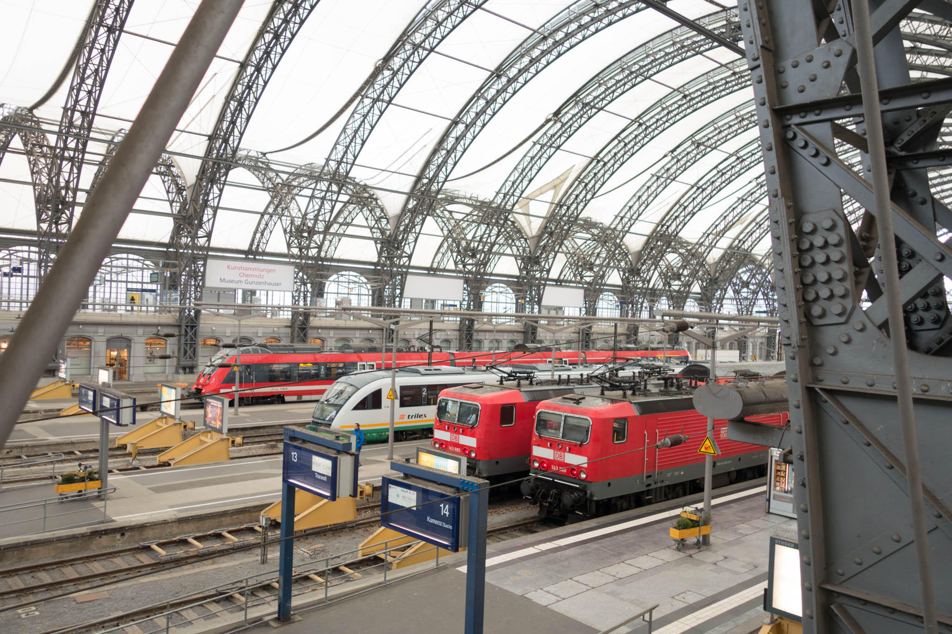
Use Case 2
(Floor Guide, Timetable, Advertisement)
AP
Train
STA
Smartphone
Digital Signage Device
Anyone in a shopping mall, conference venue like here, who has a smartphone can see the floor guide on their device.
Anyone in a train station who has a smartphone can see the timetable on their device.
Digital signage device in the area can show the same information.

Slide 7
Current User Experience
Poor user experience to get local information
  Many steps to get local information
  Options to connecting to the Internet:
    Require to obtain and input ID/Password,
      For security reasons
    Require to answer to captive portal,
    Use EAP-SIM. It depends on mobile carrier and WLAN operator, or
    Use cellular network.
  Search local information
  Get local information

Slide 8
An Example of Ideal User Interface
App automatically receives broadcast frames and shows the available channels (information).
User just selects the channel.
  No need to search web site.
TV like user interface
Time | Destination | Track
13:00 | Hanover | 6
13:07 | Frankfurt | 3
13:12 | Paris | 1
13:15 | Munich | 7
13:25 | Koln | 5
13:31 | Hamburg | 4
13:33 | Hanover | 6
13:46 | Frankfurt | 2
13:48 | Koln | 3
13:55 | Amsterdam | 1
Departure
Arrival
Station map
Shops
Restaurants
1
2
3
4
5
6
7
Example in train station

Slide 9
Security Considerations
Target broadcasting service model
  Anyone in the area can receive information.
    No eavesdropping concerns.
Authentication
  AP does not need to authenticate STAs.
  STA should authenticate APs.
    STA should authenticate each broadcast data frame to prevent fake-AP and MITM attack.
    Current IEEE802.11 broadcast frame has potential risk of Fake-AP/MITM attack.
      GTK is a key shared by all members in the GTKSA.
      Anyone in the GTKSA can generate broadcast data frames as a fake-AP.
Encryption
  Encryption is not required.
So only “Frame Authentication Mechanism” should be implemented.

Slide 10
IEEE802.11 Authentication, Association and RSNA
In this broadcasting model, the IEEE802.11 authentication, association and RSNA are not required.
  AP does not need to care which STA listens.
  Because non-AP STA never send data to AP.
  Operators of broadcasting AP do not need to care non-AP STAs’ network abuse.
  IEEE802.11 authentication, association and RSNA can be used if an operator wants to identify users.
Make new standard for Class 1 broadcast data frame.
  Class 1 frame can be used both in state 1 and in state 4.

Slide 11
QoS Considerations
QoS for broadcast frames
  In general, the loss rate of broadcast frame is higher than unicast frame.
  Broadcast does not have ACK mechanism.
  Existing 802.11 uses BCC/LDPC.
  Is required stronger FEC/Interleaving algorithm?
  Consider to apply 802.11aa GCR mechanism.
    In this case, association to AP is required.
QoS for other .11 frames
  How much bandwidth can be used for broadcasting?
  Define limit of bandwidth?
  Adaptive control?
  Consider to apply 802.11aa OBSS management.

Slide 12
Conclusion
Broadcasting on WLAN can improve user experience.
For broadcasting on WLAN:
  Define Class 1 broadcast data frame
  Consider QoS mechanism.
  Define frame authentication mechanism
It’s time to start work for broadcasting
  Because we can assign “IEEE802.11bc” for broadcasting!

Slide 13
Comments & Questions

Slide 14
Straw poll 1
Are you interested in “broadcasting on WLAN”?
  Yes:
  No:

Slide 15
Straw poll 2
Do you support to make a standard for “broadcasting on WLAN”?
  Yes:
  No:
  Don’t care:
  Need more info:

