Slide 1
Midamble Design
Date: 2017-07-06
Authors:

Slide 2
Introduction
Midamble was proposed in [1][2] to address the Doppler scenario for 11ax.
This presentation:
  Midamble Frame Format
  Further simulations to address the options for Midamble periodicity
  Tx and Rx PHY Parameter Computations

Slide 3
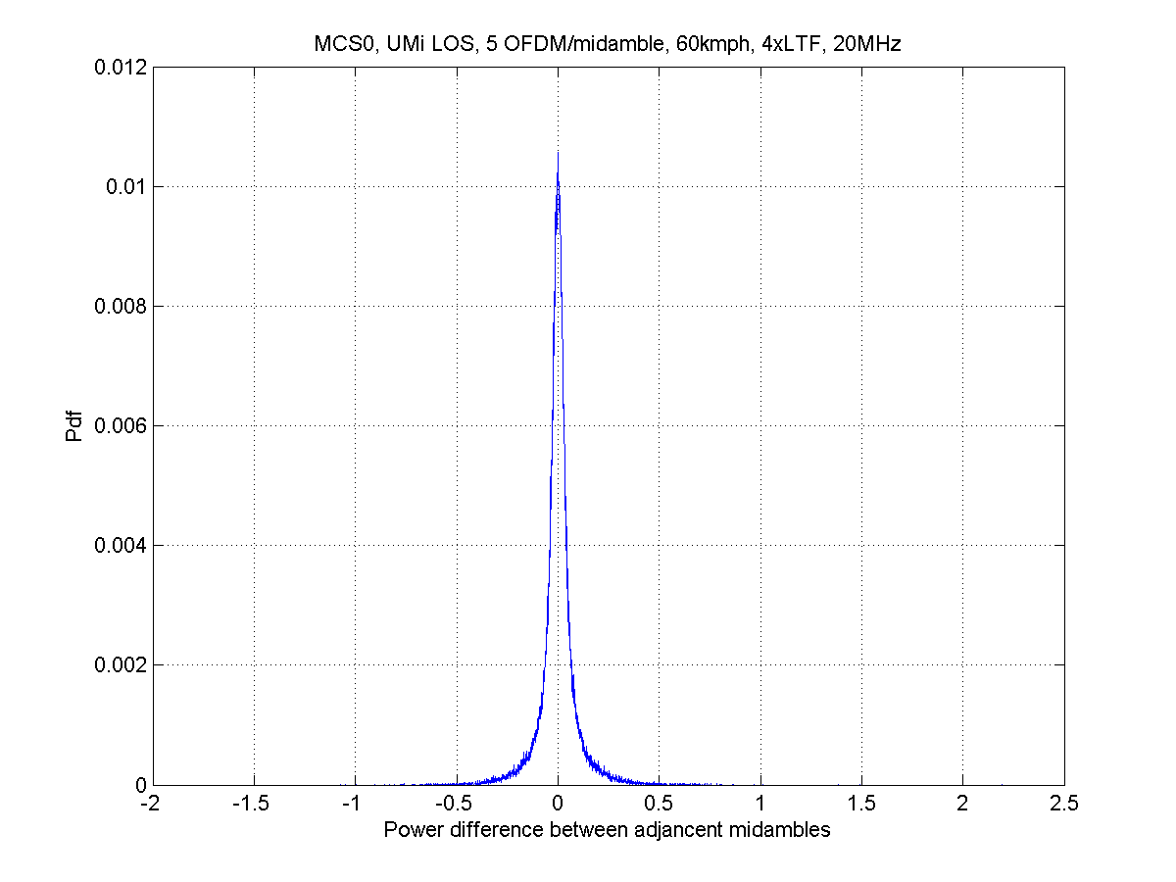
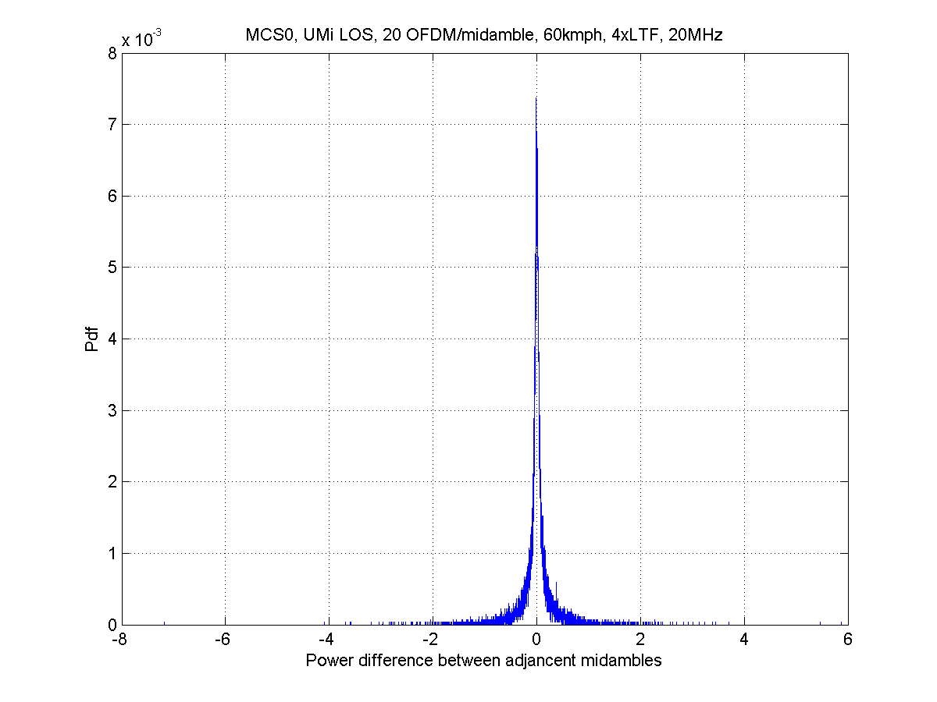
Midamble Format (1)
According to [1], the typical power fluctuation between midambles in predestrian scenarios is low, much below the typical headroom.
Even if there is some power fluctuation, receiver should be able compensate digitally without additional STF field.
Propose to NOT have HE-STF field in the midamble.
MMA=5
MMA=20
Hongyuan Zhang, Marvell, et al

Slide 4

Midamble Format (2)
HE-LTF: propose HE-LTFs in midamble is the same as those in the preamble of the same PPDU.
Number of Midambles: $N_{MA}=\left\lceil \frac{N_{SYM}}{M_{MA}}\right\rceil −1,$ i.e. the 1st Midamble is right after the M_{MA}-th symbol, and no Midamble inserted after the last (even when NSYM is dividable by MMA).
Hongyuan Zhang, Marvell, et al

Slide 5
Midamble Periodicity
Simulation Setups:
  DNLOS channel, speed: [3kmph, 60kmph, 3kmph]
  UMi-LOS channel, Speed: 60kmph on 2nd and 3rd clusters, 3kmph on all other clusters
  80M BW @ 5GHz—testing high throughput feasibility
  Packet length: 100 OFDM symbols regardless of MCS
  LDPC, 4xLTF, GI 1.6us
  4x2, 2ss
  2x4, 2ss
  1x1, 1ss

Slide 6
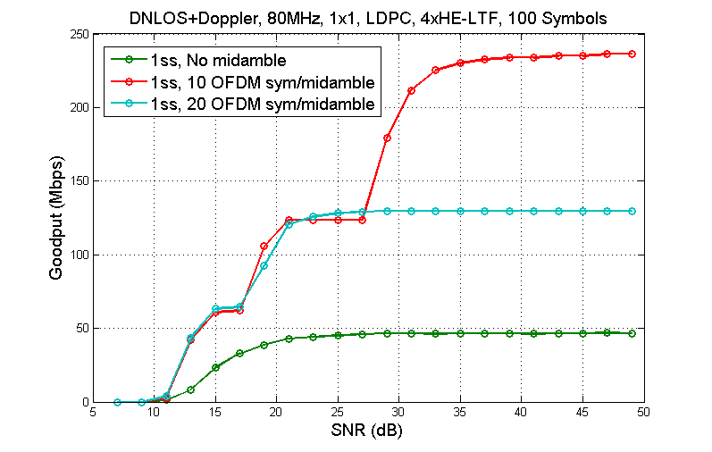
DNLOS 1x1

Slide 7
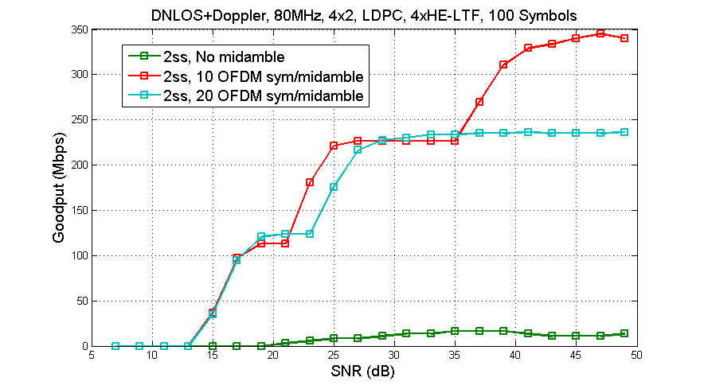
DNLOS 4x2

Slide 8
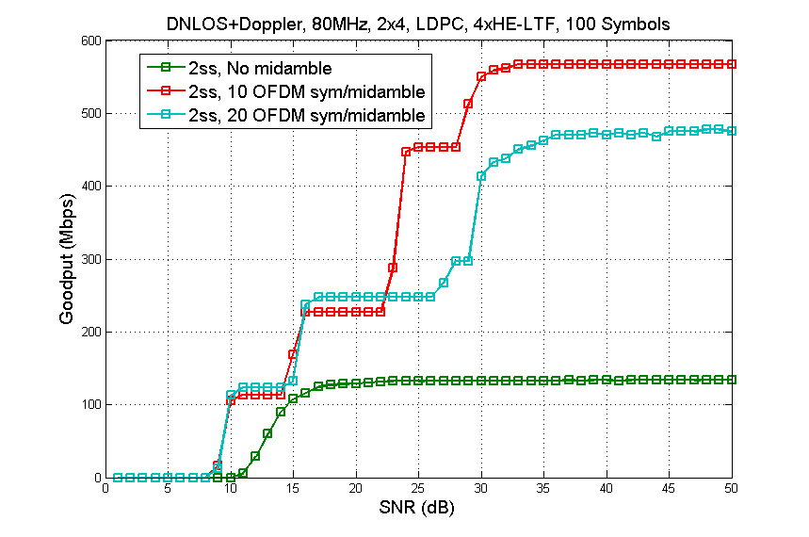
DNLOS, 2x4

Slide 9
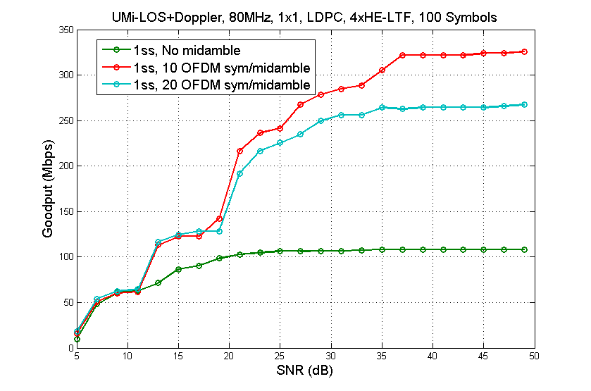
UMI-LOS, 1x1

Slide 10
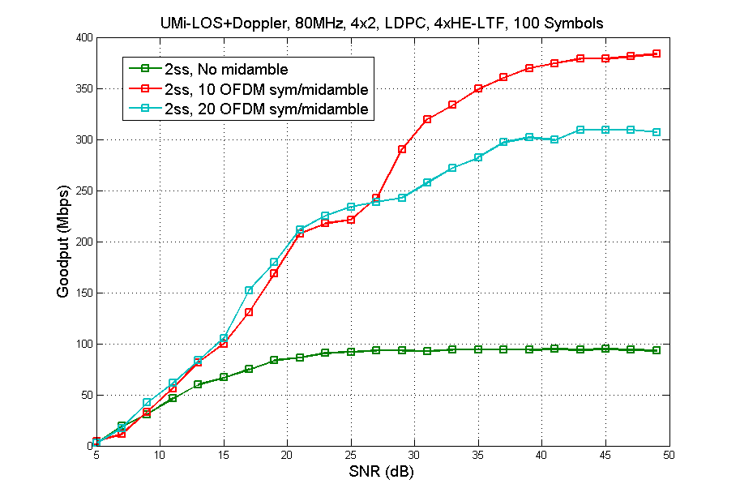
UMI-LOS, 4x2

Slide 11
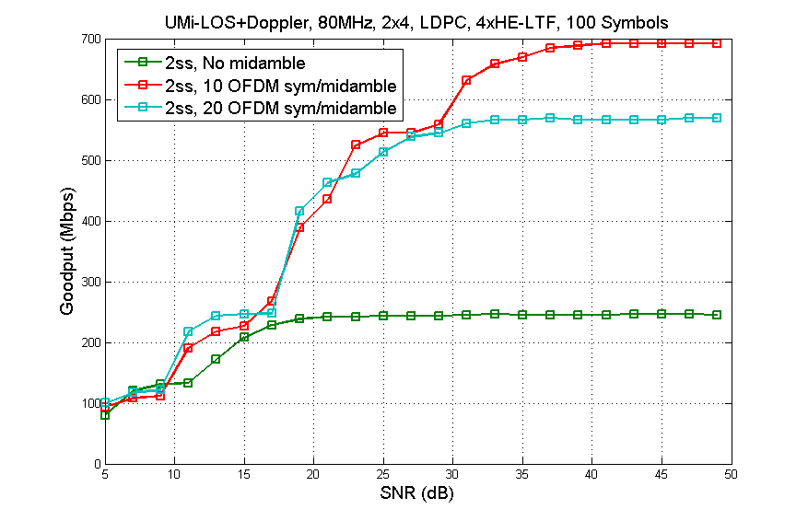
UMI-LOS, 2x4

Slide 12
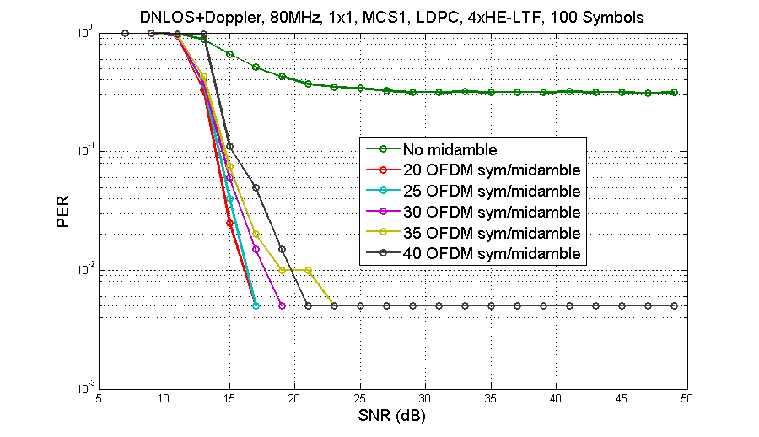
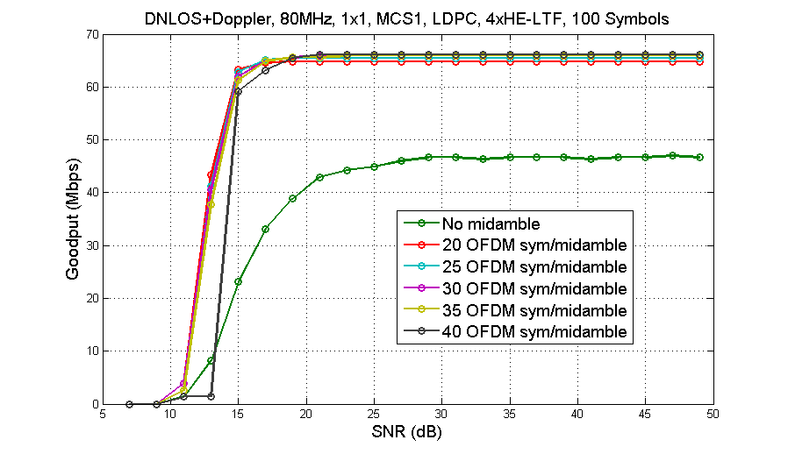
DNLOS, MCS1, 1x1, Different Midamble Periodicity

Slide 13
Midamble Periodicity Discussions
MMA = 10 is a good choice
  Good performance in most cases
  Reduces PER at high MCS and/or high Doppler
MMA = 20 has some advantage at low MCS and/or low Doppler
  Further increasing MMA value does not improve much from MMA = 20
Propose to define 2 options of midamble periodicity: 10 and 20 symbols
  Tradeoff between flexibility and complexity

Slide 14

Tx PHY Parameters
Tx side: TXTIME needs to be adjusted when midamble is present.
All other parameters (e.g. L-LENGTH) are adjusted based on TXTIME.
where $N_{MA}=\left\lceil \frac{N_{SYM}}{M_{MA}}\right\rceil −11$
$$=\left\lceil \frac{N_{SYM}}{M_{MA}}\right\rceil −1$$

Slide 15
Rx PHY Parameters (1)
Rx computation on number of midambles NMA—multiple options, receiver may choose whatever more feasible for its implementation, e.g.
where
Corner case:

Slide 16
Rx PHY Parameters (2)
Another Example:
where

Slide 17
Rx PHY Parameters (3)
Rx computation on NSYM and TPE:
Rx computation on RXTIME:

Slide 18
Conclusions
Midamble is appropriate to address channel Doppler, meanwhile possible to achieve high throughput.
  Shown 80MHz, multi-stream and relative mid-high MCS performances.
Simple to implement, fast industry adoption.
Detailed Midamble design proposals:
  No HE-STF, same HE-LTF as preamble.
  Two periodicity options.
  Tx, and Rx parameter computations.
Refer to [3] for detailed text change proposals (comment resolution for Doppler related CIDs)

Slide 19
SP1
Do you agree that
  Midamble is composed by HE-LTF(s) the same as in the preamble of the same PPDU, and no HE-STF field.
  There is always no midamble inserted after the last Data OFDM symbol?

Slide 20
SP2
Do you agree that there are two options of midamble periodicity, which are 10 and 20 Data OFDM symbols, respectively?

Slide 21
References
[1] 11-17-0734-01-00ax-doppler-discussions
[2] 11-17-0773-02-00ax-thoughts-on-doppler-design-in-802-11ax
[3] 11-17-0995-00-00ax-Doppler-comment-resolutions

