Slide 1
Preamble Design and Simulations
Date: 2017-07-08
Authors:

Slide 2
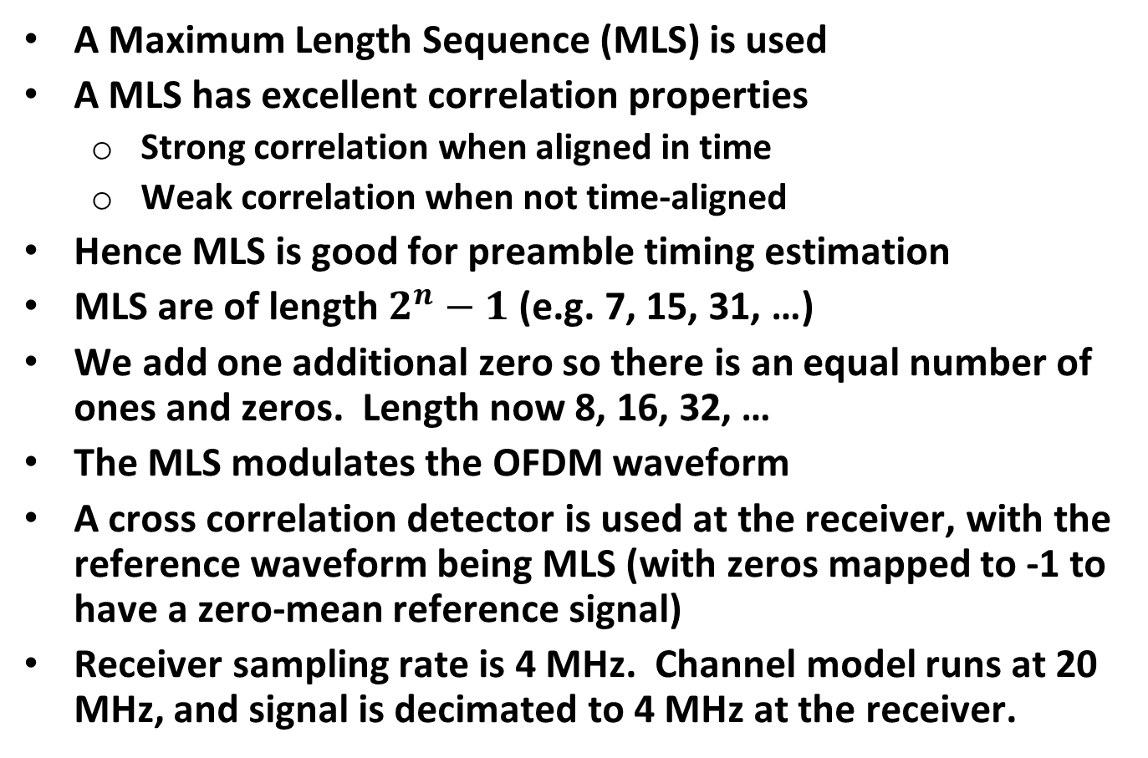
Preamble Design
A Maximum Length Sequence (MLS) is used
A MLS has excellent correlation properties
  Strong correlation when aligned in time
  Weak correlation when not time-aligned
Hence MLS is good for preamble timing estimation
MLS are of length $2^{n}−1$ (e.g. 7, 15, 31, …)
We add one additional zero so there is an equal number of ones and zeros. Length now 8, 16, 32, …
The MLS modulates the OFDM waveform
A cross correlation detector is used at the receiver, with the reference waveform being MLS (with zeros mapped to -1 to have a zero-mean reference signal)
Receiver sampling rate is 4 MHz. Channel model runs at 20 MHz, and signal is decimated to 4 MHz at the receiver.

Slide 3
Example MLS’s
[0,1,0,0,1,1,1,0]
[0,1,0,0,0,1,1,1,1,0,1,0,1,1,0,0]
[0,1,0,0,0,0,1,0,1,0,1,1,1,0,1,1,0,0,0,1,1,1,1,1,0,0,1,1,0,1,0,0]
Example Receiver Reference Sequence
[-1,1,-1,-1,1,1,1,-1]
[-1,1,-1,-1,-1,1,1,1,1,-1,1,-1,1,1,-1,-1]
[-1,1,-1,-1,-1,-1,1,-1,1,-1,1,1,1,-1,1,1,-1,-1,-1,1,1,1,1,1,-1,-1,1,1,-1,1,-1,-1]

Slide 4
Simulation
Simulate two hypothesis
  H0 – Noise Only
  H1 – Signal + Noise
Pad preamble with zeros to 2 ms, which is the RX listening duration
The Test Statistic is the maximum value of the correlator output over the 2 ms interval

Slide 5
SNR Level
Design | Data Rate (kb/s) | 10%-PER SNR (dB) AWGN | 10%-PER SNR (dB) Model D
Manchester Code | 125 | -7.3 | -1.1
The Data Rates have not yet been selected
We simulate at the SNR for the 125 kb/s rate
Based on these Data Field simulations the following SNR values were simulated for H1 sims
AWGN (dB) | Model D (dB)
-7.3 | -1.1

Slide 6
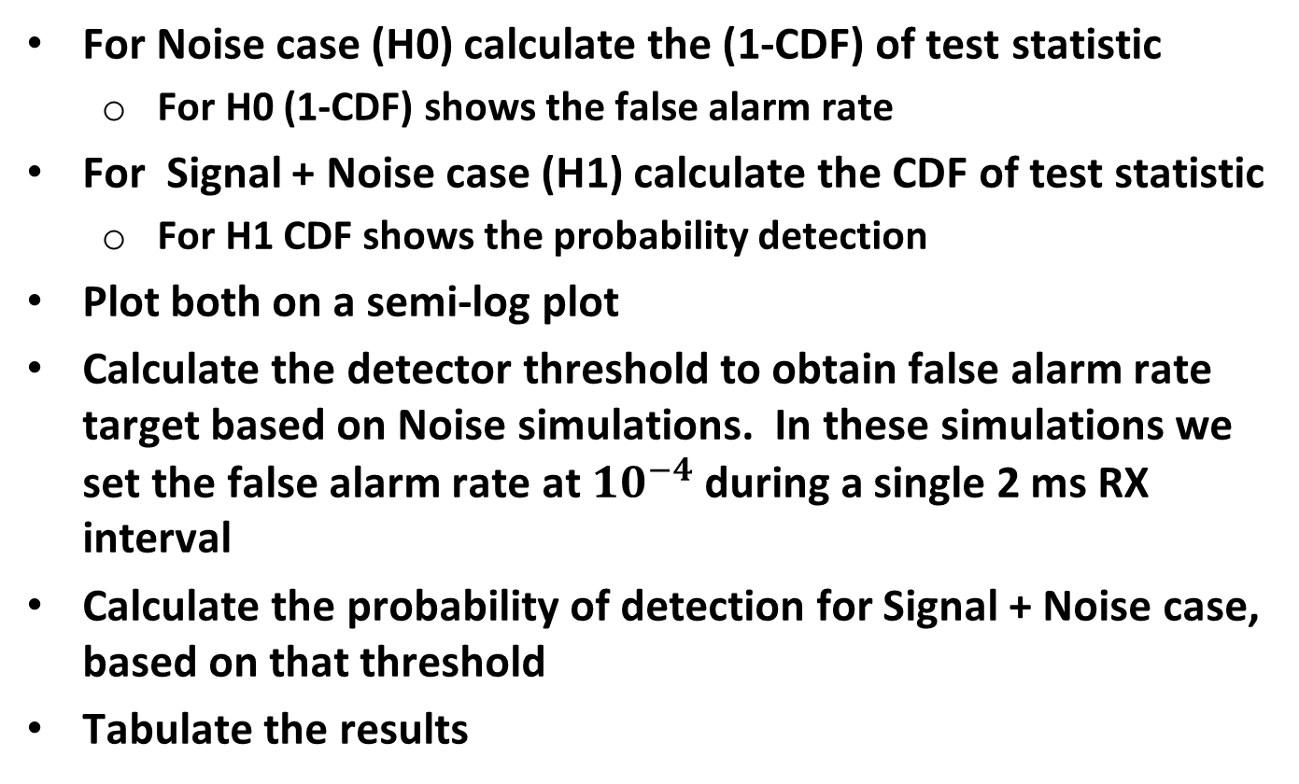
Post Simulation Processing
For Noise case (H0) calculate the (1-CDF) of test statistic
  For H0 (1-CDF) shows the false alarm rate
For Signal + Noise case (H1) calculate the CDF of test statistic
  For H1 CDF shows the probability detection
Plot both on a semi-log plot
Calculate the detector threshold to obtain false alarm rate target based on Noise simulations. In these simulations we set the false alarm rate at $10^{−4}$ during a single 2 ms RX interval
Calculate the probability of detection for Signal + Noise case, based on that threshold
Tabulate the results

Slide 7

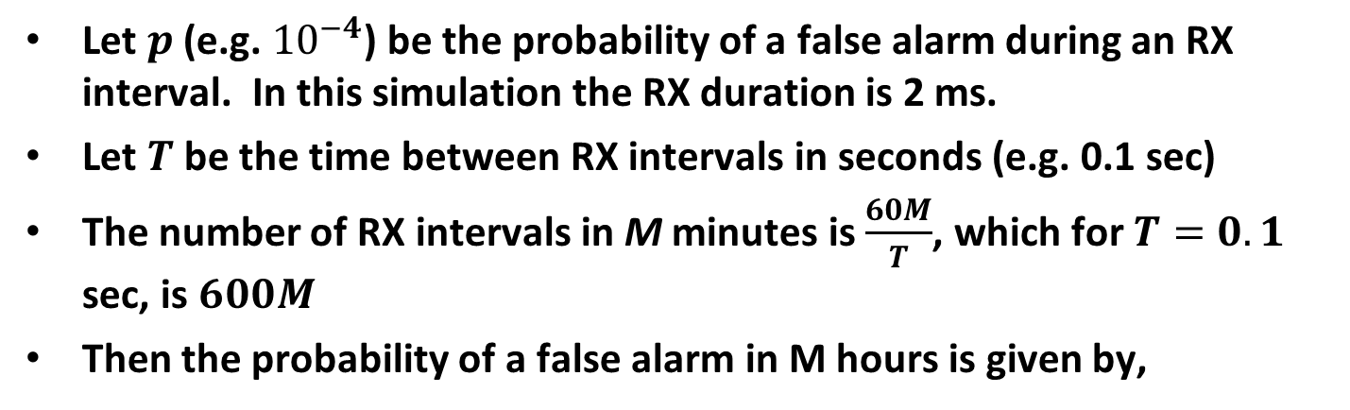
False Alarms over a Period of Time
Let $p$ (e.g. ${10}^{−4}$) be the probability of a false alarm during an RX interval. In this simulation the RX duration is 2 ms.
Let $T$ be the time between RX intervals in seconds (e.g. 0.1 sec)
The number of RX intervals in M minutes is $\frac{60M}{T}$, which for $T=0.1$ sec, is $600M$
Then the probability of a false alarm in M hours is given by,
$$Prob=1 −{\left(1 −p\right)}^{600M}$$
For $p=10^{−4}$ we get the following false alarm rates
Duration (Minutes) | False Alarm Rate
1 | 0.06
10 | 0.45

Slide 8
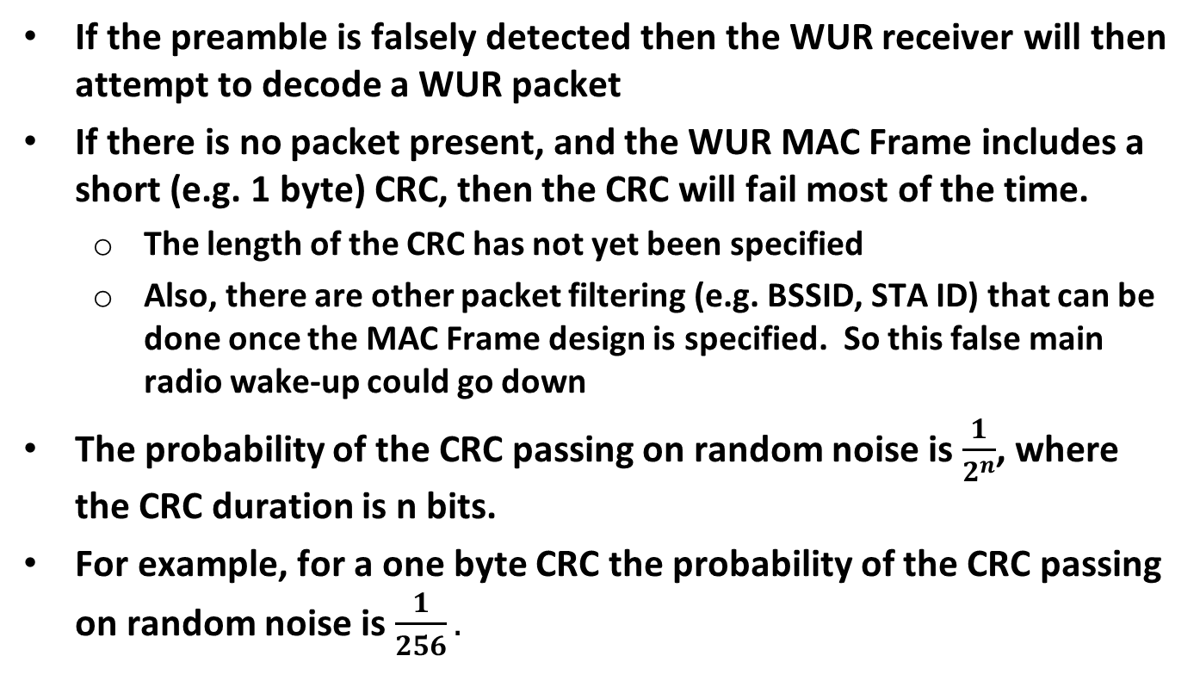
False Main Radio Wake-up
If the preamble is falsely detected then the WUR receiver will then attempt to decode a WUR packet
If there is no packet present, and the WUR MAC Frame includes a short (e.g. 1 byte) CRC, then the CRC will fail most of the time.
  The length of the CRC has not yet been specified
  Also, there are other packet filtering (e.g. BSSID, STA ID) that can be done once the MAC Frame design is specified. So this false main radio wake-up could go down
The probability of the CRC passing on random noise is $\frac{1}{2^{n}}$, where the CRC duration is n bits.
For example, for a one byte CRC the probability of the CRC passing on random noise is $\frac{1}{256}.$

Slide 9

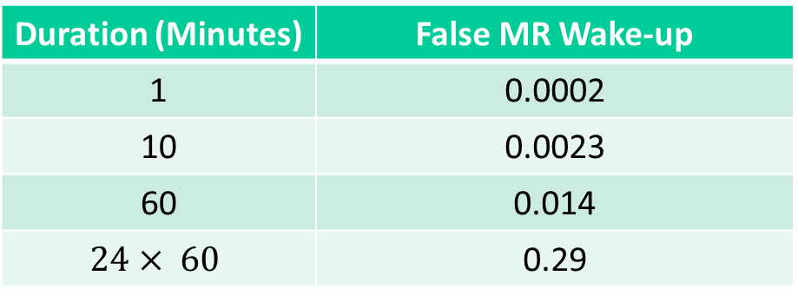
False Main Radio Wake-up (cont.)
Then the probability of a false Main Radio wake-up is given by
$$Prob=1 −{\left(1 −2^{−n}p\right)}^{600M}$$
Duration (Minutes) | False MR Wake-up
1 | 0.0002
10 | 0.0023
60 | 0.014
$$24× 60$$ | 0.29

Slide 10
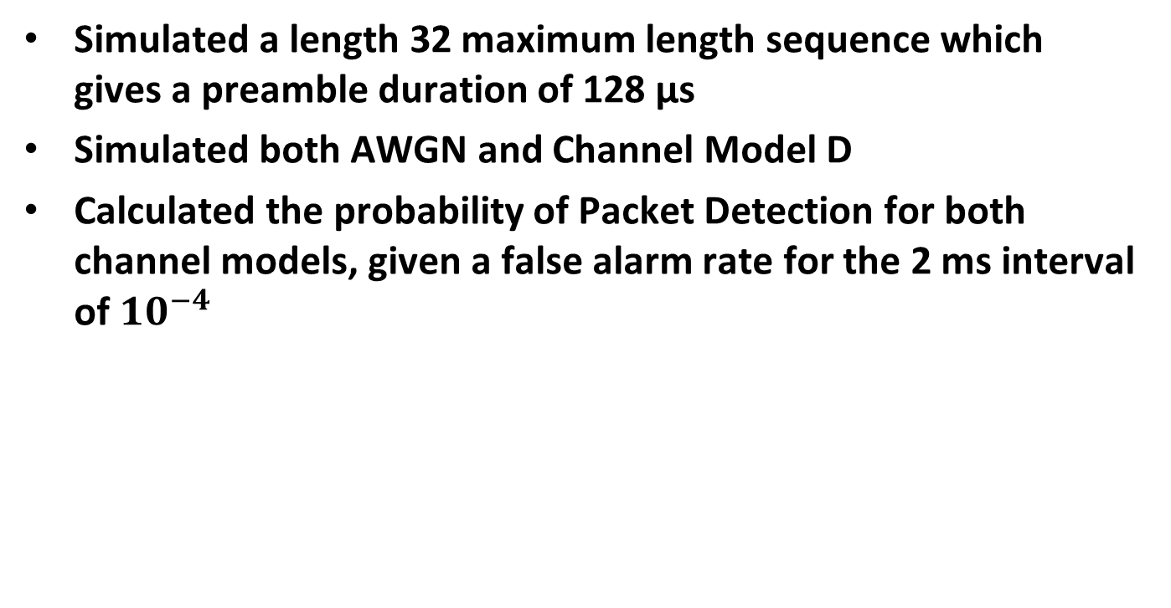
Simulation
Simulated a length 32 maximum length sequence which gives a preamble duration of 128 µs
Simulated both AWGN and Channel Model D
Calculated the probability of Packet Detection for both channel models, given a false alarm rate for the 2 ms interval of $10^{−4}$

Slide 11
AWGN Sim

Slide 12
Channel Model D Sim

Slide 13
Results Summary
SNR (dB) | Channel | Probability of Detection
-7.3 | AWGN | 0.99999
-1.1 | Model D | 0.94
Preamble length: 128 µs
Detection method: cross-correlation
  Performance of autocorrelation based method likely no better

Slide 14
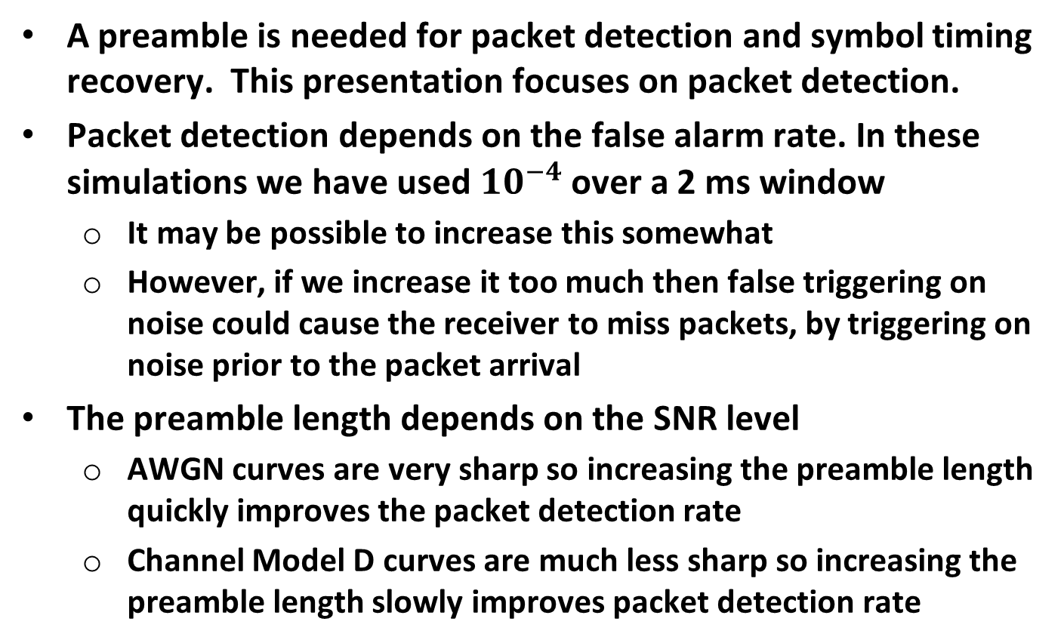
Conclusions
A preamble is needed for packet detection and symbol timing recovery. This presentation focuses on packet detection.
Packet detection depends on the false alarm rate. In these simulations we have used $10^{−4}$over a 2 ms window
  It may be possible to increase this somewhat
  However, if we increase it too much then false triggering on noise could cause the receiver to miss packets, by triggering on noise prior to the packet arrival
The preamble length depends on the SNR level
  AWGN curves are very sharp so increasing the preamble length quickly improves the packet detection rate
  Channel Model D curves are much less sharp so increasing the preamble length slowly improves packet detection rate

Slide 15
Next Steps
Finalize on false alarm rate
Once we settle on the data rates, design and simulate for the SNR associated with those data rates
Begin to investigate symbol timing recovery

