Slide 1
More on the Wake-up AP usage model
Date: 2017-07-10
Authors | Affiliations | Address | Phone | email
Eduard Garcia-Villegas | Universitat Politècnica de Catalunya (UPC) |  |  | eduardg@entel.upc.edu
Elena López-Aguilera | Universitat Politècnica de Catalunya (UPC) |  |  | elopez@entel.upc.edu
Ilker Demirkol | Universitat Politècnica de Catalunya (UPC) |  |  | ilker.demirkol@entel.upc.edu
Josep Paradells-Aspas | Fundació i2CAT and Universitat Politècnica de Catalunya (UPC) |  |  | josep.paradells@entel.upc.edu
Eduard Garcia-Villegas (UPC)

Slide 2
Background
Document 11-17/0029r4 (approved draft TGba Usage Models document [1]) lists several multi-colored usage models:
  Smart Home
  Warehouse
  Outdoor Cattle Farms
  Sensor Network Synchronized Wake Up
  Wearable Devices Unsynchronized Wake Up
  Wearable Devices Reconnection
  Moving Goods Tracking Wake Up
Eduard Garcia-Villegas (UPC)

Slide 3
Background
Document 11-17/0372r3 (Additional usage models for WUR [2]) proposed to add new usage models:
  Put to Sleep packet (decision to move to power save can come from the network)
  Wake-up AP (as a STA, AP can also have a WUR)
  WUP Forwarding (send WUP through multi-hop path)
  Out-of-band Signaling (inter-AP communication)
  Beyond IEEE 802.11 (from 802.11 to non-802.11 device communication)
Only “Wake-up AP” made it to the usage model document (11-17/0029r7 [3]) through a motion
  The rest were (arguably) considered out of the TGba’s PAR scope and were disregarded.
Usage model document [3] (including “wake-up AP” usage model) failed to be approved because of concerns regarding Wake-up AP case
Eduard Garcia-Villegas (UPC)

Slide 4
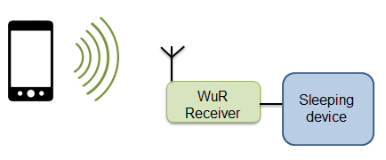
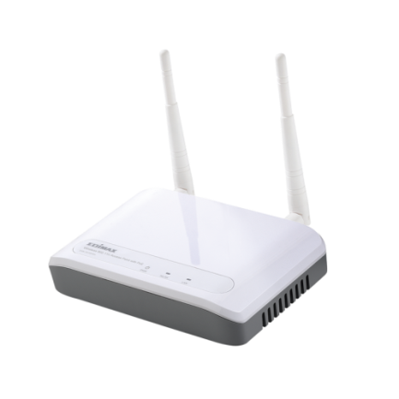

The proposed Wake up AP usage model
Environment
Domestic and small-office/home-office (SOHO) IEEE 802.11 deployments where network is in use only during office hours (or morning/evening hours in the case of domestic users).
Applications
Wake-up of IEEE 802.11 APs for energy savings, reduced interference, increased security and privacy.
Traffic Conditions
Interference with WUP/Sleep Packet SP transmission.
Interference with neighboring legacy 802.11 transmissions in dense environments.
Use case
1.After TBD time of inactivity (or after Sleep Packet) , AP1 is put to sleep in order to save energy, to reduce interference with neighboring WLANs (no beacons, no probe responses, etc.) and to improve security (turning off Wi-Fi reduces the chances of an intruder to access the network).
2.When user of STA1 requires network services, STA1 sends WUP to AP1.WUP may include initial configuration parameters (e.g. channel, bandwidth, power level, etc.) for the AP or AP discovery-related information.
3.Once AP1 is up, regular IEEE 802.11 is established between AP1 and STA1 (and other STAs).
Requirements
  The WUP transmission should enable coexistence with legacy IEEE 802.11 devices operating in the same band.
  WUR-enabled AP has unique identifier
  Optionally, WUP carries control information (e.g. initial config. parameters).
Wake up!
zZzZz
Eduard Garcia-Villegas (UPC)

Slide 5
The approved Wake up AP usage model
Environment
Domestic and small-office/home-office (SOHO) IEEE 802.11 deployments where network is in use only during office hours (or morning/evening hours in the case of domestic users).
Applications
Wake-up of IEEE 802.11 APs for energy savings, reduced interference, increased security and privacy.
Traffic Conditions
Interference with WUP/Sleep Packet SP transmission.
Interference with neighboring legacy 802.11 transmissions in dense environments.
Use case
1.After TBD time of inactivity (or after Sleep Packet) , AP1 is put to remains in sleep in order to save energy, to reduce interference with neighboring WLANs (no beacons, no probe responses, etc.) andor to improve security (turning off Wi-Fi reduces the chances of an intruder to access the network).
2.When user of STA1 requires network services, STA1 sends WUP to AP1.WUP may include initial configuration parameters (e.g. channel, bandwidth, power level, etc.) for the AP or AP discovery-related information..
3.Once AP1 is up, regular IEEE 802.11 transmission is established used between AP1 and STA1 (and other STAs).
Requirements
  The WUP transmission should enable coexistence with legacy IEEE 802.11 devices operating in the same band.
  WUR-enabled AP WUR device has unique identifier
  Optionally, WUP carries control information (e.g. initial config. parameters).
Wake up!
zZzZz
Eduard Garcia-Villegas (UPC)

Slide 6
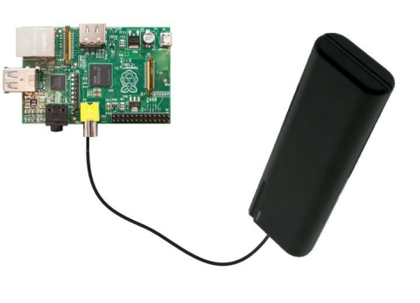
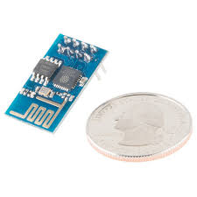

More on the Wake-up AP usage model
Does it make sense for an AP to save power?
  Many applications use mobile APs (cell phones, ad-hoc devices mounted on low power battery-driven equipment)
    c.f. usage model 3 (cattle farm), models 5,6 (wearable devices).
  Simulations in [4] show that power consumption could be as low as 1.2% of that of an AP with no power save mode
IEEE 802.11 STA < > AP
transmission
Cellular (3G/4G/etc.)
UE < > BS transmission
AP1:
Tethering with IEEE 802.11 capable cell phone
AP2:
Battery-driven SBC (e.g an RPi) with IEEE 802.11 NIC
AP3:
MCU+IEEE 802.11 NIC (e.g. ESP8266)

Slide 7
More on the Wake-up AP usage model
Does it make sense for an enterprise/domestic AP to save power?
  Besides reducing interference with neighboring WLANs (no beacons, no probe responses, etc.) and improving security (turning off Wi-Fi reduces the chances of an intruder to access the network), it would save energy (and money)
  From [5]:
 | Office building | Campus | Home
Main network activity hours | 08:00 – 18:00 | 08:00 – 22:00 | 18:00 – 00:00
Number of APs | 100 | 2000 | 1
Power cons. with no power save | 4W x 24h x 100 | 4W x 24h x 2000 | 4W x 24h x 1
Power cons. with power save | (4W x 10h + 0.5W x14h) x 100 | (4W x 14h + 0.5W x10h) x 2000 | (4W x 6h + 0.5W x18h) x 1
Power saved (yearly) | 1,789 kWh | 25,550 kWh | 23 kWh
Money saved (yearly in Italy*) | 438€ ($499) | 6,250€ ($7,122) | 5.6€ ($6.4)
(*) 0. 2446€ /kWh

Slide 8

Example of application
Putting an AP to sleep
  User/administrator manually switches off/puts to sleep the AP
    E.g. via HW button or via remote console/web interface command
  AP automatically switches to sleep state after X time of inactivity
  IEEE 802.11ba capable APs could choose to keep a WUR active during sleep/off state periods
Waking up an AP
  User/administrator manually switches on/wakes up the AP
    E.g. via HW button or via remote console/web interface command
  IEEE 802.11ba-capable APs can also be woken up upon reception of WUP (WUP on the WUR has the same effect as the HW button)
Technical requirements
  AP STAs are equipped with WUR as any other IEEE 802.11ba-capable STA
  Non-AP STAs are capable of transmitting WUP
No 11ba mechanism involved
Eduard Garcia-Villegas (UPC)

Slide 9
Summary
It’s interesting to enable power saving in APs.
  In “mobile” or battery-driven AP applications (e.g. IoT scenarios such as approved usage models 3, 5 and 6) where power saving is critical
  In Enterprise/domestic scenarios where reducing costs is desirable
    Added benefits of reduced interference and increased security
Wake up AP usage model does not impose new requirements outside the scope of TGba’s PAR
Sophisticated examples of application may benefit from a power save protocol on APs but this is neither implied in this usage model nor within the scope of TGba.
Eduard Garcia-Villegas (UPC)

Slide 10
References
[1] 11-17/0029r4, WUR Usage Model Document, Jan. 2017
[2] 11-17/0372r3, Additional usage models for WUR , Mar. 2017
[3] 11-17/0029r7, WUR Usage Model Document, Mar. 2017
[4] 11-17/0728r1, AP Power Saving, May. 2017
[5] Rizzo, Emanuela. Development and performance evaluation of Wi-Fi wake-up radio. MS thesis. Universitat Politècnica de Catalunya, 2016.

Slide 11
Straw Poll 1
Would you approve a usage model document including the wake up AP model, as described in 11-17-0029r7 (slide 17)?
  Yes, the wake up AP model is fine as it was already approved.
  Yes, only after a revision of the wake up AP usage model.
  No.
  Abstain.
  Results:
  0
  14
  9
  12
Eduard Garcia-Villegas (UPC)

