Slide 1
Efficient Positioning Method using Beacon Frames
Date: 2017-07-12
Authors:

Slide 2
Abstract
We propose a method for positioning, which can be used in dense multiuser scenarios. The main objective is to reduce the number of transmissions needed.
The proposed method does not require synchronization of the APs and can support a virtually unlimited number of STAs.
Some initial measurements results are provided.

Slide 3
Localization in Dense Multi User Scenarios
The Fine Timing Measurement (FTM) protocol generates additional traffic overhead and is hardly applicable in scenarios with a large number of users
According to [1], 384 µs is the minimum time per single FTM exchange
With 1000 users and 0.5 Hz update rate (one update per 2 seconds) the medium is consumed for 19% of the time. [1]
With N co-channel APs, the overhead gets N-fold worse [1]
Averaging is usually used for improving the measurement precision. This additionally increases the overhead

Slide 4
Solution [IEEE 802.11-16/1249r0] – sequential beacons
The proposed solution has similarities with GPS
Except: Sequential transmission with virtual synchronization of APs
AP1 transmits a timing frame (TF) frame to AP2, AP2 to AP3 and so on
Replies from AP2 to AP1, AP3 to AP2 and so on, can be very short ACKs
STAs also receive the TFs form the APs
AP1
AP2
AP3
AP4
TF
TF
ACK
TF
ACK
TF
ACK
STA

Slide 5
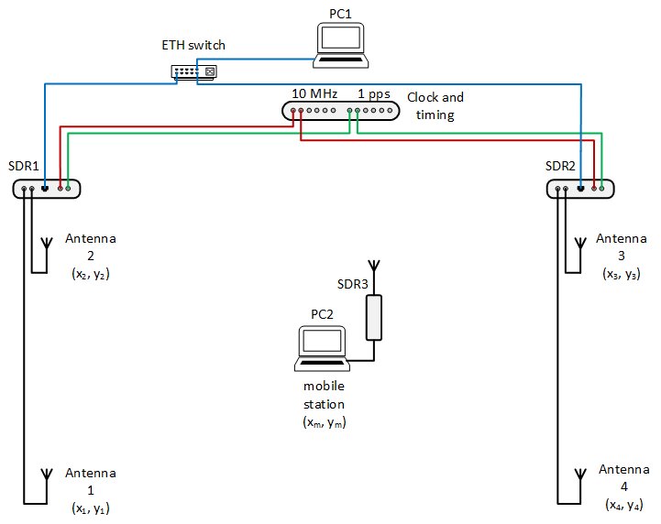
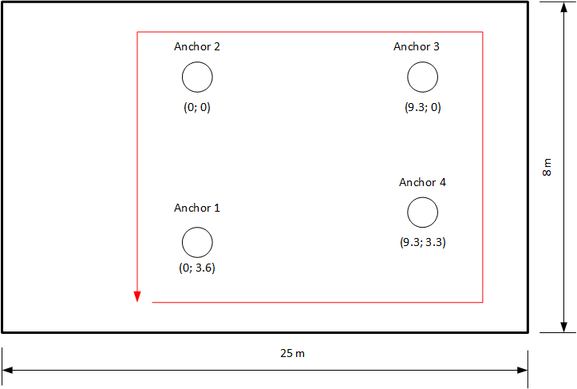
Testing scenario
Transceiver
Channel BW (3dB): 25 MHz, roll-off 1.00
Sample rate: 50 MSps
Ranging sequence: m-sequence, 1023 chips, BPSK, 2x oversampling

Slide 6
Obtained results mobile scenario
Processing
In software
4-5 measurements per second
Position filtering
Moving average 5 last estimates
Maximum velocity limit
Accuracy: 1-2 meter

Slide 7
Precision in a static case
Variation of the performed measurements with respect of the mean value
CDF of the estimated distance difference (not a CDF of position estimate)

Slide 8
Proposed modifications with respect to [IEEE 802.11-16/1249r0]
APs
Transmit beacon frames (BF) (not sequentially)
Receive beacon frames and estimate ToA
Include estimated ToA in the transmitted beacon frames
STA
Receives beacon frames and estimates ToA
Use the ToAs in the beacon frames to estimate position
AP1
AP2
AP3
AP4
BF
BF
BF
BF
STA

Slide 9
Proposed modifications (2)
APs
Need to be able to listen to the other APs
Must estimate ToA of the arriving beacon frames and report to the STAs (e.g. including them in beacon frames)
STA
Must be able to listen to all of the APs – at best simultaneously
Pros:
Passive, i.e. number of STAs not limited
Low number of transmissions for positioning purposes
Cons:
Additional complexity to listen to all APs
Time between transmission of beacon frames from different nodes must not be too big

Slide 10
Conclusion
The proposed approach further reduces the number of transmissions needed to perform localization of mobile stations
APs must not be synchronized, but must be able to listen to the neighboring APs
The larger the number of involved APs, the better the precision - scalable system.

Slide 11
References
[1] Brian Hart et al., Scalable Location, IEEE 802.11-14/1235r0

Slide 12
Straw pool
Should the APs and STAs support listening on multiple channels simultaneously in order to enable passive positioning of STAs?
Yes: No: Abstain:

