Slide 1
Analysis on the Impact of Blank GI to ISI
Date: 2017-07-10
Authors:
Name | Affiliation | Address | Phone | Email
Junghoon Suh | Huawei |  |  | junghoon.suh@huawei.com
Jia Jia
Osama Aboul-Magd

Slide 2
Background
Performance gain was observed during the RX filtering and over IEEE Chan D with Blank GI pre-pended WFC [1]
The proposed Blank GI is effective to cope with Inter Symbol Interference (ISI), however still the Intra Symbol Interference remains
Analysis on Blank GI impact to ISI and Intra Symbol Interference

Slide 3
Three Waveform Coding Designs
L-LTS occupied for middle 13 tones to generate the waveform
Equal symbol energy of WFC I, II, and III
TX power is boosted per i and q sample by ,
where 2, 2.5, 3.33 correspond to 4us/2us, 4us/1.6us, 4us/1.2us, respectively for WFC I, II, and III
WFC I : No CP
0us 2us 4us
0us 2us 4us
Information “0”
Time dispersion
ISI area
Information “1”

Slide 4
WFC II: A blank energy GI with 0.8us duration is placed before transmitting each of the 3.2us symbol. The GI is removed at RX before performing symbol detection.
WFC III: A blank energy GI with 0.8us duration is placed before each of the 1.2us ON and OFF portion in a Symbol. The GI is removed at RX before performing symbol detection.
Blank
Blank
0us 0.8us 2.4us 4us
0us 0.8us 2.4us 4us
Information “1”
Information “0”
Blank
GI
ON
Blank
GI
OFF
Blank
GI
OFF
Blank
GI
ON
0us 0.8us 2.0us 2.8us 4us
0us 0.8us 2.0us 2.8us 4us
Information “1”
Information “0”

Slide 5
Analysis on Inter and Intra Symbol Interference
WFC I : No CP
For the simplification of the analysis, it is assumed to have 5 samples per ON portion, and 5 samples per OFF portion.
Analysis is done over 4 symbols (4 bit WUR data)
Delay spread is assumed to be across two samples
5 samples are not mixed with another portion or symbol in a different energy → weight 1, weight 0 otherwise
2us
4us
6us
8us
10us
12us
14us
ON
OFF
ON (OFF)
OFF (ON)
ON (OFF)
OFF (ON)
ON (OFF)
OFF (ON)
OFF
ON
OFF (ON)
ON (OFF)
OFF (ON)
ON (OFF)
OFF (ON)
ON (OFF)

Slide 6
 |  |  |  | Sum of weights
0 | 0 | 0 | 0 | 0
0 | 0 | 0 | 1 | 1
0 | 0 | 1 | 0 | 2
0 | 0 | 1 | 1 | 1
0 | 1 | 0 | 0 | 2
0 | 1 | 0 | 1 | 3
0 | 1 | 1 | 0 | 2
0 | 1 | 1 | 1 | 1
 |  |  |  | Sum of weights
1 | 0 | 0 | 0 | 1
1 | 0 | 0 | 1 | 2
1 | 0 | 1 | 0 | 3
1 | 0 | 1 | 1 | 2
1 | 1 | 0 | 0 | 1
1 | 1 | 0 | 1 | 2
1 | 1 | 1 | 0 | 1
1 | 1 | 1 | 1 | 0
0 : OFF – ON
1: ON - OFF

Slide 7
WFC II : Blank GI pre-pended to a Symbol
For the simplification of the analysis, it is assumed to have 2 samples per Blank GI, 4 samples per ON portion, and 4 samples per OFF portion.
Analysis is done over 4 symbols (4 bit WUR data)
Delay spread is assumed to be across two samples
4 samples are not mixed with another portion or symbol → weight 1, weight 0 otherwise
Removed by GI removal
4us
8us
12us
ON
OFF
ON
OFF
ON
OFF
ON
OFF
OFF (1)
ON
OFF (1)
ON
OFF (1)
ON
OFF (1)
ON

Slide 8
WFC III : Blank GI pre-pended to each ON/OFF portion
For the simplification of the analysis, it is assumed to have 2 samples per Blank GI, 3 samples per ON portion, and 3 samples per OFF portion.
Analysis is done over 4 symbols (4 bit WUR data)
Delay spread is assumed to be across two samples
3 samples are not mixed with another portion or symbol → weight 1, weight 0 otherwise
Removed by GI removal
4us
8us
12us
ON
OFF (1)
ON
OFF (1)
ON
OFF (1)
ON
OFF (1)
OFF (1)
ON
OFF (1)
ON
OFF (1)
ON
OFF (1)
ON

Slide 9
Trivial for the Analysis
The expected value of the sum of weights indicates the performance of compensating the ISI, Inter Portion Interference as well as Intra Symbol Interference
WFC III > WFC II > WFC I
The gain of the expected value is always 3 dB between WFC III and WFC II regardless of the number of symbols
The gain of the expected value between WFC II and WFC I depends on the number of symbols, that is, the larger the size of symbols, the bigger gain on the expected value is observed
Time diversity to compensate the deep fades of the channel is not considered in the analysis
WFC I > WFC II > WFC III for time diversity
Spectrum in the freq domain gets increased for the shorter pulse in time domain
WFC III > WFC II > WFC I for the size of the side lobes in freq domain

Slide 10
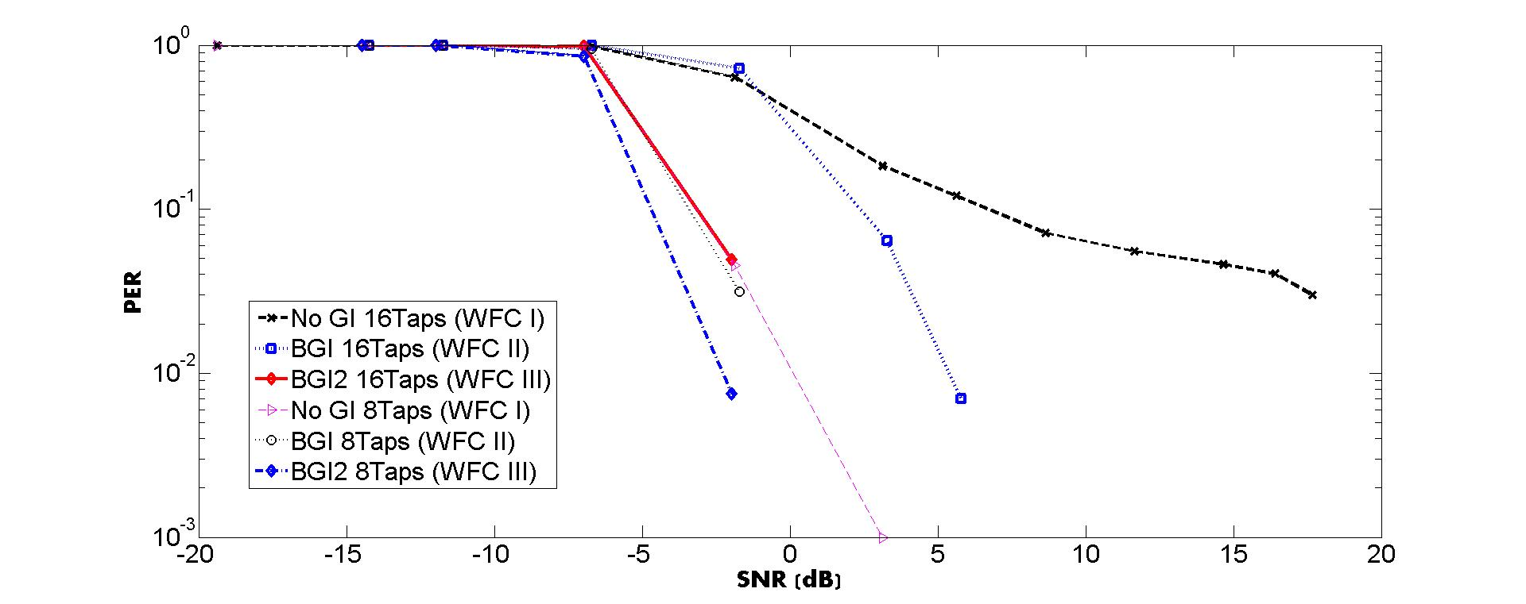
Performance of different RX Filter Taps w/ or w/o Blank GI
AWGN and RF impairments (CFO and Phase noise) considered
Packet size, 100 bits

Slide 11
Performance over Chan D
Waveform Coding applied with L-LTS
based waveform generation
Over-sampled to 100 MHz and TX filter applied
@ 4MHz BW and 100 MHz Sampling rate
for the image rejection
After Chan D is applied, down-convert the signal
to 20 MHz sampling rate based signal and then
AWGN is added → 20 MHz based SNR
LPF at the RX is applied @ 4 MHz BW and
20 MHz sampling rate
Packet size, 100 bits
RF impairments (CFO and Phase noise) considered

Slide 12
RF impairments Baseband model
RF impairments
Carrier
Freq
Offset
Phase
Noise
AWGN
Baseband
Signal
X
X
+
Phase
Noise
AWGN
CFO is 200 ppm of 2.4 GHz, i.e., -240 KHz ~ 240 KHz
Linearly shifts every 4 usec (based on 802.11 residual CFO model)
“n” varies linearly every 4 usec in
4 usec is the data rate, 250 KHz
Phase noise based on 802.11 phase noise model

Slide 13
Conclusion
Analysis and more simulations are provided
WFC III shows the best in the analysis
In consideration of the time diversity and spectrum efficiency, WFC II is a good choice between ISI compensation and time diversity
Smaller filter taps are better to avoid ISI and Intra Symbol Interferences
Trade-off between Interference rejection and ISI
We will follow the filter design according to EVM documentation, once it is decided

Slide 14
Reference
[1] Junghoon Suh, et. al. “17/696r0 Blank GI for the Waveform Coding”, IEEE 802.11 TGba, May 2017, Daejeon, South Korea

