Slide 1
Data Rate Selection for Wake-up Receiver
Date: 2017-07-08
Authors:
Name | Affiliation | Address | Email
Ning Wei | ZTE Corp.
Kaiying Lv |  |  | lv.kaiying@zte.com.cn
Bo Sun

Slide 2
Introduction
11ba group has agreed that the payload part of a wake-up packet shall support multiple data rates for a higher efficiency or wider coverage[1,2]
Wake up link information is useful for AP to select an appropriate transmission rate to transmit wake-up packet rather than blind selection
However, how to measure the WUR link is still TBD
In this proposal, we discuss WUR link measuring method for WUR data rate selection.

Slide 3
Analysis
There could be two approaches:
  Based on main radio’s measurement
    Main radio needs to support SNR measurement
    SNR of main radio link does not precisely reflect WUR link status due to different signal design
    PER performance on main radio link cannot precisely reflect WUR link status either.
  Based on WUR radio’s measurement
    SNR is typically not precisely estimated in most algorithms
We prefer to directly measure WUR link with dedicated data rate
  Should be simple
  Less time consuming

Slide 4
Proposal of WUR Link Quality Measurement
A wake-up packet is transmitted for link quality measurements, as shown in Fig 1, at wake-up receiver side
  WUR measurement signal is encoded in Manchester encoding and modulated with OFDM+OOK
  Multiple rates could be measured with the wake-up measurement packet
  Setting the bits in the WUR signal to all '1's, or '0's maximizing the measurement reliability
Legacy preamble
WUR preamble
WUR measurement signal
Fig1 wake-up measurement packet format

Slide 5
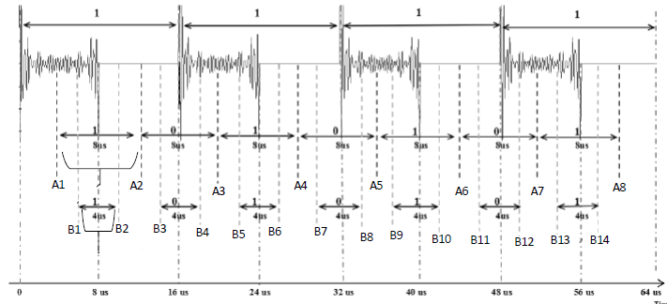
Proposal of WUR Link Quality Measurement(Cont.)
A wake-up receiver is required to decode measurement signal in multiple measurement periods for acquiring link performances of multiple date rates, as shown in Fig 2
  The received bit stream of '1111…’ is encoded by Manchester encoding, the symbol duration is 16us, and noise is ignored for simplicity
  A first measurement is performed over each 16 us symbol to measure 62.5 kbps link performance
  A second measurement is performed over each 8 us symbol [A1,A2], [A2,A3], etc, to measure 125 kbps link performance, with corresponding bit sequences are ‘101010…’
  A third measurement is performed over each 4 us symbol [B1, B2],...[B13, B14] , etc, to measure 250 kbps link performance, with corresponding bit sequences are ‘101010…’
  Calculate the BERs or PERs for each data rate for WUR data rate selection.
Fig2 multiple data rate measurement

Slide 6
Proposal of WUR measurement protocol(Cont.)
Finally, as a respond, STA should feedback the WUR link performance measurement
  Include the measurement results of multiple data rate to assist AP on WUR transmission rate selection; Or
  Inform AP the preferred data rate

Slide 7
Conclusion
In this contribution, we proposed an approach to achieve link performance measurement for multiple data rates with one WUR measurement packet:
  The measurement sequence of all '1's or '0's at a single data rate is proposed to maximize the measurement reliability
  Wake-up receiver is required to decode received signal several times with different measurement periods

Slide 8
Straw Poll #1
Do you agree to add the following to the 11ba SFD?
  WUR measurement protocol should be defined in 11ba
Y/N/A :

Slide 9
Straw Poll #2
Do you agree to add the following to the 11ba SFD?
  A WUR measurement packet supporting multi-rate measurement should be defined in 11ba as shown in slide 4
Y/N/A :

Slide 10
Straw Poll #3
Do you agree to add the following to the 11ba SFD?
  A WUR measurement procedure supporting multi-rate measurement should be defined in 11ba as shown in slide 5
Y/N/A :

Slide 11
References
11-17-0654-01-00ba-multiple-data-rates-for-wur
11-17-0575-01-00ba-spec-framework

