Slide 1
Follow-up on Doppler Design in 802.11ax
Date: 2017-07-09
Authors:
Name | Affiliation | Address | Phone | Email
Lochan Verma | Qualcomm | 5775 Morehouse Dr. San Diego, CA, USA |  | lverma@qti.qualcomm.com
Bin Tian |  |  |  | btian@qti.qualcomm.com

Slide 2
Introduction
Mid-amble Doppler procedure introduced in [1], [2]
  Do you agree that Doppler procedure in 802.11ax is based on mid-ambles? Y/ N/ A : 14/ 0/ 8. [3]
Simulation of various mid-amble update intervals, MCSs, and Doppler was presented in [1]
  However, [1] stopped short of proposing the mid-amble update interval values for 802.11ax and its respective signaling
In this slide-set, we propose two mid-amble update intervals of 10 & 20 from [1] and propose its signaling
  Two values are selected for simplicity of Doppler procedure, which is optional in 11ax

Slide 3
What is Mid-amble Update Interval
‘Mid-amble update interval’ is the number of data symbols between two mid-ambles
A mid-amble has one or many HE-LTF symbols
  # of HE-LTF symbols is a function of # of space-time streams (Nsts)
NOTE: Slide-3/4/5 presented in [1] but included here as a refresher
L-STF
L-LTF
L-SIG
RL-SIG
HE-SIG-A
HE-SIG-B
HE-STF
HE-LTF1
…
HE-LTFn
Data Symbol
…
Mid-amble
Data Symbol
…
Mid-amble
Data Symbol
PE
Mid-amble Update Interval
HE-LTF1
…
HE-LTFn

Slide 4
Simulation Setup
Channel : UMI-NLOS; 5 GHz
Ntx = Nrx = 2; NSS = 1; STBC: Off
MCSs = 0, 1, 3, 5, 8
GI = 3.2 us
Doppler
  15 Km/h on all taps
  30 Km/h on all taps
  60 Km/h on all taps
  60 Km/h on 2nd and 3rd tap and all other taps at 3 Km/h

Slide 5
Mid-amble Update Interval (M)
Ntx = Nrx = 2; Nss = 1
Mid-amble update interval for 1 to 2 dB performance loss @ 10% PER compared to No Doppler
Doppler/MCS | BPSK (MCS0) | QPSK (MCS1) | 16 QAM (MCS3) | 64 QAM (MCS5 | 256 QAM (MCS8)
60 Km/h on 2nd/3rd tap | 50 | 30 | 15 | 8 | 4
60 Km/h on all taps | 30 | 20 | 10 | 5 | 2
30 Km/h on all taps | 60 | 40 | 20 | 10 | 5
15 Km/h on all taps | 120 | 80 | 40 | 20 | 10
M = 10 enables using higher MCSs w/ low Doppler and Lower MCSs w/ higher Doppler
M = 20 reduces mid-amble overhead compared M = 10 while enabling lower to higher MCSs for variety of Doppler
M < 10 is noticeable overhead while M > 20 does not offer significant overhead savings
  Furthermore, these values don’t support wide range of Doppler and MCSs

Slide 6
Mid-amble Update Interval Indication
Currently 1 bit ‘Doppler’ field exists in HE Preamble
  ‘This’ can indicate presence or absence of mid-ambles
  E.g., 0 – indicates absence of mid-ambles; 1 – indicates presence of mid-ambles
When Doppler is ON, additional 1 bit needed to indicate mid-amble update interval in HE Preamble
  Propose to limit the Doppler cases to up to 4 space-time streams and borrow 1 bit from “Nsts” or “# of HE-LTF symbols” field in HE Preamble

Slide 7
Mid-amble Update Interval indicated in 1 bit in HE Preamble
When Doppler is ON, mid-amble update interval is signaled in 1 bit in HE-SIG-A
  Bit borrowed from ‘Nsts’ or ‘# of HE-LTF symbols’ depending on PPDU format
  2 values (10, 20) can be signaled
  For non-Doppler cases: ‘Nsts’ & ‘# of HE-LTF symbols’ is 3 bits, [as in D1.3]
Mid-amble Update Interval field in HE Preamble
Field | Bits | Description
Mid-amble Update Interval | 1 | 0 → mid-amble update interval of 10. 1 → mid-amble update interval of 20.

Slide 8
Mid-amble Update Interval Signaling in HE-SIG-A of HE SU/HE ER SU PPDU
Doppler = 0 in HE SIG-A
Doppler = 1 in HE SIG-A
Field | # of Bits | Description
Nsts | 3 | # of space-time streams minus 1 (values 0 – 7)
Doppler | 1 | Set to 0
Others | … | …
Field | # of Bits | Description
Nsts | 2 | # of space-time streams minus 1 (values 0 -- 3)
Mid-amble Update Interval | 1 | 0 → mid-amble update interval of 10. 1 → mid-amble update interval of 20.
Doppler | 1 | Set to 1
Others | … | …
HE-SIG-A Fields of HE SU/HE ER SU PPDU

Slide 9
Mid-amble Update Interval Signaling in HE-SIG-A of HE MU PPDU
Doppler = 0 in HE SIG-A
Doppler = 1 in HE SIG-A
Field | # of Bits | Description
# of HE-LTF symbols | 3 | Indicates number of HE-LTF symbols
Field | # of Bits | Description
# of HE-LTF symbols | 2 | Indicates number of HE-LTF symbols
Mid-amble update interval | 1 | 0 → mid-amble update interval of 10. 1 → mid-amble update interval of 20.
HE-SIG-A fields in HE MU PPDU

Slide 10
Mid-amble Frequency Signaling in HE TB PPDU
‘# of HE-LTF Symbols’ field (B23-B25) in Common Info field of the Trigger frame is repurposed when ‘Doppler’ field (B53) in Common Info field of the Trigger frame is 1
‘Doppler = 0’ in Trigger frame
‘Doppler = 1’ in Trigger frame
Field | # of Bits
# of HE-LTF Symbols | 3
Field | # of Bits
# of HE-LTF Symbols | 2
Mid-amble Update Interval | 0 → mid-amble update interval of 10. 1 → mid-amble update interval of 20.
# of HE-LTF Symbols field in Trigger frame

Slide 11
Summary
We propose mid-amble update interval (M) of 10 and 20 for 802.11ax mid-amble Doppler procedure
  Two values proposed for simplicity of Doppler design, which is optional in 11ax
  M=10 enables using higher MCSs at low Doppler and lower MCSs at high Doppler
  M=20 reduces mid-amble overhead by 50% compared with M=10, while enabling lower to higher MCSs for variety of Doppler
  M<10 is noticeable overhead & M>20 does not offer significant overhead savings
    Furthermore, these values don’t support wide range of Doppler and MCSs
Mid-amble update interval signaling in HE Preamble is discussed
  Doppler support is limited to up to 4 space-time streams
  When Doppler is ON, mid-amble update interval is signaled in 1 bit in HE-SIG-A
    Bit borrowed from ‘Nsts’ or ‘# of HE-LTF Symbols’ depending on PPDU format

Slide 12
References
[1] 11-17-0773-02-00ax-thoughts-on-Doppler-in-802-11ax
[2] 11-17-0734-01-00ax-Doppler-Discussions
11-17-0783-02-00ax-tgax-may-2017-meeting-phy-adhoc-agenda

Slide 13
SP #1
Do you support mid-amble update interval of 10 and 20 for mid-amble Doppler procedure in 11ax?
Y / N / A

Slide 14
SP #2
Do you support signaling mid-amble update interval in HE-SIG-A of HE PPDUs?
  HE SU PPDU: Borrow 1 bit from ‘Nsts’ field
  HE MU PPDU: Borrow 1 bit from ‘# of HE-LTF Symbols’ field
  HE TRIG PPDU: Borrow 1 bit from ‘# of HE-LTF Symbols’ field in Trigger frame
  NOTE: For non-Doppler cases: ‘Nsts’ = 3 bits and ‘# of HE-LTF Symbols’ = 3 bits [as in D1.3]

Slide 15
Appendix

Slide 16
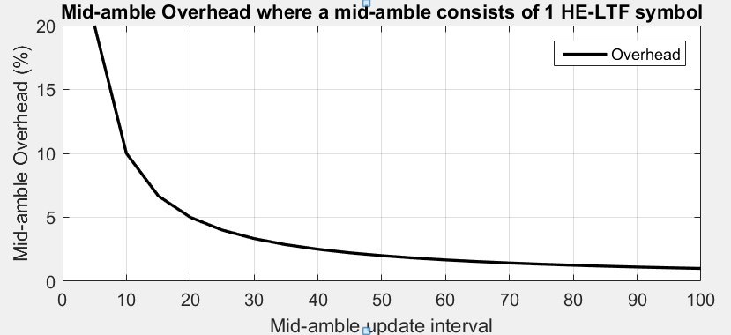
Mid-amble Update Interval Overhead

