Slide 1
FRD Requirements for Scalable Location
Date: 2017-05-10
Authors:

Slide 2
Abstract
This submission provides additional functional requirements for the scalable FTM mode, to complete the location services for usages such as (Access Network-centric) asset tracking and client-centric indoor navigation.

Slide 3

Support for Asset Tracking - Recap
Submission 11-16-0137 TGAz use-case document describes several usages involving electronic and asset tracking by a Access Network administrator:
  Location-based NW management (usage #19)
  Position for electronic tag (usage #22)
  Smart building (usage #20)
  Location services of underground mining (usage #9)
Asset tracking normally involves a transaction initiated by the NW-administrator to locate the whereabouts of high-valued or assets of high-importance.
  The positioning results are normally used by the administrator or its associated application.
Notes:
Send a nurse to bring a dialysis machine

Slide 4
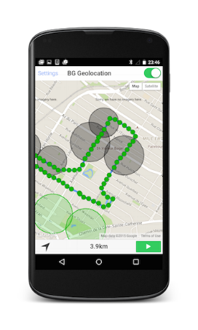
Support for Navigation Services - Recap
For example, indoor navigation services:
  The location calculation is performed by the client device.
  The location result endpoint is the user/client device (or associated application).
Notes:
Send a nurse to bring a dialysis machine

Slide 5
Location Services Terminology
Origination – position information requester / initiator.
  Access Network-initiated vs. Client-initiated
  For example: asset tracking is normally a Access Network-initiated location procedure.
Termination – positioning information endpoint user.
  Access Network-terminated vs. Client-terminated
  For example, in asset-tracking, the Access Network-administrator is normally the end-point user.
Centrality – positioning calculation location
  Access Network-centric vs. Client-centric
  For example, in asset tracking , in many cases, the entity at which the location is calculated resides within the Access Network, allowing for a simple and cheap asset tag.

Slide 6
FRD Requirements
The scalable mode positioning protocol shall support at least one mode of Access Network-initiated, Access Network-centric and Access Network-terminated location, not excluding other supporting actions from the client side.
The scalable mode positioning protocol shall support at least one mode of client-initiated, client-centric and client-terminated location, not excluding other supporting actions from the Access Network side.

Slide 7
Straw-Poll #1
We support the addition of the functional requirements outlined in slides #5 & #6 to the FRD under section “scalability” (2.1.3).
Y: N: A:

Slide 8
Thank you for your attention!

