Slide 1
TG md
Estimated Throughput and
Metrics for Handover decision
Date: 2017-05
Authors:

Slide 2
Background
eMail May 18, 2017
Call for contributions on the following topics:
(a) Adding accuracy requirements for the existing estimated throughput metric (see Clause 11.46 in IEEE Std 802.11™-2016) and
(b) Defining additional metrics to support 3GPP features
1. LWA activation/deactivation
2. Mobility across WLANs cells and
3. Traffic scheduling decisions such as forwarding to WLAN
This presentation is an outline of Clause 11.46 and then a discussion.
At the moment it may wander a bit, as trying to formulate ideas and look for solution and guidance.

Slide 3
Clause 11.46 Estimated Throughput
MLME-ESTIMATED-THROUGHPUT.request and confirm
Contains:
Peer STA Address
Average MSDU Size Inbound – From Peer to this STA per AC
Average MSDU Size Outbound – To Peer from this STA per AC
  (-1 = unspecified, 0 = none)
MLME-ESTIMATED-THROUGHPUT.confirm
Contains:
Peer STA Address
EstimatedThroughputOutbound
EstimatedThroughputInbound
  If Average MSDU Size = -1, then EstimatedThroughput = 0
  If Average MSDU Size = 0, then EstimatedThroughput may use any MSDU but should use 1500B

Slide 4
How does it work?
‘Estimated Throughput Request’ received at the MLME containing the estimates for the inbound and outbound MSDU sizes
I assume that this is the traffic that the STA wants to transfer to Wi-Fi? Is this right? No real indication.
STA uses MSDU sizes, plus RSSI, #SS, BW, estimated air fractional time, BA window time (from the ESP IE in the beacon?) to calculate
EstimatedThroughputs (out and in) using R7 formula for each AC, and replies ‘confirm’ details
  What is this, the new traffic? New Total traffic per AC? Something else? What is good/bad/don’t know?

Slide 5
Estimated Service Parameters element ESP
Aside “ESP” is apply named as STA needs to be clairvoyant to get this right.
ESP Element contains ESP Info field
  AC
  Data Format
      No aggregation
      A-MSDU no A-MPDU
      A-MSDU for data
      A-MSDU and A-MPDU for data
  Block Ack window size(0 to 64)
  Estimated Air Time Fraction
      Predicted % time new STA joining BSS will be allocated for data
  Data PPDU duration target
      Target duration of data MPDUs in units of 50us
      What is this?? Huge differences wrt data rates.

Slide 6
Using the ESP IE
From the AP ESP IE, for example AC_VO
  AC VO
  No Aggregation
  No Block Ack
  Predicted % time allocated, 50% ?
  (Note nothing is actually “allocated”,
  also is it 50% of just AC_VO, i.e. it has one other voice call, or of all traffic? It has to be of VO traffic. Is % really useful?
  Target Duration of data MPDU,
  How does it calculate this? It’s voice, so short packets. Depends on data rate but AP does not know.
Needs some clarification, description?

Slide 7
Back to Basics
Question - What is the objective?
Answer – If STA transfers traffic to the Wi-Fi link, will it have good QoE?
STEPS
STA needs to know if the BSS is saturated, near saturated, busy, not busy….,
  The Estimated Air Time Fraction maybe most useful parameter for what BSS is doing now, plus RSSI to estimate data rate once associated?
STA needs to know its own traffic and potential traffic,
Then estimate if room in the BSS.
How accurate does this have to be?
  Plenty of room - should be good - maybe enough - no way?

Slide 8
I am a simple soul so I tend to look for easy.
So:
Do I really need to know the traffic parameters to a high degree of accuracy?
  What if the STA is simply transferring a VoIP call, it’s only 30 -100 kbps or such. QoE is required, how much room do I need? Maybe more of an EDCA overhead thing than actual traffic. If data rate is high (>24 Mbps) should never be a problem.
  If I have a video, say 5 Mbps or less? QoE is required. Again number of video streams may be important (EDCA overhead)
  Surfing data? No real expectation of QoE but speed is nice. How much capacity left after VO and VI? This is important point, BE effectively takes the capacity left over.

Slide 9
Let’s say something controversial:
All this has been covered in the Std.
It is called TSPECs and Admission Control. Used and tested with 11r FT (RIC)
Used with BSS Available Admission Capacity element
Examined in detail in 11aa for sharing across WLANs
Maybe re-using some of these fields/ideas might have been a good approach? BUT probably too late now as consistent effort to prevent use of TSPECs has been noticeable.
However, let’s just look at the ideas

Slide 10
With Admission Control, the STA asked the AP if it could accept the traffic it wanted to bring with it.
  With this new ESP scheme, the STA has to work it out itself based upon indications from the AP.
STA could inform AP of its intended traffic,
  but the ESP IE does not do this for the STA.
  The MLME-ESTIMATED-THROUGHPUT.request/confirm is only within the STA. AP not a party to the decision.
So where to put the decision?
AP – “come on over”
  STA tells AP requirement, AP sends back advisory
or STA – “I think you should have room for me”
  STA gathers AP info and makes decision.
  AP does not know STA requirement, just supplies what info it can

Slide 11
After all that, what am I saying/thinking?
Are we really addressing the problem? I’m not so sure. I am concerned that the Estimated throughput and ESP is way too complicated and the results will vary from STA to STA, AP to AP
How about looking at what is relatively easy to measure, and should be repeatable?
  Who knows the BSS best, the AP or a new STA? – the AP
  Who knows what the new data is? – the STA
Do we need highly accurate throughput calculations?
  How accurate is required?
  % Air time, RSSI and accurate throughput required? May be difficult to define the “Pass” requirement – not done so far.
  Do we simply need a ‘decision’ rather than accurate calculations?
Let’s face it, are we are trying to have a “poor man’s Admission Control” ?– can we learn from this?

Slide 12
Admission Control recap
AP advertises ACM bit in Beacon to indicate if admission control is mandatory for any Access Category
To use AC that has ACM bit set, STA sends ADDTS Request Action Frame to AP that includes a TSPEC
Required parameters for Admission Control:
  Nominal MSDU size
  Mean Data Rate
  Min PHY Rate
  Surplus Bandwidth Allowance (SBA)
AP runs the admission control algorithm and communicates back to the station the admission decision using ADDTS Response Action frame
  Medium Time (>0 if TSPEC Admitted)
STA checks “Used Time” over a preset period (WMM specifies 1sec)
  If Used Time > Medium Time, STA must cease using that AC’s EDCA parameters (may use an AC that does not have ACM bit set)
Recommended used only for AC_VO and AC_VI

Slide 13
Other “Capacity IEs” already in the Std.
BSS Load Element 9.4.2.28
  Station Count, Channel Utilization, Available Admission Capacity
    % Channel busy time using CS mechanisms (virtual and physical)
BSS Average Access Delay element 9.4.2.39
  AP Average Access Delay
BSS Available Admission Capacity element 9.4.2.43
  Available admission capacity, per UP AC
BSS AC Access Delay element 9.4.2.44
  Access Category access delay, per AC
QoS Traffic Capability element 9.4.2.78
  # of associated STAs with QoS traffic VO VI
Qload Report element 9.4.2.123
  Potential QoS traffic and sharing across OBSS, uses admission control and HCCA
Extended BSS Load element 9.4.2.160
  # STAs MU Beamformees, spatial stream underutilization (primary CH), observable secondary 20, 40, 80 MHz utilization (Look at formulas )
ESP element 9.4.3.174

Slide 14
Points to ponder on
Objective - Aid decision to steer traffic to an 802.11 WLAN – STA wants to know “what is likelihood of good user QoE?”
Is the emphasis just on QoS traffic, VO and VI?
  One would be highly tempted to say YES
Remember, even if % busy time is high, if this is all BE traffic, VO and VI may still have relatively no problem
  A possible problem for BSS Load element? Just measures overall busy time (“channel utilization”)
  Access delays do measure traffic loads
BSS Capacity pointers
  AP Capability (e.g. HT,VHT, #SS, MU MIMO), STA RSSI,
Traffic is very transient
  No guarantees (with EDCA and no admission control)
A managed network should/could have lots of capacity: 11ax will solve this…right?
  Assuming STAs roam correctly, and spatial reuse correctly applied,
  A measurement of the MCSs in use may indicate good layout
  WLAN throughput may degrade as traffic increases but each STA should still have throughput

Slide 15
(Ideal) Schemes might be along the lines of:
Admission control-like
  STA tells AP what traffic it has
  AP tells STA “come on over”, or not, based upon its known traffic.
BSS Load element-like
  AP advertises spare capacity or loading – overall, per AC? HOW?
  STA makes calculation based on requirement(s) and makes its decision – assuming it knows its requirements
c.f. ESP
  AP advertises Air time fraction, BA sizes, aggregations – per AC
  STA accurately calculates its estimated throughputs, per AC, if it joined WLAN, and makes decision – based on ‘is estimated throughput enough’?

Slide 16
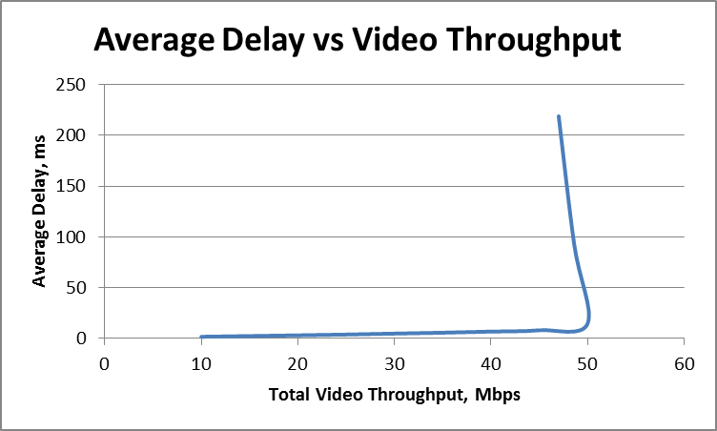
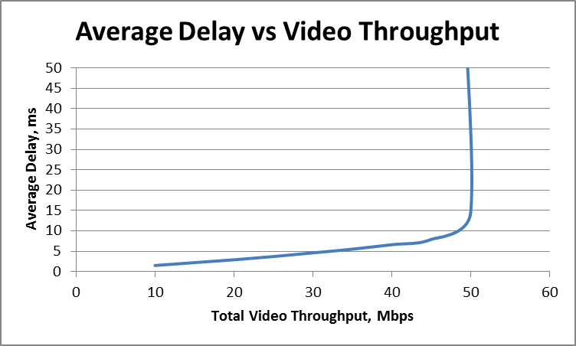
Let’s look at AC Access Delay
The AP Average Access Delay is a scalar indication of the relative level of loading at an AP. A low value indicates more available capacity than a higher value.
The QoS AP measures and averages the medium access delay for all transmit frames of the indicated AC using EDCA mechanism over a continuous 30 s measurement window. (see 11.11.16)
<100 us accuracy, at least 200 frames (not defined for <200 frames)
Question is “How to interpret the readings?” Can’t find a contribution that actually rates the delays.
For AC_VO the Service Interval is 20 ms, for AC_VI the Service Interval is 16 ms,
Fixed data rate (~100Mbps), increase number of 5Mbps video streams
Knee is close to 16ms

Slide 17
Average Delay Goodness Factor
Possible “Goodness Factor” GF= Average Delay/SI,
As GF approaches 1, the spare capacity decreases
For GF< 1 throughput is approx. linear, so “spare capacity” = (1 – GF)
_______________________________________________________________
Possible problem is that the measurement is only for DL traffic, is that OK? (works as long as at least one Video is DL), also
AIFSN is 1, not 2 for the AP.
Simulation shows that the AP DL Access delay is much less (see next slide)
  Threshold is about 4.0 to 4.2ms for the AP (1- 4 DL streams)
  Good thing is that it seems to be consistent
Voice seems to be slightly different
  STA UL Delay Threshold appears to be 2 x SI (~40ms)
  BUT AP DL Delay Threshold ~3ms
  Having said that, as VO traffic is so low, in practice it does not really matter.

Slide 18
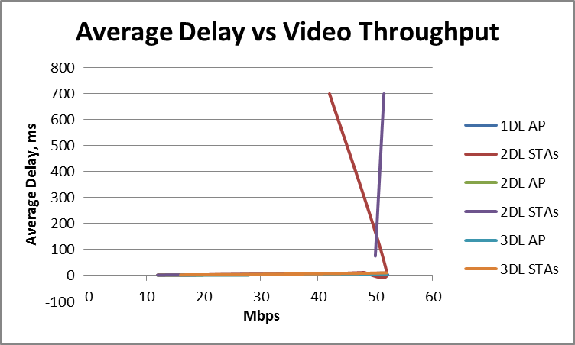
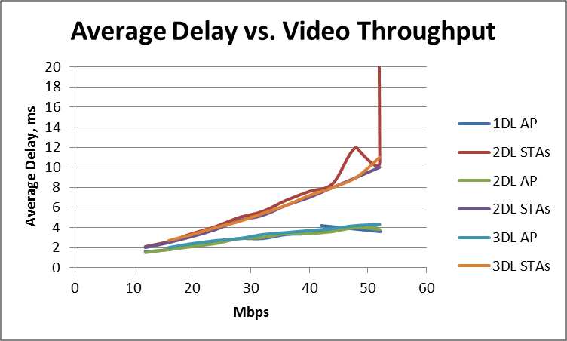
AP and STA Delay
Video delay threshold is 4ms Linear with traffic
Re-define GF as Average Delay/ 4ms,
or just use Max Delay = 4ms x F
NOTE: “Delay” includes AIFS

Slide 19
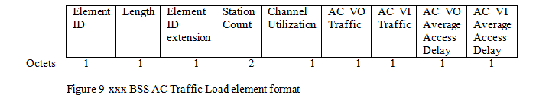
BSS AC Traffic Load IE - NEW
Useful parameters might be:
  From BSS Load element (not sure about Extended BSS Load element)
    Channel Utilization
    Station Count
  From BSS AC Access Delay element
    Average AC access delay (? Do we need VO?)
  New
    # AC_VO active streams (bi-directional voice?)
    # AC_VI active streams
Need to address the access delay table to reflect SI values (not sure where the present range of values came from). Do we need 255 levels?

Slide 20
Proposed scheme for Handover STAs
Add new IE “BSS AC Traffic Load element”
Add procedure in new Clause 11.48 for how to use it (or is this an Annex?)
Procedure:
  AP monitors its BSS and inserts values into the BSS AC Traffic Load element
  STA monitors RSSI of AP (1st consideration)
  STA checks BSS AC Traffic Load element values (N streams, Ave Delay)
  STA checks current Ave Delay per AC and estimates new Ave Delay with own traffic M streams New Average Delay = current Ave Delay x N/M ms
  If estimated New Average Delay < Max Delay (3.6ms?), then “Pass”
Note: BE Traffic decision based upon the Delay for VO and VI AND Channel Utilization. These indicate the spare capacity for BE.

Slide 21
What do you think?
Am I crazy?
Too simple? Does it have merit?
Is there another/better candidate in place of Average Delay?
  Does this cast doubt on the usefulness of the existing BSS (AC) Access Delay element IE?
More peer review required? More investigation?
Worthwhile starting on text?

