Slide 1
PHY-CCA Indication
Date: 2017-05-20
Authors: Oren Kedem
Name | Affiliation | Address | Phone | email
Oren Kedem | Intel |  |  | oren.kedem@intel.com
Carlos Cordeiro | Intel |  |  | carlos.cordeiro@intel.com
Solomon Trainin | Qualcomm |  |  | solomon.trainin@intel.com

Slide 2
Purpose and definitions
Current PHY-CCA.Indication text do not address all TX Mask options
Contribution suggest modifications to address current issues

Slide 3
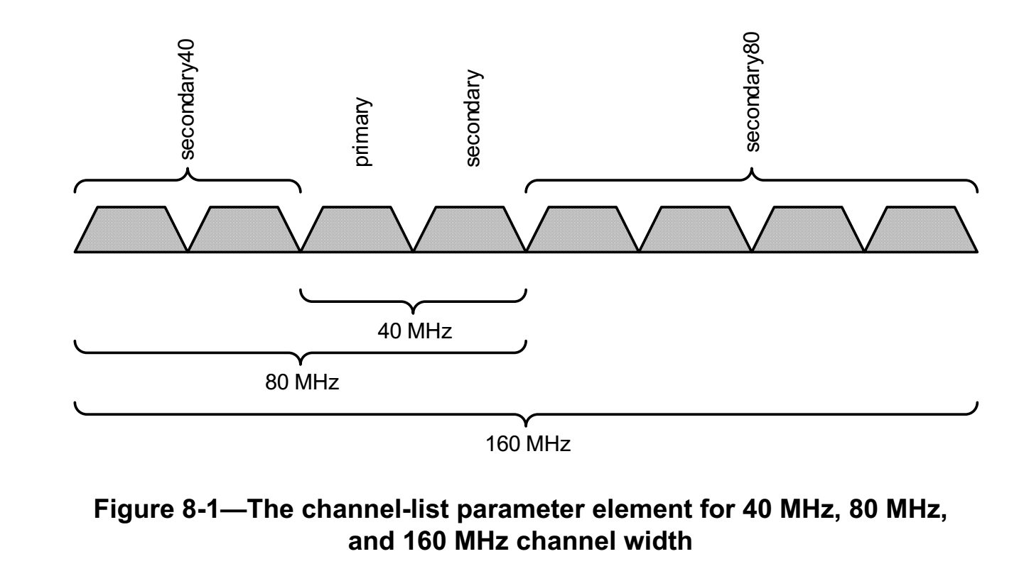
11ac CCA Definition
8.3.5.12 PHY-CCA.indication
channel-list parameter | Meaning
secondary40 | Indicates that the secondary 40 MHz channel is busy according to the rules specified in 21.3.18.5.4. In a TVHT STA, indicates that the secondary TVHT_2W channel is busy according to the rules specified in 22.3.18.6.4.
secondary80 | Indicates that the secondary 80 MHz channel is busy according to the rules specified in 21.3.18.5.4.
secondary4.32 | Indicates that the secondary 4.32 GHz channel is busy.
secondary6.48 | Indicates that the secondary 6.48 GHz channel is busy.
CCA for Secondary channels are defined for wide channels
  Secondary40 indicates CCA for 40MHz wide channel
  Secondary80 indicates CCA for 80MHz wide channel
11ac STA may transmit only on 20MHz, 40MHz, 80NHz and 160MHz TX Masks

Slide 4
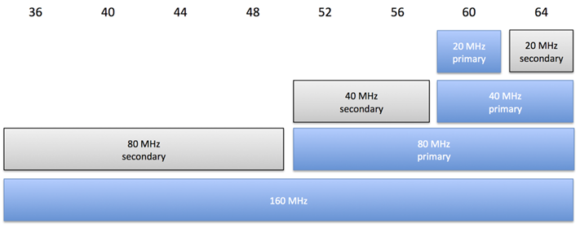
11ac TX Masks options
User set the “Primary channel”
User set the “Secondary channel offset”
80MHz, 160MHz TX schemed follows
Transmit a 40 MHz mask PPDU on the primary 40 MHz channel if the secondary channel was idle during an interval of PIFS immediately preceding the start of the TXOP
Transmit a 20 MHz mask PPDU on the primary 20 MHz channel.
Transmit an 80 MHz mask PPDU on the primary 80 MHz channel if both the secondary channel and the secondary 40 MHz channel were idle during an interval of PIFS immediately preceding the start of the TXOP.
Transmit a 160 MHz or 80+80 MHz mask PPDU if the secondary channel, the secondary 40 MHz channel, and the secondary 80 MHz channel were idle during an interval of PIFS immediately preceding the start of the TXOP.

Slide 5
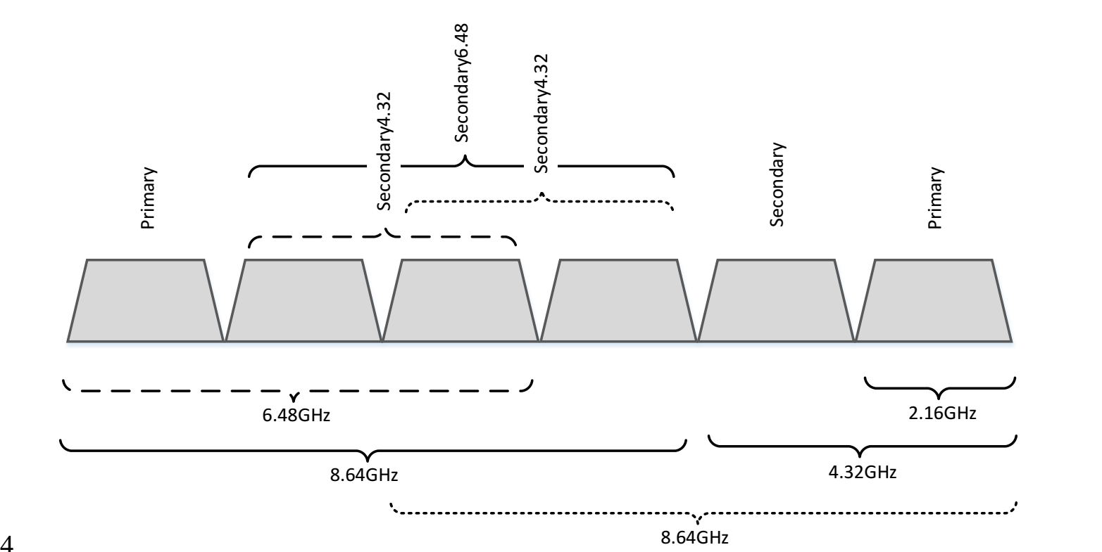
Current 11ay definition
11ay tried to follow 11ac approach
CCA for Secondary channels were indicated also on wide channel
However, secondary4.32 and secondary6.48 locations changed per the operated channels and the location of Primary
Secondary CCA in 11ay should allow better flexibility TX scheme compare to 11ac
channel-list parameter | Meaning
secondary40 | Indicates that the secondary 40 MHz channel is busy according to the rules specified in 21.3.18.5.4. In a TVHT STA, indicates that the secondary TVHT_2W channel is busy according to the rules specified in 22.3.18.6.4.
secondary80 | Indicates that the secondary 80 MHz channel is busy according to the rules specified in 21.3.18.5.4.
secondary4.32 | Indicates that the secondary 4.32 GHz channel is busy.
secondary6.48 | Indicates that the secondary 6.48 GHz channel is busy.

Slide 6
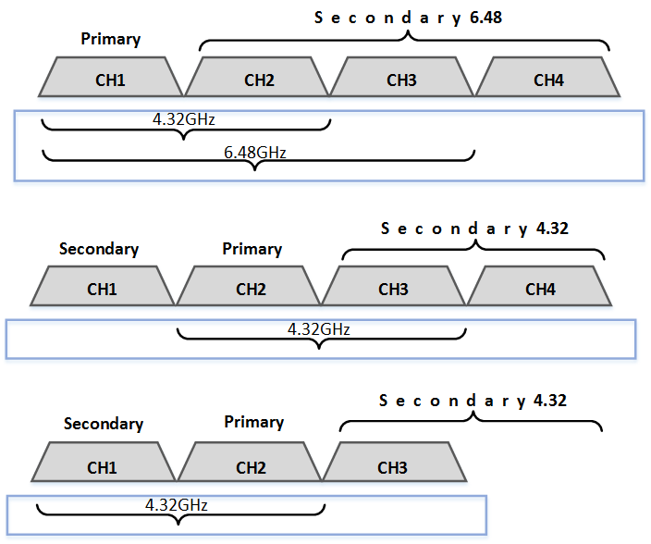
Issues with current 11ay definition
Current definition does not provide the flexibility required to address allowed TX Masks resulted from Primary location options
One 6.48GHz CCA indication doesn’t provide the resolution to transmit lower TX mask (4.32GHz, 6.48GHz)
No option to transmit lower TX mask (4.32GHz)
Secondary4.32 doesn't adders CCA when Primary is set to CH2

Slide 7
Unavoidable Conclusion
11ay secondary channels should be provided on single channel in order to allow 11ay required flexibility
Secondary channels should be set according to Primary Channel

Slide 8
TX Mask - Primary set on the edge of Band
When Primary is located at the edges of the band, it shall be referred as Primary Channel Offset = 0
Total of 3 TX Mask should be supported
Transmit a 4.32 GHz mask PPDU or 2.16+2.16 GHz mask PPDU if the secondary channel was idle during an interval of PIFS immediately preceding the start of the TXOP
Transmit a 6.48 GHz mask PPDU if the secondary and secondary4.32 channels were idle during an interval of PIFS immediately preceding the start of the TXOP.
Transmit a 8.64 GHz mask PPDU or 4.32+4.32 GHz mask PPDU if the secondary, secondary4.32 and secondary6.48 channels were idle during an interval of PIFS immediately preceding the start of the TXOP

Slide 9
TX Mask - Primary set inside the Band
When Primary is located within the band, it shall be referred as: Primary Channel Offset = 1
Additional TX Masks are allowed (total of 5)
Transmit 6.48 GHz mask PPDU if primary channel offset is 1 and the secondary4.32 and secondary6.48 channels were idle during an interval of PIFS immediately preceding the start of the TXOP
Transmit 4.32 GHz mask PPDU if primary channel offset is 1 and the secondary4.32 channel was idle during an interval of PIFS immediately preceding the start of the TXOP

Slide 10
Channel Aggregation
Proposed definition is aligned also with Channel Aggregation definition

Slide 11
Straw Poll
Would you agree to make the following changes per the text described in 11-17-0818-02-00ay-updates-to-edca-channel-access-in-an-edmg-bss.docx

Slide 12
BACKUP

