Slide 1
802.11 Working Group Opening Report
July 2017
Authors:
Date: 2017-06-05

Slide 2
Introduction
This presentation, together with the reports cited on the next slide, forms the opening report of the IEEE 802.11 Working Group for July 2017.
Subgroup status is reported in the “Snapshots” submission (see documents slide for link). This is incorporated by reference into this opening report.
“Mx.y.z” terminology indicates that the item was on the tentative agenda for the Monday 802.11 plenary, and was agenda item x.y.z.

Slide 3
M1.3 Meeting Decorum
%
Photography or recording by permission only (December 2014 IEEE-SA Standards Board Ops Manual 5.3.3.2)
Press (i.e., anyone reporting publicly on this meeting) are to announce their presence (December 2015 IEEE-SA Standards Board Ops Manual 5.3.3.3)
Laptop speakers, cell phone / tablet ringers off
Wear your badges at all times in meeting areas
  Help the hotel security staff improve the general security of the meeting rooms
  Laptops HAVE BEEN STOLEN at previous meetings
  DO NOT assume that meeting areas are secure
Please observe proper decorum in meetings

Slide 4
M2.3.1 Summary of Liaisons - Outgoing
Outgoing from 802.11 last session:
  11-17/0378r2 - to 3GPP RAN2 – “Reply LS to Reply LS from 3GPP RAN2 on Estimated Throughput 11-17/315r”
  11-17/0738r3 – “Proposed LS to 3GPP RAN4 on SIR for below ED tests”
  11-17-1574r3 – “IEEE 802.11 Working Group Liaison Statement Requesting status and technical information on WLAN integration in 3GPP NextGen System.”
  11-17-634r5 – “Next revision of EN 301 893”

Slide 5
M2.3.1 Summary of Liaisons - Incoming
Incoming from 3GPP SA:
  11-17-0903 on WLAN Integration
Incoming from 3GPP TSG CT WG1:
  11-17/854r0 on formatting of emergency call numbers
From 3GPP to IEEE 802:
  From RAN: 11-17/907r0 on PD and ED issues
  From RAN1: 11-17/866r0 on LAA
  From RAN1 & RAN4: 11-17/867r0 on PDED

Slide 6
M3.1 802.11 Working Group Session Documents
WG Session Reports
WG Agenda | https://mentor.ieee.org/802.11/dcn/11-17-0847
Opening report | https://mentor.ieee.org/802.11/dcn/11-17-0848
Snapshots | https://mentor.ieee.org/802.11/dcn/11-17-0873
1st vice chair | https://mentor.ieee.org/802.11/dcn/11-17-0856
2nd vice chair | https://mentor.ieee.org/802.11/dcn/11-17-0874
Treasurer | https://mentor.ieee.org/802.11/dcn/11-17-0855
Chair's Supplementary Material | https://mentor.ieee.org/802.11/dcn/11-17-0849
Motions | https://mentor.ieee.org/802.11/dcn/11-17-0875
Closing report | https://mentor.ieee.org/802.11/dcn/11-17-0876
Previous Session Minutes | https://mentor.ieee.org/802.11/dcn/11-17-0739

Slide 7
M3.2 Joint meetings and Reciprocal Credit
Reciprocal credit is provided to 802.11 voters for attendance at: 802.18, 802.19, 802.24, 802.1**
  Reciprocal credit for 802.1 is for 801.1Qbz, 802.1CF, 802E, 802c
** When meeting

Slide 8
M3.10 802 EC and IEEE-SA Standards Board decisions
The EC Approved (6 June telecon)
  802.11 and 802.11ai comment responses to ISO/IEC JTC1/SC6
  802.11aj D5.0 and 802.11ak D4.0 for information to ISO/IEC JTC1/SC6
  802.11 & 802.11ai press release (http://standards.ieee.org/news/2017/ieee_802.11.html )
  Update to IEEE SA standards board on TGax
    ec-17-0086-01
    While the WG chair moved this in the EC, the source of this document is the IEEE 802 chair. The WG officers contributed to it.
  Note, it was determined that no EC approval was necessary to liaise the PDED liaison to ETSI BRAN (11-17/634r5), so this was sent on the 7th June without EC approval.

Slide 9
M3.11 Enquiry into effectiveness of TGax Remedy
The IEEE-SA standards board chair asked the IEEE-SA LMSC (802) chair to provide an update for the June SASB meeting.
The 802 chair provided an update:
  https://mentor.ieee.org/802-ec/dcn/17/ec-17-0086-01-00EC-chair-letter-to-sasb-providing-802-11ax-update.pdf
The IEEE-SA standards board considered this information in executive session during their July meeting.
No report out was approved at that meeting.
Given no change, the previous state still applies (“SASB oversight will continue”).

Slide 10
IEEE-SA Public Review
This is a 60-day public review/comment process that starts at the start of the first sponsor ballot. See: https://standards.ieee.org/develop/publicreview.html
Any public review comments have to be responded to (via a new IEEE-SA tool).
Reviews completed:
  P802.11aq – no comments received
  P802.11ak – no comments received
  P802.11aj – no comments received

Slide 11
M4.1.1 Type of Groups
Type of Group | Description
WG | Working Group
SC | Standing Committee
TG | Task Group
SG | Study Group
TIG | Topic Interest Group

Slide 12
M4.1.1 Groups
Type | Group | Description
WG | WG11 | The IEEE 802.11 Working Group
SC | AANI | Advanced Access Networking Interface (AANI)
SC | ARC | Architecture
SC | PAR | PAR review
SC | WNG | Wireless Next Generation
802 SC | JTC1 | ISO/IEC JTC1/SC6
TG | AJ | China Milli-Meter Wave (CMMW)
TG | AQ | Pre-association Discovery (PAD)
TG | AK | General Link (GLK)
TG | AX | High Efficiency Wireless LAN (HEW)
TG | AY | Next Generation 60 GHz (NG60)
TG | AZ | Next Generation Positioning (NGP)
TG | BA | Wake-up Radio
TG | MD | Revision (REVmd)
TIG | LC | Light Communication TIG

Slide 13
M4.1.2 PAR Expiration/Renewal Schedule
Project | PAR Expiration Date
AJ | 31-DEC-2018
AK | 31-DEC-2018
AQ | 31-DEC-2018
AX | 31-DEC-2018
AY | 31-DEC-2019
AZ | 31-DEC-2019
BA | 31-DEC-2020
802.11 (REVmd) | 31-DEC 2021
http://www.ieee802.org/11/PARs/index.html

Slide 14
M4.1.3 802.11 WG Appointed positions
WG Secretary – Stephen McCann
Treasurer – Jon Rosdahl
ANA Authority – Robert Stacey
WG Technical Editors – Robert Stacey, Peter Ecclesine

Slide 15
M4.1.3 Officers
Cat | Group | Chair | Vice Chair | Technical Editor | Secretary
WG |  | Adrian STEPHENS | Jon ROSDAHL Dorothy STANLEY | Robert STACEY Peter ECCLESINE | Stephen MCCANN
SC | AANI | Joseph LEVY | Roger Marks
SC | ARC | Mark HAMILTON | Joseph LEVY |  | Joseph LEVY
SC | Coex | Andrew MYLES
SC | PAR | Jon ROSDAHL | Michael MONTEMURRO |  | Michael MONTEMURRO
SC | WNG | Jim LANSFORD | Lei WANG
TG | MD | Dorothy STANLEY | Mark HAMILTON Michael MONTEMURRO | Emily QI Edward AU (subeditor) | Jon ROSDAHL
TG | AJ | Jiamin CHEN | Haiming WANG (Acting chair) | Jiamin CHEN Shiwen HE (subeditor) | Open
TG | AK | Donald EASTLAKE | Mark HAMILTON | Donald EASTLAKE Norm FINN | Open
TG | AQ | Stephen MCCANN | Yunsong YANG | Lee ARMSTRONG | Open
TG | AX | Osama ABOUL-MAGD | Simone MERLIN Ron PORAT | Robert STACEY | Yasuhiko INOUE
TG | AY | Edward AU | Sang Kim | Carlos CORDEIRO | Jeorge HURTARTE
TG | AZ | Jonathan SEGEV | Carlos ALDANA | CC WANG | Roy WANT
TG | BA | Minyoung PARK | Yunsong YANG Eunsung PARK |  | Leif WILHELMSSON
TIG | LC | Nikola SERAFIMOVSKI |  | John LI
Changed in last session

Slide 16
IEEE 802.11 Revisions
802.11
-2016
802.11
-2012
802.11
-2007
802.11
-2003
11aa
Video Transport
11k
RRM
11s
Mesh
11e
QoS
MAC
11u
WIEN
11v
Network
Management
11h
DFS & TPC
IEEE
Std
802.11
-1997
11ae
QoS Mgt Frames
11z
TDLS
11i
Security
11d
Intl roaming
11w
Management
Frame
Security
11r
Fast Roam
11f
Inter AP
11af
TV Whitespace
11n
High
Throughput
(>100 Mbps)
11j
JP bands
11a
54 Mbps
5GHz
PHY & MAC
11ac -VHT
>1 Gbps @ 5GHz
11p
WAVE
11y
Contention
Based
Protocol
11g
54 Mbps
2.4GHz
11b
11 Mbps
2.4GHz
11ad - VHT
>1 Gbps @ 60GHz
Notes:
doc.: IEEE 802.11-11/0483r0
May 2011
Bruce Kraemer (Marvell)
Page 16

Slide 17
IEEE 802.11 Standards Pipeline
MAC
802.11
-2016
802.11
REVmd
802.11aq
PAD
802.11az
NGP
802.11ak
GLK
802.11ai
FILS
802.11ba
WUR
WNG
Light Comms
(LC) TIG
802.11ax
HEW
802.11ah
< 1Ghz
802.11ay
NG60
802.11aj
CMMW
MAC & PHY
Discussion Topics
TIG/Study
groups
TG without
Approved draft
WG
Letter Ballot
Sponsor
Ballot
Published
Amendment
Published
Standard
17
Notes:
doc.: IEEE 802.11-11/0483r0
May 2011
Bruce Kraemer (Marvell)
Page 17

Slide 18
M4.1.5 Summary of ballots and comment collections
Type | Label | Group | Opened (mm-dd) | Dur (d) | # Comments | Ballot Group | Approve | Disapprove + invalid | Abstain | Return % | Approve % | Result
CC | 25 | TGmd | 05-10 | 34 | 398
CC | 26 | LC TIG | 05-17 | 23 | 36

Slide 19
M4.1.6 Current Membership Status
Status | Number
Aspirant | 112
Potential Voter | 29
Voter | 328
Ex Officio Voter | 12
Definitions:
  Aspirant: a member who has attended 1 qualifying meeting
  Potential Voter: a member who has attended 2 qualifying meetings and will become a voter at the start of the next plenary they attend
  Ex Officio Voter: a voter who has voting rights by virtue of their membership of the 802 EC and has requested to be recorded as an ex officio voter in 802.11
Data as of 2017-05-15

Slide 20
M4.1.6 Recent voting member history

Slide 21
background data

Slide 22
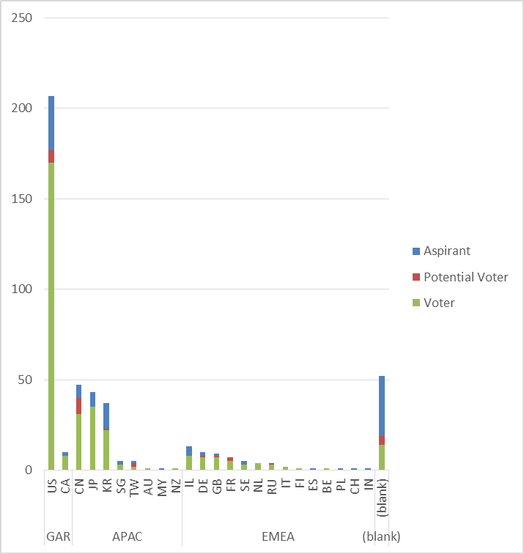
Membership by Country and Region

Slide 23
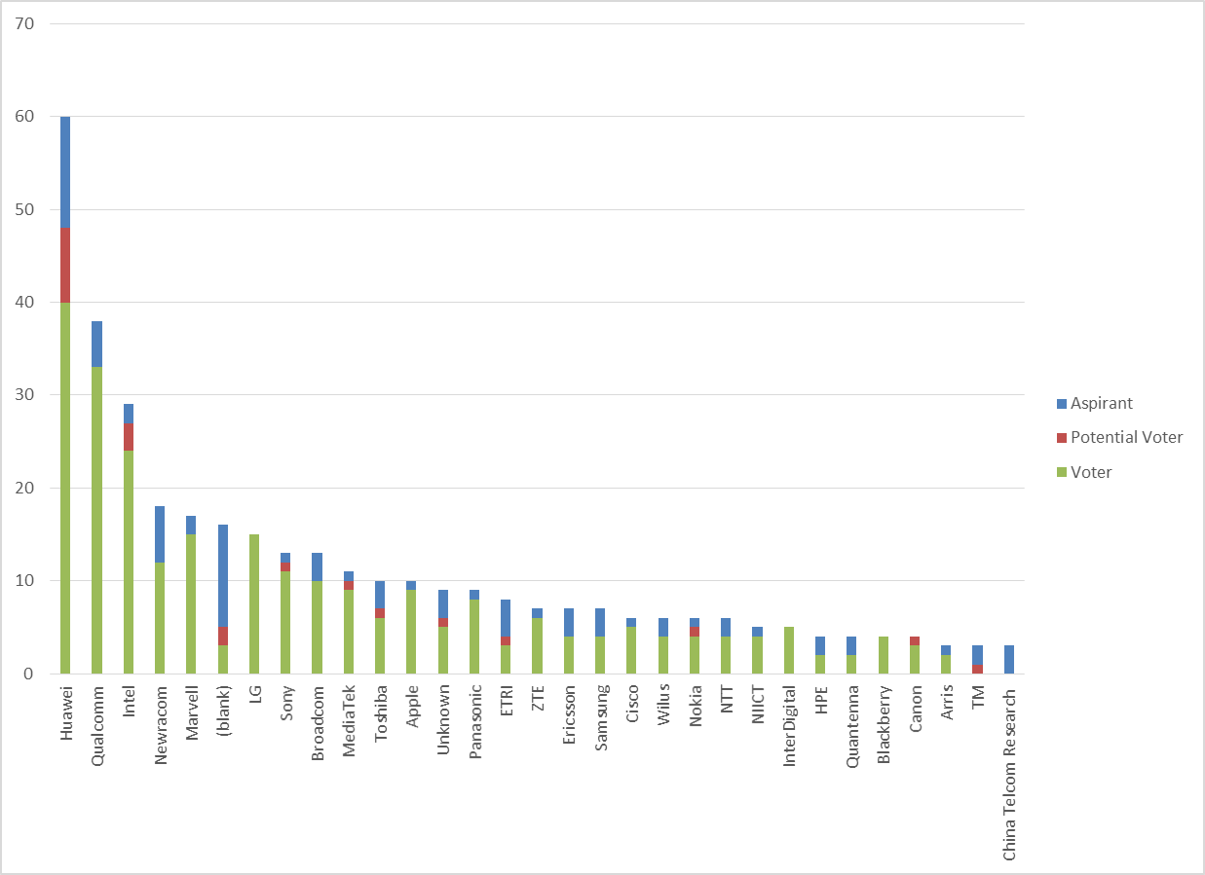
Members by Affiliation

Slide 24
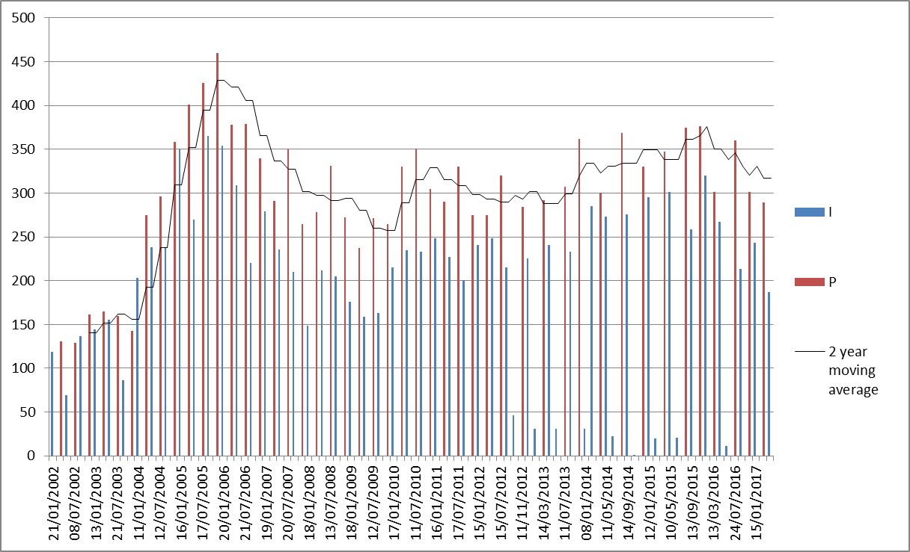
Meeting Attendance – Historic Data

Slide 25
Membership – Historic Data

