Slide 1
TGax Spatial Reuse Ad Hoc Group
May 2017 Meeting Agenda
Date: 2017-05-09
Authors:
Name | Affiliations | Address | Phone | email
Jae Seung Lee | ETRI | 161 Gajeong-dong Yuseong-gu Daejeon Korea | +82-42-860-1326 | jasonlee@etri.re.kr
Guido R. Hiertz | Ericsson | Ericsson Allee 1 52134 Herzogenrath Germany | +49-2407-575-5575 | hiertz@ieee.org
Laurent Cariou | Intel | 2111 NE 21st Avenue Hilsboro USA | +1-503-329-4020 | laurent.cariou@intel.com

Slide 2
Meeting Protocol, Attendance, Voting & Document Status
Please announce your affiliation when you first address the group during a meeting slot
Cell Phones to be silent or Off
Register your attendance via https://imat.ieee.org while on a meeting SSID (e.g. Verilan-secure)
Make sure your badges are correct
If you plan to make a submission, be sure it does not contain company logos or advertising
Questions on Voting status, Ballot pool, Access to Reflector, Documentation, Member’s Area
  Contact Jon Rosdahl – jrosdahl@ieee.org
Slide 2

Slide 3
Patent Policy and Other Guidelines
See the following 5 slides

Slide 4
Instructions for the WG Chair
The IEEE-SA strongly recommends that at each WG meeting the chair or a designee:
  Show slides #1 through #4 of this presentation
  Advise the WG attendees that:
    The IEEE’s patent policy is described in Clause 6 of the IEEE-SA Standards Board Bylaws;
    Early identification of patent claims which January be essential for the use of standards under development is strongly encouraged;
    There January be Essential Patent Claims of which the IEEE is not aware. Additionally, neither the IEEE, the WG, nor the WG chair can ensure the accuracy or completeness of any assurance or whether any such assurance is, in fact, of a Patent Claim that is essential for the use of the standard under development.
  Instruct the WG Secretary to record in the minutes of the relevant WG meeting:
    That the foregoing information was provided and that slides 1 through 4 (and this slide 0, if applicable) were shown;
    That the chair or designee provided an opportunity for participants to identify patent claim(s)/patent application claim(s) and/or the holder of patent claim(s)/patent application claim(s) of which the participant is personally aware and that January be essential for the use of that standard
    Any responses that were given, specifically the patent claim(s)/patent application claim(s) and/or the holder of the patent claim(s)/patent application claim(s) that were identified (if any) and by whom.
  The WG Chair shall ensure that a request is made to any identified holders of potential essential patent claim(s) to complete and submit a Letter of Assurance.
  It is recommended that the WG chair review the guidance in IEEE-SA Standards Board Operations Manual 6.3.5 and in FAQs 14 and 15 on inclusion of potential Essential Patent Claims by incorporation or by reference.
  Note: WG includes Working Groups, Task Groups, and other standards-developing committees with a PAR approved by the IEEE-SA Standards Board.
(Optional to be shown)

Slide 5
Participants, Patents, and Duty to Inform
All participants in this meeting have certain obligations under the IEEE-SA Patent Policy.
  Participants [Note: Quoted text excerpted from IEEE-SA Standards Board Bylaws subclause 6.2]:
    “Shall inform the IEEE (or cause the IEEE to be informed)” of the identity of each “holder of any potential Essential Patent Claims of which they are personally aware” if the claims are owned or controlled by the participant or the entity the participant is from, employed by, or otherwise represents
    “Should inform the IEEE (or cause the IEEE to be informed)” of the identity of “any other holders of potential Essential Patent Claims” (that is, third parties that are not affiliated with the participant, with the participant’s employer, or with anyone else that the participant is from or otherwise represents)
  The above does not apply if the patent claim is already the subject of an Accepted Letter of Assurance that applies to the proposed standard(s) under consideration by this group
  Early identification of holders of potential Essential Patent Claims is strongly encouraged
  No duty to perform a patent search
Slide #1

Slide 6
Patent Related Links
  All participants should be familiar with their obligations under the IEEE-SA Policies & Procedures for standards development.
  Patent Policy is stated in these sources:
  IEEE-SA Standards Boards Bylaws
  http://standards.ieee.org/develop/policies/bylaws/sect6-7.html#6
  IEEE-SA Standards Board Operations Manual
  http://standards.ieee.org/develop/policies/opman/sect6.html#6.3
  Material about the patent policy is available at
  http://standards.ieee.org/about/sasb/patcom/materials.html
If you have questions, contact the IEEE-SA Standards Board Patent Committee Administrator at patcom@ieee.org or visit http://standards.ieee.org/about/sasb/patcom/index.html
This slide set is available at https://development.standards.ieee.org/myproject/Public/mytools/mob/slideset.ppt
Slide #2

Slide 7
Call for Potentially Essential Patents
If anyone in this meeting is personally aware of the holder of any patent claims that are potentially essential to implementation of the proposed standard(s) under consideration by this group and that are not already the subject of an Accepted Letter of Assurance:
  Either speak up now or
  Provide the chair of this group with the identity of the holder(s) of any and all such claims as soon as possible or
  Cause an LOA to be submitted
Slide #3

Slide 8
Other Guidelines for IEEE WG Meetings
All IEEE-SA standards meetings shall be conducted in compliance with all applicable laws, including antitrust and competition laws.
  Don’t discuss the interpretation, validity, or essentiality of patents/patent claims.
  Don’t discuss specific license rates, terms, or conditions.
    Relative costs, including licensing costs of essential patent claims, of different technical approaches January be discussed in standards development meetings.
      Technical considerations remain primary focus
  Don’t discuss or engage in the fixing of product prices, allocation of customers, or division of sales markets.
  Don’t discuss the status or substance of ongoing or threatened litigation.
  Don’t be silent if inappropriate topics are discussed … do formally object.
---------------------------------------------------------------
See IEEE-SA Standards Board Operations Manual, clause 5.3.10 and “Promoting Competition and Innovation: What You Need to Know about the IEEE Standards Association's Antitrust and Competition Policy” for more details.
Slide #4

Slide 9
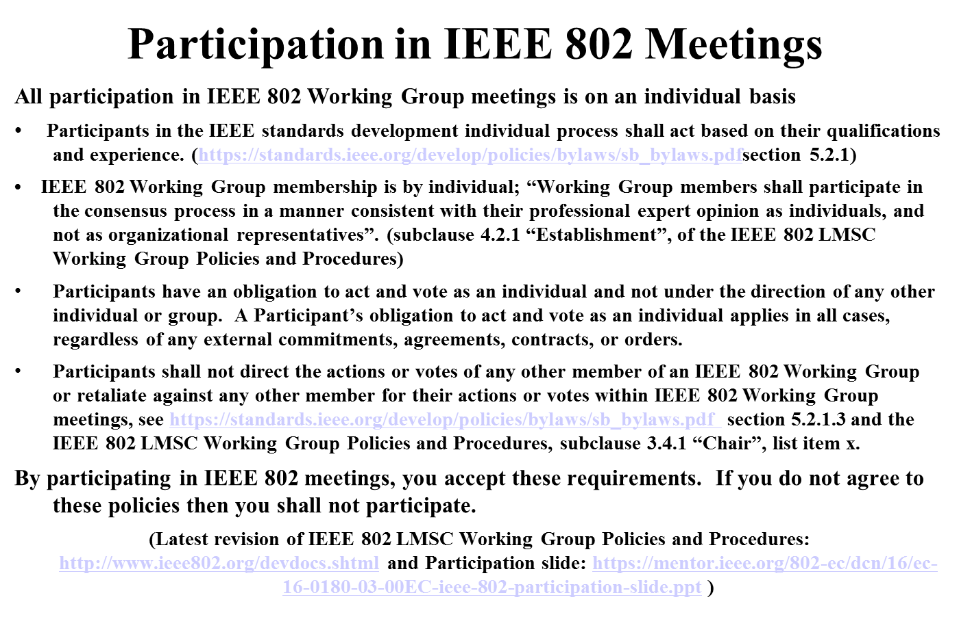

Slide 10
Ad Hoc Groups Operation (1/2)
Governing document is 15/075r0
Proposed changes to the specification framework shall be discussed in the ad hoc groups first, which are then brought to the Taskgroup for an approval vote.
A straw poll (doesn’t require voting rights) result of >=75% is required within an Ad Hoc to approve the resolution of all or part of an issue and forward that resolved item to the Taskgroup where it becomes a motion that requires >=75% approval to modify the specification framework or the draft specification.
The straw poll affection the TG specification framework shall include
    Do you agree to add to the TG Specification Framework:
    x.y.z. [brief description of the feature]
In the case a consensus can not be reached within an Ad Hoc group (a stalemate that prohibits further progress), the subject is moved to the Taskgroup if an Ad Hoc straw poll vote to move the subject to the Taskgroup achieves >50% approval.

Slide 11
Ad Hoc Groups Operation (2/2)
Governing document is 15/075r0
A motion passing with >50% in the Taskgroup shall be sufficient to move an issue previously assigned to an Ad Hoc group to any Ad Hoc group. A straw poll vote of >50% is required in an Ad Hoc group to refuse an issue from the Taskgroup.
An issue may be sent from one Ad Hoc to another if both the sending Ad Hoc and the receiving Ad Hoc approve straw polls for taking the respective actions with >50% approval. A notice should be sent to the reflector indicating the approval of a straw poll to move an issue.
During Taskgroup face to face Plenary and Interim sessions, Chairs for each of the Functional Block Ad Hocs shall report on Progress and Content to the Entire Taskgroup. These Update sessions provide the opportunity for peer review to ensure the creation of a coherent Specification.

Slide 12

Straw polls
All straw polls to be sequentially numbered by chairmen
  Year, Month, Day, three digits: YYYYMMDDxyz
Two Straw Poll categories
  Ad hoc Straw Polls: A20150312001
    During discussions
    Test for Ad hoc group internal opinions
  Report Straw Polls: R20150312001
    Result to be reported to Task Group 802.11ax
    Meant as advise for Task Group (motion)

Slide 13
IEEE 802.11 TGax
High Efficiency WLAN Task Group
Ad hoc Group Spatial Reuse
IEEE 802.11 TGax
High Efficiency WLAN Task Group
Ad hoc Group Spatial Reuse
Daejeon, Korea
2017-05-09
Ad hoc chairmen:
Jae Seung Lee (ETRI), Laurent Cariou (Intel), Guido R. Hiertz (Ericsson)

Slide 14
Agenda Items for the Week
Call meeting to order
Patent policy, etc. (Call for Potentially Essential Patents)
Review ad hoc rules
  See Slides 10 ~ 11
Call for submissions
Set and approve agenda
Technical presentations approved by 802.11ax chair for presentation this week, and related straw polls
Any other technical presentations
Any other business
Adjourn

Slide 15
Submissions (SR)
DCN | Title | Author | Presentation Order
11-17/0633 | CR-27-9-spatial-reuse-updates | Matthew Fischer | 1
11-17/0640 | cr-27-2-SRG-updates | Matthew Fischer | 2
11-17/0748 | Supplementary instructions related to OBSS_PD spatial reuse Disallow / Prohibit | Sean Coffey | 3
11-17/0724 | LBS2 various | Matthew Fischer | 4 (deferred to next F2F meeting)
11-17/0669 | CR for CID 4928 | Kaiying Lv | 5
11-17/0808 | OBSSPD simplification | Laurent | 6

Slide 16
Straw Poll R20170509001
Do you agree to accept the text proposed by 11-17/0748r1 and to treat this as the resolution to CID 6768 and modify TGax D1.2 as proposed by the contribution?
  Y: 11
  N: 0
  Abs: 11

Slide 17
Straw Poll R20170509002
Do you agree to accept the resolutions provided in 11-17/0633r2 for the comments with CIDs 5941 and 5873?
  Unanimously accepted

Slide 18
Straw Poll R20170509003
Do you agree to accept the resolutions provided in 11-17/0640r2 for the comment with CID 8111?
  Unanimously accepted

Slide 19
Straw Poll R20170509003
Do you agree to accept the resolution provided in 11-17/0808r0 as the modified resolution for the comment with CID 3222?
  Y:
  N:
  Abs:

Slide 20
Straw Poll R20170509005
Do you agree to accept the resolutions provided in 11-17/0669r2 for the comment with CID 4928?
  Y:
  N:
  Abs:

Slide 21


Slide 22
Straw Poll R20170509001
Do you agree to accept the resolutions provided in 11-17/xxxxr0 for the comments with CIDs xxx?
  Yes:
  No:
  Abstain:
Template

Slide 23
Straw Poll R20150312001
Do you agree to add to the TG Specification Frame work document?
x.y.z. <feature description>
  Y:
  N:
  Abs:
Template

Slide 24
Straw Poll A20150312001
Your Question …
  Yes/No/Abstain
  Alternative A, B, C …
Template

