Slide 1
Uplink Sounding Sequence Design for MU Scenario in 11az
Date: 2017-04-14

Slide 2
Introduction
In the last IEEE meeting at Vancouver, we presented some analysis and simulation results that show substantial performance degradation caused by Class B devices to STAs with the adjacent codes in the same P-matrix allocation [1], [2]
Reviewed several techniques that reuse of the 11ax multi-user framework to address the near-far problem
[1] IEEE 802.11-17/0478r4 Intel_Analysis of Near-far Problem’s Impact in UL MU-MIMO with Residual CFO
[2] IEEE 802.11-17/0476r0 Qualcomm_UL MU Ranging Options in Light of Rx Power Imbalances

Slide 3
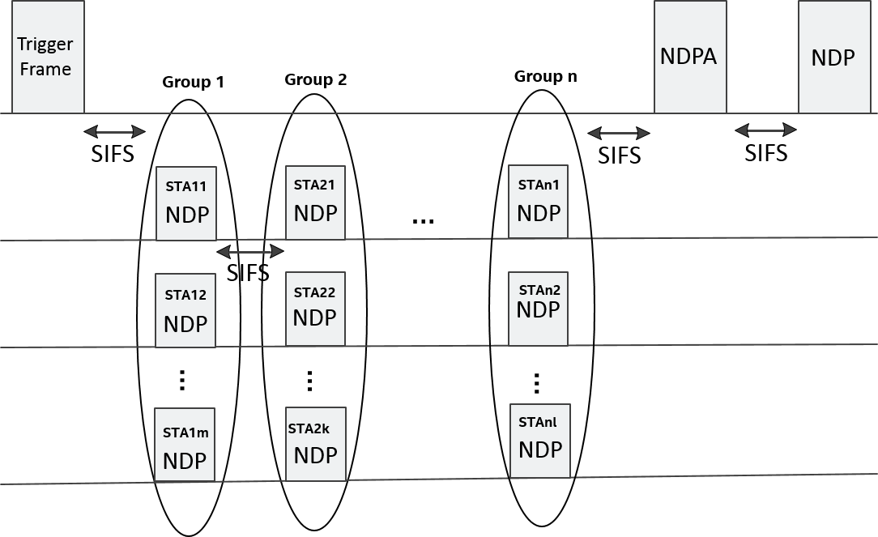
Method 1: Use Different Time Slots to Separate STAs
AP schedules the STAs based on receive signal power level and device type
Need to define a new trigger frame format to indicate the scheduling results to STAs

Slide 4
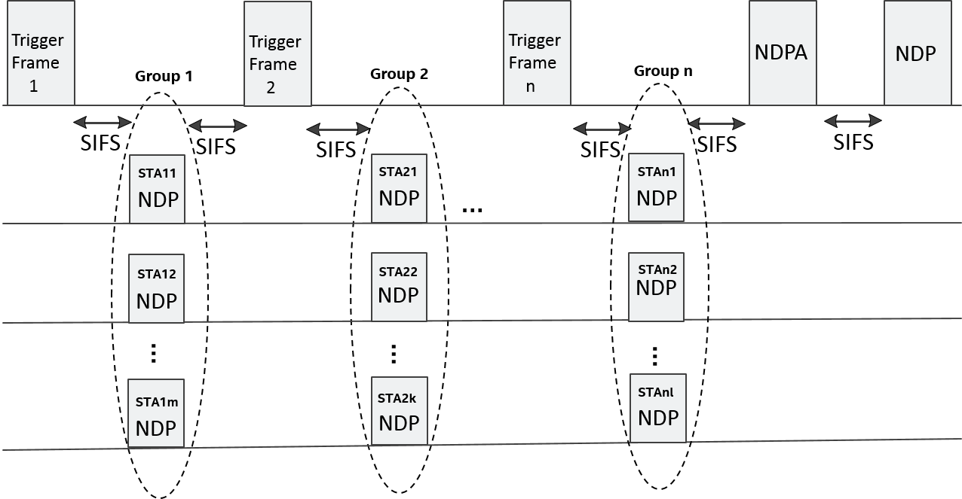
Method 2: Use Different Trigger Frames to Separate STAs
AP schedules the STAs based on receive signal power level and device type
Re-use the trigger frame format in 11ax and simplify the implementation. A new trigger frame type is needed to solicit NDP from STAs
The efficiency is lower than first method

Slide 5
Conclusion
Two UL sounding sequence designs are proposed for the MU scenario to solve the near-far problem
Method 1 achieves the best tradeoff between the medium usage efficiency and the implementation complexity
Method 2 maximally reuses the components in the 11ax spec and has the lowest implementation complexity, but meanwhile the efficiency is low

Slide 6
Straw poll
Do you support that:
The measurement phase for the MU ranging protocol shall consists of one or more rounds of uplink sounding followed by one round of downlink sounding, where each round of uplink sounding consists of one trigger frame and simultaneous NDP sounding frames and each round of downlink sounding consists of one NDPA frame and one NDP sounding frame.
Y: N: Abstain:

Slide 7
Motion
We agree to add the following text for 11az SFD under the “Accuracy and Coverage over 2.4 and 5GHz” subsection:
The measurement phase for the MU ranging protocol shall consists of one or more rounds of uplink sounding followed by one round of downlink sounding, where each round of uplink sounding consists of one trigger frame and simultaneous NDP sounding frames and each round of downlink sounding consists of one NDPA frame and one NDP sounding frame.
Y: N: Abstain:

Slide 8
Appendix

Slide 9
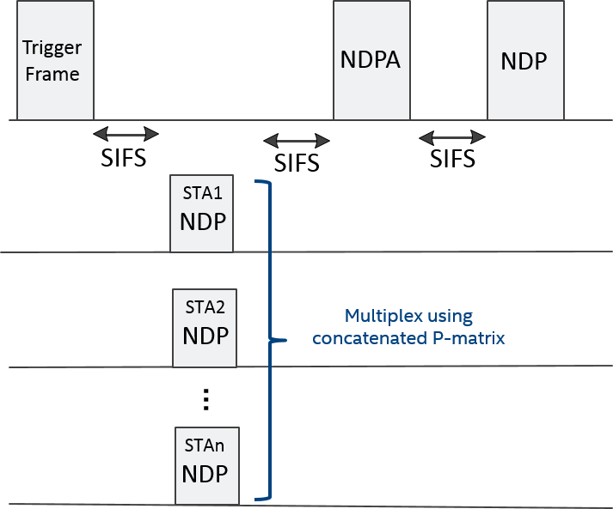
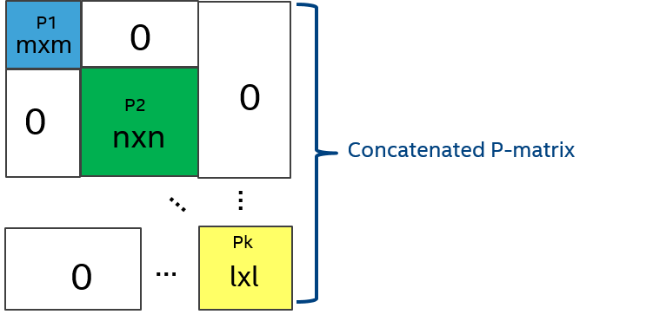
Method 3: Use Different P-matrix to Separate STAs
AP schedules the STAs based on receive signal power level and device type
Re-use the P-matrix structure and remove the redundant preamble overhead.
Achieve high efficiency in medium usage
Need to define a new trigger frame format to indicate the P-matrix allocation to STAs
Some concern about AGC

Slide 10
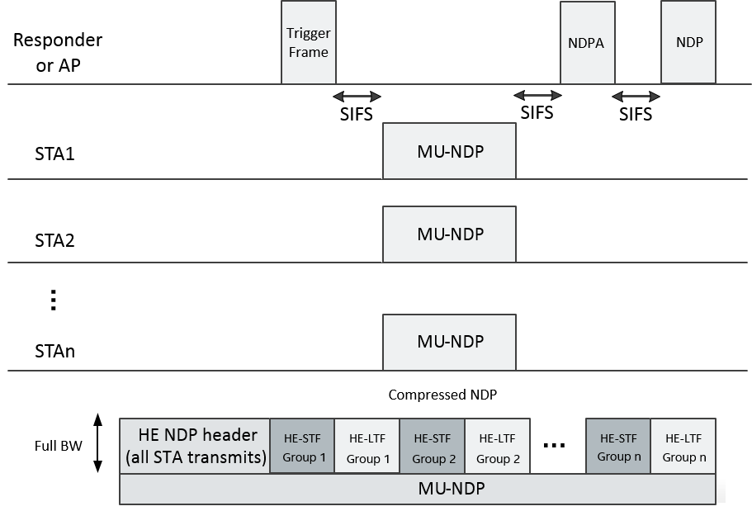
Method 4: Use Compressed NDP to Separate STAs
Similar to method 3, but insert HE-STF between different P-matrix groups to adjust AGC gain
AP schedules the STAs based on receive signal power level and device type
Need to define a new trigger frame format to indicate the scheduling results to STAs

