Slide 1
Concurrent multi-band transmission in WLAN
Date: 2017-05-09
Authors:

Slide 2
Abstract
Utilizing multiple frequency bands at the same time to concurrently transmit and receive data by a wireless node will increase the available bandwidth and improve the achievable QoS.
This presentation describes several ways to utilize multiple bands :
  Multi-band capable AP with multiple independent transceivers
  Introducing concurrent multi-band technology to a STA
    Splitting data into either of available bands before queuing, taking into account the average channel condition
    Splitting data into either of available bands, based on instantaneous channel condition, after queuing

Slide 3
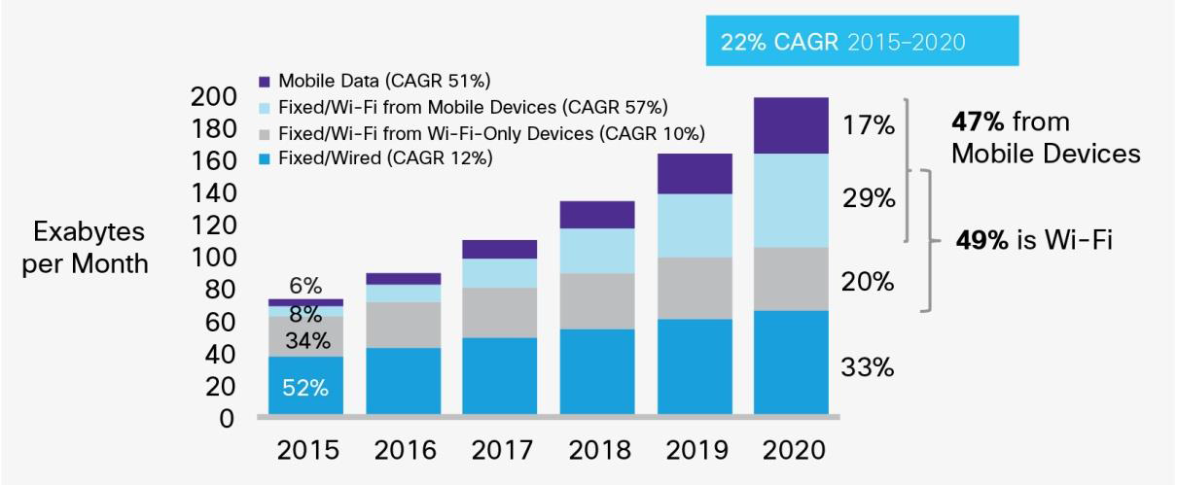
Background
The amount of wireless LAN traffic is increasing every year.
Forecasted amount of traffic will become four times larger from 2015 to 2020 [1].
Traffic offload to WLAN will increase to 63% of all mobile traffic, with forecasted mobile traffic increasing seven times from 2016 to 2021 [1].
Thus, enhancement of system throughput of the wireless LAN is still necessary.
Growth of IP traffic forecasted by Cisco [1].

Slide 4
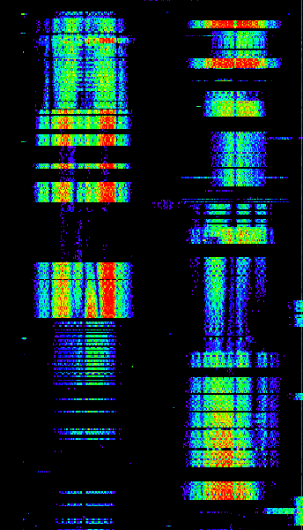
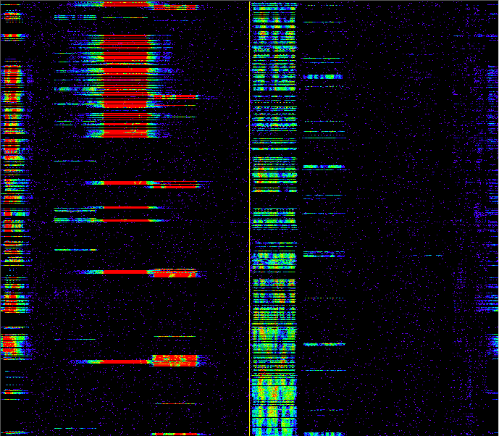
Exploiting instantaneous channel idle periods
500
We conducted channel measurements at a main-line railway station in Japan to record the received signal strength of WLAN channels
Example 500ms snapshot shows there are many short idle periods of which duration is typically 10-70 ms
An “agile receiver” will have the potential to exploit idle periods in other channels or bands
But to exploit the diversity, need to be able to switch channel sufficiently fast.
400
300
Time (ms)
200
100
0
1
6
108
112
116
(Left) 2.4 and (Right) 5 GHz Spectrogram
(Channel numbers shown)

Slide 5
Multi-band capable APs with multiple transceivers
A way to utilize multiple bands without fast switching of the band is to employ multiple transceivers having a different operating band.
Multi-band capable AP have been available for around 10 years.
  The multi-band capable AP sets up a different BSS for each transceiver.
  Each STA joins one of the BSSs provided by the multi-band AP.
  If the STA chooses the joining BSS properly, the average QoS will be improved. However, each STA cannot utilize multiple bands simultaneously in this configuration.
Upper MAC
Band A
Band A
BSS A
Queue A
STA1
Lower
MAC
PHY
(BB)
RF
OS
Band B
BSS B
Lower
MAC
PHY
(BB)
Band B
RF
AP
STA2
Queue B
Upper MAC

Slide 6
Concurrent multi-band technology
A STA needs to have a capability to utilize multiple bands if it wants to exploit the multi-band diversity.
Concurrent multi-band is a technology for a wireless node to connect to two or more bands at the same time. It would be beneficial to enhance QoS achievable at a STA.
  Recently concurrent multi-band technology has been developed for smartphones and automotive use-cases. [2]
The architectures of concurrent multi-band can be categorized into 2 types:
- Type 1: Data is split into either of
available bands before queuing
- Type 2: Data is split into either of
available bands, based on instantaneous
channel condition, after queuing
(Proposed idea)
Multi-band wireless adapter
Band A
Band B
AP
STA

Slide 7
Type 1: Splitting before queuing
Consider a STA connecting to an AP on two or more bands
The queues in the Upper MAC on each band are totally independent
Assume data of different applications are transmitted on different bands, taking into account the required QoS of each application and average channel condition
Since the data cannot change the transmitted band after queuing,
it would be difficult to adapt to the instantaneous change of channel,
if the length of queue is long.
Upper MAC
Band A
Queue A
From
NW
layer
Lower
MAC
PHY
(BB)
RF
Splitter
Band B
Lower
MAC
PHY
(BB)
RF
Queue B

Slide 8
Type 2: Splitting based on instantaneous channel condition after queuing (Proposed idea)
Here we consider a wireless device having concurrent connections on two or more bands as in the previous slide.
However, this configuration employs a common queue for all bands.
The splitter directs each transmit data at the front of the queue to a particular band.
Splitting decisions can now be controlled by real-time feedback of channel Busy-Idle status and/or channel state information.
Upper MAC
Band A
From
NW
layer
Lower
MAC
PHY
(BB)
RF
Splitter
Band B
Lower
MAC
PHY
(BB)
RF
Common Queue
Lower MAC and BB Feedback
Busy-Idle and CSI information

Slide 9
Type 2: Splitting based on instantaneous channel condition after queuing (Continued)
Transmission latency will be reduced by the new approach if a STA can agilely exploit the real-time availability of idle periods.
Splitting of data taking into account current channel state can be more appropriately matched with the required QoS or priority
As the splitter is more sophisticated, QoS will be more improved.

Slide 10
Summary
This talk discussed features of concurrent multi-band technology to exploit multi-band diversity at a wireless node.
If a STA has a capability to utilize multiple bands,
the achievable QoS would be improved.
In addition, if the transmitted data is split into available bands based on instantaneous channel condition, further QoS improvement would be achieved.

Slide 11
Straw Poll #1
Do you agree that a concurrent multi-band technology is beneficial to improve achievable QoS of wireless LAN?
  Y:
  N:
  Need more information:

Slide 12
Straw Poll #2
Do you think that a concurrent multi-band technology, with splitting the transmitted data into available bands based on instantaneous channel condition, is a promising approach as a way to further improve the QoS of wireless LAN?
  Y:
  N:
  Need more information:

Slide 13
References
[1] Cisco, “Cisco Visual Networking Index: Global Mobile Data Traffic Forecast Update, 2016–2021,” Cisco White Paper C11-738429-00, March 2017.
[2] BCM89359 - Single-Chip 5G WiFi IEEE 802.11ac 2x2 MAC/Baseband/Radio with Integrated Bluetooth 4.1/RSDB for Automotive Applications, Available at: http://www.cypress.com/documentation/datasheets/bcm89359-single-chip-5g-wifi-ieee-80211ac-2x2-macbasebandradio-integrated [Accessed May 2, 2017]

